Slide 1
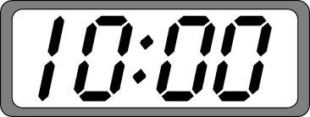
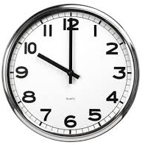
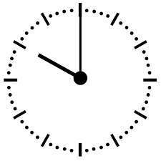
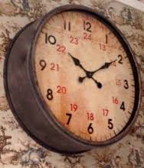
Starter
What’s the same and what’s different?

Slide 2
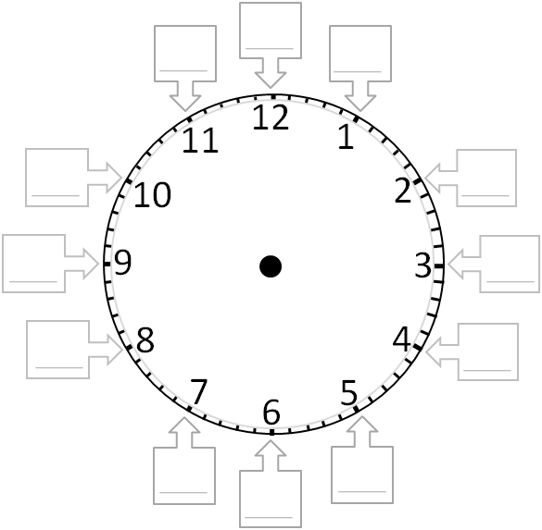
o’clock
The little hand tells you the hour.
Label your clock face with what the minute hand tells you.
5 to
5 past
24
10 to
23
13
10 past
22
14
quarter to
21
15
quarter past
20
16
20 to
20 past
19
17
18
25 to
25 past
half past

Slide 3
Telling the Time Bingo
Draw a bingo grid like this and fill it with 9 of the times below.
ten to 6 | 9:39 am | 17:00 | 15:20
quarter past 8 | five past 9 | 10:10 | 13:42
3:39 pm | 8:05 am | 12:25 pm | ten past 12
10:12 | 00:20 | 3 o’clock | 7pm

Slide 4
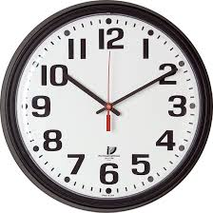

Slide 5
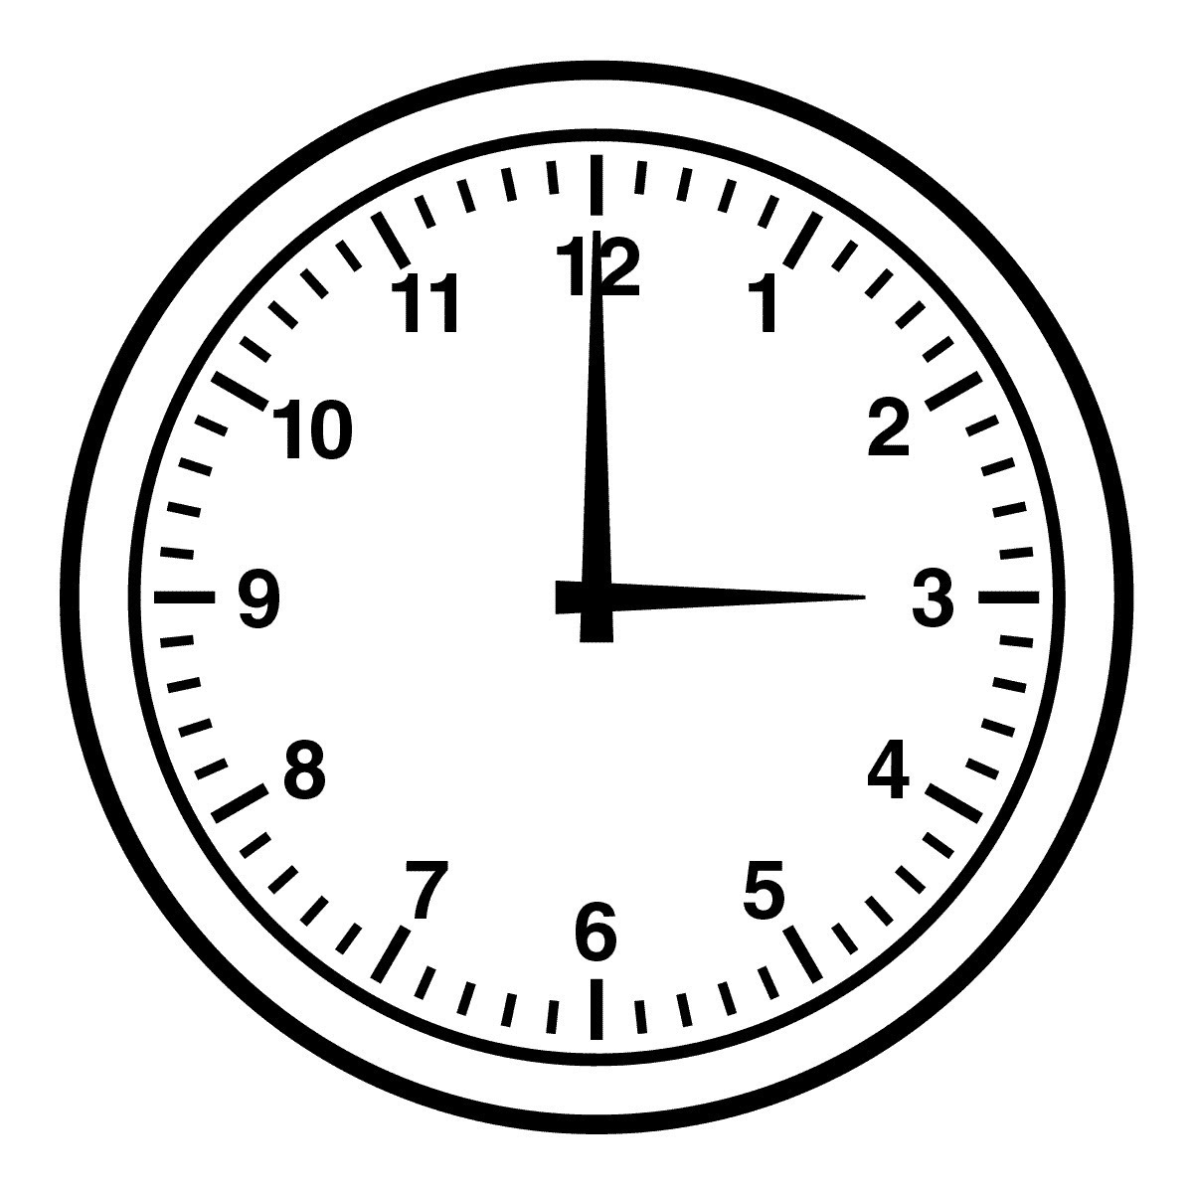

Slide 7
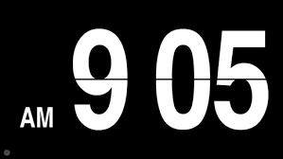

Slide 8
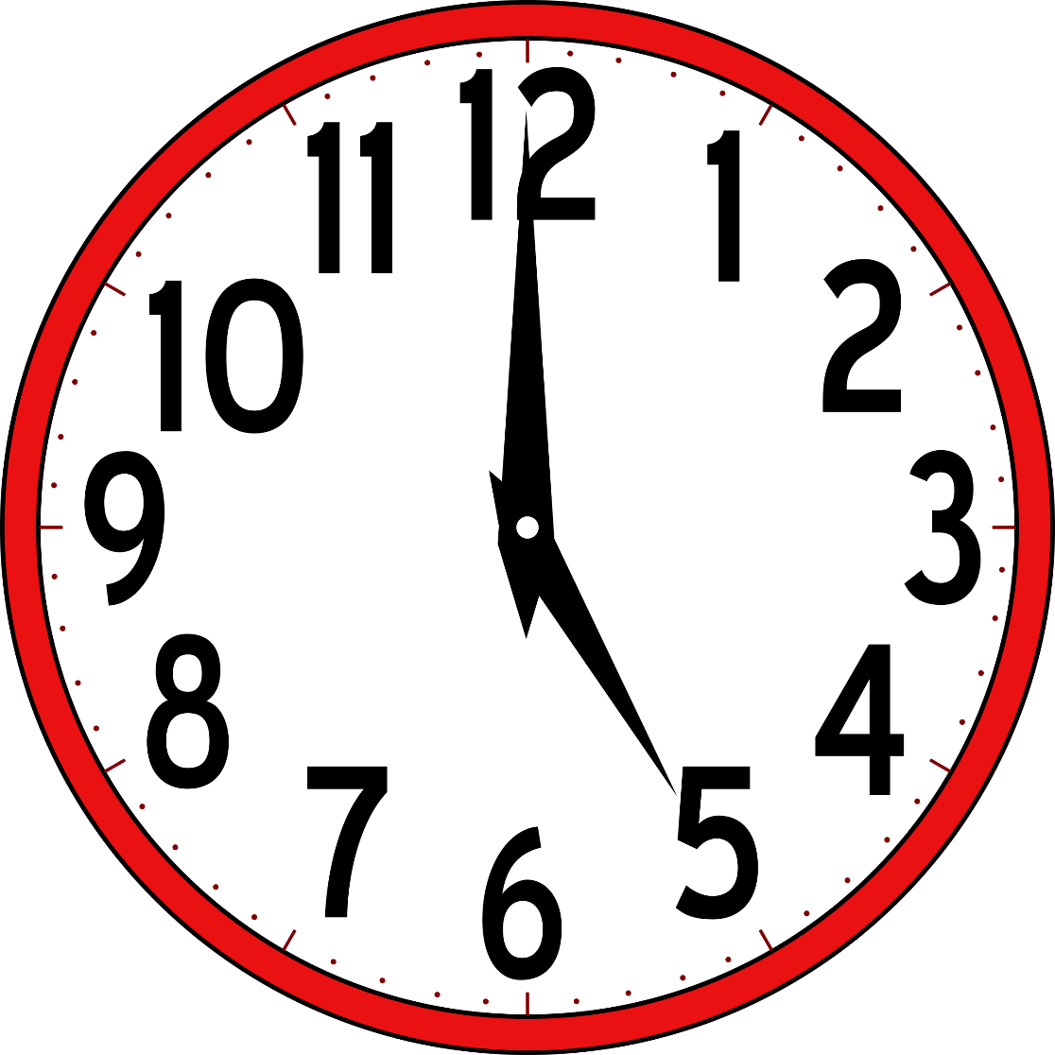

Slide 9
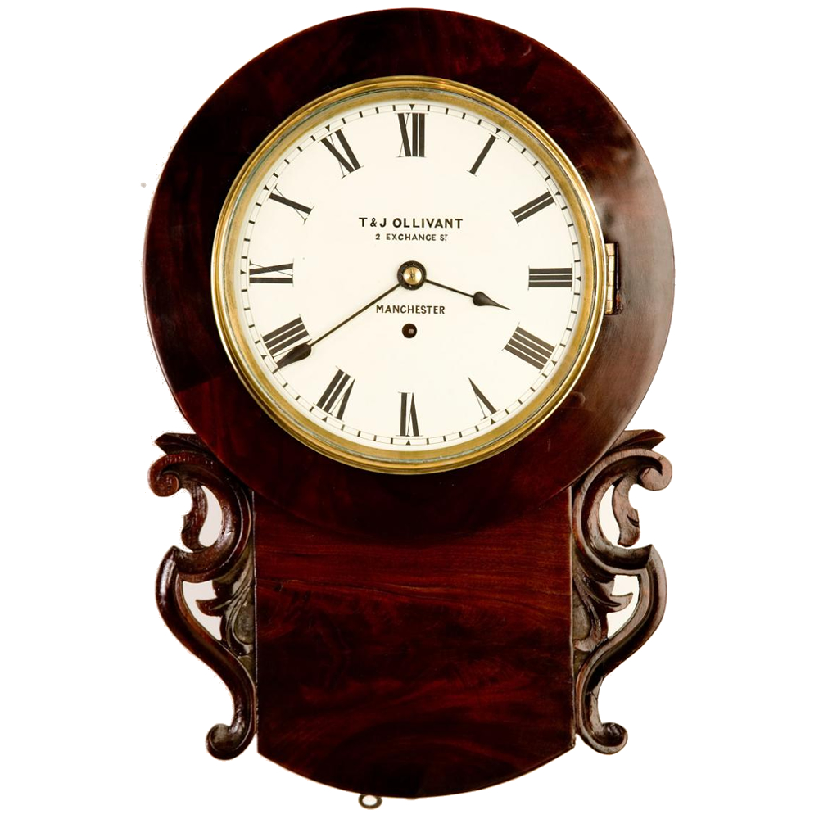

Slide 11
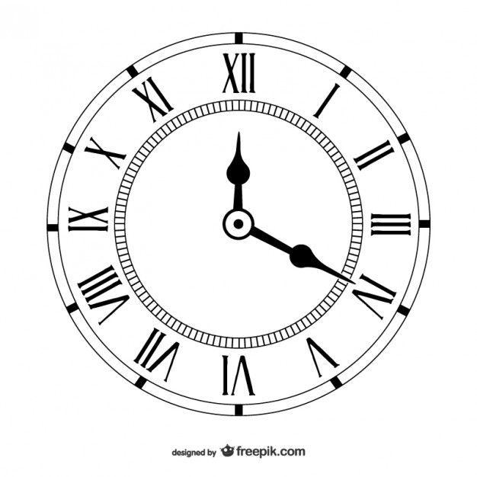

Slide 12
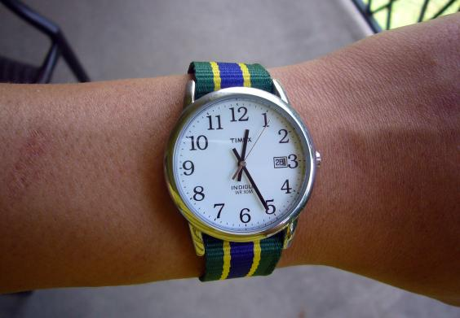

Slide 13
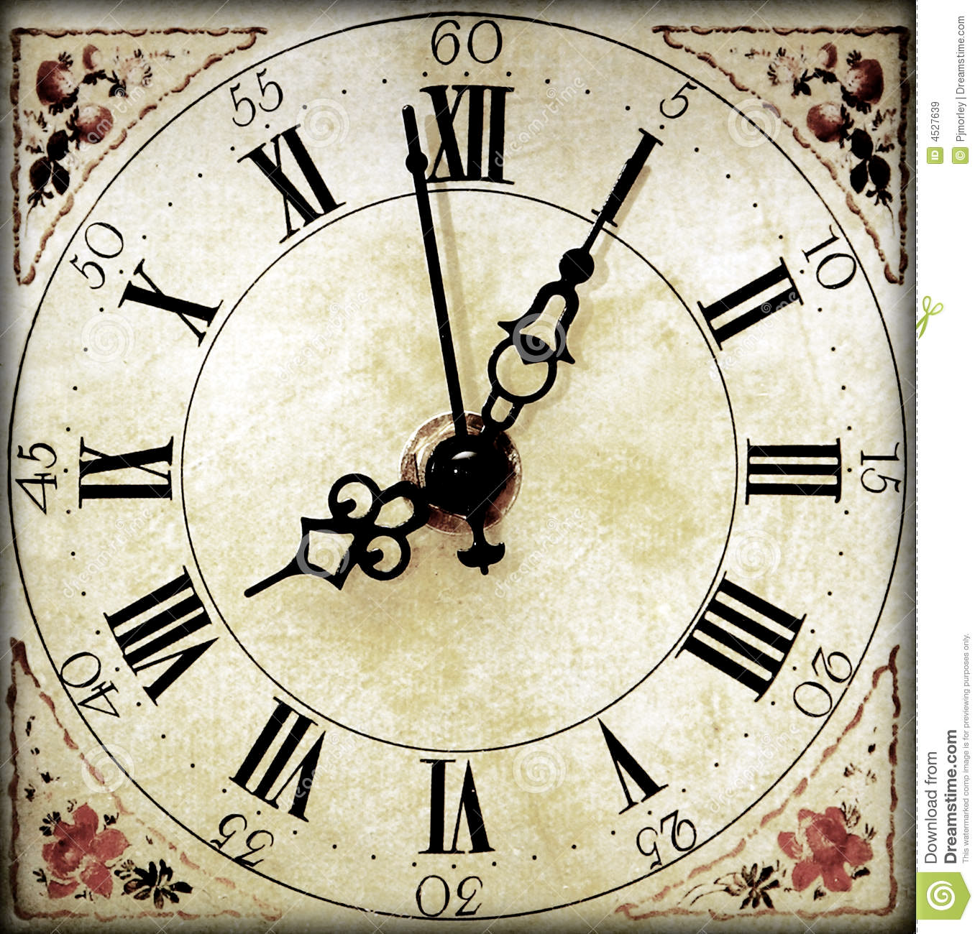

Slide 14
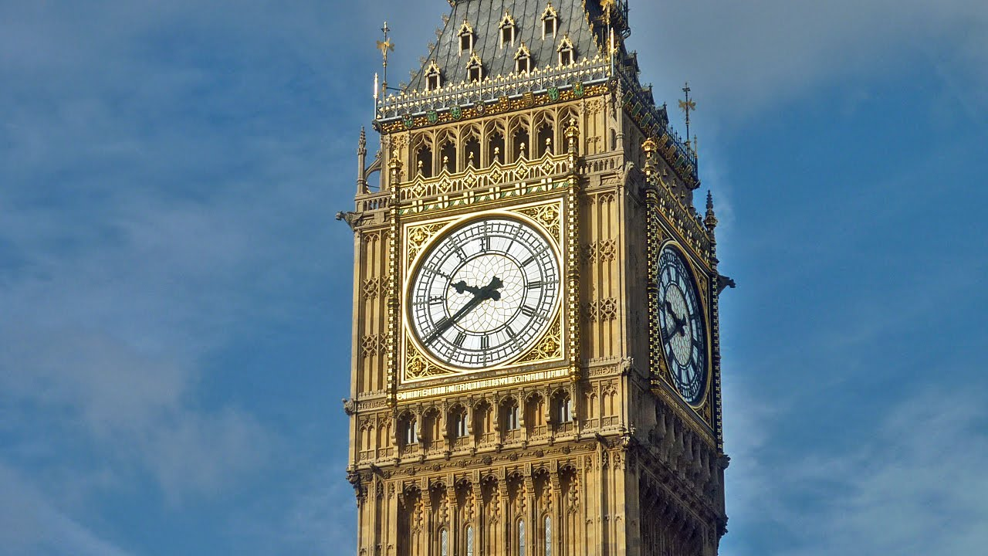

Slide 15
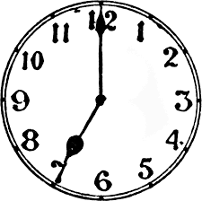

Slide 16
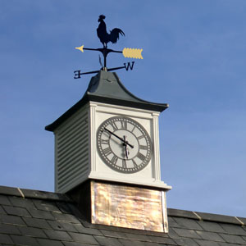

Slide 17
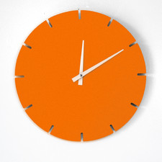

Slide 18
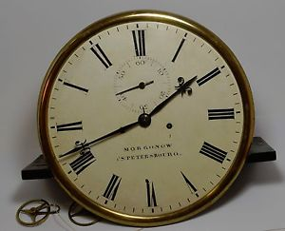

Slide 19
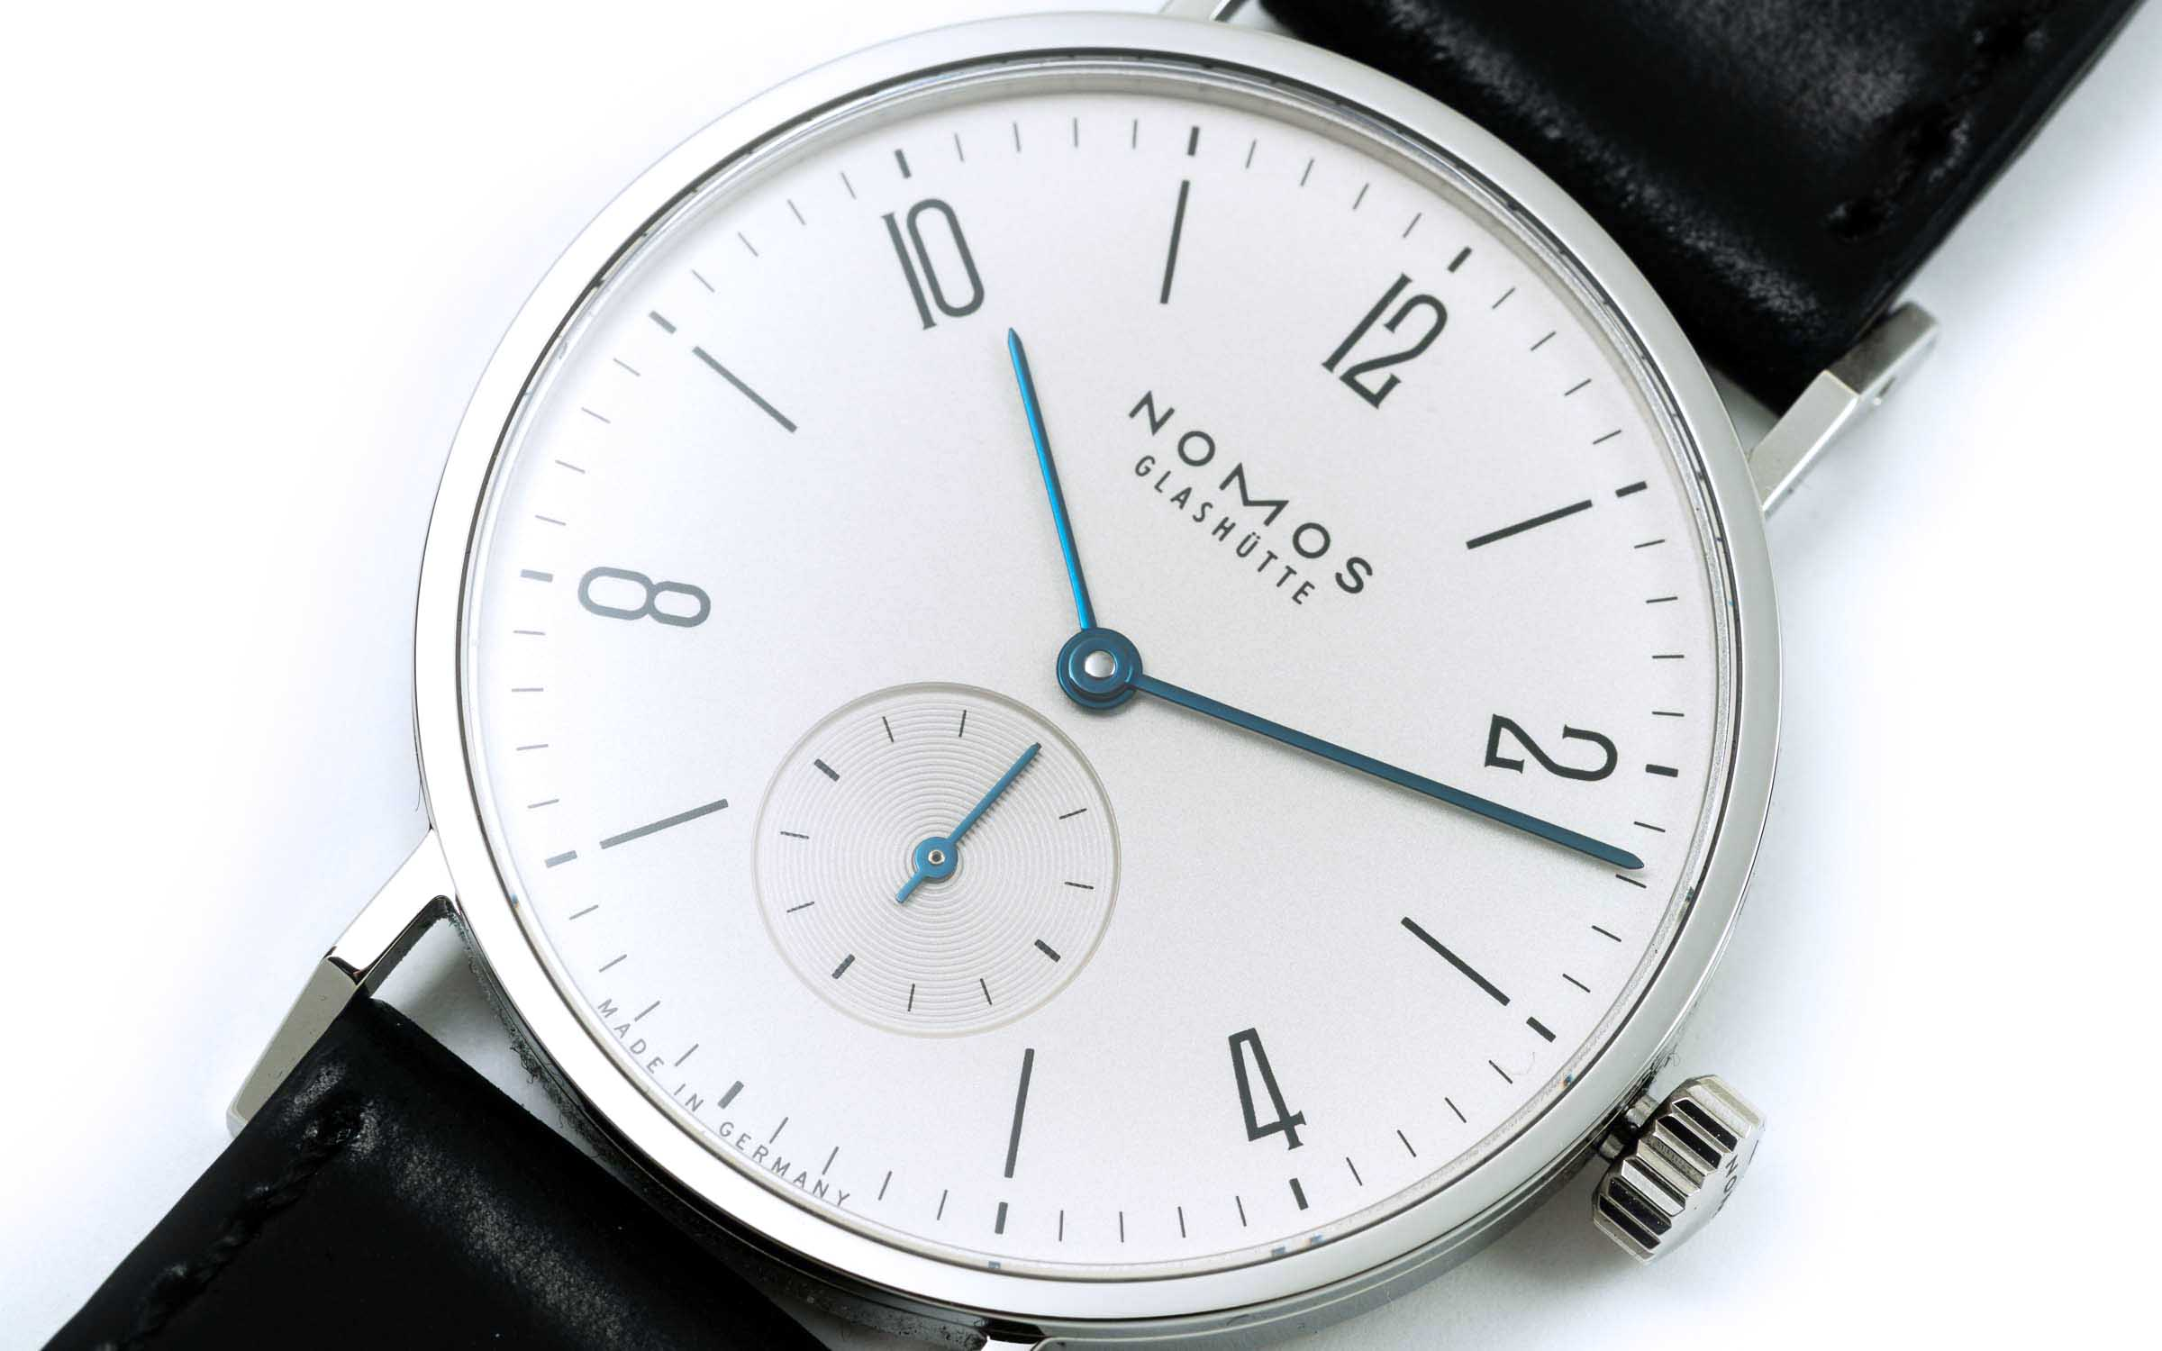

Slide 20
Key Facts
There are 60 seconds in a minute.
There are 60 minutes in an hour.
There are 24 hours in a day.

Slide 21
1. For each of these times in minutes, change them into seconds:
a) 7 minutes b) 13 minutes
c) 20 minutes d) 11 minutes
2. For each of these times in seconds, change them into minutes:
a) 180 seconds b) 660 seconds
c) 420 seconds d) 1140 seconds
3. For each of these times in hours, change them into minutes:
a) 8 hours b) 13 hours
c) 15 hours d) 10.5 hours

Slide 22
1. For each of these times in minutes, change them into seconds:
a) 420 seconds b) 780 seconds
c) 1200 seconds d) 660 seconds
2. For each of these times in seconds, change them into minutes:
a) 3 minutes b) 11 minutes
c) 7 minutes d) 19 minutes
3. For each of these times in hours, change them into minutes:
a) 480 minutes b) 780 minutes
c) 900 minutes d) 630 minutes

Slide 23
Time Intervals
Start by counting up in hours
Calculate the time interval between 11:20 and 15:40
Start 11:20
1 hour 12:20
2 hours 13:20
3 hours 14:20
4 hours 15:20
5 hours 16:20
How many more minutes?
20 minutes
Total: 4 hours and 20 minutes

Slide 24
Time Intervals
Start by counting up in hours
Calculate the time interval between 01:17 and 19:10
Start 01:17
5 hours 06:17
10 hours 11:17
15 hours 16:17
16 hours 17:17
17 hours 18:17
18 hours 19:17
How many more minutes?
43 + 10 minutes
53 minutes
Total: 17 hours and 53 minutes

Slide 25
Task
Calculate the time intervals between:
1) 12:00 – 14:25
2) 12:12 – 16:42
3) 16:50 – 19:15
4) 17:59 – 18:11
5) 17:45 – 21:30
6) 09:41 – 16:02
7) 12:15 – 20:10
8) 10:26 – 14:09
2 hours, 25 minutes
4 hours, 30 minutes
2 hours, 25 minutes
12 minutes
3 hours, 45 minutes
6 hours, 21 minutes
7 hours, 55 minutes
3 hours, 43 minutes

Slide 26
Task
Answer the exam questions about time.
Use the method you have just practised.

Slide 27
Answers
2 hours, 30 minutes
09 50
No (only 90 mins left)
3 hours
4 pm
a) 15 minutes
b) 3:05 pm
c) No (4:20 pm)
No (arrive at 8:53 am)
a) 2 hours, 20 minutes
b) No (arrive at 21 32)
30 minutes
a) 20 45
b) No (more than half)

