Slide 1
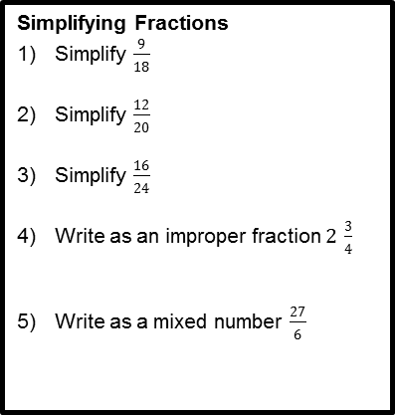
Ratio and Proportion Revision Mat
Calculating with Decimals
Which is the biggest?
3.013
3.0014
3.0013
Calculate 2.5 + 0.37?
Three friends compare their heights. Who is the tallest?
Anna is 1.58m
Chris is 1.62m
Drew is 1.47m
Calculate the answer to 4.8 divided by 3
£8.40 is shared equally between three brothers. How much does each brother receive?
Aisha buys a magazine for £1.25 and chocolates for £2.99. She pays with a £10 note. How much change does she receive?
Simplifying Fractions
Simplify $\frac{9}{18}$
Simplify $\frac{12}{20}$
Simplify $\frac{16}{24}$
Write as an improper fraction $2 \frac{3}{4}$
Write as a mixed number $\frac{27}{6}$
Calculating with Fractions
Give your answers in their simplest form.
$\frac{1}{2}$ + $\frac{1}{4}$
$\frac{5}{12}$ x $\frac{6}{15}$
$\frac{16}{27}$ ÷ $\frac{8}{9}$
$2 \frac{1}{3}$ - $1\frac{2}{3}$
Equivalent Fractions, Decimals and Percentages
Complete the table below.
Would you rather have ¾, 70% or 0.72 of a pizza? Why?
Fraction | Decimal | Percentage
½
 | 0.6
 |  | 15%
¼
Percentages of Amounts
Calculate 40% of 600 ml. 2) Calculate 67% of £120.
Bobby went to the shop and there was a 20% sale. He was going to buy a top for £24. How much does he save?
Sarah went to the shop and there was a 15% sale. She was going to buy a CD for £8. How much does she save?
Simplify Ratio
Simplify 16 : 8
Simplify 11 : 22
Simplify 24 : 12
Simplify 50p : £2.50
Simplify 4 : 8 : 12
There are 32 pupils in a class. 20 of them are girls. What is the ratio of boys to girls in its simplest form?
Divide into a Ratio
Paul is making grey paint. He mixes black and white paint in the ratio 1: 3. He makes 35 litres of grey paint. How much white paint does he use?
The ratio of adults to children in the sports club is 5 : 2. There are 120 adults in the club. How many children are there?
Tim, Shula and Carol share the running costs of the car in the ratio 1 : 2 : 3. Last year it cost £1860 to run the car. How much did Carol pay?
Increasing and Decreasing by Percentages
Claire improves her further distance for running by 19%. She used to be able to run 4km. How far can she run now?
Michael gets 42% better at kick ups. He used to be able to do 32. How many can he do now?
Ben loses 36% of his Instagram followers. He used to have 380. How many does he have now?
Red bull has 94% more sugar than Coke Life. Coke Life has 1.2g of sugar. How much does Red Bull have?

