Slide 1

Starter
Rearrange the following formulae to make $t$ the subject.
$y=5t+2$
$L=\frac{t+2}{7}$
$p=\sqrt{t−f}$
$v^{2}=h^{2}+2at$
$t=\frac{y−2}{5}$
$t=7L−2$
$t=p^{2}+f$
$t=\frac{v^{2}−h^{2}}{2a}$

Slide 2
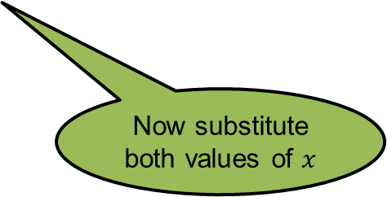
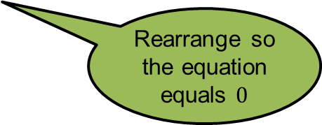
Show that the equation $x³+4x=1$ has a solution between $x=0$ and $x=1$.
Rearrange so the equation equals $0$
$x³+4x=1$
$−1$
$$−1$$
Now substitute both values of $x$
$$x³+4x−1=0$$
$$f(0)=(0)³+4(0)−1$$
$$f(1)=(1)³+4(1)−1$$
$$f(0)=−1$$
$$f(1)=4$$
As one value is positive, and the other negative, there is a solution between $x=0$ and $x=1$.

Slide 3
Between which of the following two values does the equation $3x3+5x−11=0$ have a solution?
A
Between -2 and -1
B
Between -1 and 0
C
Between 0 and 1
D
Between 1 and 2

Slide 4
Between which of the following two values does the equation $−5x4+6x2+1=0$ have one of its solutions?
A
Between -3 and -2
B
Between -2 and -1
C
Between -1 and 0
D
Between 0 and 1

Slide 5
Between which of the following two values does the equation $−7x3+20x2−x+1=0$ have a solution?
A
Between -1 and 0
B
Between 0 and 1
C
Between 1 and 2
D
Between 2 and 3

Slide 6
Between which of the following two values does the equation $−2x3+5x−5=0$ have a solution?
A
Between -4 and -3
B
Between -3 and -2
C
Between -2 and -1
D
Between -1 and 0

Slide 7
Between which of the following two values does the equation $x5−3x3+7x2−3=0$ NOT have a solution?
A
Between -3 and -2
B
Between -2 and -1
C
Between -1 and 0
D
Between 0 and 1

Slide 8
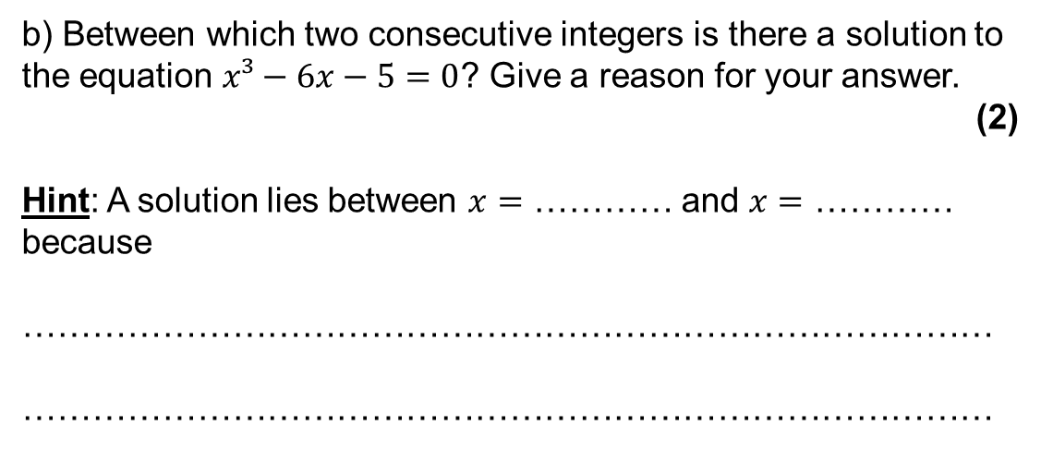
Exam Question
a) Complete the table of values for $y=x³−6x−5$. (2)
$$x$$ | 0 | 1 | 2 | 3 | 4
$$y$$ |  | -10 | -9 | 4
-5
35
b) Between which two consecutive integers is there a solution to the equation $x³−6x−5=0$? Give a reason for your answer.
(2)
Hint: A solution lies between $x=$ ………… and $x=$ ………… because
…………………………………………………………………………
…………………………………………………………………………
2
3
$f(2)$ is negative and $f(3)$ is positive. The change of sign
means there is a solution between them.

Slide 9
Iteration means the act of repeating a process with the aim of approaching a desired goal, target or result.
Each repetition of the process is also called an "iteration”.
$x_{n+1}=4x_{n}+1$
Means the next number in the sequence $(n+1)$ is four times the previous term $(n)$, add one

Slide 10
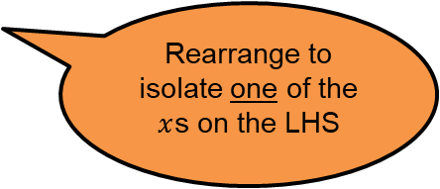

Example
Show that two possible rearrangements of $x^{3}−4x+1=0$ lead to the iterative formulae:
$x_{n+1}=\frac{1}{4}({x_{n}}^{3}+1)$ and $x_{n+1}=\sqrt[3]{4x_{n}−1}$
$x^{3}−4x+1=0$
$4x=x^{3}+1$
$x=\frac{1}{4}(x^{3}+1)$
$x_{n+1}=\frac{1}{4}({x_{n}}^{3}+1)$
Rearrange to isolate one of the $x$s on the LHS
$x^{3}−4x+1=0$
$x^{3}=4x−1$
$x=\sqrt[3]{4x−1}$
$x_{n+1}=\sqrt[3]{4x_{n}−1}$

Slide 11
Pair Activity
Complete the Tarsia jigsaw on rearranging equations into iterative formulae.
Show all of your working in your book.

Slide 12
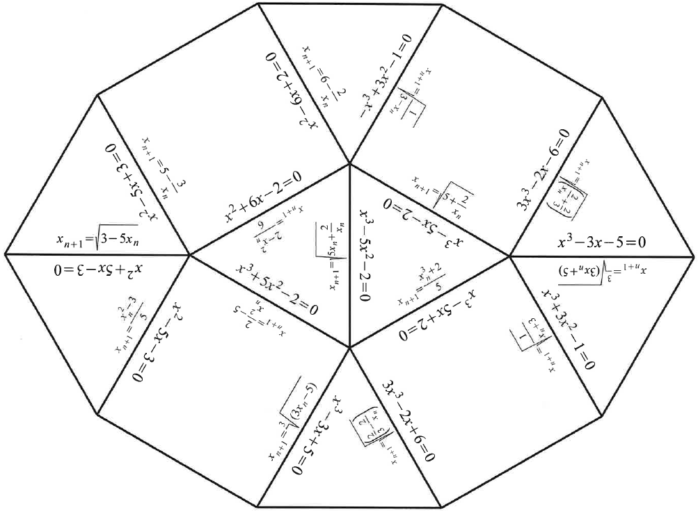

Slide 13

Example
Find the positive roots of $x^{3}−4x+1=0$, correct to 3 decimal places by substituting $x_{0}=1$ into $x_{n+1}=\frac{1}{4}({x_{n}}^{3}+1)$
$x_{n+1}=\frac{1}{4}({x_{n}}^{3}+1)$
$x_{0}=1$
$x_{1}=\frac{1}{4}\left(1^{3}+1\right)=0.5$
$x_{2}=\frac{1}{4}\left({ANS}^{3}+1\right)=0.28125$
$x_{3}=0.255 561…$
$x_{4}=0.254 172…$
$x_{5}=0.254 105…$
Always write the calculator display to a couple more decimal places than asked for in the question
The sequence converges and the root is $0.254$ (3 dp)

Slide 14
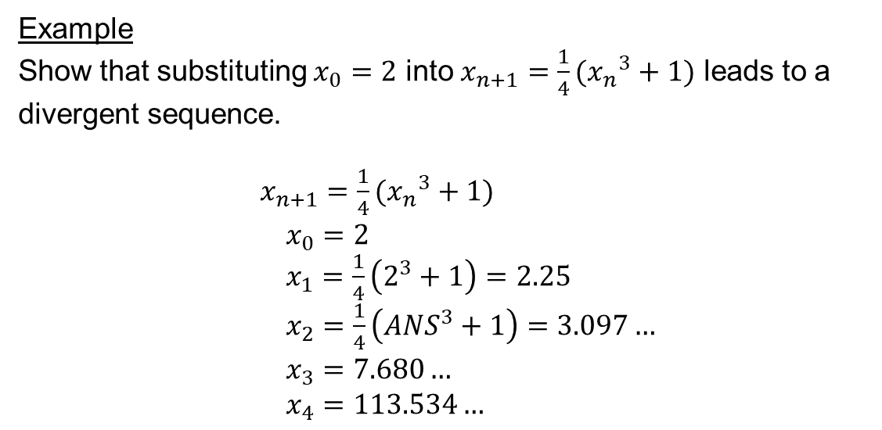
Example
Show that substituting $x_{0}=2$ into $x_{n+1}=\frac{1}{4}({x_{n}}^{3}+1)$ leads to a divergent sequence.
$x_{n+1}=\frac{1}{4}({x_{n}}^{3}+1)$
$x_{0}=2$
$x_{1}=\frac{1}{4}\left(2^{3}+1\right)=2.25$
$x_{2}=\frac{1}{4}\left({ANS}^{3}+1\right)=3.097…$
$x_{3}=7.680…$
$x_{4}=113.534…$
This sequence diverges.

Slide 15
Example
Show that $x^{2}−6x+2=0$ can be written in the form $x=\sqrt{6x −2}$
Use the iteration formula $x_{n+1}=\sqrt{6x_{n}−2}$ to find $x_{4}$ to 2 decimal places. Start with $x_{0}=2.$
$$x^{2} −6x+2=0$$
$$x_{n+1} = \sqrt{6x_{n} −2}$$
$$x^{2}=6x −2$$
$$x_{1} = \sqrt{6(2) −2}=3.1622…$$
$$x= \sqrt{6x −2}$$
$$x_{2} =4.1199…$$
$$x_{3} =4.7664…$$
$$x_{4} =5.1574…=5.16 (2 dp)$$

Slide 16
Prove to me that $x=\sqrt[3]{\frac{4−3x}{4}}$ and $x=\frac{4−4x^{3}}{3}$ represent the same equation.
Why will the iterative formula $x=\sqrt{4−3x^{3}}$ not yield any results after $x_{1}$ when starting with $x_{0}=1$?

Slide 18
Answers
1) 5.40 5) 0.38
2) 2.79 6) 1.82
3) 4.12 7) 1.5
4) 6.23 8) 12.81

