Slide 1
Starter
Calculate the areas and circumferences of these circles to 1 d.p.
Q1
Q2
Q3
7 cm
2.5 cm
8 cm
Q4
Q5
Q6
3 cm
4.5 cm
2 cm

Slide 2
Answers
Q1 A = 38.5 cm², C = 22.0 cm
Q2 A = 19.6 cm², C = 15.7 cm
Q3 A = 50.3 cm², C = 25.1 cm
Q4 A = 12.6 cm², C = 12.6 cm
Q5 A = 28.3 cm², C = 18.8 cm
Q6 A = 15.9 cm², C = 14.1 cm

Slide 3
A prism is a 3D shape with two identical 2D shapes facing each other.
These identical shapes are called the cross-section.
The bases can be a triangle, square, rectangle or any other polygon.
A cylinder is not a prism, although it behaves like a prism when we are calculating its volume and surface area.
Volume of prism:
area of cross-section $×$ perpendicular length

Slide 4
Volume of prism:
area of cross-section $×$ perpendicular length
Example
Calculate the volume of this cylinder. Give your answer correct to 1 decimal place.
$π×{12}^{2}×20$
$12$ cm
$=9047.8$ cm³
$20$ cm

Slide 5
Volume of prism:
area of cross-section $×$ perpendicular length
Example
Calculate the volume of this cylinder. Give your answer correct to 3 significant figures.
$π×5^{2}×12$
$10$ cm
$=943$ cm³
$12$ cm

Slide 7
Answers
Question 1
a) 226.2 cm³ b) 150.8 cm³ c) 471.2 cm³
Question 2
a) 8.0 cm b) 2.0 cm c) 2.8 cm
Question 3
198 cm³

Slide 8
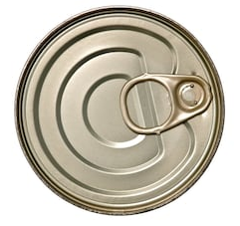
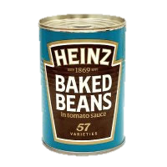
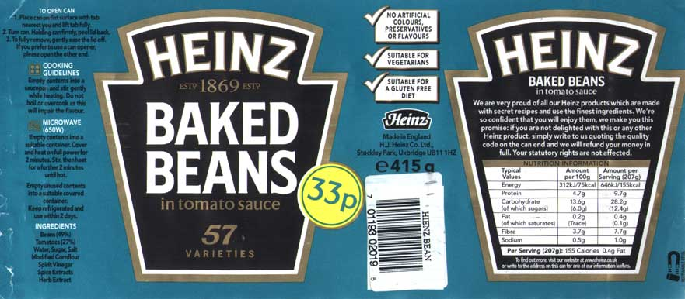
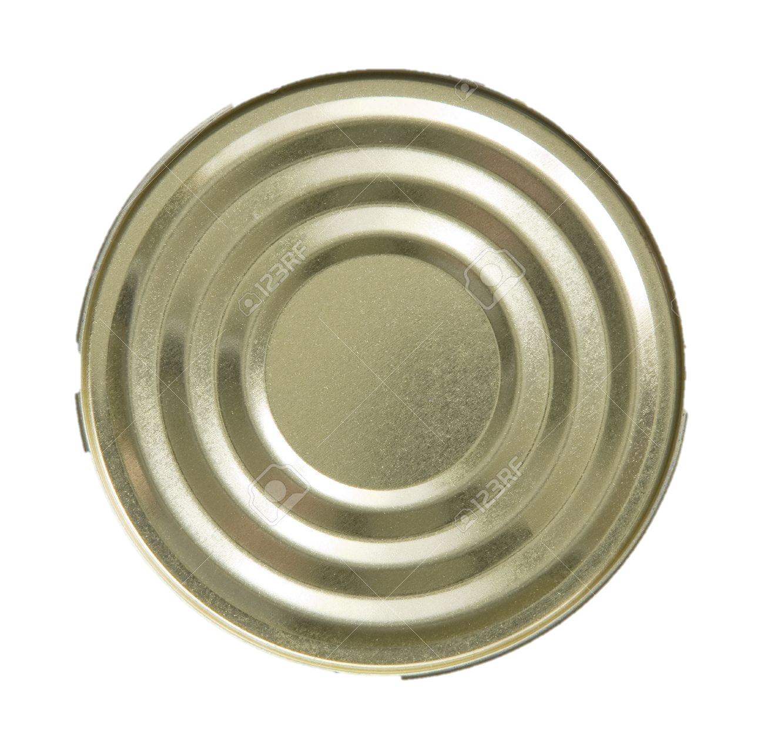
The surface area of a shape is the total area of all of its faces.
To calculate the total surface area, work out the areas of every face and add them together.

Slide 9
Area of top circle $=πr²$
Area of bottom circle $=πr²$

Slide 10
Circumference ($πd$)
Height ($h$)

Slide 11
Area of top circle $=πr²$
Area of label $=πdh$
Area of bottom circle $=πr²$

Slide 12
Example
Calculate the total surface area of the cylinder. Give your answer correct to 1 decimal place.
Top: $π×2^{2}=12.566…$
Bottom: $π×2^{2}=12.566…$
Label: $π×4×6=75.398…$
Total surface area:
$=100.5$ cm²
$4$ cm
$6$ cm

Slide 14
Answers
Question 1
a) 207.3 cm² b) 175.9 cm² c) 345.6 cm²
Question 2
£47.85
Question 3
$x=$ 10

Slide 15
Plenary
Your friend has missed today’s lesson. Write a text (in your book!) telling them what they need to know.

