Slide 1
Starter
Match each area and perimeter to its rectangle.
Fill in the missing cards.

Slide 2
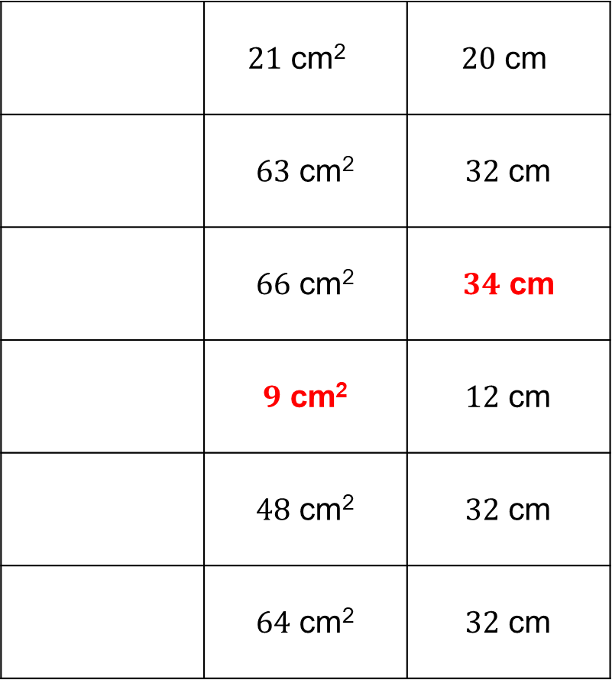
 | $21$ cm² | $20$ cm
 | $63$ cm² | $32$ cm
 | $66$ cm² | $34$ cm
 | $9$ cm² | $12$ cm
 | $48$ cm² | $32$ cm
 | $64$ cm² | $32$ cm
Answers
8cm
8cm

Slide 3
Task
Calculate the missing lengths of the parallel lines.
?
3
30
10
10
17
?
5.8
?
12

Slide 4
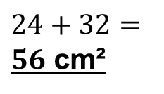
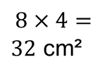
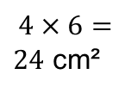
Example
Calculate the area of this compound shape which is made up of two rectangles.
$6$ cm
$$4×6=$$
$24$ cm²
$4$ cm
$8$ cm
$6$ cm
$8$ cm
$$8×4=$$
$32$ cm²
$4$ cm
$10$ cm
? cm
$24+32=$
$56$ cm²
$10−6=4$ cm

Slide 5
Example
Calculate the perimeter of this compound shape which is made up of two rectangles.
$$10−6$$
$$8−4$$
$=4$ cm
$=4$ cm
$8$ cm
$6$ cm
$4$ cm
$10$ cm
$$4+8+10+4+6+4=$$
$36$ cm

Slide 7
Answers
$A=13$ cm² $A=66$ cm²
$P=22$ cm $P=34$ cm
$A=42$ cm² $A=126$ cm²
$P=30$ cm $P=49$ cm
$A=112$ cm² $A=108$ cm²
$P=56$ cm $P=66$ cm

Slide 8
A triangle is half of a rectangle.
So we can calculate the area of the rectangle that the triangle fits inside, then halve it!
Area of a triangle $=\frac{1}{2}bh$
base
perpendicular
height

Slide 9
Example
Calculate the area of the triangle.
Area of a triangle $=\frac{1}{2}bh$
$=\frac{1}{2}×6×4$
$=12$ cm²
$4$ cm
$6$ cm

Slide 10
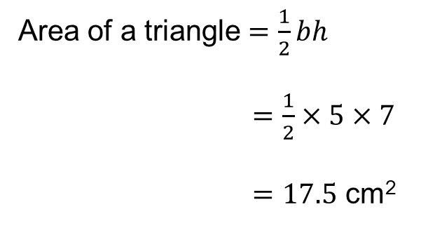
Example
Calculate the area of the triangle.
Area of a triangle $=\frac{1}{2}bh$
$=\frac{1}{2}×5×7$
$=17.5$ cm²
$7$ cm
$5$ cm

Slide 11
Task
Calculate the areas of the triangles below:
$15$ cm²
$10$ cm²
$6$ cm
$4$ cm
$5$ cm
$5$ cm
$5$ cm
$4$ cm
$6$ cm²
$7$ cm
$21$ cm²
$6$ cm
$3$ cm
Extension
If a triangle has a base length of $7$ cm and an area of $42$ cm², what is the height of the triangle?
$6$ cm

Slide 12
How can we calculate the area of this parallelogram?
$4$ cm $2$ cm
$6$ cm
$5$ cm
5cm
5cm

Slide 13
How can we calculate the area of this parallelogram?
$4$ cm $2$ cm
$5$ cm
$2$ cm
$4$ cm

Slide 14
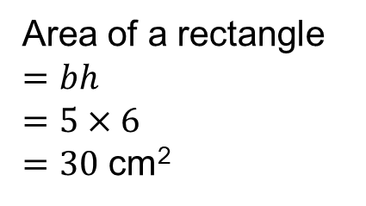
How can we calculate the area of this parallelogram?
Area of a rectangle
$=bh$
$=5×6$
$=30$ cm²
$5$ cm
$2$ cm
$4$ cm
$6$ cm

Slide 15
This was the original question…
Area of a parallelogram $=bh$
$6$ cm
$5$ cm
5cm
5cm
base
perpendicular
height

Slide 16
$7$ cm
$9$ cm
$56$ cm² | $32$ cm²
$63$ cm² | $54$ cm²
A
B
C
D

Slide 17
$7$ cm
$9$ cm
$56$ cm² | $32$ cm²
$63$ cm² | $54$ cm²
A
B
C
D

Slide 18
$8$ cm
$7$ cm
$15$ cm² | $56$ cm²
$49$ cm² | $64$ cm²
A
B
C
D

Slide 19
$8$ cm
$7$ cm
$15$ cm² | $56$ cm²
$49$ cm² | $64$ cm²
A
B
C
D

Slide 20
$5$ cm
$4$ cm
$9$ cm
$20$ cm² | $45$ cm²
$180$ cm² | $36$ cm²
A
B
C
D

Slide 21
$5$ cm
$4$ cm
$9$ cm
$20$ cm² | $45$ cm²
$180$ cm² | $36$ cm²
A
B
C
D

Slide 22
$10$ cm
$8$ cm
$10$ cm
$80$ cm² | $20$ cm²
$100$ cm² | $18$ cm²
A
B
C
D

Slide 23
$10$ cm
$8$ cm
$10$ cm
$80$ cm² | $20$ cm²
$100$ cm² | $18$ cm²
A
B
C
D

Slide 24
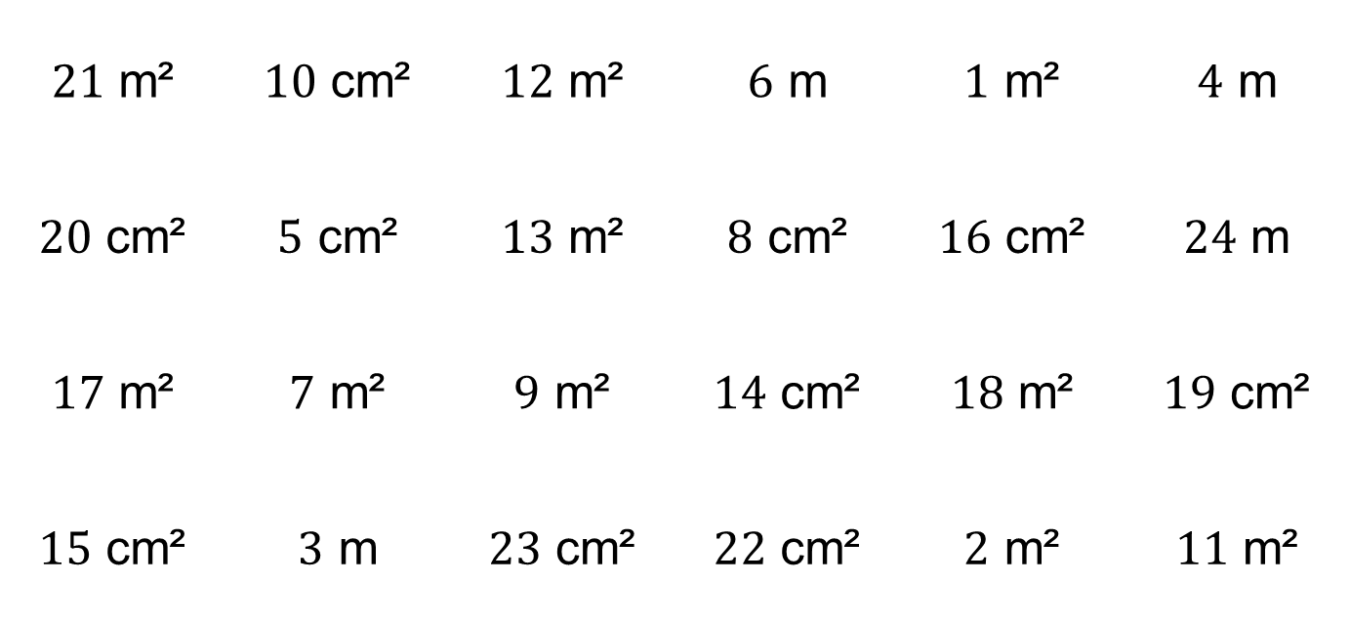
Area and Perimeter Bingo
Draw a $3×3$ grid (what’s its area?) and fill it with 9 of the numbers below. Don’t forget to include the units!
$21$ m² | $10$ cm² | $12$ m² | $6$ m | $1$ m² | $4$ m
$20$ cm² | $5$ cm² | $13$ m² | $8$ cm² | $16$ cm² | $24$ m
$17$ m² | $7$ m² | $9$ m² | $14$ cm² | $18$ m² | $19$ cm²
$15$ cm² | $3$ m | $23$ cm² | $22$ cm² | $2$ m² | $11$ m²

Slide 25
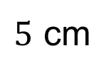
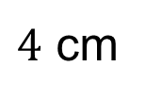
What is the area of this shape?
$4$ cm
$5$ cm

Slide 26
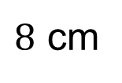
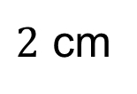
What is the area of this shape?
$2$ cm
$8$ cm

Slide 27
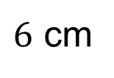
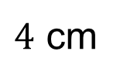
What is the area of this shape?
$6$ cm
$4$ cm

Slide 28
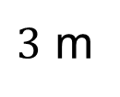
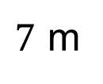
What is the area of this shape?
$3$ m
$7$ m

Slide 29
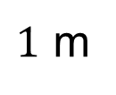

What is the area of this shape?
$1$ m
$17$ m

Slide 30
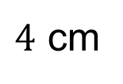
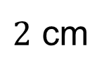
What is the area of this shape?
$4$ cm
$2$ cm

Slide 31
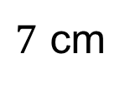
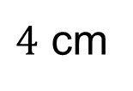
What is the area of this shape?
$7$ cm
$4$ cm

Slide 32
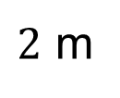
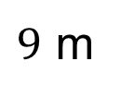
What is the area of this shape?
$2$ m
$9$ m

Slide 33
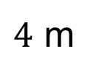
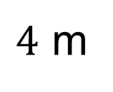
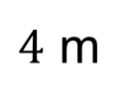
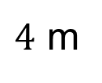
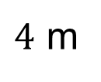
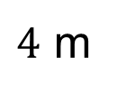
What is the perimeter of this shape?
$4$ m
$4$ m
$4$ m
$4$ m
$4$ m
$4$ m

Slide 34

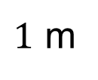
What is the area of this shape?
$1$ m
$13$ m

Slide 35
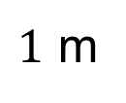
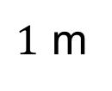
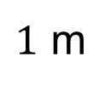
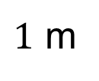
What is the perimeter of this shape?
$1$ m
$1$ m
$1$ m
$1$ m

Slide 36
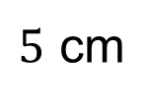
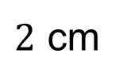
What is the area of this shape?
$5$ cm
$2$ cm

Slide 37
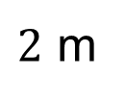
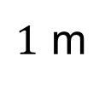
What is the perimeter of this shape?
$2$ m
$1$ m

Slide 38
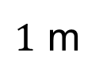
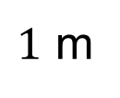
What is the area of this shape?
$1$ m
$1$ m

Slide 39
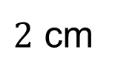
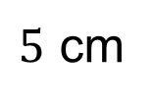
What is the area of this shape?
$2$ cm
$5$ cm

Slide 40
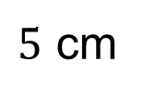
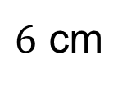
What is the area of this shape?
$5$ cm
$6$ cm

Slide 41
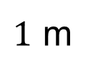
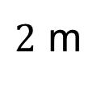
What is the area of this shape?
$1$ m
$2$ m

Slide 42
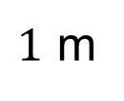
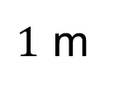
What is the perimeter of this shape?
$1$ m
$1$ m
$1$ m

Slide 43
What is the area of this shape?
$2$ cm
$11$ cm

Slide 44
What is the area of this shape?
$1$ m
$11$ m

Slide 45
What is the area of this shape?
$1$ m
$7$ m

Slide 46
What is the area of this shape?
$1$ cm
$19$ cm

Slide 47
What is the area of this shape?
$3$ m
$3$ m

Slide 48
What is the area of this shape?
$1$ cm
$23$ cm

Slide 49
How can we calculate the area of this trapezium?
Area of parallelogram $=\left(a+b\right)h$
Area of trapezium $=\frac{1}{2}\left(a+b\right)h$
$$a$$
$$b$$
$$h$$
$$h$$
$$b$$
$$a+b$$
$$a$$

Slide 50
Example
Calculate the area of the trapezium.
$5$ cm
Area of trapezium $=\frac{1}{2}\left(a+b\right)h$
$=\frac{1}{2}×\left(5+7\right)×8$
$=48$ cm²
$8$ cm
$7$ cm

Slide 52
Answers
$30$ cm² $18$ cm²
$77$ cm² $54$ cm²
$121$ cm² $168$ cm²

