Slide 1
Starter
Find the equation of the line which is perpendicular to
$y=−4x+1$ and passes through the point $(2,3)$.
Gradient $=−1÷−4=\frac{1}{4}$
$$y–y1=m(x–x1)$$
$y–3=\frac{1}{4}(x–2)$
$y=\frac{1}{4}x+\frac{5}{2}$

Slide 2
A tangent and a normal are perpendicular
$$y$$
$$y=f(x)$$
Tangent at $A$
$$A$$
What can you remember about perpendicular gradients?
$$0$$
$$x$$
Normal at $A$

Slide 3
Do you remember previously that we described differentiation as a rate of change?
$\frac{dy}{dx}$ literally means “the change in y divided by the change in x”.
That’s pretty similar to $\frac{y_{2}−y_{1}}{x_{2}−x_{1}}$
We can use differentiation to find the gradient of a curve at a given point, as long as we know some other pieces of information.

Slide 4
Curve $C$ has equation $y={8x}^{3}−{3x}^{2}−25x$
Find the $x$ coordinates of the points on $C$ where the gradient is $5$.
Start by finding the gradient function
$\frac{dy}{dx}=24x^{2}−6x−25$
$5=24x^{2}−6x−25$
We know that this has to be equal to $5$
$0=24x^{2}−6x−30$
$0=4x^{2}−x−5$
$0=(4x−5)(x+1)$
$x=1.25$ and $−1$

Slide 5
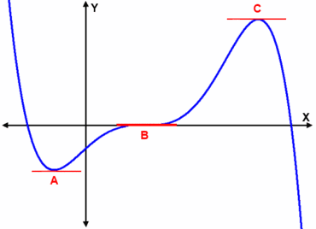
A stationary point (or turning point) on a curve is any point where the curve has gradient zero.
A stationary point could be a minimum, maximum or point of inflection.
Maximum
$$y=f(x)$$
Minimum
Point of inflection

Slide 6
Example
Find the coordinates of the turning point of the graph with the equation
$y=x^{2}+6x−3$ .
$\frac{dy}{dx}=2x+6$
Step 1: differentiate
$2x+6=0$
Step 2: solve with
$\frac{dy}{dx}=0$
$2x=−6$
$x=−3$
Step 3: substitute $x$ into the original equation to find the corresponding $y$ value
$$y={(−3)}^{2}+6(−3)−3$$
$$y=9−18−3$$
$$y=−12$$
Stationary point at $(−3,−12)$

Slide 7
Example
Find the coordinates of the stationary points of the curve
$y=x^{3}+9x^{2}+24x+4$
$\frac{dy}{dx}={3x}^{2}+18x+24$
Step 1: differentiate
${3x}^{2}+18x+24=0$
Step 2: solve with $\frac{dy}{dx}=0$
$x^{2}+6x+8=0$
$\left(x+2\right)\left(x+4\right)=0$
Step 3: substitute $x$ into the original equation to find the corresponding $y$ value
$x=−2$ or $x=−4$
$y={(−2)}^{3}+9{(−2)}^{2}+24(−2)+4$
$y={(−4)}^{3}+9{(−4)}^{2}+24(−4)+4$
$$y=−8+36−48+4$$
$$y=−64+144−96+4$$
$$y=−16$$
$$y=−12$$
Stationary points at $(−2,−16)$ and $(−4,−12)$

Slide 9
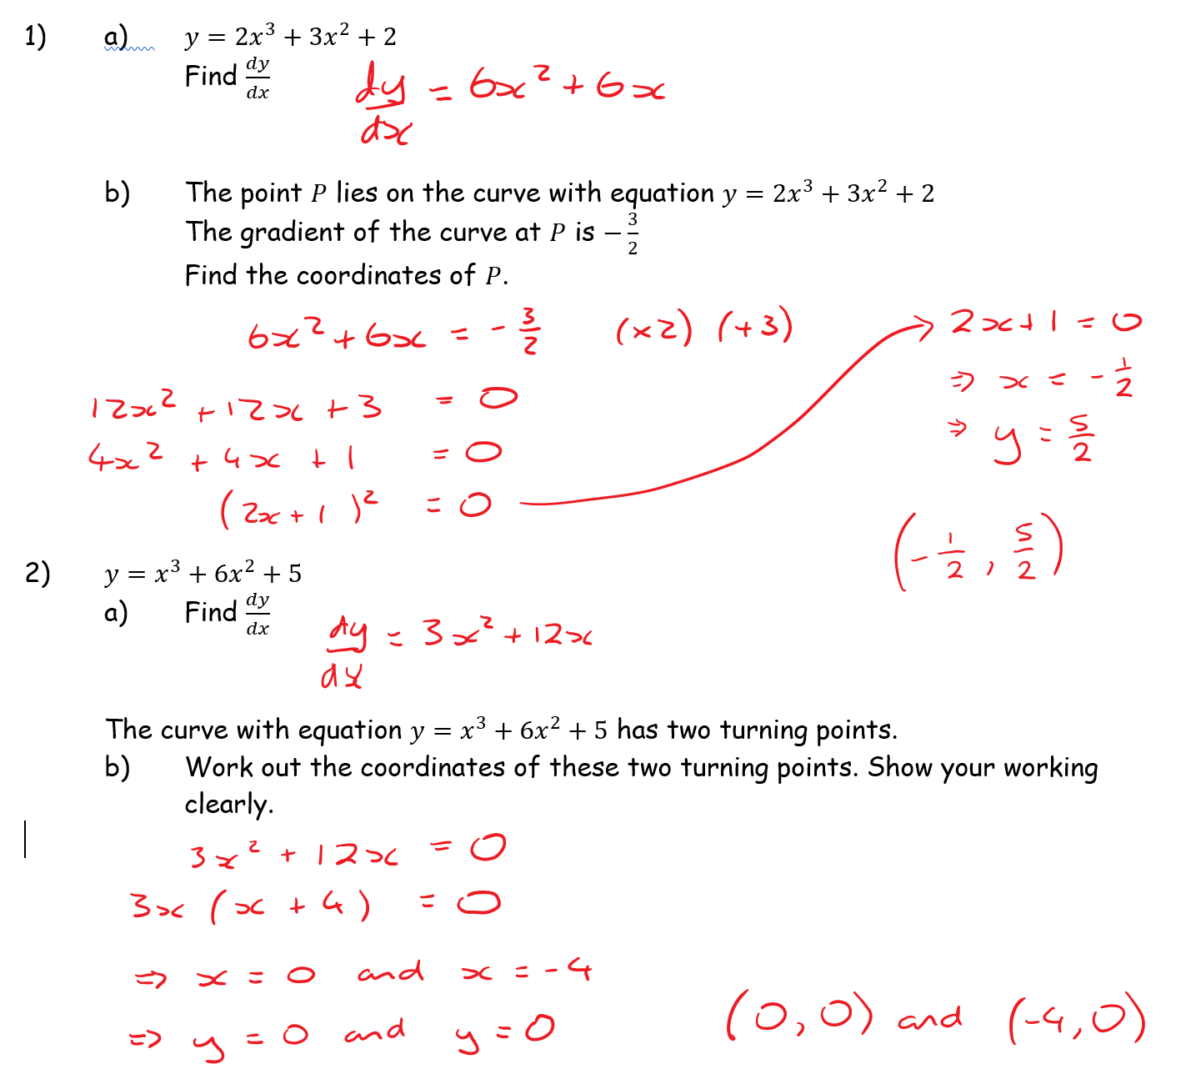
Solutions

Slide 10
Solutions

Slide 11
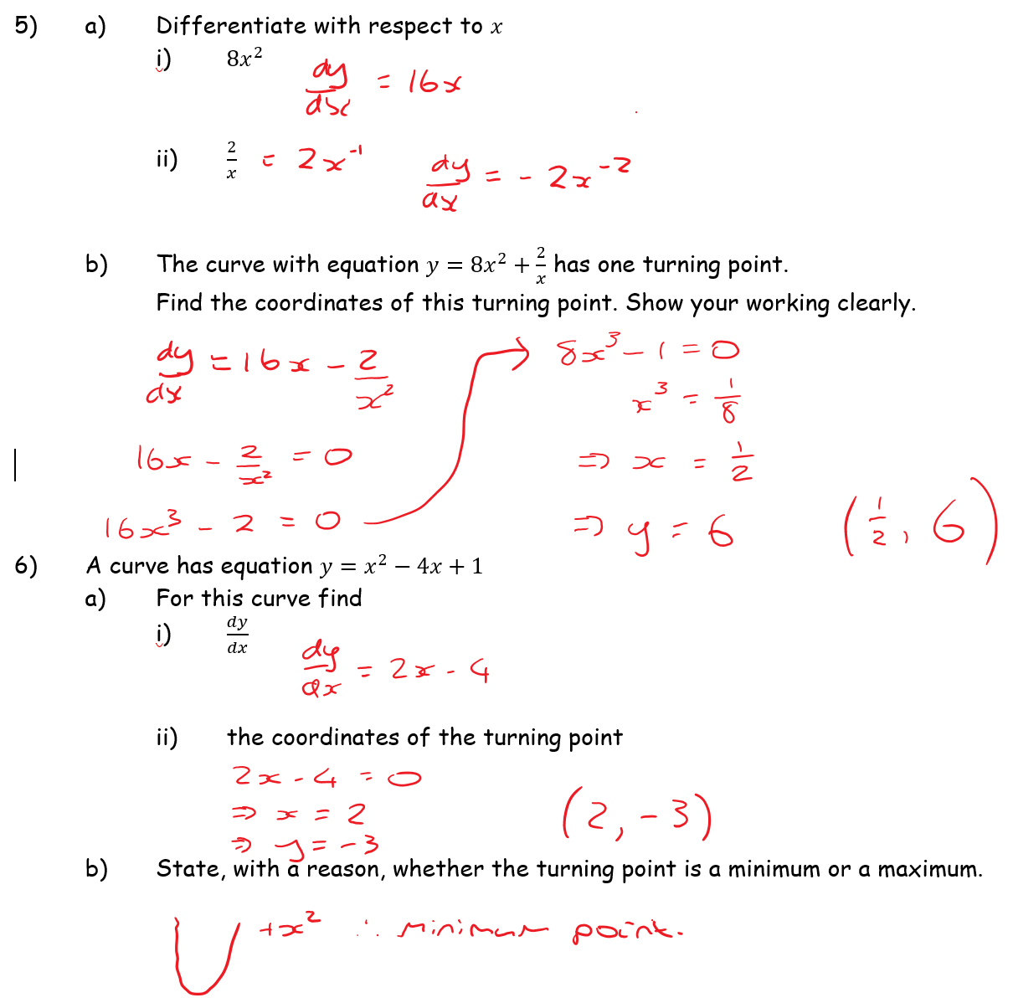
Solutions

