Slide 1

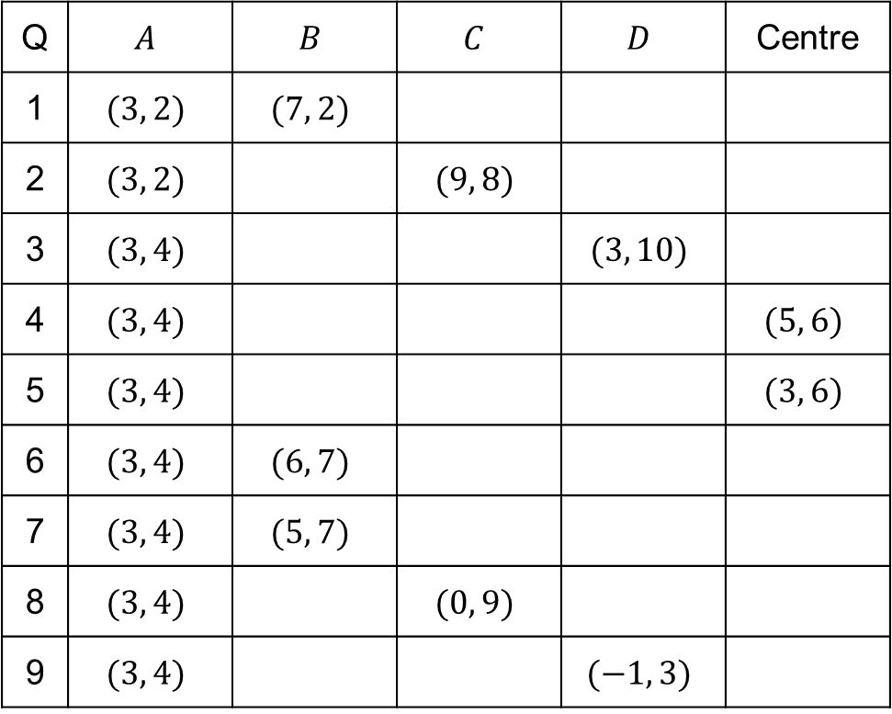





Starter
Point $A$ is always opposite point $C$:
Q | $$A$$ | $$B$$ | $$C$$ | $$D$$ | Centre
1 | $$(3, 2)$$ | $$(7, 2)$$
2 | $$(3, 2)$$ |  | $$(9, 8)$$
3 | $$(3, 4)$$ |  |  | $$(3, 10)$$
4 | $$(3, 4)$$ |  |  |  | $$(5, 6)$$
5 | $$(3, 4)$$ |  |  |  | $$(3, 6)$$
6 | $$(3, 4)$$ | $$(6, 7)$$
7 | $$(3, 4)$$ | $$(5, 7)$$
8 | $$(3, 4)$$ |  | $$(0, 9)$$
9 | $$(3, 4)$$ |  |  | $$(−1, 3)$$
$$D$$
$$C$$
$$A$$
$$B$$
The points are always read anti-clockwise around the square
But the square could change orientation:
$$C$$
$$D$$
$$B$$
$$A$$
Notes:
Source: VariationTheory.com

Slide 2
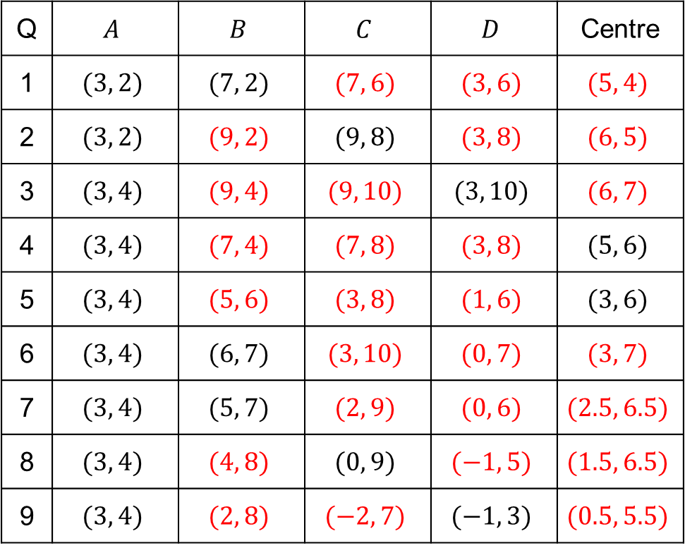
Answers
Point $A$ is always opposite point $C$:
Q | $$A$$ | $$B$$ | $$C$$ | $$D$$ | Centre
1 | $$(3, 2)$$ | $$(7, 2)$$ | $$(7, 6)$$ | $$(3, 6)$$ | $$(5, 4)$$
2 | $$(3, 2)$$ | $$(9, 2)$$ | $$(9, 8)$$ | $$(3, 8)$$ | $$(6, 5)$$
3 | $$(3, 4)$$ | $$(9, 4)$$ | $$(9, 10)$$ | $$(3, 10)$$ | $$(6, 7)$$
4 | $$(3, 4)$$ | $$(7, 4)$$ | $$(7, 8)$$ | $$(3, 8)$$ | $$(5, 6)$$
5 | $$(3, 4)$$ | $$(5, 6)$$ | $$(3, 8)$$ | $$(1, 6)$$ | $$(3, 6)$$
6 | $$(3, 4)$$ | $$(6, 7)$$ | $$(3, 10)$$ | $$(0, 7)$$ | $$(3, 7)$$
7 | $$(3, 4)$$ | $$(5, 7)$$ | $$(2, 9)$$ | $$(0, 6)$$ | $$(2.5, 6.5)$$
8 | $$(3, 4)$$ | $$(4, 8)$$ | $$(0, 9)$$ | $$(−1, 5)$$ | $$(1.5, 6.5)$$
9 | $$(3, 4)$$ | $$(2, 8)$$ | $$(−2, 7)$$ | $$(−1, 3)$$ | $$(0.5, 5.5)$$
$$D$$
$$C$$
$$A$$
$$B$$
The points are always read anti-clockwise around the square
But the square could change orientation:
$$C$$
$$D$$
$$B$$
$$A$$
Notes:
Source: VariationTheory.com

Slide 3
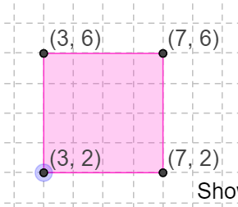
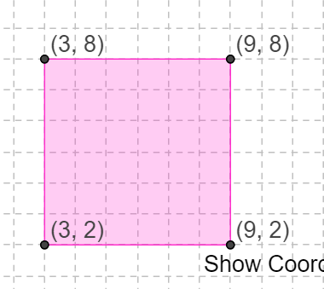
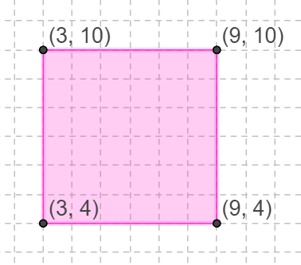
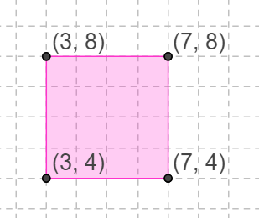
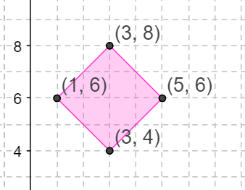
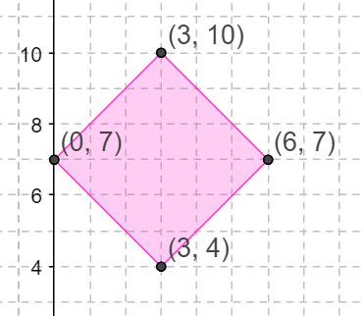
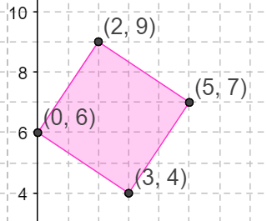
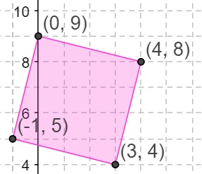
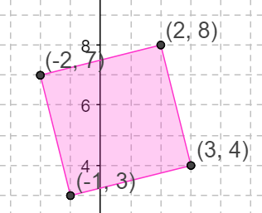
Answers
1 | 2 | 3
4 | 5 | 6
7 | 8 | 9
Notes:
Source: VariationTheory.com

Slide 4
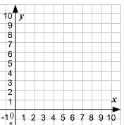
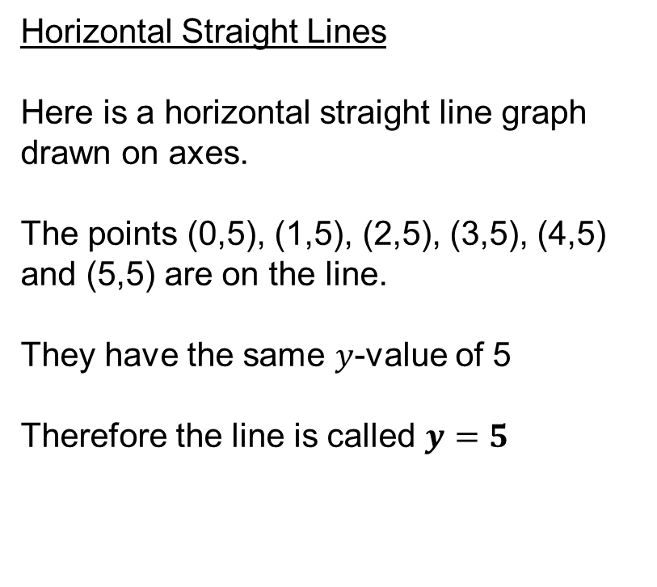
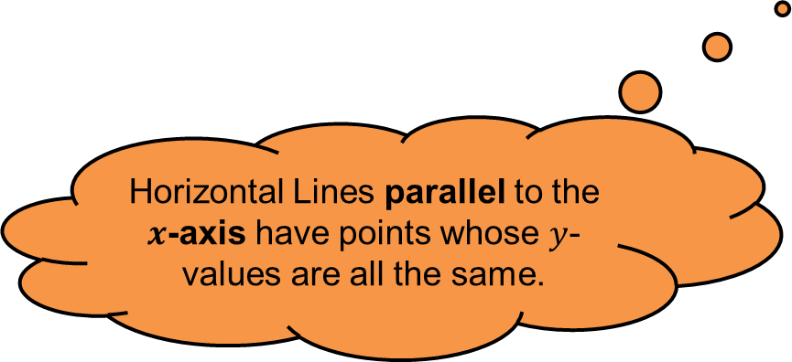
Horizontal Straight Lines
Here is a horizontal straight line graph
drawn on axes.
The points (0,5), (1,5), (2,5), (3,5), (4,5) and (5,5) are on the line.
They have the same $y$-value of 5
Therefore the line is called $y=5$
Horizontal Lines parallel to the $x$-axis have points whose $y$-values are all the same.
Notes:
Source: MathsbyFintan on TES

Slide 5
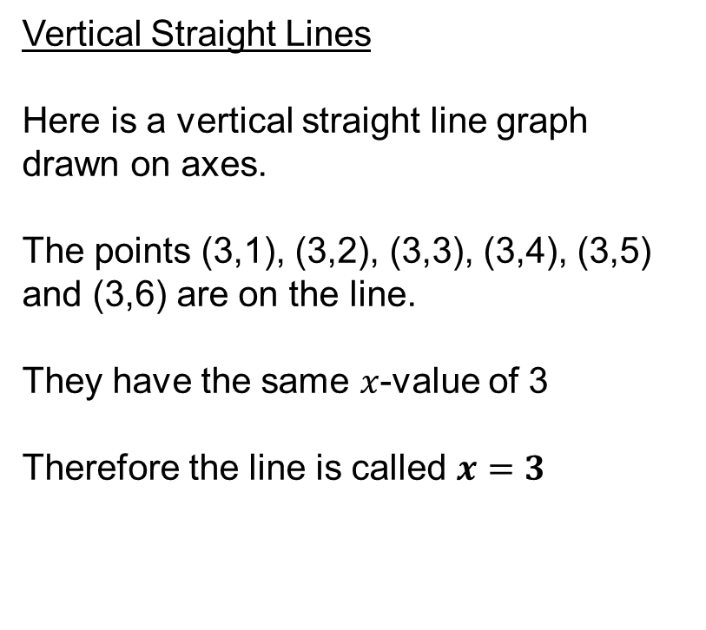
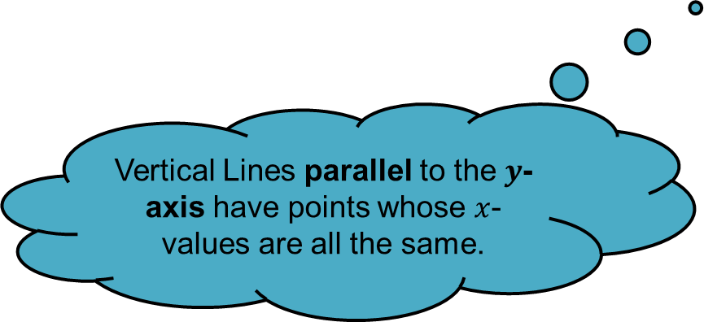
Vertical Straight Lines
Here is a vertical straight line graph
drawn on axes.
The points (3,1), (3,2), (3,3), (3,4), (3,5) and (3,6) are on the line.
They have the same $x$-value of 3
Therefore the line is called $x=3$
Vertical Lines parallel to the $y$-axis have points whose $x$-values are all the same.
Notes:
Source: MathsbyFintan on TES

Slide 6

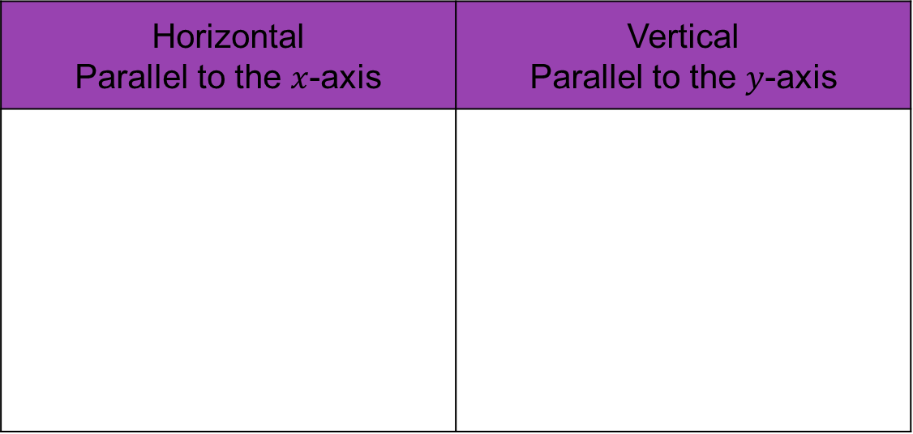







Put the following equations into the right column.
$$x=3$$
$$y=2$$
$$x=0$$
$$y=7$$
$$x=1$$
$$y=3$$
$$y=0$$
$$x=5$$
Horizontal Parallel to the $x$-axis | Vertical Parallel to the $y$-axis
Notes:
Source: MathsbyFintan on TES

Slide 7
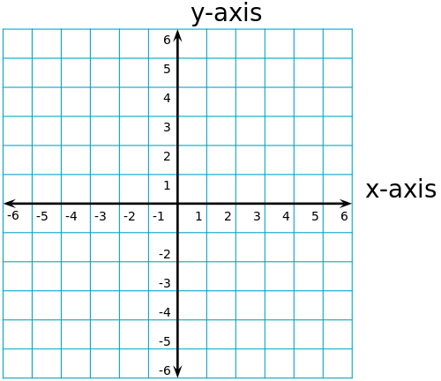
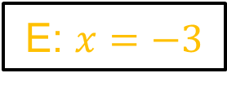
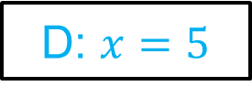
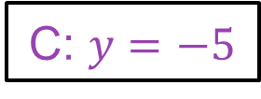
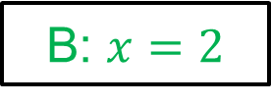
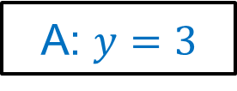
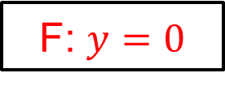
Write the equations for each of these lines.
Answers
A: $y=3$
A
B: $x=2$
C: $y=−5$
F
D: $x=5$
E: $x=−3$
C
F: $y=0$
E
B
D
Notes:
Source: MathsbyFintan on TES

Slide 8
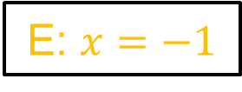
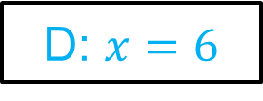
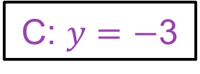
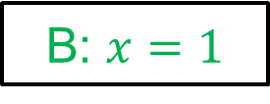
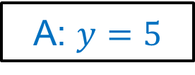
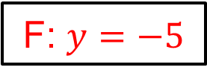
Sketch the following graphs on the same set of axes.
Answers
A: $y=5$
A
B: $x=1$
C: $y=−$3
D: $x=6$
E: $x=−1$
C
F: $y=−5$
F
E
B
D
Notes:
Source: MathsbyFintan on TES

Slide 9
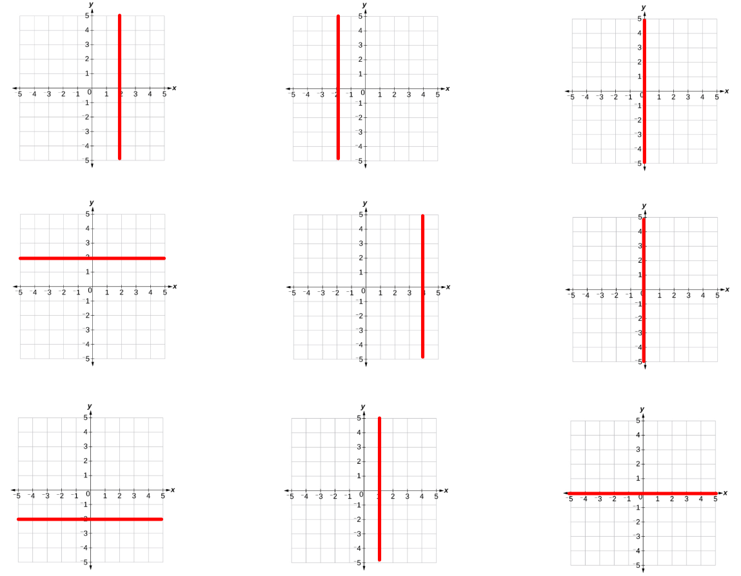









$$y=2$$
$$x=2$$
$$y=0$$
True /
False
True /
False
True /
False
$$y=2$$
$$x=4$$
$$x=0$$
True /
False
True /
False
True /
False
$$x=2$$
$$y=1$$
$$x=0$$
True /
False
True /
False
True /
False
Notes:
Source: VariationTheory.com

Slide 10









$$y=2$$
$$x=2$$
$$y=0$$
True /
False
True /
False
True /
False
$$y=2$$
$$x=4$$
$$x=0$$
True /
False
True /
False
True /
False
$$x=2$$
$$y=1$$
$$x=0$$
True /
False
True /
False
True /
False
Notes:
Source: VariationTheory.com

Slide 11
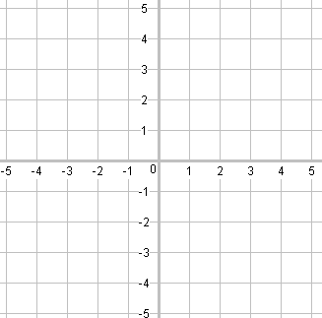
Write down the equation of the two missing lines needed to complete these squares.

Slide 12






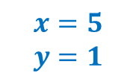
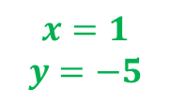
Answers
$$x=2$$
$$y=4$$
$$x=5$$
$$y=1$$
$$x=−3$$
$$y=2$$
$$x=−2$$
$$y=1$$
$$x=1$$
$$y=−1$$
$$x=3$$
$$y=−2$$
$$x=1$$
$$y=−5$$
$$x=−4$$
$$y=−4$$

Slide 13
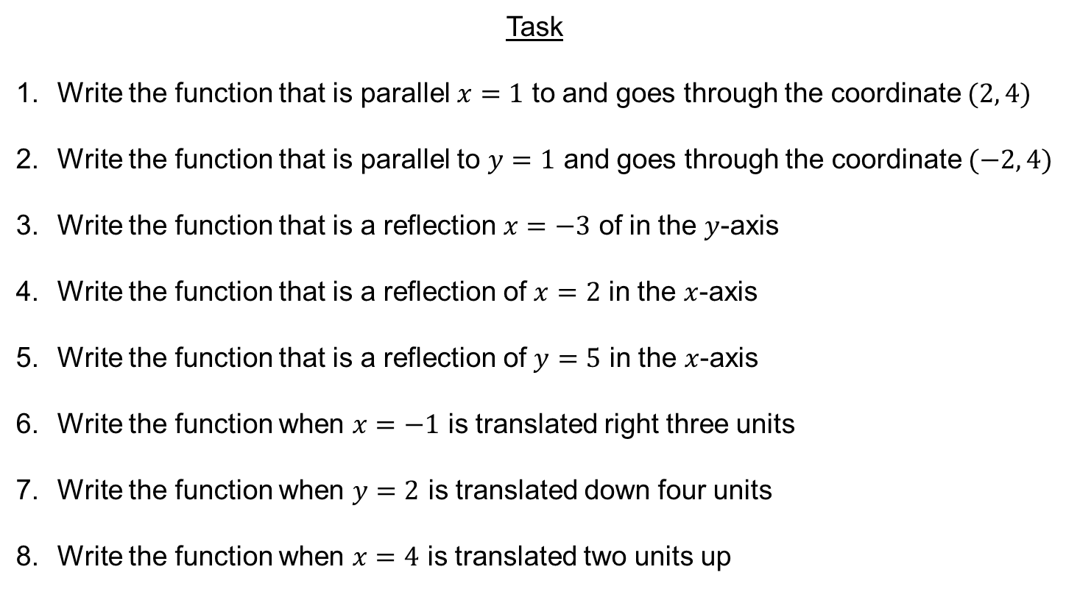

Task
Write the function that is parallel $x=1$ to and goes through the coordinate $(2, 4)$
Write the function that is parallel to $y=1$ and goes through the coordinate $(−2, 4)$
Write the function that is a reflection $x=−3$ of in the $y$-axis
Write the function that is a reflection of $x=2$ in the $x$-axis
Write the function that is a reflection of $y=5$ in the $x$-axis
Write the function when $x=−1$ is translated right three units
Write the function when $y=2$ is translated down four units
Write the function when $x=4$ is translated two units up
$$x=2$$
$$y=4$$
$$x=3$$
$$x=2$$
$$y=−5$$
$$x=2$$
$$y=−2$$
$$x=4$$
Notes:
Source: MathsbyFintan on TES

