Slide 1









Starter
Find the lengths of the missing sides. Give your answer in surd form where appropriate.
$14$ cm
$$2\sqrt{33}$$
$3$ cm
_____ cm
$$5$$
___ cm
$4$ cm
$8$ cm
$$4\sqrt{5}$$
$4$ cm
____ cm
$16$ cm

Slide 2
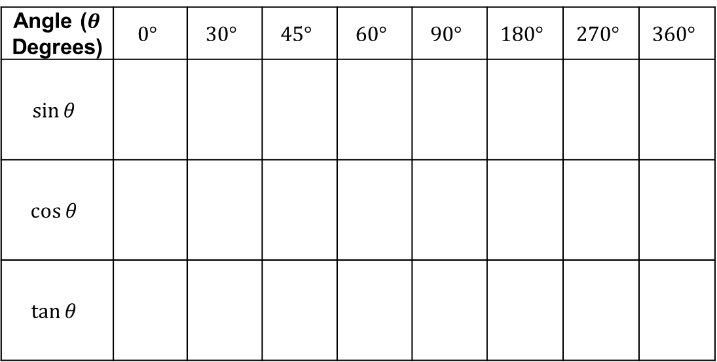
Make sure you fill in your table as we go – you’ll need it later!
Angle ($θ$ Degrees) | $$0°$$ | $$30°$$ | $$45°$$ | $$60°$$ | $$90°$$ | $$180°$$ | $$270°$$ | $$360°$$
$$sin⁡θ$$
$$cos⁡θ$$
$$tan⁡θ$$

Slide 3
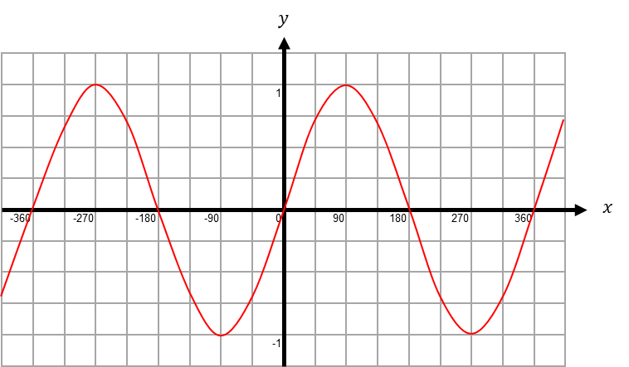

$$y=sin x$$
Periodic…
Symmetrical…
Notes:
Discuss periods and symmetry

Slide 4
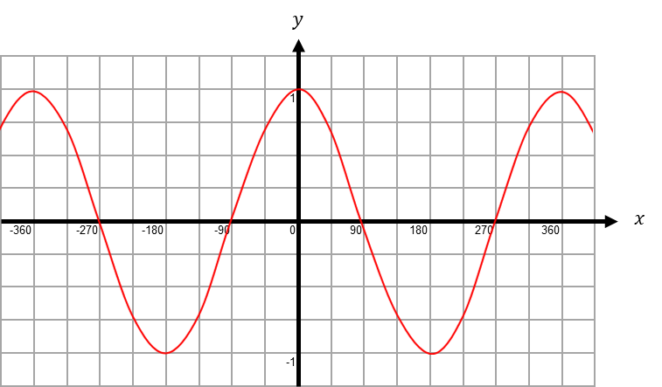

$$y=cos x$$
Periodic…
Symmetrical…
Notes:
Discuss periods and symmetry

Slide 5
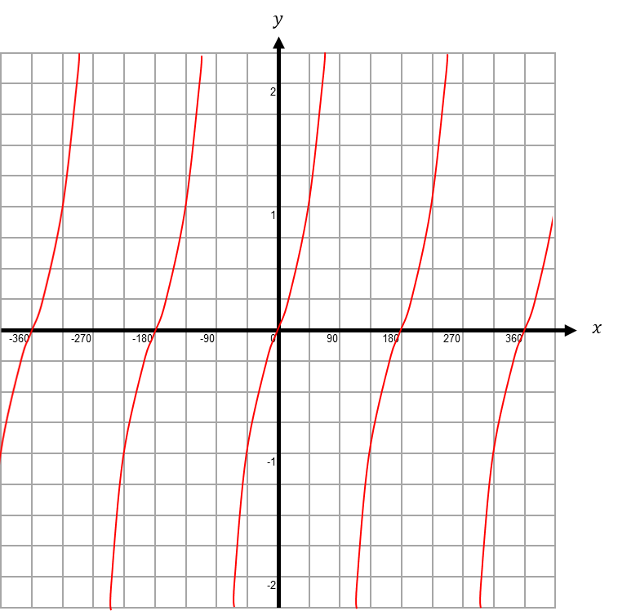

$$y=tan x$$
Periodic…
Notes:
Discuss periods

Slide 6
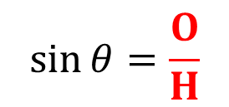

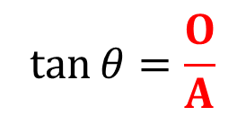
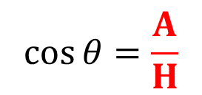
Remember:
(You may want to copy this down!)
H
Trigonometric ratios can help us to find missing sides and angles in right-angled triangles.
O
$$θ$$
A
$$\sin{θ}=\frac{O}{H}$$
$$\cos{θ}=\frac{A}{H}$$
$$\tan{θ}=\frac{O}{A}$$

Slide 7
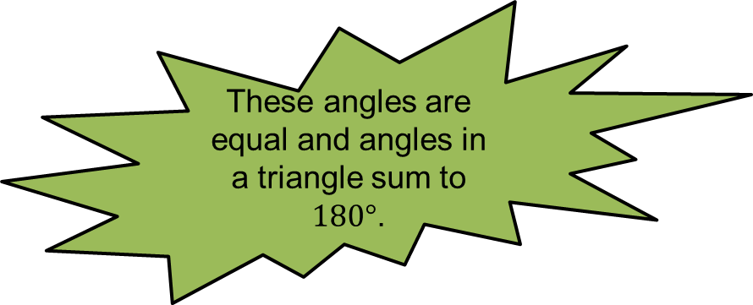





Let’s start with an isosceles right-angled triangle with equal sides of $1$ cm.
These angles are equal and angles in a triangle sum to $180°$.
$$45°$$
$1$ cm
$$45°$$
$1$ cm

Slide 8


Let’s start with an isosceles right-angled triangle with equal sides of $1$ cm.
$$45°$$
$\sqrt{2}$ cm
$1$ cm
By Pythagoras’ Theorem, the hypotenuse is $\sqrt{2}$.
$$45°$$
$1$ cm

Slide 9
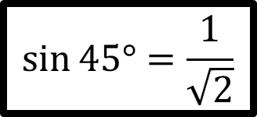





$$sin⁡45°=\frac{1}{\sqrt{2}}$$
$$45°$$
$\sqrt{2}$ cm
$1$ cm
$$45°$$
$1$ cm

Slide 10
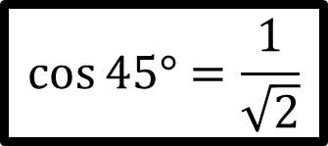
$$sin⁡45°=\frac{1}{\sqrt{2}}$$
$$45°$$
$\sqrt{2}$ cm
$$cos⁡45°=\frac{1}{\sqrt{2}}$$
$1$ cm
$$45°$$
$1$ cm

Slide 11
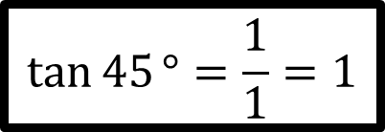
$$sin⁡45°=\frac{1}{\sqrt{2}}$$
$$45°$$
$\sqrt{2}$ cm
$$cos⁡45°=\frac{1}{\sqrt{2}}$$
$1$ cm
$$45°$$
$$\tan{45}°=\frac{1}{1}=1$$
$1$ cm

Slide 12

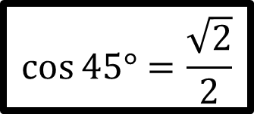
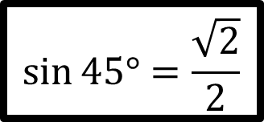
$$sin⁡45°=\frac{\sqrt{2}}{2}$$
$$45°$$
$\sqrt{2}$ cm
$$cos⁡45°=\frac{\sqrt{2}}{2}$$
$1$ cm
$$45°$$
$$\tan{45}°=1$$
$1$ cm
Rationalising the denominators gives…

Slide 13







Now let’s look at an equilateral triangle with sides of $2$ cm.
$$60°$$
$2$ cm
$2$ cm
$$60°$$
$$60°$$
$2$ cm

Slide 14




By Pythagoras’ Theorem, the height is $\sqrt{3}$.
Now let’s look at an equilateral triangle with sides of 2 cm.
$$30°$$
$2$ cm
$\sqrt{3}$ cm
$$60°$$
$1$ cm

Slide 15
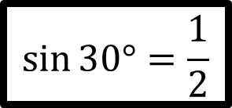
$$sin⁡30°=\frac{1}{2}$$
$$30°$$
$2$ cm
$\sqrt{3}$ cm
$$60°$$
$1$ cm

Slide 16
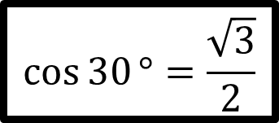
$$sin⁡30°=\frac{1}{2}$$
$$\cos{30}°=\frac{\sqrt{3}}{2}$$
$$30°$$
$2$ cm
$\sqrt{3}$ cm
$$60°$$
$1$ cm

Slide 17
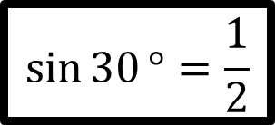
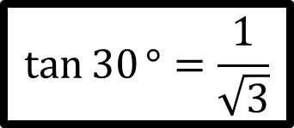
$$\sin{30}°=\frac{1}{2}$$
$$\cos{30}°=\frac{\sqrt{3}}{2}$$
$$30°$$
$2$ cm
$\sqrt{3}$ cm
$$\tan{30}°=\frac{1}{\sqrt{3}}$$
$$60°$$
$1$ cm

Slide 18
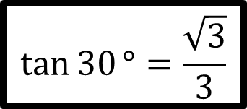
Rationalising the denominator gives…
$$\sin{30}°=\frac{1}{2}$$
$$\cos{30}°=\frac{\sqrt{3}}{2}$$
$$30°$$
$2$ cm
$\sqrt{3}$ cm
$$\tan{30}°=\frac{\sqrt{3}}{3}$$
$$60°$$
$1$ cm

Slide 19
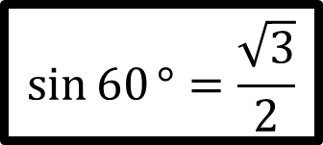
$$\sin{60}°=\frac{\sqrt{3}}{2}$$
$$30°$$
$2$ cm
$\sqrt{3}$ cm
$$60°$$
$1$ cm

Slide 20
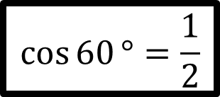
$$\sin{60}°=\frac{\sqrt{3}}{2}$$
$$\cos{60}°=\frac{1}{2}$$
$$30°$$
$2$ cm
$\sqrt{3}$ cm
$$60°$$
$1$ cm

Slide 21
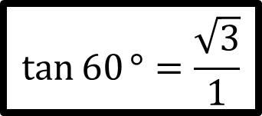
$$\sin{60}°=\frac{\sqrt{3}}{2}$$
$$\cos{60}°=\frac{1}{2}$$
$$30°$$
$2$ cm
$\sqrt{3}$ cm
$$\tan{60}°=\frac{\sqrt{3}}{1}$$
$$60°$$
$1$ cm

Slide 22

$$\sin{60}°=\frac{\sqrt{3}}{2}$$
$$\cos{60}°=\frac{1}{2}$$
$$30°$$
$2$ cm
$\sqrt{3}$ cm
$$\tan{60}°=\sqrt{3}$$
$$60°$$
$1$ cm

Slide 23
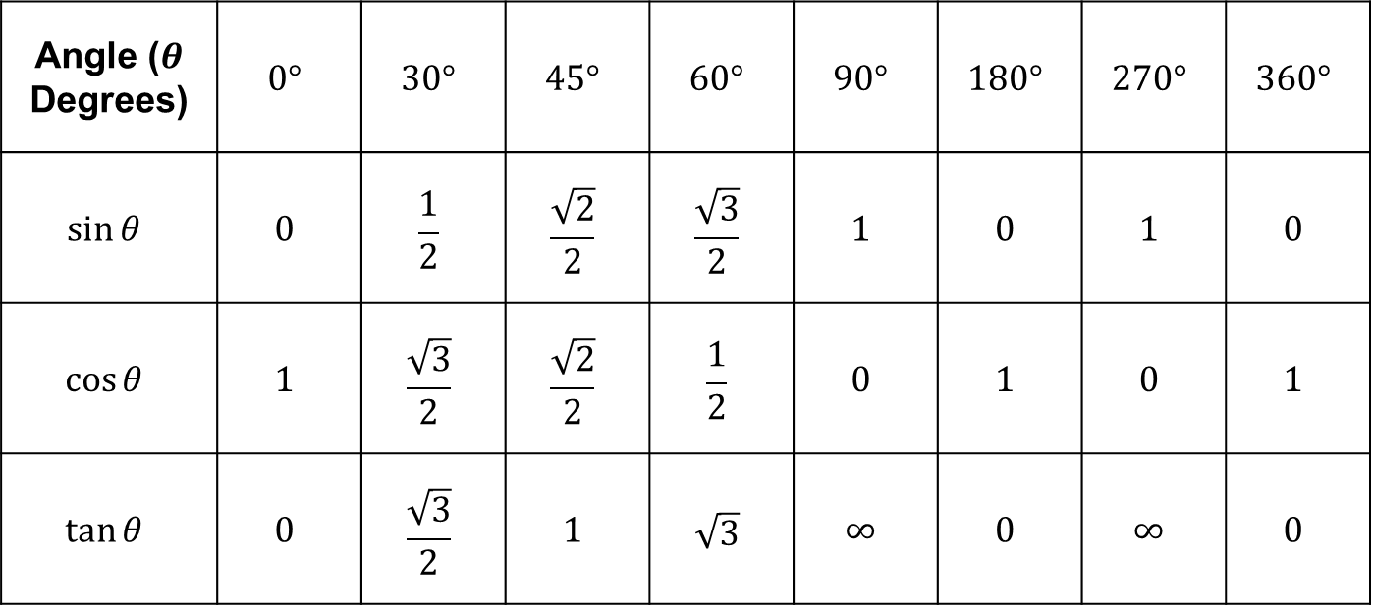
Angle ($θ$ Degrees) | $$0°$$ | $$30°$$ | $$45°$$ | $$60°$$ | $$90°$$ | $$180°$$ | $$270°$$ | $$360°$$
$$sin⁡θ$$ | $$0$$ | $$\frac{1}{2}$$ | $$\frac{\sqrt{2}}{2}$$ | $$\frac{\sqrt{3}}{2}$$ | $$1$$ | $$0$$ | $$1$$ | $$0$$
$$cos⁡θ$$ | $$1$$ | $$\frac{\sqrt{3}}{2}$$ | $$\frac{\sqrt{2}}{2}$$ | $$\frac{1}{2}$$ | $$0$$ | $$1$$ | $$0$$ | $$1$$
$$tan⁡θ$$ | $$0$$ | $$\frac{\sqrt{3}}{2}$$ | $$1$$ | $$\sqrt{3}$$ | $$∞$$ | $$0$$ | $$∞$$ | $$0$$

Slide 25
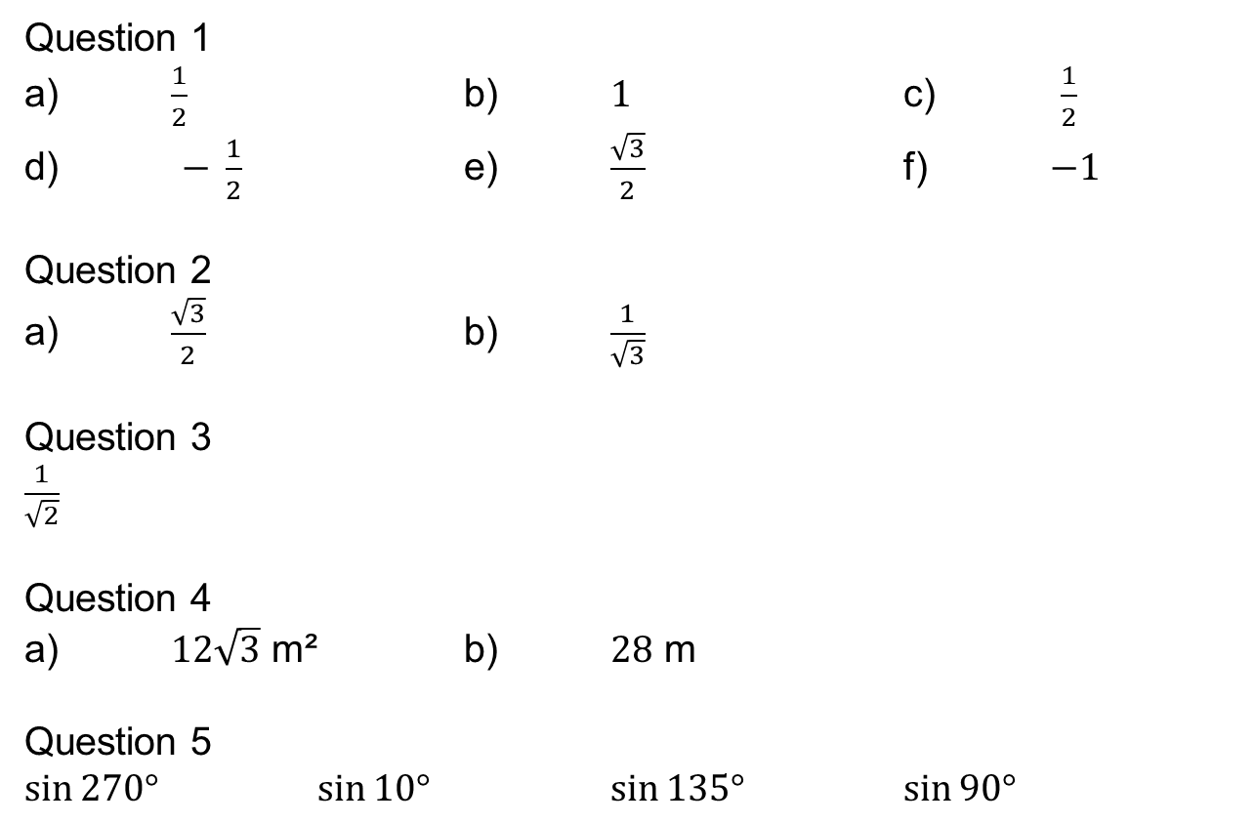
Answers
Question 1
a) $\frac{1}{2}$ b) $1$ c) $\frac{1}{2}$
d) $− \frac{1}{2}$ e) $\frac{\sqrt{3}}{2}$ f) $−1$
Question 2
a) $\frac{\sqrt{3}}{2}$ b) $\frac{1}{\sqrt{3}}$
Question 3
$\frac{1}{\sqrt{2}}$
Question 4
a) $12\sqrt{3}$ m² b) $28$ m
Question 5
$sin⁡270°$ $sin⁡10°$ $sin⁡135°$ $sin⁡90°$

