Slide 1
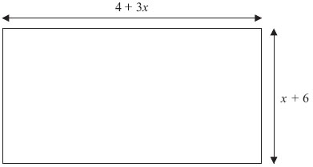
Treasure Hunt
1
Treasure Hunt
2
Answer
$$24$$
Answer
$$12$$
Question
Kumar has three boxes of counters A, B and C.
There are $x$ counters in box A.
There are $(2x+7)$ counters in box B.
There are $(3x−4)$ counters in box C.
There is a total of $75$ counters in the three boxes.
Work out the number of counters in box A.
(Total for question = 4 marks)
Question
The diagram shows a garden in the shape of a rectangle.
All measurements are in metres.
The perimeter of the garden is $32$ metres.
Work out the value of $x$
(Total for Question is 4 marks)

Slide 2
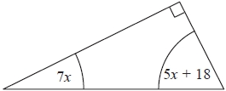
Treasure Hunt
3
Treasure Hunt
4
Answer
$$4x+3$$
Answer
$$10$$
Question
The diagram shows a right-angled triangle.
All the angles are in degrees.
Work out the size of the smallest angle of the triangle.
(Total for question is 3 marks)
Question
The diagram shows a trapezium.
$AD=x$ cm.
$BC$ is the same length as $AD$.
$AB$ is twice the length of $AD$.
$DC$ is $4$ cm longer than $AB$.
The perimeter of the trapezium is $34$ cm.
Work out the length of $AD$.
(Total for Question is 4 marks)

Slide 3
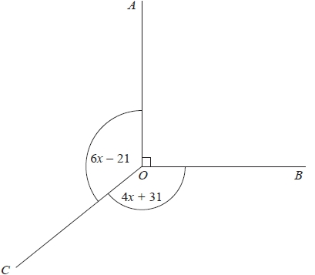
Treasure Hunt
5
Treasure Hunt
6
Answer
$$1.5$$
Answer
$$16x+8$$
Question
Dan has some marbles.
Ellie has twice as many marbles as Dan.
Frank has $15$ marbles.
Dan, Ellie and Frank have a total of $63$ marbles.
How many marbles does Dan have?
(Total for Question is 3 marks)
Question
In the diagram, all angles are in degrees.
Angle $AOB$ is a right angle.
Angle $AOC=$ Angle $BOC$.
Work out the value of $x$.
(Total for question = 3 marks)

Slide 4
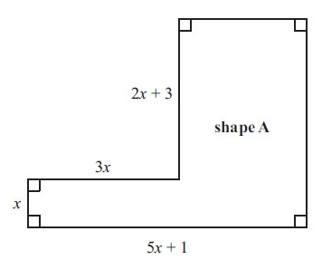
Treasure Hunt
7
Treasure Hunt
8
Answer
$$16$$
Answer
$$26$$
Question
The diagram shows shape A.
All the measurements are in centimetres.
Find an expression, in terms of $x$, for the perimeter of shape A.
(Total for Question is 3 marks)
Question
Julie is $x$ years old.
Kevin is $x+3$ years old.
Omar is $2x$ years old.
Write an expression, in terms of $x$, for the total of their ages.
(Total for Question is 2 marks)

Slide 5
Treasure Hunt
9
Treasure Hunt
10
Answer
$$5$$
Answer
$$42$$
Question
In the diagram all measurements are in centimetres.
The perimeter of the quadrilateral is twice the perimeter of the triangle.
Work out the perimeter of the triangle.
(Total for question = 4 marks)
Question
The diagram shows a rectangle.
All measurements are given in centimetres.
The perimeter of the rectangle is $48$ cm.
Work out the value of $x$.
(Total for question = 3 marks)

