Slide 1
Starter
1. Round the following to the nearest integer:
23.85 396.3872 0.0539
2. Round the following to 1 decimal place:
23.85 396.3872 0.0539
3. Round the following to 2 significant figures:
23.85 396.3872 0.0539

Slide 2
Answers
1. Round the following to the nearest integer:
23.85 396.3872 0.0539
24 396 0
2. Round the following to 1 decimal place:
23.85 396.3872 0.0539
23.9 396.4 0.1
3. Round the following to 2 significant figures:
23.85 396.3872 0.0539
24 400 0.054

Slide 3
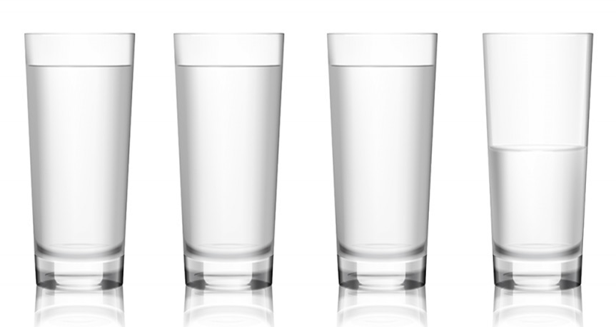
It’s not always appropriate to round how we’re used to.
At 15 years and 8 months old, your age would round to 16. But would you tell someone you were 16 if asked?
If I can fill $3\frac{2}{3}$ cups with fizzy water,
it wouldn’t be right to round this to
4 cups as they wouldn’t all be full!
These are examples of truncation.
Truncating is just chopping part of
the number off.

Slide 4
Step-by-Step Guide
Determine the cut-off point.
Ignore any numbers after the cut-off point.
Use zero place-holders if necessary to maintain place value.

Slide 5
Examples
Truncate 4 7 2 0 to the thousand.
Truncate 3 . 2 8 4 9 to the integer.
Truncate 6 . 7 8 2 0 1 to 1 decimal place.
Truncate 0 . 0 5 3 5 to 2 significant figures.
Determine the cut-off point.
Ignore any numbers after the cut-off point.
4
0 0 0
Use zero place-holders if necessary to maintain place value.
3
6 . 7
0 . 0 5 3

Slide 6
Your Turn
1. Truncate the following to the integer:
23.85 396.3872 0.0539
2. Truncate the following to 1 decimal place:
23.85 396.3872 0.0539
3. Truncate the following to 2 significant figures:
23.85 396.3872 0.0539

Slide 7
Answers
1. Truncate the following to the integer:
23.85 396.3872 0.0539
23 396 0
2. Truncate the following to 1 decimal place:
23.85 396.3872 0.0539
23.8 396.3 0
3. Truncate the following to 2 significant figures:
23.85 396.3872 0.0539
23 390 0.053

Slide 8
If I tell you my age is 28, what could my age actually be?
28 and 2 months
28 and 3 months
28 and 0 months
28 and 6 months
28 and 10 months
28 and 4 months
28 and 9 months
28 and 11 months
28 and 1 month
28 and 8 months
28 and 5 months
28 and 7 months

Slide 9
If I tell you my age is 28, what could my age actually be?
27
28
29
Includes this
Doesn’t include this
28 $≤x<$ 29

Slide 10
Examples
A number $x$ is truncated to 1 decimal place. The result is 6.2. Write down the error interval for $x$.
A number $y$ is truncated to 2 significant figures. The result is 390. Write down the error interval for $y$.
6.2
6.3
6.4
6.2 $≤x<$ 6.3
380
390
400
390 $≤y<$ 400

Slide 12
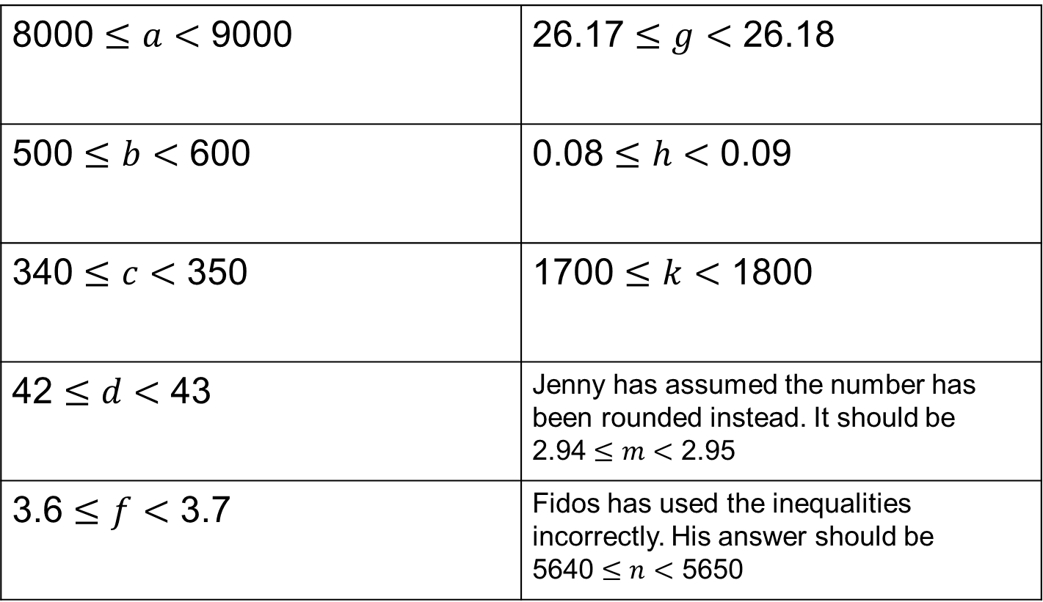
Answers
8000 $≤a<$ 9000 | 26.17 $≤g<$ 26.18
500 $≤b<$ 600 | 0.08 $≤h<$ 0.09
340 $≤c<$ 350 | 1700 $≤k<$ 1800
42 $≤d<$ 43 | Jenny has assumed the number has been rounded instead. It should be 2.94 $≤m<$ 2.95
3.6 $≤f<$ 3.7 | Fidos has used the inequalities incorrectly. His answer should be 5640 $≤n<$ 5650

