Slide 1
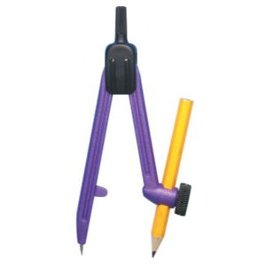
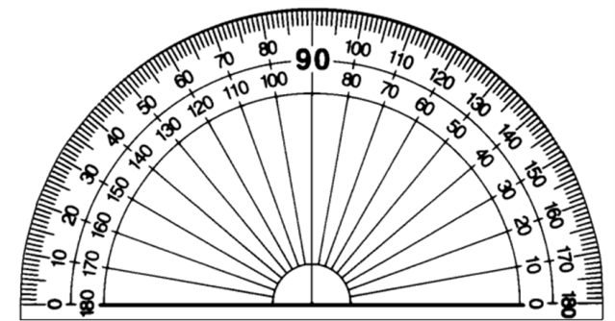
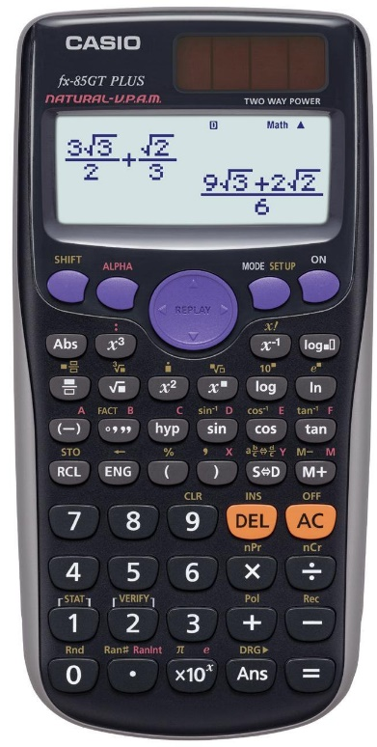
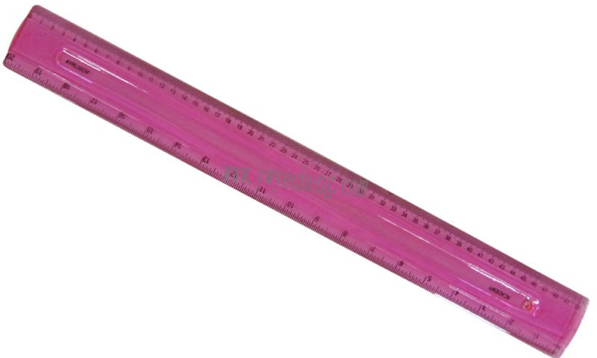

Autumn Term
Spring Term
Summer Term

Slide 2
Autumn Term
Week 1 | Lesson 1 | Lesson 2 | Lesson 3 | Lesson 4
Week 2 | Lesson 1 | Lesson 2 | Lesson 3 | Lesson 4
Week 3 | Lesson 1 | Lesson 2 | Lesson 3 | Lesson 4
Week 4 | Lesson 1 | Lesson 2 | Lesson 3 | Lesson 4
Week 5 | Lesson 1 | Lesson 2 | Lesson 3 | Lesson 4
Week 6 | Lesson 1 | Lesson 2 | Lesson 3 | Lesson 4
Week 7 | Lesson 1 | Lesson 2 | Lesson 3 | Lesson 4
Week 8 | Lesson 1 | Lesson 2 | Lesson 3 | Lesson 4
Week 9 | Lesson 1 | Lesson 2 | Lesson 3 | Lesson 4
Week 10 | Lesson 1 | Lesson 2 | Lesson 3 | Lesson 4
Week 11 | Lesson 1 | Lesson 2 | Lesson 3 | Lesson 4
Week 12 | Lesson 1 | Lesson 2 | Lesson 3 | Lesson 4
Week 13 | Lesson 1 | Lesson 2 | Lesson 3 | Lesson 4
Week 14 | Lesson 1 | Lesson 2 | Lesson 3 | Lesson 4

Slide 3
Spring Term
Week 1 | Lesson 1 | Lesson 2 | Lesson 3 | Lesson 4
Week 2 | Lesson 1 | Lesson 2 | Lesson 3 | Lesson 4
Week 3 | Lesson 1 | Lesson 2 | Lesson 3 | Lesson 4
Week 4 | Lesson 1 | Lesson 2 | Lesson 3 | Lesson 4
Week 5 | Lesson 1 | Lesson 2 | Lesson 3 | Lesson 4
Week 6 | Lesson 1 | Lesson 2 | Lesson 3 | Lesson 4
Week 7 | Lesson 1 | Lesson 2 | Lesson 3 | Lesson 4
Week 8 | Lesson 1 | Lesson 2 | Lesson 3 | Lesson 4
Week 9 | Lesson 1 | Lesson 2 | Lesson 3 | Lesson 4
Week 10 | Lesson 1 | Lesson 2 | Lesson 3 | Lesson 4
Week 11 | Lesson 1 | Lesson 2 | Lesson 3 | Lesson 4
Week 12 | Lesson 1 | Lesson 2 | Lesson 3 | Lesson 4
Week 13 | Lesson 1 | Lesson 2 | Lesson 3 | Lesson 4
Week 14 | Lesson 1 | Lesson 2 | Lesson 3 | Lesson 4

Slide 4
Summer Term
Week 1 | Lesson 1 | Lesson 2 | Lesson 3 | Lesson 4
Week 2 | Lesson 1 | Lesson 2 | Lesson 3 | Lesson 4
Week 3 | Lesson 1 | Lesson 2 | Lesson 3 | Lesson 4
Week 4 | Lesson 1 | Lesson 2 | Lesson 3 | Lesson 4
Week 5 | Lesson 1 | Lesson 2 | Lesson 3 | Lesson 4
Week 6 | Lesson 1 | Lesson 2 | Lesson 3 | Lesson 4
Week 7 | Lesson 1 | Lesson 2 | Lesson 3 | Lesson 4
Week 8 | Lesson 1 | Lesson 2 | Lesson 3 | Lesson 4
Week 9 | Lesson 1 | Lesson 2 | Lesson 3 | Lesson 4
Week 10 | Lesson 1 | Lesson 2 | Lesson 3 | Lesson 4
Week 11 | Lesson 1 | Lesson 2 | Lesson 3 | Lesson 4
Week 12 | Lesson 1 | Lesson 2 | Lesson 3 | Lesson 4
Week 13 | Lesson 1 | Lesson 2 | Lesson 3 | Lesson 4
Week 14 | Lesson 1 | Lesson 2 | Lesson 3 | Lesson 4

Slide 5
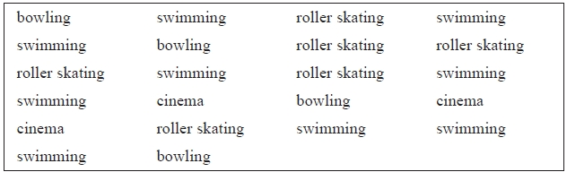


List all the factors of 12.
Write down the mode of:
  6 5 6 7 4 6 8
Mr Khan asked the 22 students in his class what activity they wanted to do on a school trip. Draw a frequency table (including a tally column) to show the results.

Slide 6
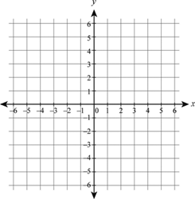
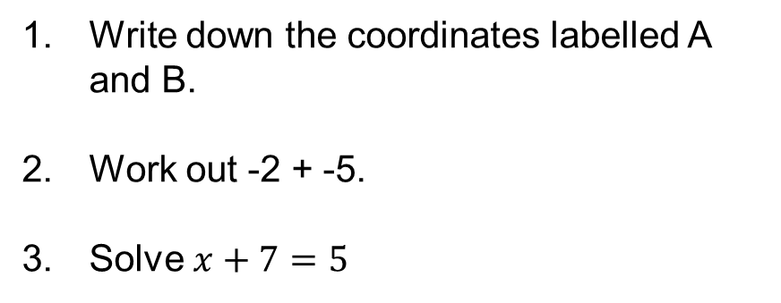
Write down the coordinates labelled A and B.
Work out -2 + -5.
Solve $x+7=5$
A x
B x

Slide 7
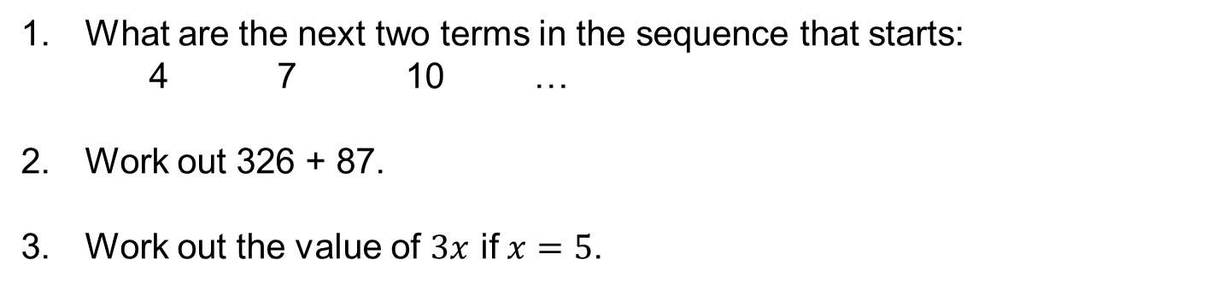
What are the next two terms in the sequence that starts:
  4 7 10 …
Work out 326 + 87.
Work out the value of $3x$ if $x=5$.

Slide 8
Write out the first 10 prime numbers.
Draw the net of a cube.
Write 16 : 48 as a ratio in its simplest form.

Slide 9


Express 36 as a product of its prime factors.
How many lines of reflective symmetry does the picture on the right have?
Here are the marks 20 students got in a French test. Show this information in a stem and leaf diagram. (Don’t forget a key!)

Slide 10
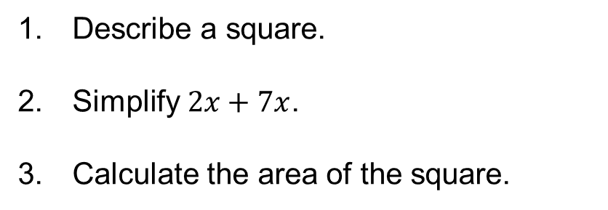
Describe a square.
Simplify $2x+7x$.
Calculate the area of the square.
5 cm

Slide 11

Write the value of the 3 in the number 4392.
Here is a probability scale. It shows the probability of each of the events A, B, C and D. Write down the letter of the event that is certain.
Calculate the volume of the cube.
4 cm

Slide 12
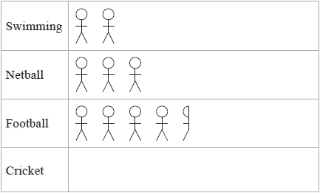

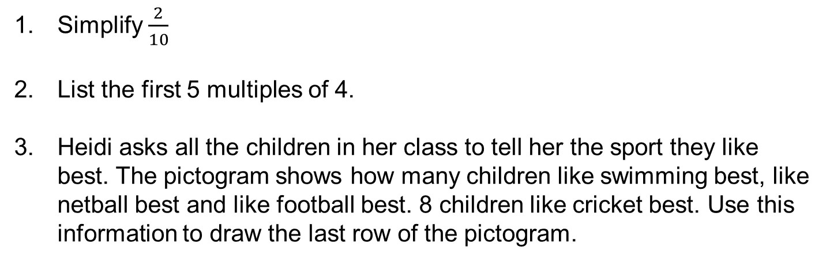
Simplify $\frac{2}{10}$
List the first 5 multiples of 4.
Heidi asks all the children in her class to tell her the sport they like best. The pictogram shows how many children like swimming best, like netball best and like football best. 8 children like cricket best. Use this information to draw the last row of the pictogram.

Slide 13
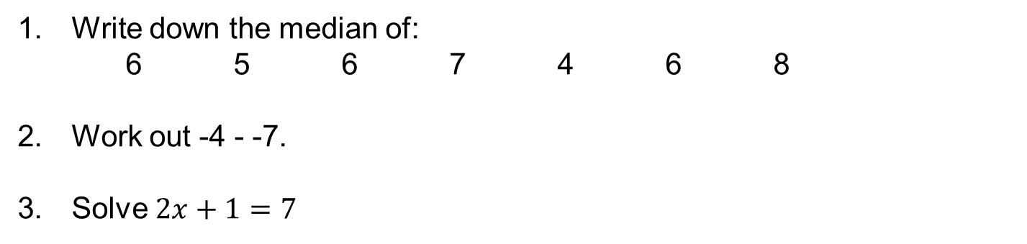
Write down the median of:
  6 5 6 7 4 6 8
Work out -4 - -7.
Solve $2x+1=7$

Slide 14
Write down the coordinates labelled A and B.
-8 + -5
Draw a line that is 8 cm long.
A x
B x

Slide 15
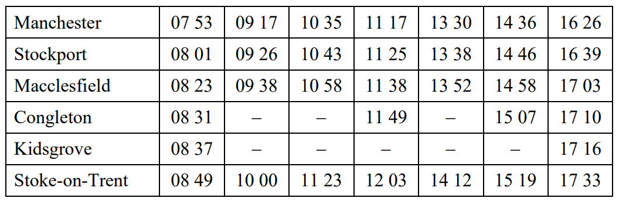
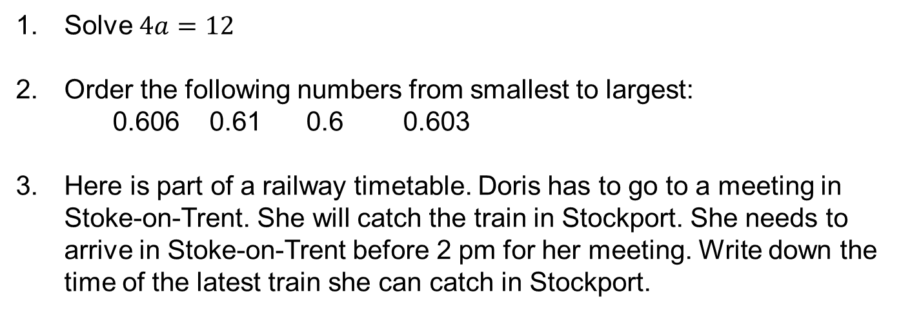
Solve $4a=12$
Order the following numbers from smallest to largest:
  0.606 0.61 0.6 0.603
Here is part of a railway timetable. Doris has to go to a meeting in Stoke-on-Trent. She will catch the train in Stockport. She needs to arrive in Stoke-on-Trent before 2 pm for her meeting. Write down the time of the latest train she can catch in Stockport.

Slide 16
Work out 528 - 378
The table shows information about the number of Year 7 pupils absent from Keith's school last week. Draw a dual bar chart to show this information.
Write out the first 10 prime numbers.
 | Monday | Tuesday | Wednesday | Thursday | Friday
Boys | 8 | 11 | 12 | 14 | 13
Girls | 10 | 9 | 12 | 13 | 11

Slide 17
Express 24 as a product of its prime factors.
What are the next two terms in the sequence that starts:
  2 7 12 …
Draw the net of a cuboid.

Slide 18
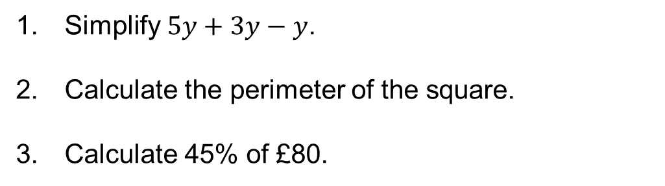
Simplify $5y+3y−y$.
Calculate the perimeter of the square.
Calculate 45% of £80.
5 cm

Slide 19
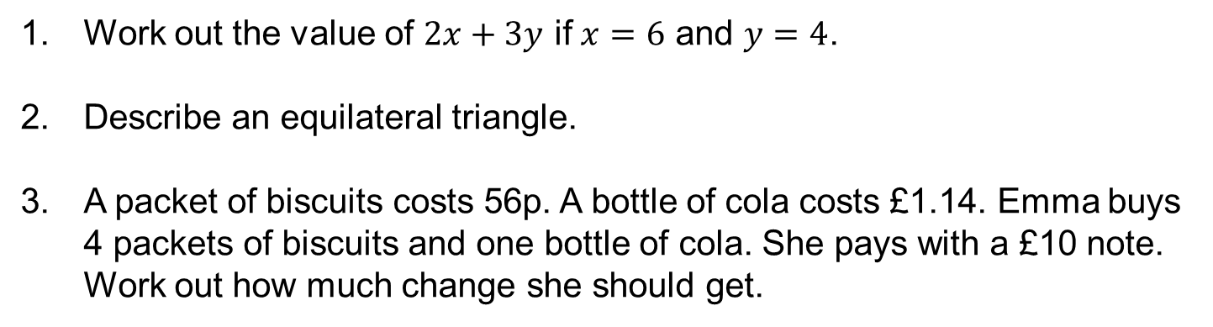
Work out the value of $2x+3y$ if $x=6$ and $y=4$.
Describe an equilateral triangle.
A packet of biscuits costs 56p. A bottle of cola costs £1.14. Emma buys 4 packets of biscuits and one bottle of cola. She pays with a £10 note. Work out how much change she should get.

Slide 20
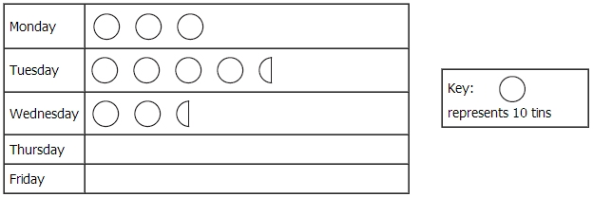
List all the factors of 15.
Write 16 : 24 as a ratio in its simplest form.
The pictogram shows the number of tins of dog food sold in a shop on Monday, on Tuesday and on Wednesday last week. On Thursday, 60 tins of dog food were sold in the shop. On Friday, 35 tins of dog food were sold in the shop. Use this information to draw the last two rows of the pictogram.

Slide 21
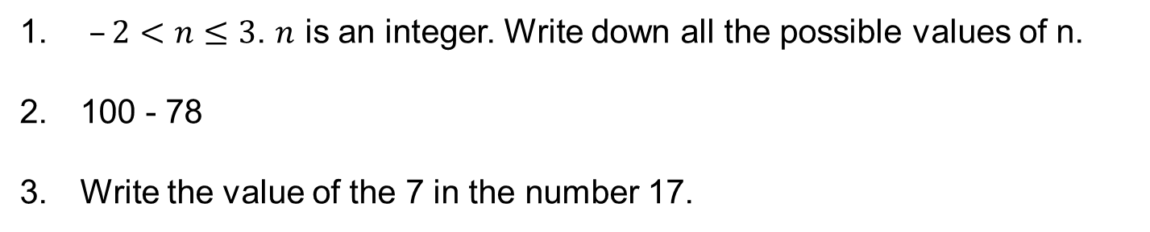
$–2<n≤3$. $n$ is an integer. Write down all the possible values of n.
100 - 78
Write the value of the 7 in the number 17.

Slide 22

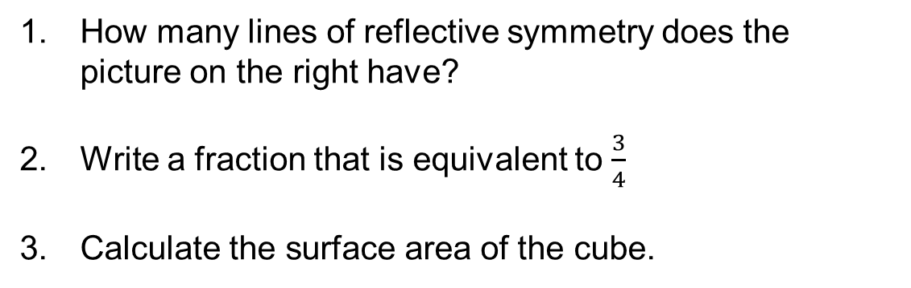
How many lines of reflective symmetry does the picture on the right have?
Write a fraction that is equivalent to $\frac{3}{4}$
Calculate the surface area of the cube.
4 cm

Slide 23
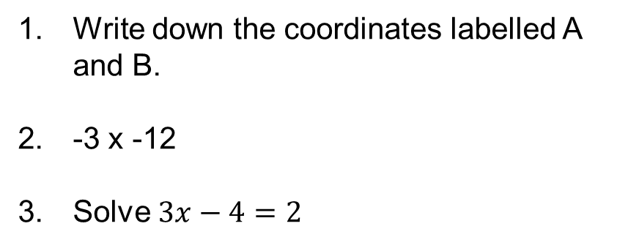
Write down the coordinates labelled A and B.
-3 x -12
Solve $3x−4=2$
B x
A x

Slide 24
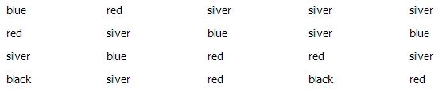
Jay recorded the colour of each car going past his house one morning. The results are shown below. Draw a frequency table (including a tally column) to show the results.
Draw an angle of 34°.
Work out the mean of:
  6 5 6 7 4 6 8

Slide 25
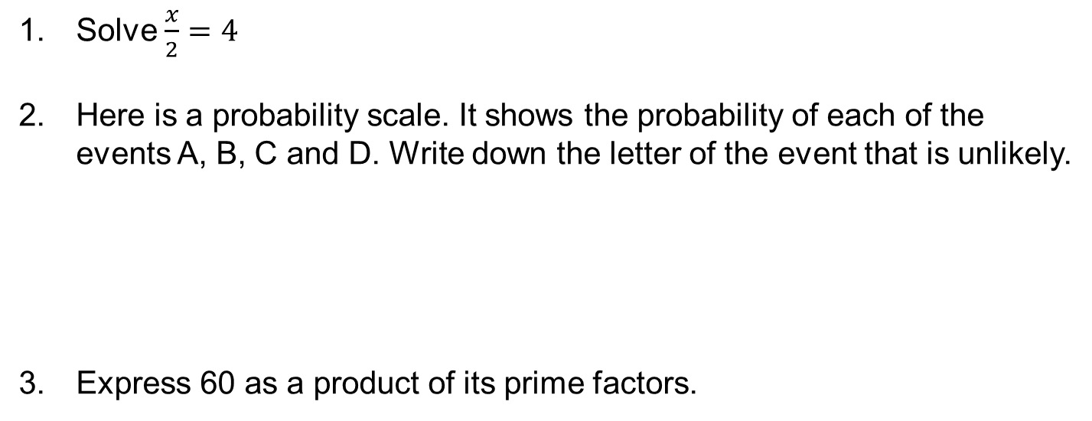
Solve $\frac{x}{2}=4$
Here is a probability scale. It shows the probability of each of the events A, B, C and D. Write down the letter of the event that is unlikely.
Express 60 as a product of its prime factors.

Slide 26
Work out -3 x 4.
Calculate the area of the rectangle.
What are the next two terms in the sequence that starts:
  -1 4 9 …
5 cm
9 cm

Slide 27
Draw the net of a triangular prism.
Order the following numbers from smallest to largest:
  8.6 0.86 8.06 6.8
Calculate 65% of 20 ml.

Slide 28
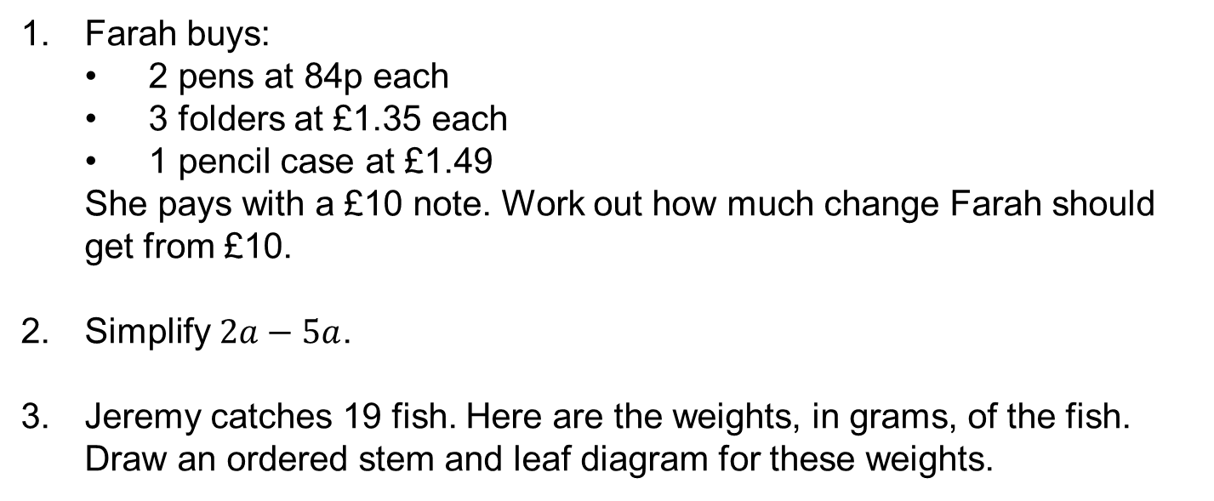
Farah buys:
  2 pens at 84p each
  3 folders at £1.35 each
  1 pencil case at £1.49
  She pays with a £10 note. Work out how much change Farah should get from £10.
Simplify $2a−5a$.
Jeremy catches 19 fish. Here are the weights, in grams, of the fish. Draw an ordered stem and leaf diagram for these weights.

Slide 29
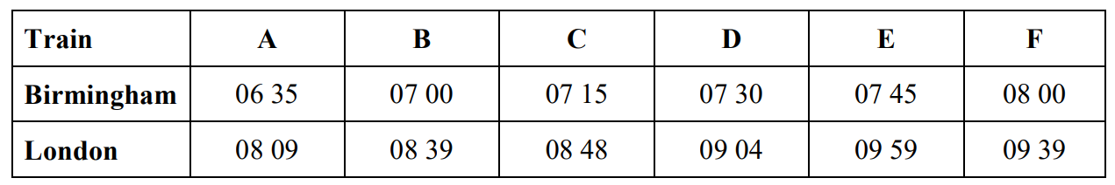
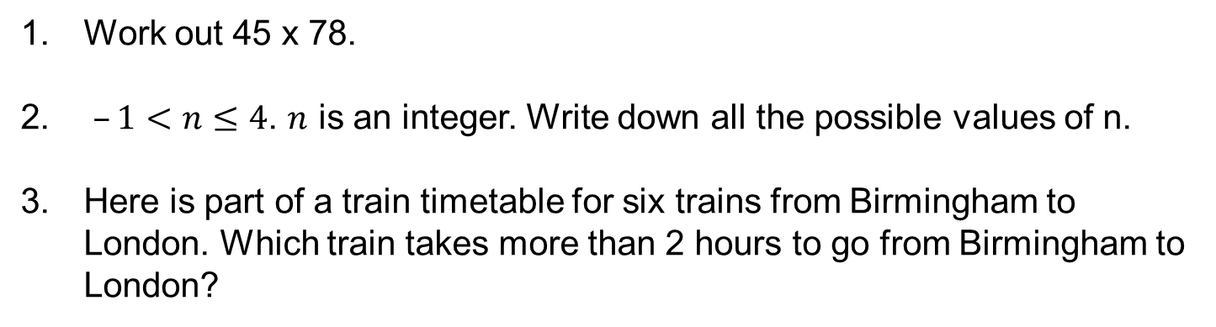
Work out 45 x 78.
$–1<n≤4$. $n$ is an integer. Write down all the possible values of n.
Here is part of a train timetable for six trains from Birmingham to London. Which train takes more than 2 hours to go from Birmingham to London?

Slide 30
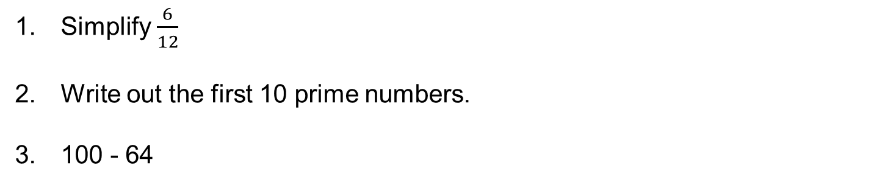
Simplify $\frac{6}{12}$
Write out the first 10 prime numbers.
100 - 64

Slide 31
Write the value of the 6 in the number 8.64.
Calculate the volume of the cuboid.
List the first 5 multiples of 8.
4 cm
2 cm
6 cm

Slide 32

Describe a parallelogram.
How many lines of reflective symmetry does the picture on the right have?
The table shows information about the favourite sport of some students. Draw a dual bar chart to show this information.
Favourite sport | Men | Women
Hockey | 3 | 6
Tennis | 8 | 14
Football | 15 | 7
Golf | 9 | 1

Slide 33
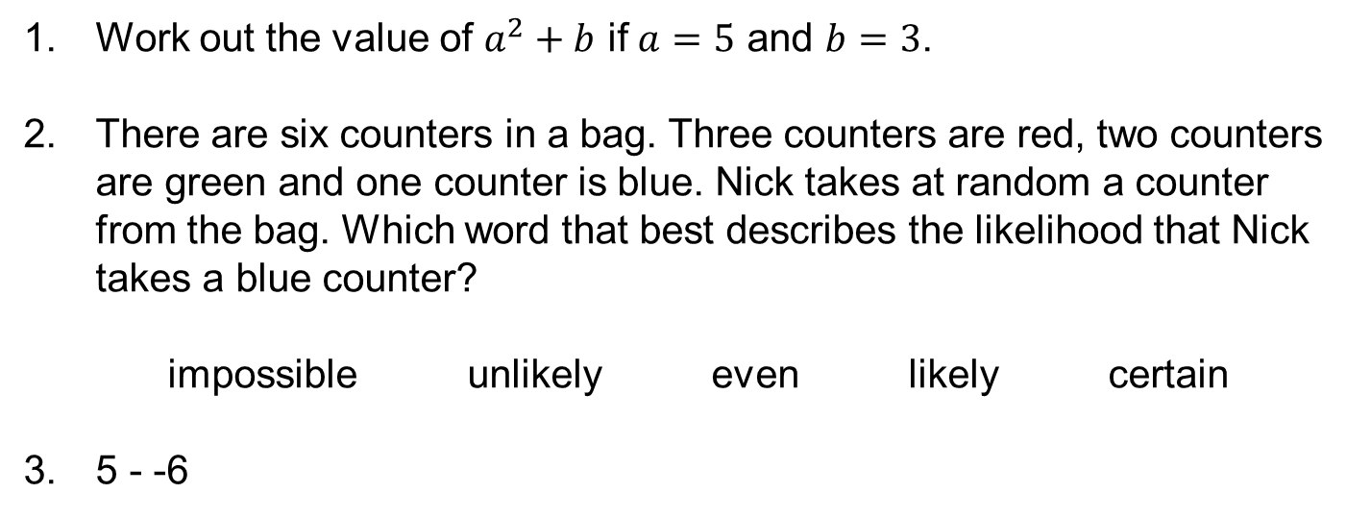
Work out the value of $a^{2}+b$ if $a=5$ and $b=3$.
There are six counters in a bag. Three counters are red, two counters are green and one counter is blue. Nick takes at random a counter from the bag. Which word that best describes the likelihood that Nick takes a blue counter?
impossible unlikely even likely certain
5 - -6

Slide 34
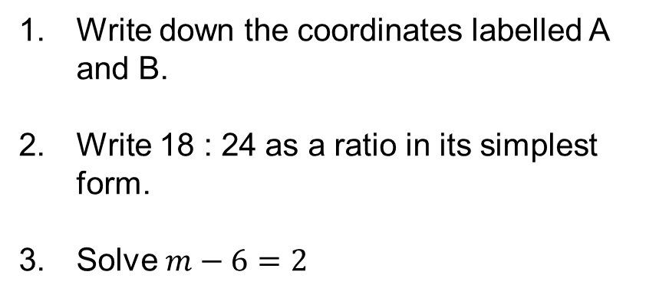
Write down the coordinates labelled A and B.
Write 18 : 24 as a ratio in its simplest form.
Solve $m−6=2$
A x
B x

Slide 35
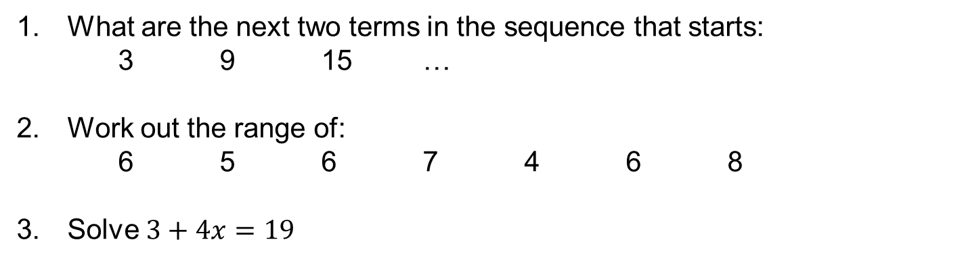
What are the next two terms in the sequence that starts:
  3 9 15 …
Work out the range of:
  6 5 6 7 4 6 8
Solve $3+4x=19$

Slide 36
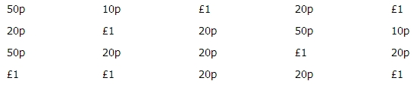
Express 16 as a product of its prime factors.
Draw a line that is 5.6 cm long.
Here is the value of each of 20 coins. Draw a frequency table (including a tally column) to show the results.

Slide 37
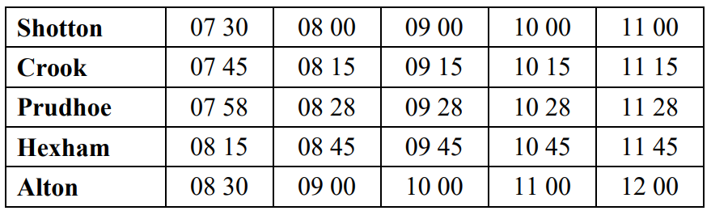

The table shows part of a bus timetable from Shotton to Alton. A bus leaves Shotton at 07 30. What time should it arrive at Alton?
Order the following numbers from smallest to largest:
  0.11 0.1 0.01 0.101
Simplify $6b+4c−5c$.

Slide 38
Work out 24 ÷ -6.
Calculate 30% of £56.
A badge costs 78p. Sam has £5. He buys as many badges as he can. Work out the amount of change Sam should get from £5.

Slide 39
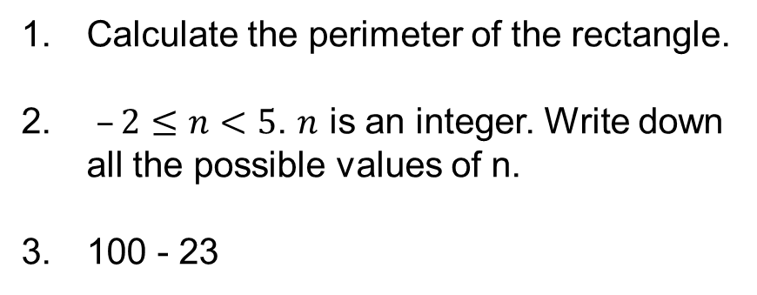
Calculate the perimeter of the rectangle.
$–2≤n<5$. $n$ is an integer. Write down all the possible values of n.
100 - 23
5 cm
9 cm

Slide 40
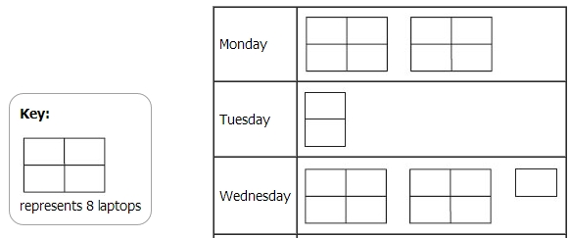
Write the value of the 0 in the number 903.
Draw the net of a cylinder.
The pictogram shows the number of laptops sold in a shop on Monday, on Tuesday and on Wednesday. How many laptops were sold on Wednesday?

Slide 41
Work out 434 ÷ 7.
List all the factors of 16.
Calculate the surface area of the cuboid.
4 cm
2 cm
6 cm

Slide 42

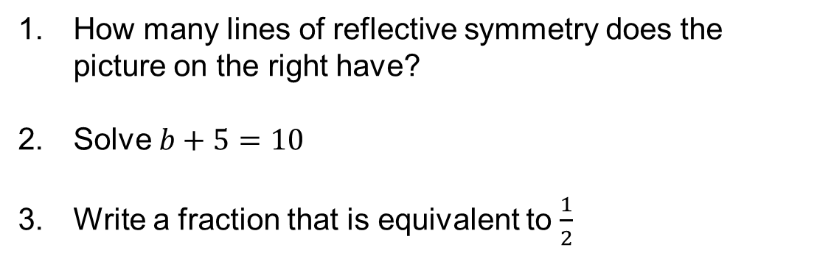
How many lines of reflective symmetry does the picture on the right have?
Solve $b+5=10$
Write a fraction that is equivalent to $\frac{1}{2}$

Slide 43
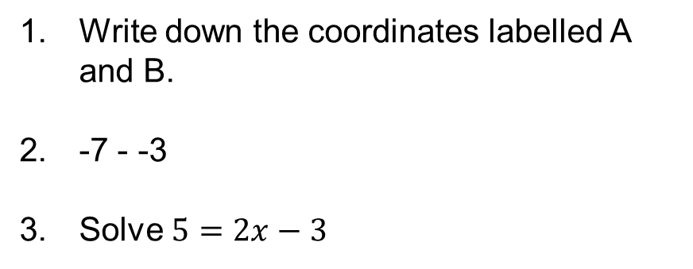
Write down the coordinates labelled A and B.
-7 - -3
Solve $5=2x−3$
B x
A x

Slide 44
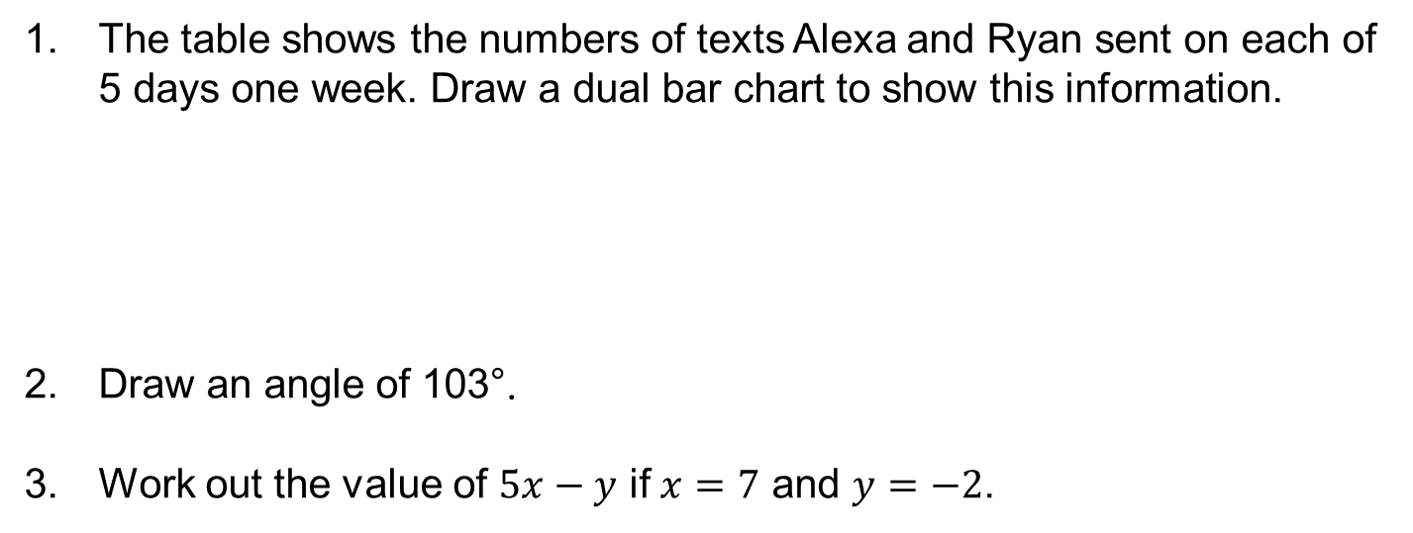
The table shows the numbers of texts Alexa and Ryan sent on each of 5 days one week. Draw a dual bar chart to show this information.
Draw an angle of 103°.
Work out the value of $5x−y$ if $x=7$ and $y=−2$.
 | Monday | Tuesday | Wednesday | Thursday | Friday
Alexa | 3 | 4 | 2 | 5 | 6
Ryan | 6 | 2 | 5 | 4 | 3

Slide 45
Write down the mode of:
  12 14 13 16 13 13 11 12
Describe an isosceles triangle.
Express 20 as a product of its prime factors.

Slide 46

What are the next two terms in the sequence that starts:
  2 9 16 …
There are six counters in a bag. Three counters are red, two counters are green and one counter is blue. Nick takes at random a counter from the bag. On the probability scale, mark with a cross the probability that Nick takes a red counter.
Order the following numbers from smallest to largest:
  4.5 4.05 5.4 0.405

Slide 47
Write out the first 10 prime numbers.
Calculate 70% of 85 kg.
The table shows part of a bus timetable from Shotton to Alton. Serena lives in Crook. She has to be in Hexham by quarter past 11. What is the time of the latest bus she can catch from Crook to arrive in Hexham by quarter past 11?

Slide 48
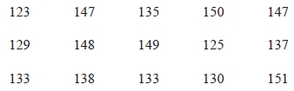
Work out -4 + 9.
Write 20 : 48 as a ratio in its simplest form.
Here are the heights, in centimetres, of 15 children. Show this information in an ordered stem and leaf diagram.

Slide 49
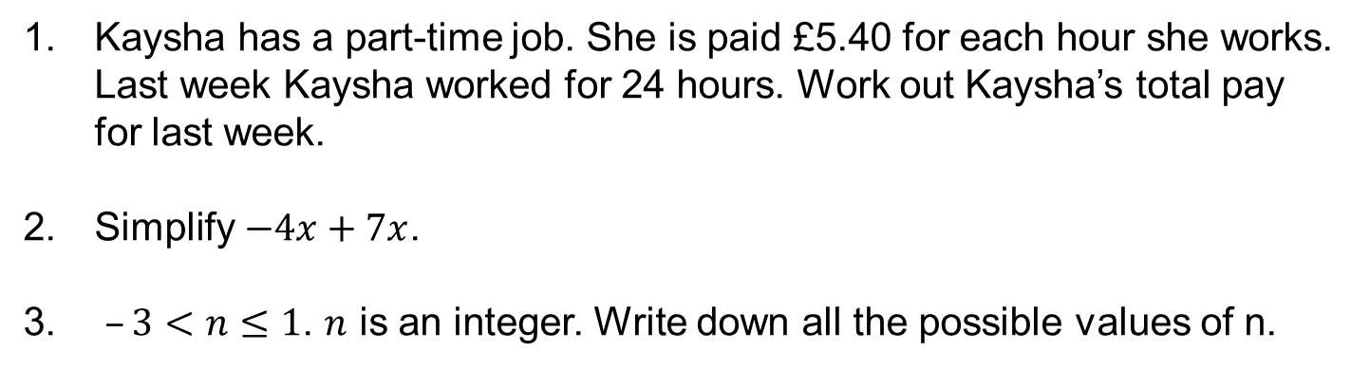
Kaysha has a part-time job. She is paid £5.40 for each hour she works. Last week Kaysha worked for 24 hours. Work out Kaysha’s total pay for last week.
Simplify $−4x+7x$.
$–3<n≤1$. $n$ is an integer. Write down all the possible values of n.

Slide 50
List the first 5 multiples of 9.
Calculate the area of the rectangle.
100 - 49
3 cm
7 cm

Slide 51
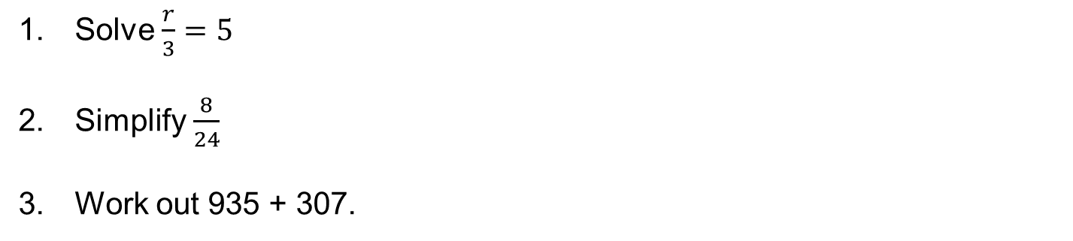
Solve $\frac{r}{3}=5$
Simplify $\frac{8}{24}$
Work out 935 + 307.

Slide 52

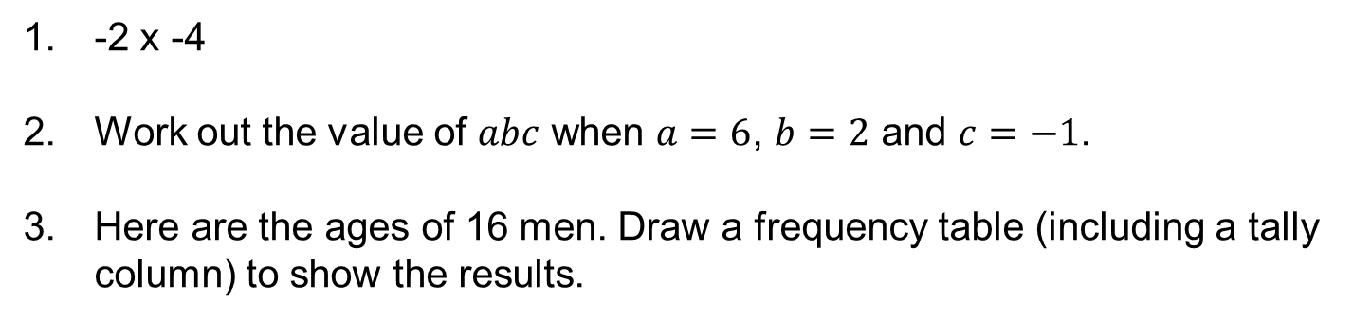
-2 x -4
Work out the value of $abc$ when $a=6$, $b=2$ and $c=−1$.
Here are the ages of 16 men. Draw a frequency table (including a tally column) to show the results.

Slide 53
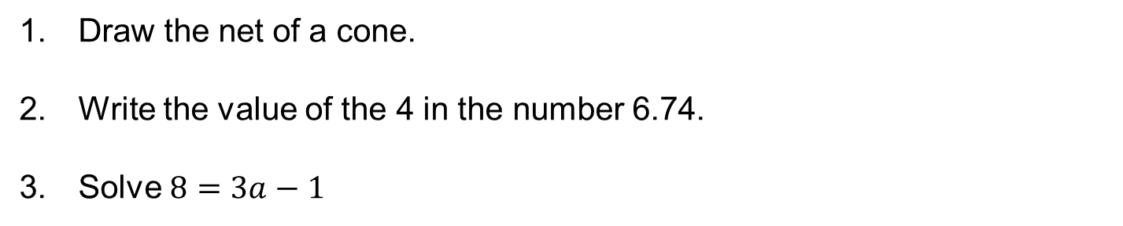
Draw the net of a cone.
Write the value of the 4 in the number 6.74.
Solve $8=3a−1$

Slide 54
Write down the median of:
  12 14 13 16 13 13 11 12
Draw a line 5.4 cm long.
Calculate the volume of the cube.
6 cm

Slide 55

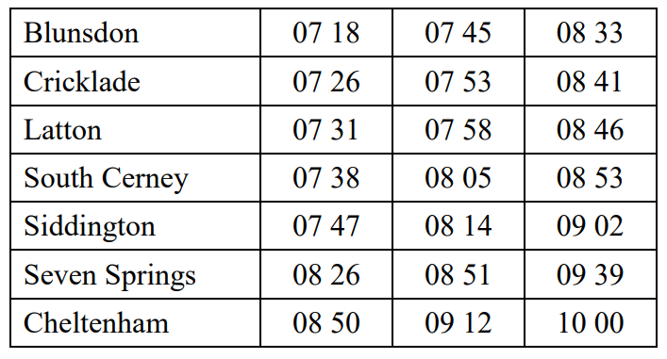
Describe a rectangle.
How many lines of reflective symmetry does the picture on the right have?
Here is part of a timetable for a bus. A bus leaves Blunsdon at 07 45. At what time should the bus arrive at Siddington?

Slide 56
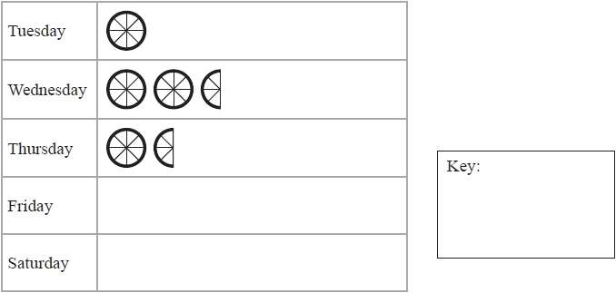
Express 50 as a product of its prime factors.
Calculate 87% of £40.
The incomplete pictogram shows information about the number of cycles sold in a shop on Tuesday, on Wednesday and on Thursday. A total of 20 cycles were sold on Tuesday, Wednesday and Thursday. Use this information to draw a key.

Slide 57
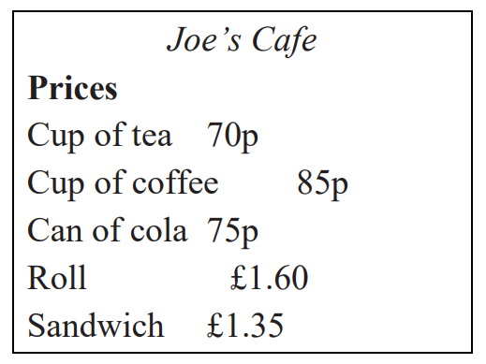
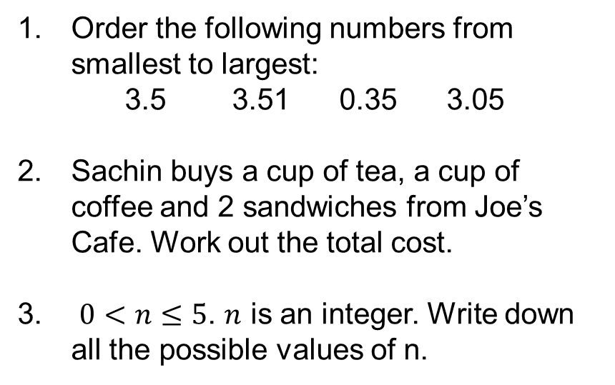
Order the following numbers from smallest to largest:
  3.5 3.51 0.35 3.05
Sachin buys a cup of tea, a cup of coffee and 2 sandwiches from Joe’s Cafe. Work out the total cost.
$0<n≤5$. $n$ is an integer. Write down all the possible values of n.

Slide 58
Write out the first 10 prime numbers.
Work out 421 – 274.
100 - 68

Slide 59
Work out -3 – 5.
What are the next two terms in the sequence that starts:
  -3 2 7 …
There are six counters in a bag. Three counters are red, two counters are green and one counter is blue. Nick takes at random a counter from the bag. On the probability scale, mark with a cross ( ) the probability that Nick takes a white counter.

Slide 60

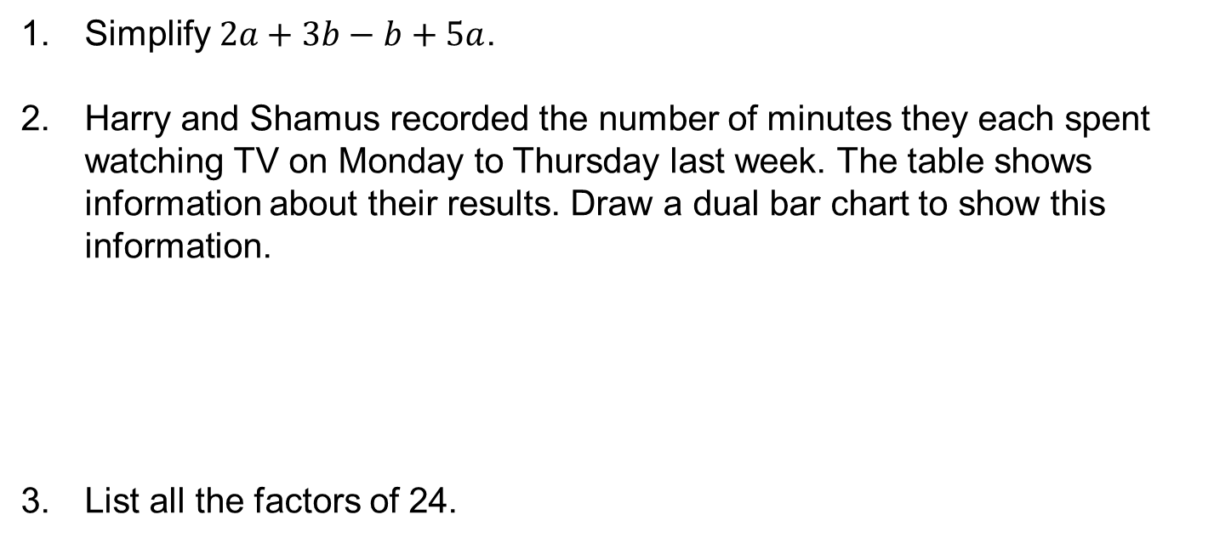
Simplify $2a+3b−b+5a$.
Harry and Shamus recorded the number of minutes they each spent watching TV on Monday to Thursday last week. The table shows information about their results. Draw a dual bar chart to show this information.
List all the factors of 24.

Slide 61
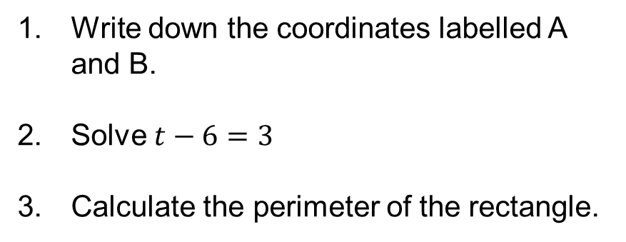
Write down the coordinates labelled A and B.
Solve $t−6=3$
Calculate the perimeter of the rectangle.
B x
A x
3 cm
7 cm

Slide 62
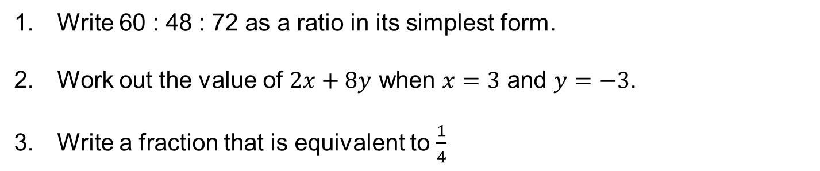
Write 60 : 48 : 72 as a ratio in its simplest form.
Work out the value of $2x+8y$ when $x=3$ and $y=−3$.
Write a fraction that is equivalent to $\frac{1}{4}$

Slide 63
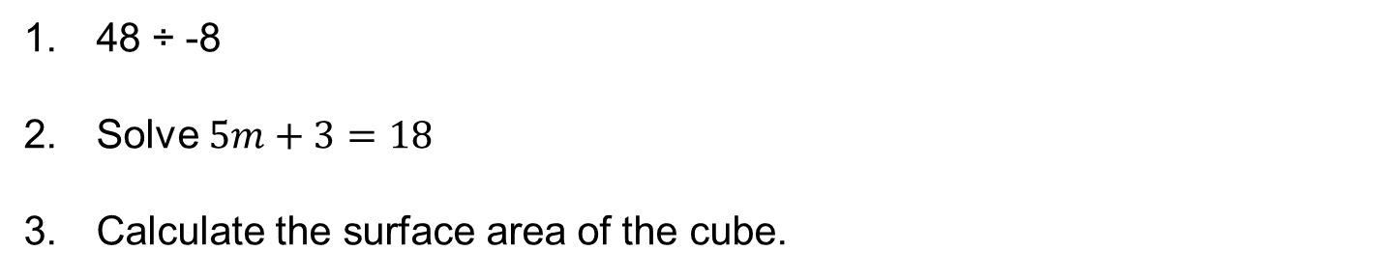
48 ÷ -8
Solve $5m+3=18$
Calculate the surface area of the cube.
6 cm

Slide 64
Write the value of the 8 in the number 8 730 244.
Draw an angle of 235°.
The list below shows the weight, in grams, of 15 baskets of strawberries. Show this information in an ordered stem and leaf diagram. You must include a key.
193 200 207 211 198
189 218 195 206 189
223 190 207 205 212

Slide 65

How many lines of reflective symmetry does the picture on the right have?
Calculate 75% of £63.
Here is part of a timetable for a bus. Peter arrives at the Latton bus stop at 08 35. He waits for the next bus to Seven Springs. How many minutes should he wait?

Slide 66
Order the following numbers from smallest to largest:
  0.23 0.203 0.32 0.032
Kim buys a can of cola, a cup of coffee and a sandwich from Joe’s Café. She pays with a £5 note. Work out how much change she should get.
Describe a scalene triangle.

Slide 67

$–1≤n≤2$. $n$ is an integer. Write down all the possible values of n.
Solve $7x=63$
Write out the first 10 prime numbers.

Slide 68

Work out the mean of:
  12 14 13 16 13 13 11 12
Express 72 as a product of its prime factors.
Mrs Jones recorded the number of boys and the number of girls absent from school each day last week. The table shows this information. Draw a dual bar chart to show this information.

Slide 69

Draw the net of a square-based pyramid.
Here are 10 cards. Each card has a letter on it. Jai is going to take at random one of the cards.
  Which word best describes the likelihood that the card will have an A on it?
impossible unlikely evens likely certain
What are the next two terms in the sequence that starts:
  -4 -1 2 …

Slide 70

Write down the coordinates labelled A and B.
Work out -5 x -6.
Simplify $6x+5y−8y−2x$.
B x
A x

Slide 71

Calculate the length of a rectangle with an area of 40 cm² and a width of 5 cm.
Work out the value of $6m^{2}$ when $m=3$.
Calculate the volume of the cuboid.
4 cm
3 cm
8 cm

Slide 72
Write 8 : 12 : 16 as a ratio in its simplest form.
Jamal plays 15 games of ten-pin bowling. Here are his scores. Draw an ordered stem and leaf diagram to show Jamal's scores.
Work out 527 x 61.

Slide 73

How many lines of reflective symmetry does the picture on the right have?
List the first 5 multiples of 12.
100 - 38

Slide 74

Simplify $\frac{8}{20}$
Describe a trapezium.
-2 + 9

Slide 75

Express 80 as a product of its prime factors.
Solve $6x−2=34$
Here is part of a timetable for a bus. Marie gets the bus from Cricklade at 07 26. How many minutes should this bus take to travel from Cricklade to Cheltenham?

Slide 76

Draw a line that is 3.4 cm long.
Write out the first 10 prime numbers.
The pictogram gives information about the number of buns Sujata sold in her shop on each of four days last week. Write down the number of buns Sujata sold on Monday.

Slide 77
Write the value of the 2 in the number 428.9.
Order the following numbers from smallest to largest:
  6.03 0.36 6.3 30.6
Calculate 32% of 60 g.

Slide 78

The cost of 20 litres of petrol is £18. Work out the cost of 1 litre of petrol.
What are the next two terms in the sequence that starts:
  -6 -2 2 …
$1<n≤6$. $n$ is an integer. Write down all the possible values of n.

Slide 79

Solve $p−7=3$
Write a fraction that is equivalent to $\frac{2}{3}$
100 - 39

Slide 80

Work out the value of $abc^{2}$ when $a=2$, $b=3$ and $c=−2$.
-5 x -3
There are 25 students in a class. 12 of the students are girls. Here are the heights, in cm, of the 12 girls. Show this information in an ordered stem and leaf diagram.

Slide 81

Solve $9=2x+5$
Here are 10 cards. Each card has a letter on it. Jai is going to take at random one of the cards.
  Which word best describes the likelihood that the card will have an A on it?
impossible unlikely evens likely certain
Simplify $5x+7x−3y+2z−y$.

Slide 82
Draw the net of a tetrahedron.
List all the factors of 36.
Work out 4869 ÷ 9.

Slide 83
Write down the coordinates labelled A and B.
Calculate the length of a rectangle with a perimeter of 28 cm and a width of 5 cm.
Work out -40 ÷ -8.
A x
B x

Slide 84

The table shows information about the numbers of cars sold in Tyler's garage and in Fletcher's garage for each of four months. Draw a dual bar chart to show this information.
Draw an angle of 342°.
Work out the range of:
  12 14 13 16 13 13 11 12

Slide 85
Order the following numbers from smallest to largest:
  5.09 5.9 5.91 5.19
Write 12 : 24 : 48 as a ratio in its simplest form.
Calculate the surface area of the cuboid.
4 cm
3 cm
8 cm

Slide 86

Write out the first 10 prime numbers.
How many lines of reflective symmetry does the picture on the right have?
Calculate 84% of 90 kg.

Slide 87


Solve $4x=0$
Express 48 as a product of its prime factors.
The table shows part of a train timetable from Weymouth to London Waterloo. Sally lives in Weymouth. She has a meeting in Southampton at 12 00. When Sally arrives at Southampton she takes 25 minutes to travel to her meeting. What is the time of the latest train she can take from Weymouth?

Slide 88

Describe a rhombus.
A car hire company wants to know if people are happy with their hire cars. The company asks different people if they are happy with their hire cars. The results for Monday, Tuesday, Wednesday and Thursday are shown in the pictogram. How many people were happy with their hire cars on Tuesday?
Write the value of the 1 in the number 46.51.

