Slide 1
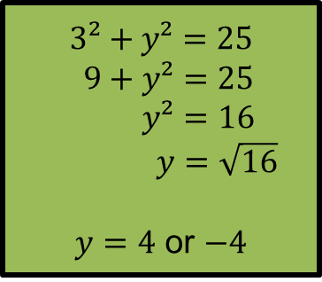
Starter
Draw axes from $−10$ to $10$, then copy and complete the table below, to sketch a graph for $x²+y²=25$.
$$x$$ | $$−5$$ | $$−4$$ | $$−3$$ | $$0$$ | $$3$$ | $$4$$ | $$5$$
$$y_{1}$$ |  |  |  |  | $$4$$
$$y_{2}$$ |  |  |  |  | $$−4$$
$$3²+y²=25$$
$$9+y²=25$$
$y²=16$
$y=\sqrt{16}$
$y=4$ or $−4$

Slide 2
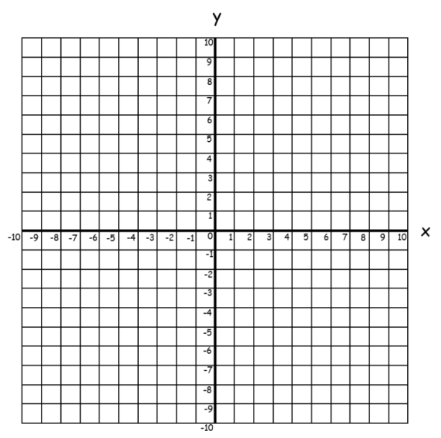
Starter
$$x$$ | $$−5$$ | $$−4$$ | $$−3$$ | $$0$$ | $$3$$ | $$4$$ | $$5$$
$$y_{1}$$ | $$0$$ | $$3$$ | $$4$$ | $$5$$ | $$4$$ | $$3$$ | $$0$$
$$y_{2}$$ |  | $$−3$$ | $$−4$$ | $$−5$$ | $$−4$$ | $$−3$$
$x²+y²=25$
x
What is the radius of the circle?
x
x
x
x
x
$5$ units
x
$\sqrt{25}$ = 5
x
x
x
x
x

Slide 3
General Equation of a Circle
$x²+y²=r²$
Radius $r$, centre $(0, 0)$
$(x–a)²+(y–b)²=r²$
Radius $r$, centre $(a, b)$
x
x
x
x
x
x
x
x
x
x
x
x
$$x²+y²=25$$

Slide 4
Can you write an equation that will produce a circle radius $6$?
Can you write an equation that will produce a circle radius $2$?
Can you write another equation that will produce a circle radius $2$?
Write an equation that gives a circle with centre $(3, 9)$?
Write an equation that gives a circle with centre $(3,9)$ AND has a radius of 9?

Slide 5
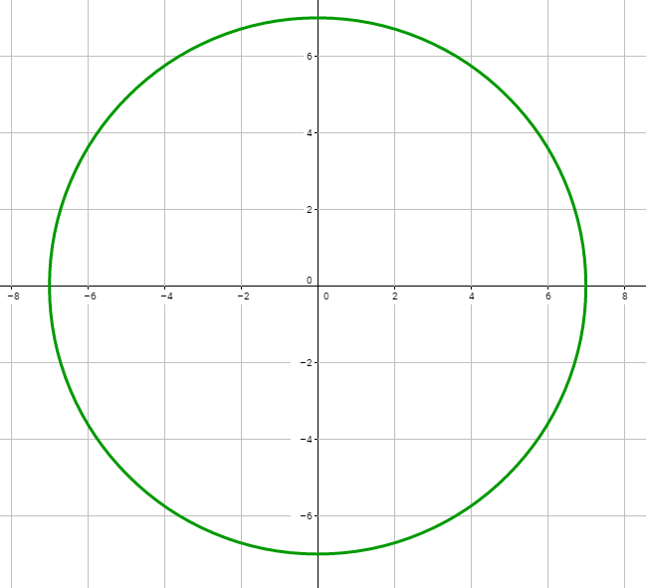
Give the equation of this circle.

Slide 6
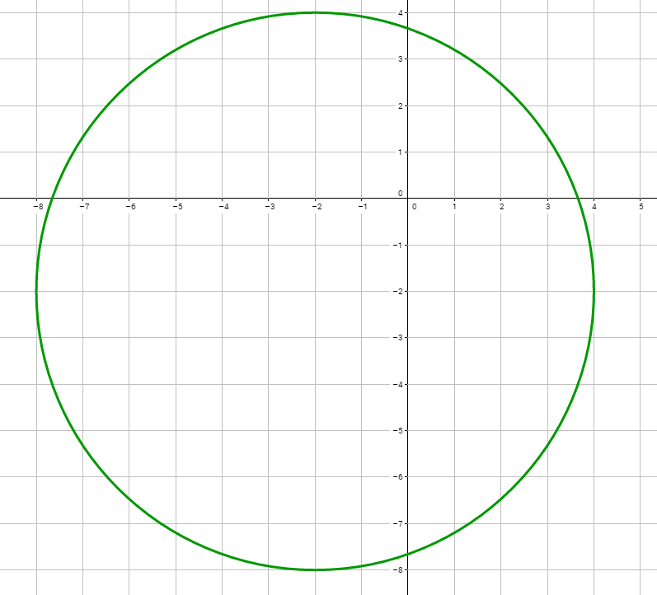
Give the equation of this circle.

Slide 7
Worksheet
 | Centre (0, 0) | Centre (3, 4) | Centre (-1, 5) | Centre (___, ___)
Radius 4
Radius 6
Radius ___ |  |  | $$(x+1)²+(y–5)²=49$$
Radius 5 |  |  |  | $$(x+2)²+(y+1)²=25$$
Radius ___ | $$x²+y²=1$$
Extension: Can you sketch these circles? Make sure your axes are an appropriate size ☺

Slide 8
Answers
 | Centre (0, 0) | Centre (3, 4) | Centre (-1, 5) | Centre (-2, -1)
Radius 4 | $$x²+y²=16$$ | $$(x−3)²+(y−4)²=16$$ | $$(x+1)²+(y−5)²=16$$ | $$(x+2)²+(y+1)²=16$$
Radius 6 | $$x²+y²=36$$ | $$(x−3)²+(y−4)²=36$$ | $$(x+1)²+(y−5)²=36$$ | $$(x+2)²+(y+1)²=36$$
Radius 7 | $$x²+y²=49$$ | $$(x−3)²+(y−4)²=49$$ | $$(x+1)²+(y−5)²=49$$ | $$(x+2)²+(y+1)²=49$$
Radius 5 | $$x²+y²=25$$ | $$(x−3)²+(y−4)²=25$$ | $$(x+1)²+(y−5)²=25$$ | $$(x+2)²+(y+1)²=25$$
Radius 1 | $$x²+y²=1$$ | $$(x−3)²+(y−4)²=1$$ | $$(x+1)²+(y−5)²=1$$ | $$(x+2)²+(y+1)²=1$$

Slide 9
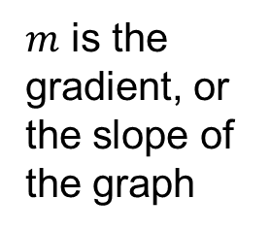
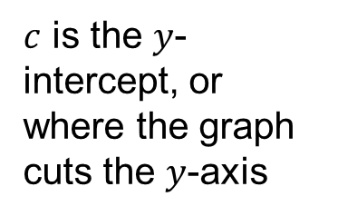
Recap
$$y=mx+c$$
$m$ is the gradient, or the slope of the graph
$c$ is the $y$-intercept, or where the graph cuts the $y$-axis
Gradients of perpendicular graphs sum to $−1$.
(negative reciprocals)

Slide 10
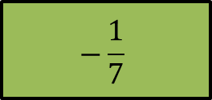
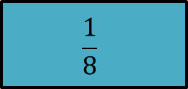
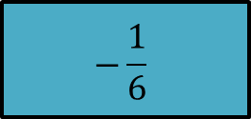
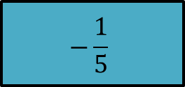
Gradient of line
Gradient of its perpendicular line
5
$$\frac{1}{3}$$
6
$$7$$
- 3
$$−9$$
- 8
$$−\frac{1}{6}$$
$$\frac{1}{9}$$
$$\frac{1}{8}$$
$$−\frac{1}{7}$$
$$−\frac{1}{5}$$

Slide 11

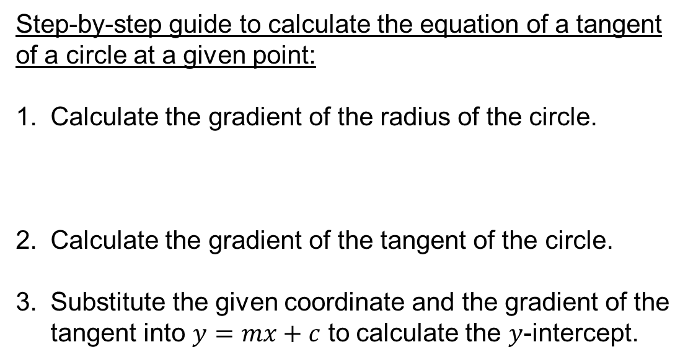
Step-by-step guide to calculate the equation of a tangent of a circle at a given point:
Calculate the gradient of the radius of the circle.
Calculate the gradient of the tangent of the circle.
Substitute the given coordinate and the gradient of the tangent into $y=mx+c$ to calculate the $y$-intercept.
Gradient of the radius
$$×$$
Gradient of the tangent
=
$$−1$$

Slide 12
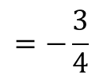
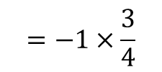

Example
Find the equation of the tangent to the circle at the point $(3, 4)$.
$$=\frac{4}{3}$$
$$=−1÷\frac{4}{3}$$
$$=−1×\frac{3}{4}$$
$$=−\frac{3}{4}$$
Gradient of radius $=\frac{rise}{run}$
Gradient of tangent
$y=mx+c$
$4=−\frac{3}{4}×3+c$
x
$4=−\frac{9}{4}+c$
$\frac{25}{4}=c$
$y=−\frac{3}{4}x+\frac{25}{4}$

Slide 14
Answers
$$y=x+10$$ | $$y=−\frac{3}{4}x+3$$ | $$y=−\frac{4}{3}x+\frac{10}{3}$$ | $$y=−\frac{4}{3}x+9$$
$$y=\frac{4}{3}x−\frac{40}{3}$$ | $$x=3$$ | $$y=−\frac{9}{8}x−\frac{145}{8}$$ | $$y=\frac{12}{5}x+12$$

