Slide 1


Starter
Calculate the following using your calculator:
1) ${3.5}^{2}$
2) ${6.7}^{2}$
3) ${2.4}^{2}$
4) ${1.75}^{2}$
5) ${3.85}^{2}$
Bonus: can you find this button?
Do you know what it does?
$=12.25$
$=44.89$
$=5.76$
$=3.0625$
$=14.8225$
$$π$$

Slide 2
A circle has radius $r$ and diameter $d$.
Circumference of a circle:
$C=πd$
Area of a circle:
$A=πr2$
$$r$$
$$d$$

Slide 3
Calculate the area and circumference of these circles:
$4$ cm
$6$ cm
What’s the difference between these two questions?

Slide 4
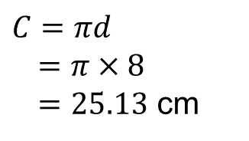
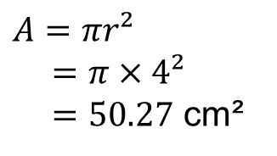
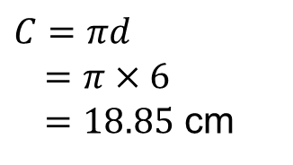
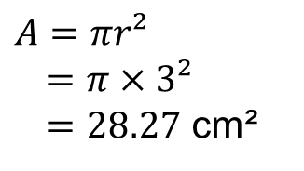
Calculate the area and circumference of these circles:
$4$ cm
$6$ cm
$A=πr²$
$=π×3²$
$=28.27$ cm²
$C=πd$
$=π×6$
$=18.85$ cm
$A=πr²$
$=π×4²$
$=50.27$ cm²
$C=πd$
$=π×8$
$=25.13$ cm

Slide 6
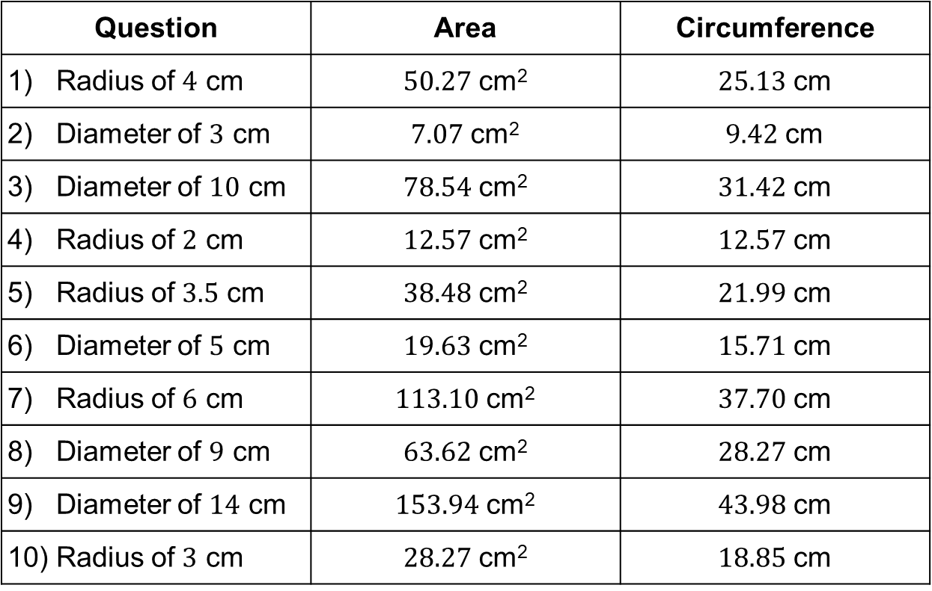
Answers
Question | Area | Circumference
1) Radius of $4$ cm | $50.27$ cm² | $25.13$ cm
2) Diameter of $3$ cm | $7.07$ cm² | $9.42$ cm
3) Diameter of $10$ cm | $78.54$ cm² | $31.42$ cm
4) Radius of $2$ cm | $12.57$ cm² | $12.57$ cm
5) Radius of $3.5$ cm | $38.48$ cm² | $21.99$ cm
6) Diameter of $5$ cm | $19.63$ cm² | $15.71$ cm
7) Radius of $6$ cm | $113.10$ cm² | $37.70$ cm
8) Diameter of $9$ cm | $63.62$ cm² | $28.27$ cm
9) Diameter of $14$ cm | $153.94$ cm² | $43.98$ cm
10) Radius of $3$ cm | $28.27$ cm² | $18.85$ cm

Slide 7
Show me a circle with a circumference bigger than $50$ cm.
Show me a circle with an area bigger than $50$ cm².
Convince me that the area of a circle with diameter $10$ cm is $78.5$ cm².

Slide 8
Calculate the area and perimeter of the following shapes. Give your answers correct to 2 decimal places.
$r=6$ cm
$r=7$ cm
$d=4$ cm
$r=4$ cm
$r=1.5$ cm
$r=4$ cm
$\frac{1}{8}$
$r=2$ cm
$r=6$ cm
$r=3$ cm
$$45°$$
$$60°$$
$$165°$$
$r=3$ cm
$r=8$ cm
$$225°$$
$r=5$ cm

Slide 9
Answers
$A=6.28$ cm² $A=14.14$ cm² $A=12.57$ cm² $A=38.48$ cm²
$P=10.28$ cm $P=15.42$ cm $P=14.28$ cm $P=25.00$ cm
$A=28.27$ cm² $A = 37.70$ cm² $A=3.53$ cm² $A=1.57$ cm²
$P=21.42$ cm $P=26.85$ cm $P=7.71$ cm $P=5.57$ cm
$A=3.53$ cm² $A=33.51$ cm² $A=17.67$ cm² $A=36.00$ cm²
$P=8.36$ cm $P=24.38$ cm $P=17.78$ cm $P=24.40$ cm

Slide 10
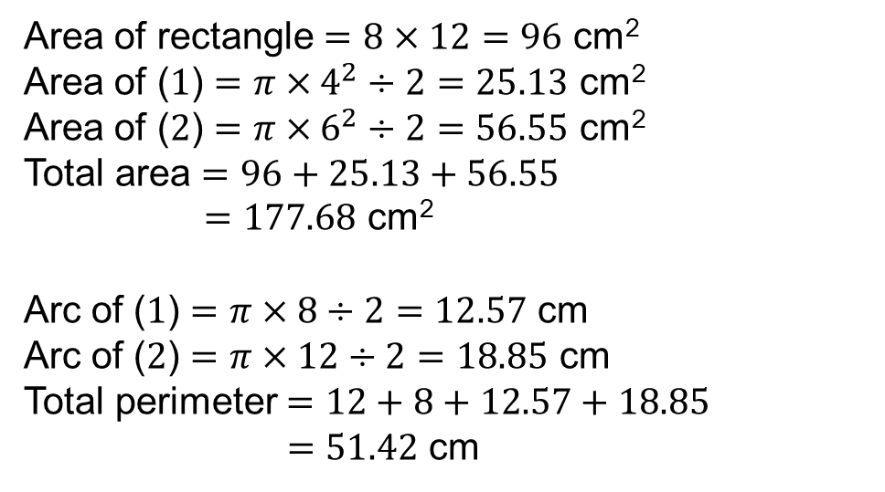
Example
The diagram shows a shape made of two semi-circles and a rectangle.
Calculate the area of the shape.
Calculate the perimeter of the shape.
Give your answers correct to 2 decimal places.
Area of rectangle $=8×12=96$ cm²
Area of ($1$) $=π×4^{2}÷2=25.13$ cm²
Area of ($2$) $=π×6^{2}÷2=56.55$ cm²
Total area $=96+25.13+56.55$
$=177.68$ cm²
Arc of ($1$) $=π×8÷2=12.57$ cm
Arc of ($2$) $=π×12÷2=18.85$ cm
Total perimeter $=12+8+12.57+18.85$
$=51.42$ cm
$8$ cm
$12$ cm
$$2$$
$$1$$

Slide 12
Answers
1) $A=38.14$ cm² 2) $A=135.03$ cm² 3) $A=147.10$ cm²
$P=23.42$ cm $P=61.28$ cm $P=56.85$ cm
4) $A=99.27$ cm² 5) $A=160.53$ cm² 6) $A=22.57$ cm²
$P=41.71$ cm $P=61.13$ cm $P=18.28$ cm

