Slide 1
Starter
Increase 75 by 12%
Decrease 64 by 16%
Increase 549 by 4%
Increase 400 by 5% then by a further 6%
Decrease 80 by 10% then by a further 25%
= 84
= 53.76
= 570.96
= 445.2
= 54

Slide 2
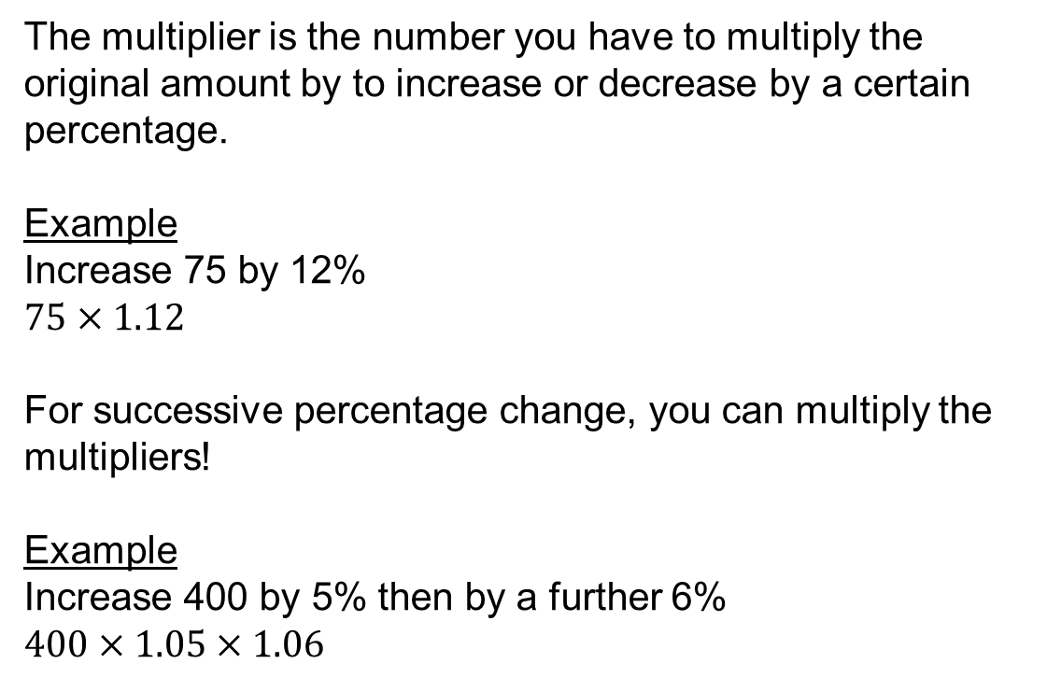
The multiplier is the number you have to multiply the original amount by to increase or decrease by a certain percentage.
Example
Increase 75 by 12%
$75×1.12$
For successive percentage change, you can multiply the multipliers!
Example
Increase 400 by 5% then by a further 6%
$400×1.05×1.06$

Slide 3
If you invest money in a building society or a bank savings account the building society or bank pays you interest.
If you borrow money you pay interest to the bank.
The interest is worked out as a percentage of the amount you lend or borrow.
Definitions
Principal – the original amount invested
Compound interest – it is added to the principal and will itself earn interest (interest on interest on interest...)
Simple interest – it is not added to the principal

Slide 4
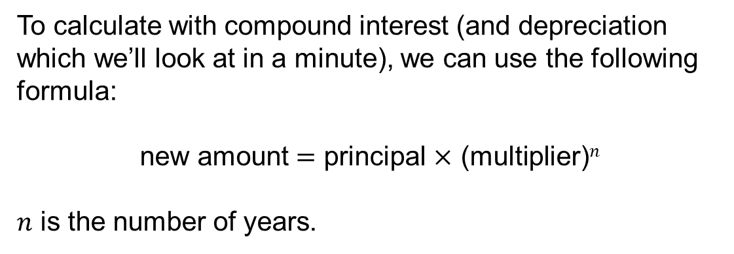
To calculate with compound interest (and depreciation which we’ll look at in a minute), we can use the following formula:
new amount $=$ principal $×$ (multiplier)$n$
$n$ is the number of years.

Slide 5
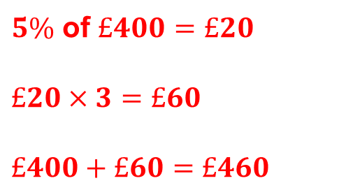
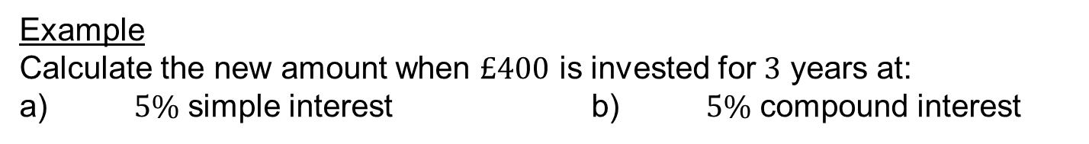

Example
Calculate the new amount when $£400$ is invested for $3$ years at:
a) $5\%$ simple interest b) $5\%$ compound interest
$5\%$ of $£400=£20$
$£20×3=£60$
$£400+£60=£460$
$400×{1.05}^{3}=£463.05$

Slide 6
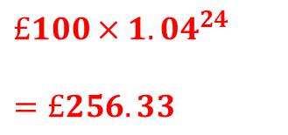
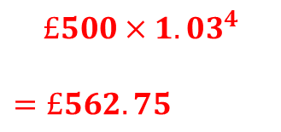
Compound Interest Examples
If you put £500 in a bank for 4 years and were paid 3% interest per year, how much would you have?
If you put £100 in a bank for 24 years and were paid 4% interest per year, how much would you have?
$$£500×{1.03}^{4}$$
$=£562.75$
$£100×1.{04}^{24}$
$=£256.33$

Slide 7
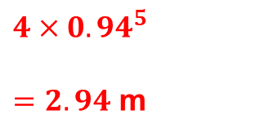
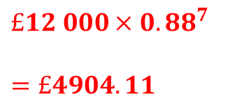
Depreciation Examples
A car loses 12% of its value each year. What is it worth after 7 years if it cost £12000 when new?
The polar ice cap in the Arctic is 4 metres thick. If the ice is thinning at a rate of 6% per year, how thick will the ice be in 5 years time?
$£12 000×0.{88}^{7}$
$=£4904.11$
$4×0.{94}^{5}$
$=2.94$ m

Slide 9
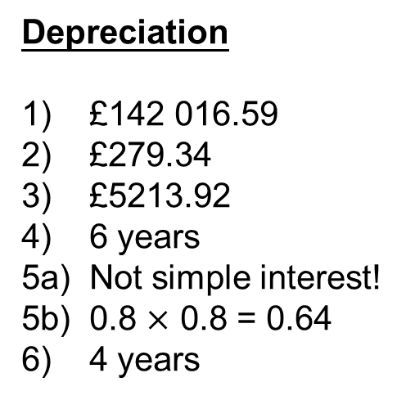
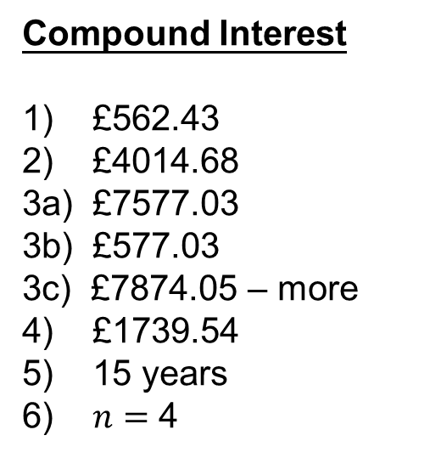
Answers
Compound Interest
1) £562.43
2) £4014.68
3a) £7577.03
3b) £577.03
3c) £7874.05 – more
4) £1739.54
5) 15 years
6) $n=$ 4
Depreciation
1) £142 016.59
2) £279.34
3) £5213.92
4) 6 years
5a) Not simple interest!
5b) 0.8 $×$ 0.8 = 0.64
6) 4 years

Slide 10
The Savings Game
You are going to invest £1000.
Three banks are willing to offer you a competitive rate of interest.
Every five years you have the option to stick with the bank you’re with or swap and look for a better rate of interest.
The aim of the game is to have made as much money as you can at the end of the 25 year period.

Slide 11
YEAR 1
Bank A = 4% for two years, unsure next three years
Bank B = 3% for two years, definitely lower next three years
Bank C = 2% for two years, definitely higher next three years

Slide 12
YEAR 2
A = 4%
B = 3%
C = 2%

Slide 13
YEAR 3
A = 3%
B = 2%
C = 3%

Slide 14
YEAR 4
A = 3%
B = 2%
C = 3%

Slide 15
YEAR 5
A = 3%
B = 2%
C = 3%

Slide 16
YEAR 6
Bank A = 6% for two years, definitely lower next three years
Bank B = 4% for two years, unsure next three years
Bank C = 2% for two years, definitely higher next three years

Slide 17
YEAR 7
A = 6%
B = 4%
C = 2%

Slide 18
YEAR 8
A = 2%
B = 3%
C = 4%

Slide 19
YEAR 9
A = 2%
B = 3%
C = 4%

Slide 20
YEAR 10
A = 2%
B = 3%
C = 4%

Slide 21
YEAR 11
Bank A = 2.5% for two years, definitely higher next three years
Bank B = 3.5% for two years, unsure next three years
Bank C = 4.5% for two years, definitely lower next three years

Slide 22
YEAR 12
A = 2.5%
B = 3.5%
C = 4.5%

Slide 23
YEAR 13
A = 3.5%
B = 2%
C = 3%

Slide 24
YEAR 14
A = 3.5%
B = 2%
C = 3%

Slide 25
YEAR 15
A = 3.5%
B = 2%
C = 3%

Slide 26
YEAR 16
Bank A = 5.2% for two years, definitely lower next three years
Bank B = 4.1% for two years, definitely higher next three years
Bank C = 3.9% for two years, unsure next three years

Slide 27
YEAR 17
A = 5.2%
B = 4.1%
C = 3.9%

Slide 28
YEAR 18
A = 4.9%
B = 4.9%
C = 4.9%

Slide 29
YEAR 19
A = 4.9%
B = 4.9%
C = 4.9%

Slide 30
YEAR 20
A = 4.9%
B = 4.9%
C = 4.9%

Slide 31
YEAR 21
Bank A = 6.2% for two years, unsure next three years
Bank B = 7.3% for two years, unsure next three years
Bank C = 5.9% for two years, unsure next three years

Slide 32
YEAR 22
A = 6.2%
B = 7.3%
C = 5.9%

Slide 33
YEAR 23
A = 7.1%
B = 6.8%
C = 6.4%

Slide 34
YEAR 24
A = 7.1%
B = 6.8%
C = 6.4%

Slide 35
YEAR 25
A = 7.1%
B = 6.8%
C = 6.4%

Slide 36


What’s your final amount?
How much did you end up making?
What can you now afford?
Notes:
Teacher note: students can’t end up with more than £3012

