Slide 1






Starter
Rearrange the following equations to make y the subject.
$$2y=8x+3$$
$$y+6x=11$$
$$4y=x+3$$
$$y+4x+6=0$$
$$2y+8=3x$$
$$x+3y=7$$
$y=2x+\frac{3}{2}$
$$y=−6x+11$$
$y=\frac{1}{4}x+\frac{3}{4}$
$$y=−4x−6$$
$y=\frac{3}{2}x−4$
$y=−\frac{1}{3}x+\frac{7}{3}$

Slide 2
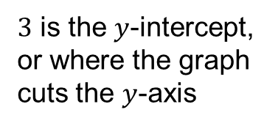
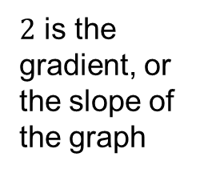
Given an equation, we can sketch its graph using its gradient and $y$-intercept.
Suppose we want to sketch:
$$y=2x+3$$
$2$ is the gradient, or the slope of the graph
$3$ is the $y$-intercept, or where the graph cuts the $y$-axis
Notes:
Explain that when we construct a table of values, the value of y depends on the value of x. That means that we choose the values for x and substitute them into the equation to get the corresponding value for y.
The minimum number of points needed to draw a straight line is two, however, it is best to plot several points to ensure that no mistakes have been made.
The points given by the table can then be plotted to give the graph of the required function.

Slide 3
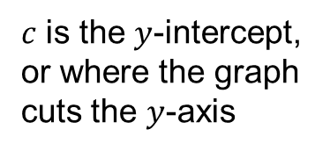
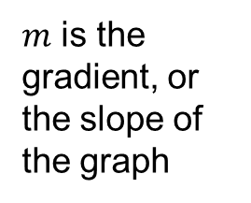
Generally:
$$y=mx+c$$
$m$ is the gradient, or the slope of the graph
$c$ is the $y$-intercept, or where the graph cuts the $y$-axis
Notes:
Explain that when we construct a table of values, the value of y depends on the value of x. That means that we choose the values for x and substitute them into the equation to get the corresponding value for y.
The minimum number of points needed to draw a straight line is two, however, it is best to plot several points to ensure that no mistakes have been made.
The points given by the table can then be plotted to give the graph of the required function.

Slide 4
Sketch the following graphs on the same set of axes.
1) $y=−2x+4$
2) $y=\frac{1}{2}x+1$
3) $y=−2x−3$
4) $y=3x+1$
What do you notice?
Use the keywords to describe relationships between the graphs.

Slide 5
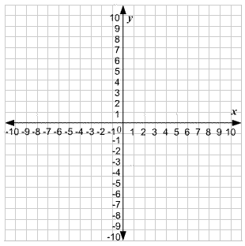
$$y=3x+1$$
$$y=−2x–3$$
$y=\frac{1}{2}x+1$
$$y=−2x+4$$

Slide 6
$$y=3x+1$$
$$y=−2x–3$$
$y=\frac{1}{2}x+1$
Parallel
$$y=−2x+4$$

Slide 7
$$y=3x+1$$
$$y=−2x–3$$
$y=\frac{1}{2}x+1$
$$y=−2x+4$$
Perpendicular

Slide 8
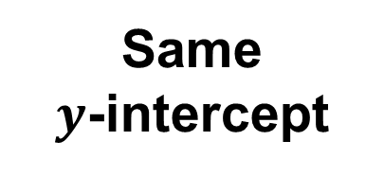
$$y=3x+1$$
$$y=−2x–3$$
$y=\frac{1}{2}x+1$
Same
$y$-intercept
$$y=−2x+4$$

Slide 9
Parallel graphs have the same gradient.
The gradients of perpendicular graphs are negative reciprocals of each other (their product is -1).
The $y$-intercept is where the graph cuts the $y$-axis.
The $x$-intercept is where the graph cuts the $x$-axis.

Slide 10
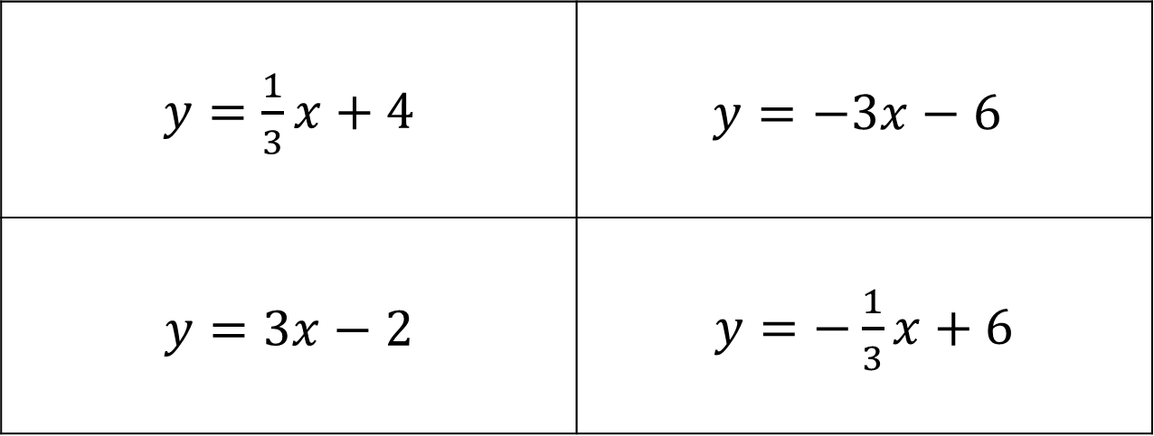
Which graph is parallel to
$y=3x+6$
$y=\frac{1}{3}x+4$ | $$y=−3x−6$$
$y=3x−2$ | $y=−\frac{1}{3}x+6$
A
B
C
D

Slide 11
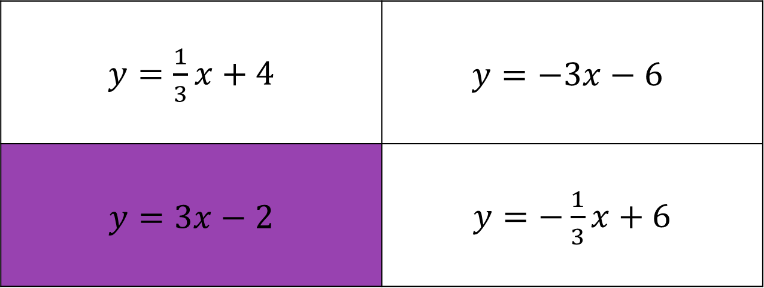
Which graph is parallel to
$y=3x+6$
$y=\frac{1}{3}x+4$ | $$y=−3x−6$$
$y=3x−2$ | $y=−\frac{1}{3}x+6$
A
B
C
D

Slide 12
Which graph is perpendicular to
$y=3x+6$
$y=\frac{1}{3}x+4$ | $$y=−3x−6$$
$y=3x−2$ | $y=−\frac{1}{3}x+6$
A
B
C
D

Slide 13
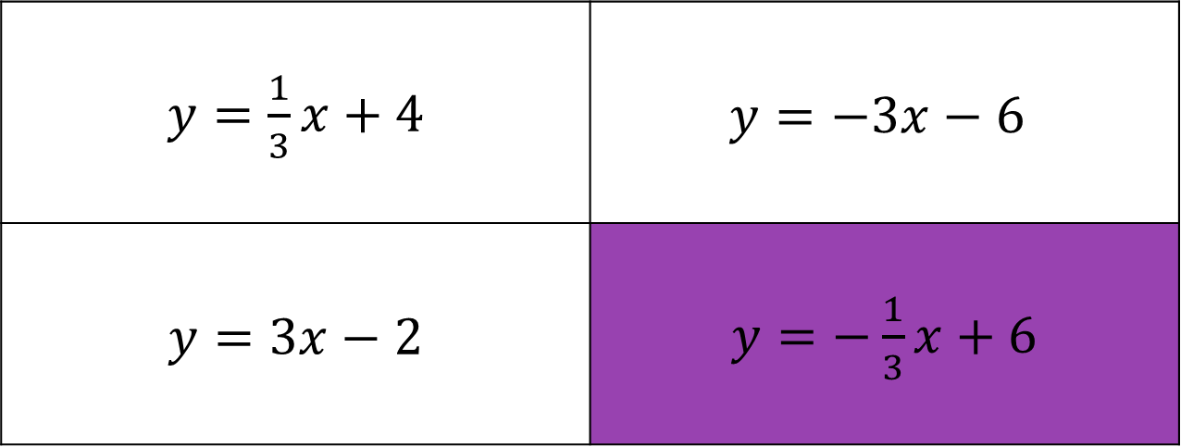
Which graph is perpendicular to
$y=3x+6$
$y=\frac{1}{3}x+4$ | $$y=−3x−6$$
$y=3x−2$ | $y=−\frac{1}{3}x+6$
A
B
C
D

Slide 14
Which graph has the same $y$-intercept as
$y=3x+6$
$y=\frac{1}{3}x+4$ | $$y=−3x−6$$
$y=3x−2$ | $y=−\frac{1}{3}x+6$
A
B
C
D

Slide 15
Which graph has the same $y$-intercept as
$y=3x+6$
$y=\frac{1}{3}x+4$ | $$y=−3x−6$$
$y=3x−2$ | $y=−\frac{1}{3}x+6$
A
B
C
D

Slide 16
Which graph has the same $x$-intercept as
$y=3x+6$
$y=\frac{1}{3}x+4$ | $$y=−3x−6$$
$y=3x−2$ | $y=−\frac{1}{3}x+6$
A
B
C
D

Slide 17
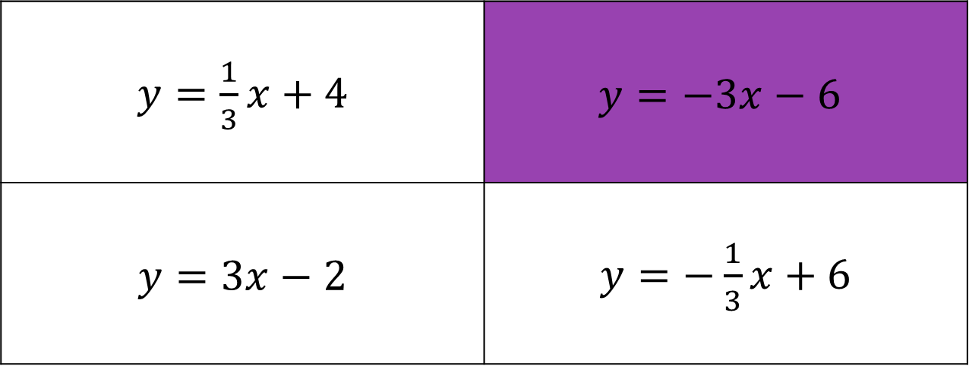
Which graph has the same $x$-intercept as
$y=3x+6$
$y=\frac{1}{3}x+4$ | $$y=−3x−6$$
$y=3x−2$ | $y=−\frac{1}{3}x+6$
A
B
C
D

Slide 18
Example
Find the equation of the line which is parallel to
$y=2x+4$ and passes through the point $(7, 3)$.
$y=2x+c$
$3=2\left(7\right)+c$
$3=14+c$
$−11=c$
$y=2x−11$
Parallel graphs have the same gradient.

Slide 19
Example
Find the equation of the line which is perpendicular to
$y=−4x+1$ and passes through the point $(2, 3)$.
$y=\frac{1}{4}x+c$
$3=\frac{1}{4}\left(2\right)+c$
$3=\frac{1}{2}+c$
$\frac{5}{2}=c$
$y=\frac{1}{4}x+\frac{5}{2}$
$−1÷−4=\frac{1}{4}$
The gradients of perpendicular graphs are negative reciprocals of each other (their product is -1).

Slide 21

Answers
1) $y=3x−7$ 6) $y=−\frac{1}{2}x+9$
2) $y=5x−10$ 7) $y=−\frac{1}{4}x+17$
3) $y=2x+16$ 8) $y=2x−1$
4) $y=−2x+7$ 9) $y=\frac{2}{3}x−6$
5) $y=−3x+15$ 10) $y=−2x+12$

Slide 22
Task
Complete the activity in your groups. Put a pair of linear equations in each box of the table.
Make sure you JUSTIFY each answer so you whole team understands.
Make sure you SHOW YOUR WORKING for every pair of lines.
Create your own rule connecting the pair of lines left over.
Extension: Exam questions.

Slide 23
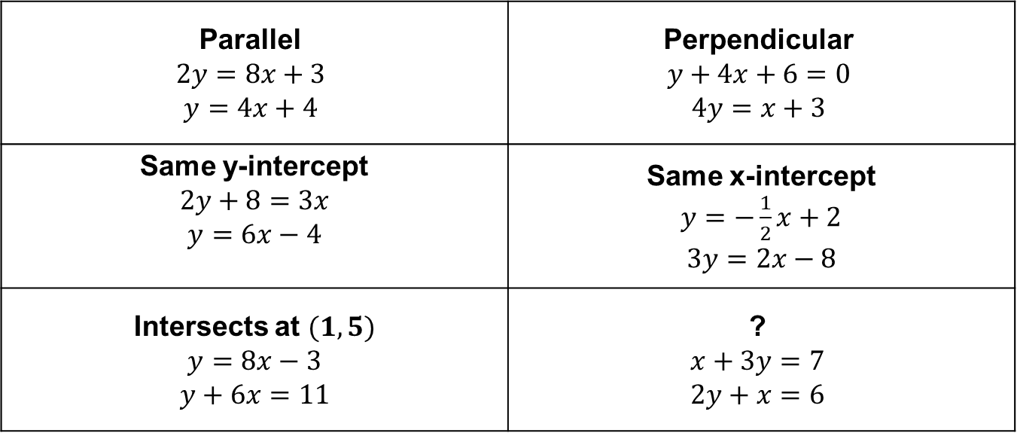
Answers
Parallel $$2y=8x+3$$ $$y=4x+4$$ | Perpendicular $$y+4x+6=0$$ $$4y=x+3$$
Same y-intercept $$2y+8=3x$$ $$y=6x−4$$ | Same x-intercept $y=−\frac{1}{2}x+2$ $$3y=2x−8$$
Intersects at $(1, 5)$ $$y=8x−3$$ $$y+6x=11$$ | ? $$x+3y=7$$ $$2y+x=6$$

Slide 24
Plenary
Spot the mistakes:
Find the equation of the line which is perpendicular to
y = 2x + 3 and passes through the point (3, 9).
$y=\frac{1}{2}x+c$
$9=\frac{1}{2}\left(3\right)+c$
$3=1\frac{1}{2}+c$
$4\frac{1}{2}=c$
$y=\frac{1}{2}x+4\frac{1}{2}$
$−1÷2=\frac{1}{2}$

