Slide 1
Starter
What is speed?
What is time?
What is distance?
What is the relationship between these?
Convince me.

Slide 2
Glossary
Velocity – speed with direction
Displacement – distance with direction
An object moving with constant velocity $u$ units in a particular direction for a time $t$ units make a displacement $s$ units in that direction, where $s=ut$

Slide 3
Units of Measure
SI (Système Internationale) units are used in mechanics – scientists all over the world have agreed to use them.
Metres (m) for displacement;
Seconds (s) for time; and
Metres per second (m s⁻¹) for velocity.
Look out for questions that try to catch you out by using different units – convert to SI units first!

Slide 4
Graphs for Constant Velocity
Displacement-time graphs
Velocity-time graphs
Velocity
Displacement
Gradient $u$
$$u$$
$$(t,v)$$
$$(t,s)$$
area $s$
$$u$$
Time
Time
$$t$$
Why does this graph pass through the origin?
What does the horizontal nature of this graph tell us?

Slide 5
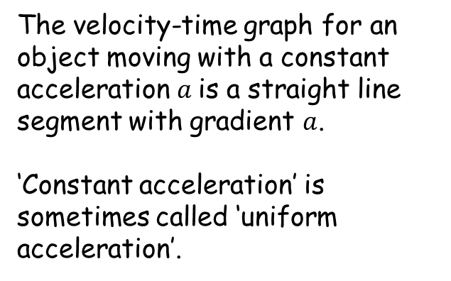
Acceleration
A vehicle at rest cannot suddenly start to move with constant velocity; there has to be a period of time where the velocity increases. The rate at which the velocity increases is called acceleration.
The velocity-time graph for an object moving with a constant acceleration $a$is a straight line segment with gradient $a$.
‘Constant acceleration’ is sometimes called ‘uniform acceleration’.
Velocity
(m s⁻¹)
Time (s)

Slide 6
Acceleration
The velocity can also drop at a constant rate. The word for this is deceleration (or retardation).
Velocity
(m s⁻¹)
The unit for acceleration and deceleration is
metres per second per second, or m s⁻².
Constant acceleration
Time (s)
Constant deceleration
Constant velocity

Slide 7
$$v=u+at$$
Constant Acceleration
Velocity
(m s⁻¹)
This is a velocity-time graph showing an object moving with constant acceleration.
The initial velocity is $u$.
The velocity at time $t$is denoted by $v$.
$$at$$
$$v$$
$$u$$
$$u$$
$$t$$
Time (s)
If the acceleration has the constant value $a$, then between time 0 and time $t$, the velocity increases by $at$. It follows that after time $t$, $v=u+at$.

Slide 8
$$v=u+at$$
Constant Acceleration
$$s=\frac{1}{2}\left(u+v\right)t$$
Velocity
(m s⁻¹)
To find an equation for the displacement $s$, you need to find the area of the shaded region under the graph between $(0,u)$ and $(t,v)$.
We can do this by finding the area of the trapezium: $s=\frac{1}{2}\left(u+v\right)t$
$$s=ut+\frac{1}{2}at^{2}$$
$$at$$
$$v$$
$$u$$
area $s$
$$u$$
$$t$$
Time (s)
Or by adding the area of the rectangle and the area of the triangle: $s=ut+\frac{1}{2}at^{2}$

Slide 9
$$v=u+at$$
Constant Acceleration Equations
These three equations involve four of the five quantities $s$, $u$, $v$, $a$ and $t$.
The first leaves out $s$, the second $a$ and the third $v$.
It is also useful to have equations that leave out t and u, and we can find those by combining the equations we already have.
$$s=\frac{1}{2}\left(u+v\right)t$$
$$s=ut+\frac{1}{2}at^{2}$$
$$v^{2}=u^{2}+2as$$
$$s=vt−\frac{1}{2}{at}^{2}$$

Slide 10
$$v=u+at$$
Constant Acceleration Equations
Sort the questions on your sheet by which constant acceleration equation you need to use to solve them.
Solve the questions. The quantities $u$, $v$, $s$ and $t$ are all positive, but $a$ could be positive or negative.
Could you write a worded problem for which they could each apply?
$$s=\frac{1}{2}\left(u+v\right)t$$
$$s=ut+\frac{1}{2}at^{2}$$
$$v^{2}=u^{2}+2as$$
$$s=vt−\frac{1}{2}{at}^{2}$$

Slide 11

$$v=u+at$$
Answers
a) $11$ b) $16$ c) $−\frac{3}{2}$
d) $45$ e) $102$ f) $1.2$
g) $14$ h) $2.5$ i) $24$
j) $−\frac{80}{3}$ k) $20$ l) $2$
m) $\frac{4}{3}$ n) $25$
$$s=\frac{1}{2}\left(u+v\right)t$$
$$s=ut+\frac{1}{2}at^{2}$$
$$v^{2}=u^{2}+2as$$
$$s=vt−\frac{1}{2}{at}^{2}$$

Slide 12
$$v=u+at$$
Example
The barrel of a shotgun is 0.9 metres long, and the shot emerges from the muzzle with a speed of 240 m s⁻¹. Find the acceleration of the shot in the barrel.
$$s=\frac{1}{2}\left(u+v\right)t$$
$$s=ut+\frac{1}{2}at^{2}$$
$$v^{2}=u^{2}+2as$$
$$s=0.9$$
$$u=0$$
$$v=240$$
Find $a$
$$s=vt−\frac{1}{2}{at}^{2}$$
$$v^{2}=u^{2}+2as$$
$${240}^{2}=0^{2}+2×0.9×a$$
$$32000=a$$
The acceleration of the shot is approximately 32 000 m s⁻².

Slide 13
$$v=u+at$$
Example
A long distance runner makes a final effort 45 metres from the finishing line, accelerating at a constant rate. He crosses the finish line 6 seconds later at a speed of 8 m s⁻¹. What is his acceleration?
$$s=\frac{1}{2}\left(u+v\right)t$$
$$s=ut+\frac{1}{2}at^{2}$$
$$v^{2}=u^{2}+2as$$
$$s=45$$
$$t=6$$
$$v=8$$
Find $a$
$$s=vt−\frac{1}{2}{at}^{2}$$
$$s=vt−\frac{1}{2}{at}^{2}$$
$$45=8×6−\frac{1}{2}×6^{2}×a$$
$$\frac{1}{6}=a$$
The runner accelerates at $\frac{1}{6}$ m s⁻².

Slide 14
$$v=u+at$$
Worded Questions
Complete the questions in pairs.
Make sure both of you understand every step.
Write your own question in a similar style to one that you have answered.
$$s=\frac{1}{2}\left(u+v\right)t$$
$$s=ut+\frac{1}{2}at^{2}$$
$$v^{2}=u^{2}+2as$$
$$s=vt−\frac{1}{2}{at}^{2}$$

Slide 15
$$v=u+at$$
Answers
40 s, $\frac{7}{8}$ m s⁻²
$\sqrt{\frac{1}{5}s}$
0.06 m s⁻²
1500 m
2.7 km, 250 s
$\sqrt{900−20s}$ m s⁻¹, 10 m s⁻¹, 5 m
60 m
$\left(5+0.8t\right)$ m s⁻¹, $\left(5t+0.4t^{2}\right)$ m, 15 s, 17 m s⁻¹
2½ m s⁻², 2 m s⁻²
16$t$ m, $\left(20t−\frac{1}{2}t^{2}\right)$ m, the impala gets away
$$s=\frac{1}{2}\left(u+v\right)t$$
$$s=ut+\frac{1}{2}at^{2}$$
$$v^{2}=u^{2}+2as$$
$$s=vt−\frac{1}{2}{at}^{2}$$

