Slide 1
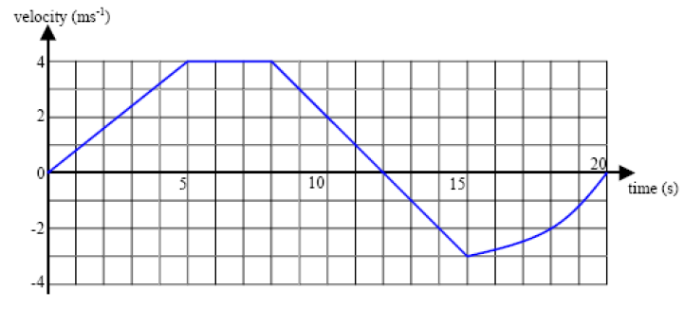
Constant velocity = 4 ms⁻¹ (gradient is zero)
Write everything you know on this velocity-time graph.
Area = displacement = ½ (3 + 12) 4 = 30 m
v = 0 indicates a change in direction
gradient = acceleration = 0.8 ms⁻²
Area = displacement = -(4.5 + 9.5) = -14 m
gradient = acceleration = -1 ms⁻²
Area 9.5 m (approx)

Slide 2
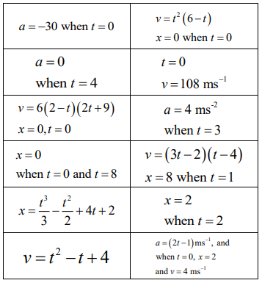
Matching activity
You should match 4 sets of three connected expressions/values involving displacement, velocity or acceleration.

Slide 3
Answers

Slide 4
Answers

Slide 5
What can you tell me about calculus in relation to this graph?
$$y$$
$$y=f(x)$$
$$a$$
$$b$$
$$x$$

Slide 6
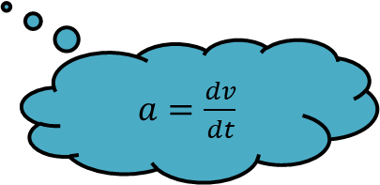
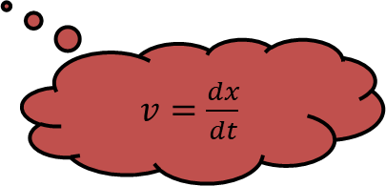
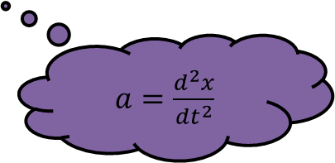
Define velocity as a rate of change.
Could you use your knowledge of calculus to write this mathematically?
How does this link to what we know about the velocity-time graph?
Define acceleration as a rate of change.
Could you use your knowledge of calculus to write this mathematically?
Could you express acceleration in terms of displacement now?
$v=\frac{dx}{dt}$
$a=\frac{dv}{dt}$
$a=\frac{d^{2}x}{dt^{2}}$

Slide 7
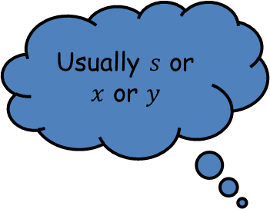
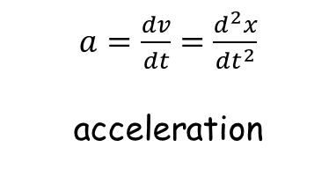
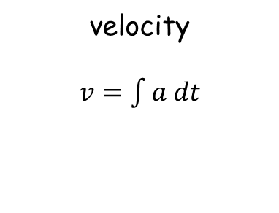
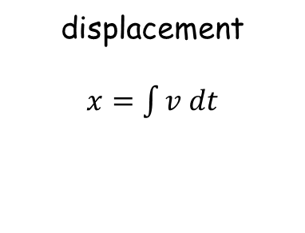
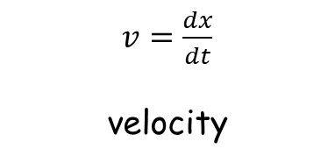
Usually $s$ or $x$ or $y$
$v=\frac{dx}{dt}$
velocity
$a=\frac{dv}{dt}=\frac{d^{2}x}{dt^{2}}$
acceleration
$$x$$
displacement
Differentiate
Integrate
displacement
$x=\int{v dt}$
velocity
$v=\int{a dt}$
acceleration
$$a$$
What must you always remember when integrating?

Slide 8
A particle moves in a straight line so that it’s displacement $x$after $t$ seconds is $x=10t2–2t3+t$ metres. Find its velocity after 3 seconds and determine whether it is speeding up or slowing down after 3 seconds.
$\frac{ⅆy}{ⅆx}=20t−6t^{2}+1$
$20\left(3\right)−6{\left(3\right)}^{2}+1=60−54+1=7$
The velocity is $7 ms^{−1}$
$\frac{ⅆ^{2}y}{ⅆx^{2}}=20−12t$
$20−12\left(3\right)=20−36=−16$
It is slowing down at a rate of $16 ms^{−2}$
Differentiate
Substitute $t=3$
Second derivative
Substitute $t=3$

Slide 9
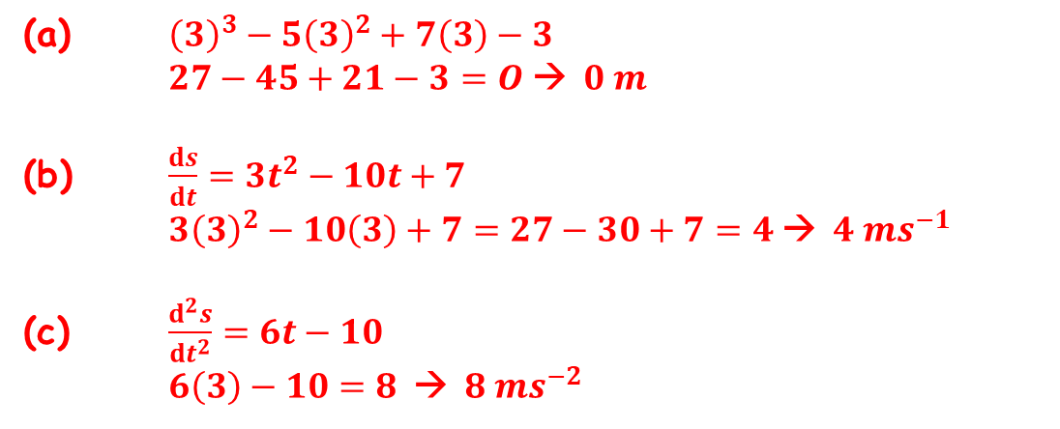
The displacement $s$ metres of a body from an origin O at time $t$ seconds is given by $s=t3−5t2+7t–3$
Find (a) the displacement,
(b) the velocity, and
(c) the acceleration of the body when $t$ = 3 seconds
(a) ${\left(3\right)}^{3}−5{\left(3\right)}^{2}+7\left(3\right)−3$
$27−45+21−3=O$→ $0 m$
(b) $\frac{ⅆs}{ⅆt}=3t^{2}−10t+7$
$3{\left(3\right)}^{2}−10\left(3\right)+7=27−30+7=4$→ $4 ms^{−1}$
(c) $\frac{ⅆ^{2}s}{ⅆt^{2}}=6t−10$
$6\left(3\right)−10=8$ → $8 ms^{−2}$

Slide 10
Pair Activity
Complete the exam questions, using the chillies as a guide.
Make sure you both understand all steps of the answer.
I will pick a question at the end for you to present to the rest of the group.

