Slide 1
Starter
5.4 x 100
720 ÷ 1000
6 ÷ 10
531 ÷ 1000 x 100
0.82 x 10 x 100
= 540
= 0.72
= 0.6
= 53.1
= 820

Slide 2
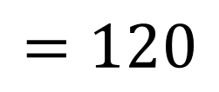
Example
Given that $4×3=12$, write down the value of:
a) $0.4×300$
b) $40×0.3$
c) $1200÷0.4$
$$=120$$
$$4×3=12$$
$$÷10$$
$$×100$$
$÷10$, $×100$
$$0.4×300$$
$$=120$$

Slide 3
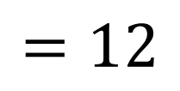
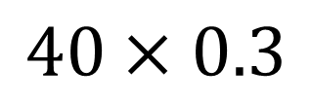
Example
Given that $4×3=12$, write down the value of:
a) $0.4×300$
b) $40×0.3$
c) $1200÷0.4$
$$=120$$
$$=12$$
$$4×3=12$$
$$×10$$
$$÷10$$
$×10,$ $÷10$
$$40×0.3$$
$$=12$$

Slide 4
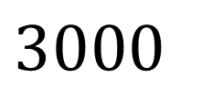
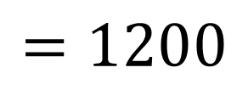
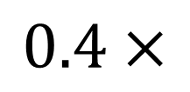
Example
Given that $4×3=12$, write down the value of:
a) $0.4×300$
b) $40×0.3$
c) $1200÷0.4$
$$=120$$
$$=12$$
$$=3000$$
$$4×3=12$$
$$÷10$$
$$×1000$$
$$×100$$
$×1000$, $÷10$
$$0.4×$$
$$3000$$
$$=1200$$

Slide 6
Answers
1a. 1632 3a. 17.01
b. 16.32 b. 0.486
c. 3.4
2a. 15.456 4a. 44.8
b. 0.15456 b. 4.48
c. 3220 c. 1.4

Slide 7
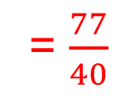

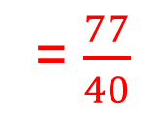
Exam Question
Use the information that:
$\frac{63 × 99}{18²}$ = $\frac{77}{4}$
To find the values, as fractions or integers, of:
a. $\frac{63 × 9.9}{18²}$
b. $\frac{6.3 × 99}{18²}$
c. $\frac{63 × 99}{1.8²}$
97% of students answered this exam question well because they used the information provided
= $\frac{77}{40}$
= $\frac{77}{40}$
= $\frac{7700}{4}$
= $1925$

