Slide 1
Starter
Complete this times tables grid.
Make sure you time yourself!

Slide 2
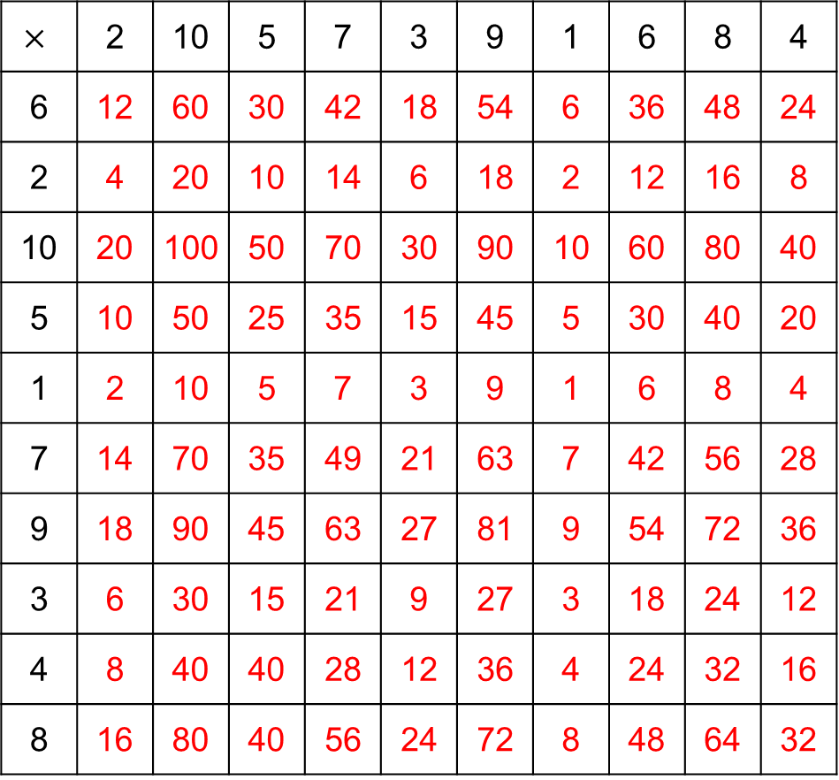
$$×$$ | 2 | 10 | 5 | 7 | 3 | 9 | 1 | 6 | 8 | 4
6 | 12 | 60 | 30 | 42 | 18 | 54 | 6 | 36 | 48 | 24
2 | 4 | 20 | 10 | 14 | 6 | 18 | 2 | 12 | 16 | 8
10 | 20 | 100 | 50 | 70 | 30 | 90 | 10 | 60 | 80 | 40
5 | 10 | 50 | 25 | 35 | 15 | 45 | 5 | 30 | 40 | 20
1 | 2 | 10 | 5 | 7 | 3 | 9 | 1 | 6 | 8 | 4
7 | 14 | 70 | 35 | 49 | 21 | 63 | 7 | 42 | 56 | 28
9 | 18 | 90 | 45 | 63 | 27 | 81 | 9 | 54 | 72 | 36
3 | 6 | 30 | 15 | 21 | 9 | 27 | 3 | 18 | 24 | 12
4 | 8 | 40 | 40 | 28 | 12 | 36 | 4 | 24 | 32 | 16
8 | 16 | 80 | 40 | 56 | 24 | 72 | 8 | 48 | 64 | 32

Slide 3
6
6
7
7
8
8
9
9
10
10

Slide 4
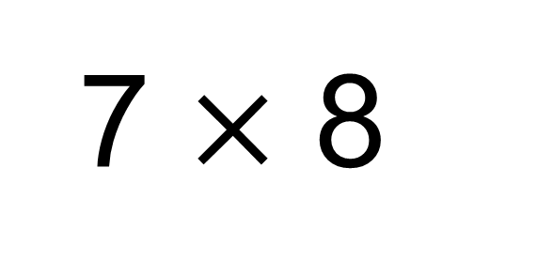
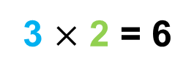
6
6
7
7
8
8
9
9
10
10
3 $×$ 2 = 6
7 $×$ 8
= 50
+ 6
= 56

Slide 5
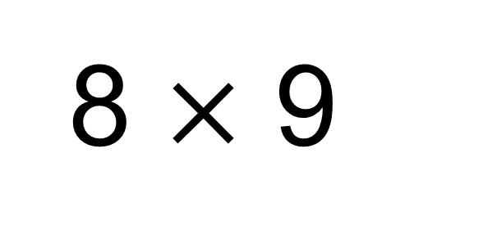
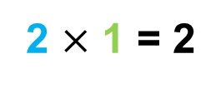
6
6
7
7
8
8
9
9
10
10
2 $×$ 1 = 2
8 $×$ 9
= 70
+ 2
= 72

Slide 6
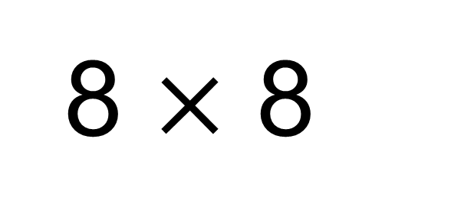
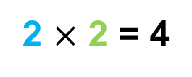
6
6
7
7
8
8
9
9
10
10
2 $×$ 2 = 4
8 $×$ 8
= 60
+ 4
= 64

Slide 7
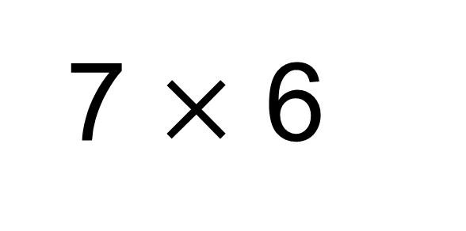
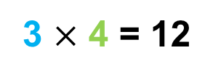
6
6
7
7
8
8
9
9
10
10
3 $×$ 4 = 12
7 $×$ 6
= 30
+ 12
= 42

Slide 8
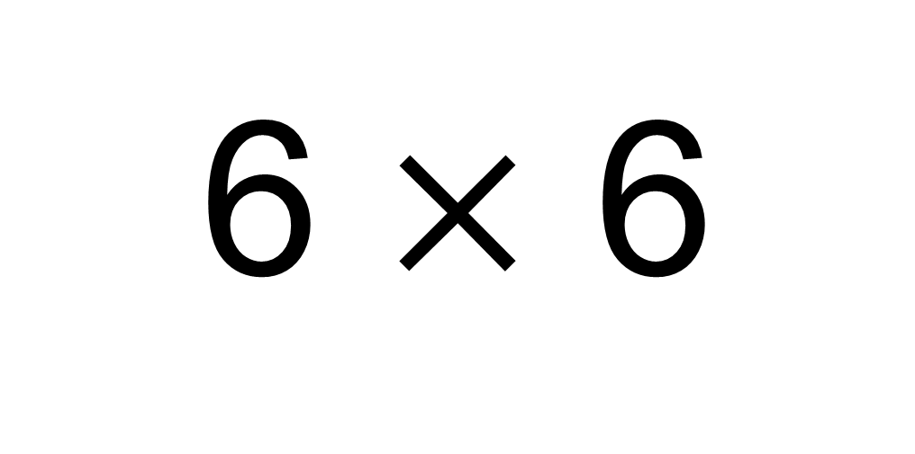
6 $×$ 6
A
36
B
30
C
42
D
32

Slide 9
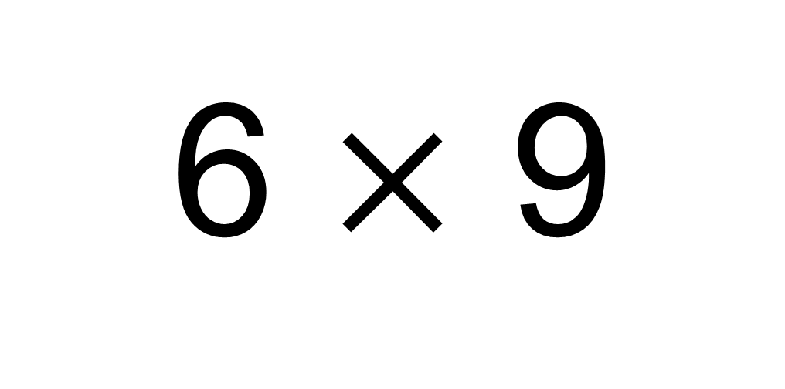
6 $×$ 9
A
56
B
48
C
54
D
52

Slide 10
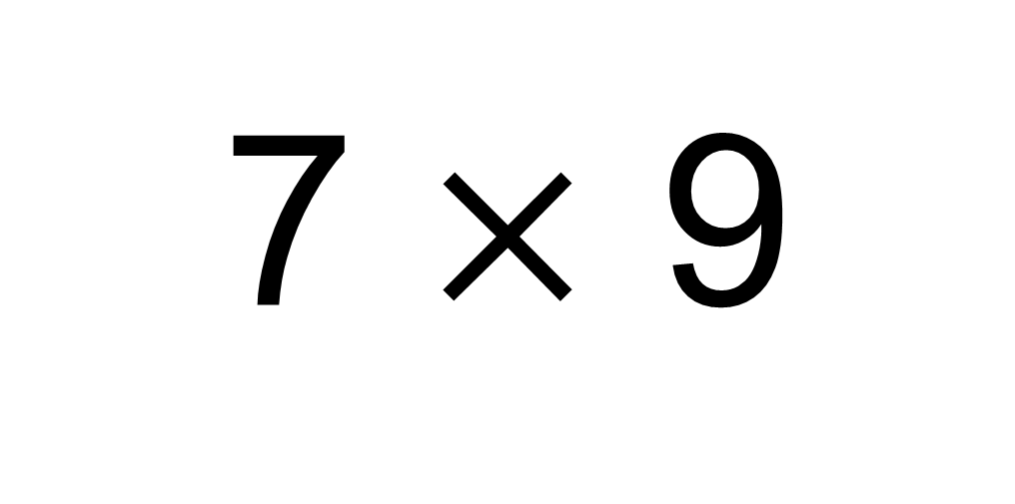
7 $×$ 9
A
63
B
72
C
67
D
56

Slide 11
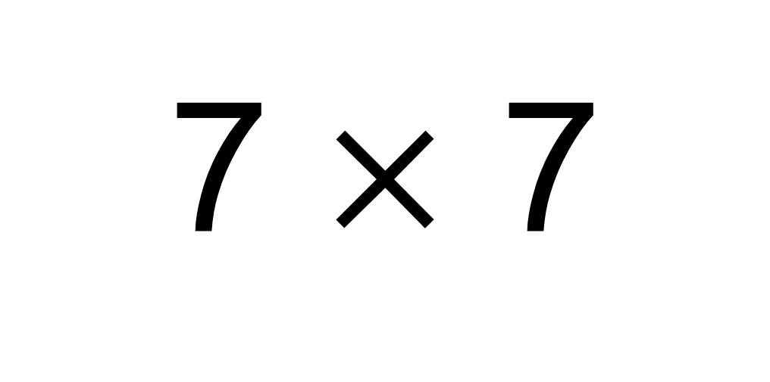
7 $×$ 7
A
56
B
42
C
48
D
49

Slide 12
Review
Complete another times tables grid.
Make sure you time yourself!

Slide 13
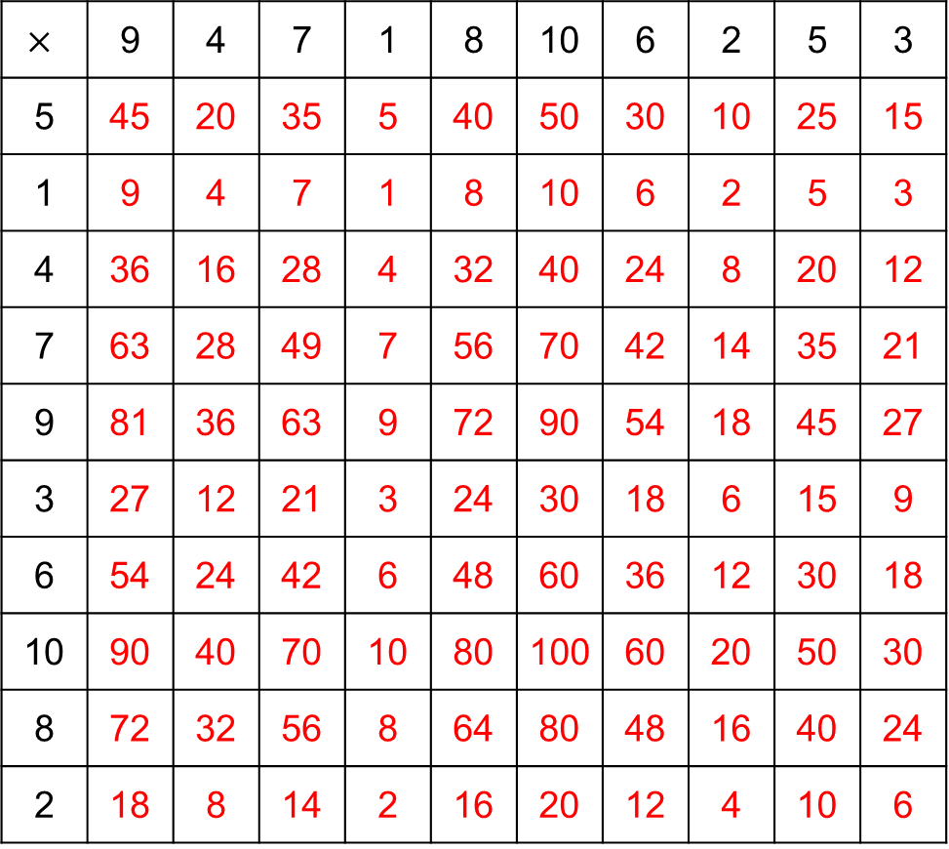
$$×$$ | 9 | 4 | 7 | 1 | 8 | 10 | 6 | 2 | 5 | 3
5 | 45 | 20 | 35 | 5 | 40 | 50 | 30 | 10 | 25 | 15
1 | 9 | 4 | 7 | 1 | 8 | 10 | 6 | 2 | 5 | 3
4 | 36 | 16 | 28 | 4 | 32 | 40 | 24 | 8 | 20 | 12
7 | 63 | 28 | 49 | 7 | 56 | 70 | 42 | 14 | 35 | 21
9 | 81 | 36 | 63 | 9 | 72 | 90 | 54 | 18 | 45 | 27
3 | 27 | 12 | 21 | 3 | 24 | 30 | 18 | 6 | 15 | 9
6 | 54 | 24 | 42 | 6 | 48 | 60 | 36 | 12 | 30 | 18
10 | 90 | 40 | 70 | 10 | 80 | 100 | 60 | 20 | 50 | 30
8 | 72 | 32 | 56 | 8 | 64 | 80 | 48 | 16 | 40 | 24
2 | 18 | 8 | 14 | 2 | 16 | 20 | 12 | 4 | 10 | 6

Slide 14
6
6
7
7
8
8
9
9
10
10
Have you improved?
Practice makes permanent!

