Slide 1
Starter
Expand and simplify the following expressions:
$(x–4)(x+2)$
$(x–7)(x–3)$
$(x+5)²$

Slide 2

Answers
$(x−4)(x+2)$ $=x^{2}−2x−8$
$(x−7)(x−3)$ $=x^{2}−10x+21$
$(x+5)²$ $=x^{2}+10x+25$

Slide 3
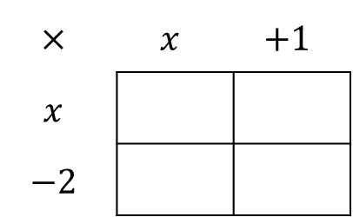
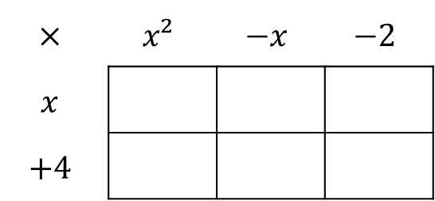
Example
Expand and simplify $(x+4)(x+1)(x−2)$
So $(x+4)(x+1)(x−2)=(x+4)(x²−x−2)$
Start by expanding one pair of brackets.
Then expand then expand these two brackets
$$×$$ | $$x$$ | $$+1$$
$$x$$
$$−2$$
$$×$$ | $$x²$$ | $$−x$$ | $$−2$$
$$x$$
$$+4$$
$$x²$$
$$+x$$
$$x³$$
$$−x²$$
$$−2x$$
$$−2x$$
$$−2$$
$$+4x²$$
$$−4x$$
$$−8$$
$=x²−2x+x−2$
$=x³+4x²−x²−4x−2x−8$
$=x²−x−2$
$=x³+3x²−6x−8$

Slide 4
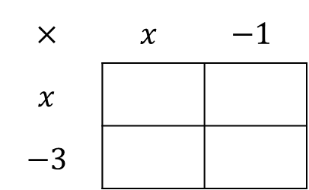
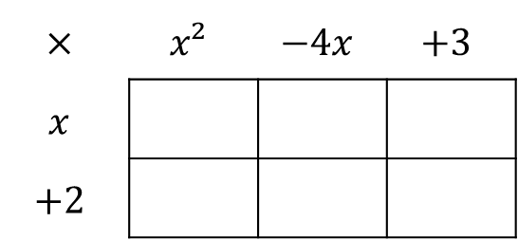
Example
Expand and simplify $(x+2)(x−1)(x−3)$
So $(x+2)(x−1)(x−3)=(x+2)(x^{2}−4x+3)$
Start by expanding one pair of brackets.
Then expand then expand these two brackets
$$×$$ | $$x$$ | $$−1$$
$$x$$
$$−3$$
$$×$$ | $$x²$$ | $$−4x$$ | $$+3$$
$$x$$
$$+2$$
$$x²$$
$$−x$$
$$x³$$
$$−4x²$$
$$+3x$$
$$−3x$$
$$+3$$
$$+2x²$$
$$−8x$$
$$+6$$
$=x^{2}−3x−x+3$
$=x^{3}+2x^{2}−4x^{2}−8x+3x+6$
$=x^{2}−4x+3$
$=x^{3}−2x^{2}−5x+6$

Slide 5
Task
Expand and simplify the following expressions:
$(x+1)(x+3)(x+5)$
$(x−4)(x+2)(x+3)$
$(x+2){(x−3)}^{2}$
${(x−2)}^{3}$
$(2x+1)(x−2)(x−4)$
Extension
${\left(ax+b\right)}^{2}\left(x+c\right)=4x^{3}+dx^{2}−55x−100$
Find the values of the integers $a$, $b$, $c$ and $d$.

Slide 6
Answers
$(x+1)(x+3)(x+5)$ $=x^{3}+9x^{2}+13x+5$
$(x−4)(x+2)(x+3)$ $=x^{3}+x^{2}−14x−24$
$(x+2){(x−3)}^{2}$ $=x^{3}−4x^{2}−3x+18$
${(x−2)}^{3}$ $=x^{3}−6x^{2}+12x−8$
$(2x+1)(x−2)(x−4)$ $=2x^{3}−11x^{2}+10x+8$
Extension
${\left(ax+b\right)}^{2}\left(x+c\right)=4x^{3}+dx^{2}−55x−100$ $a=2$ $b=5$
Find the values of the integers $a$, $b$, $c$ and $d$. $c=−4$ $d=4$

