Slide 1
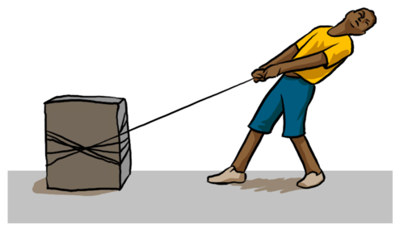
The English scientist Isaac Newton (1643-1727) tried to answer the question, “How can mathematics be used to explain why objects move in the way they do?”
In his book Principia, he put his findings in the form of three laws, called Newton's Laws of Motion.
The whole of mechanics results from applying these three laws in different situations.

Slide 2
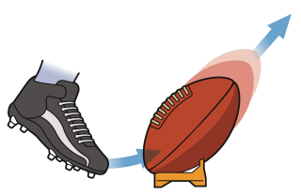
Newton's First Law:
Every object remains in a state of rest or of uniform motion in a straight line unless forces act on it to change that state.
What this means is that the natural way for an object to behave is to continue to move at the same speed in the same direction.
That is, its velocity is constant.
As a special case. if the object is stationary it will remain stationary unless there is some force to start it moving.

Slide 3
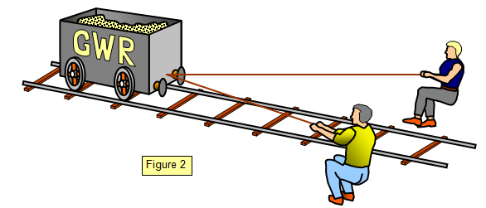
Newton’s Second Law:
When a force of $F$ newtons acts on an object of mass $m$ kg, the acceleration $a$ m s⁻² is given by $F=ma$.
If several forces act on an object parallel to a given direction the net force is the sum of the forces in that direction minus the sum of the forces in the opposite direction.
If the net force is zero, the forces on the object are said to be in equilibrium. The object then remains at rest, or moves with constant velocity.
$$F=ma$$

Slide 4
Think – Pair - Share
Think back to when you’ve looked at forces in science previously.
What types of force are there?
Could you draw diagrams to represent them?
$$F=ma$$

Slide 5
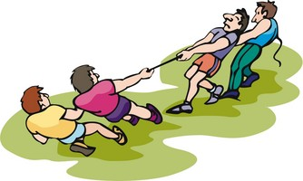
Tension
This acts in a string or spring that is being pulled.
It always acts away from the object you are considering.
It is always the same throughout
the string/spring.
$$F=ma$$

Slide 6
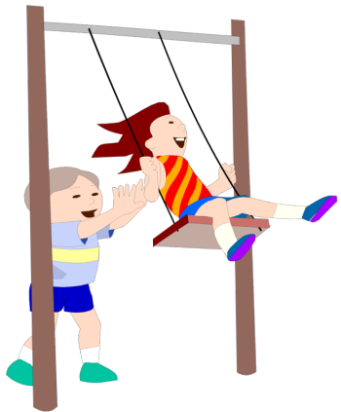
Thrust (or Driving Force)
This acts in a compressed spring or rod, or could be a push.
It always acts towards the object you are considering.
It is always the same throughout the rod/spring.
$$F=ma$$

Slide 7
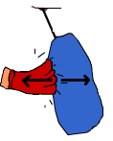
Normal Reaction
This is a contact force acting whenever a weight is on a surface.
It always acts perpendicular to, and away from, the surface.
$$F=ma$$

Slide 8
Friction
This acts when an object is trying to move along a rough surface.
It acts in the direction to oppose movement.
$$F=ma$$

Slide 9
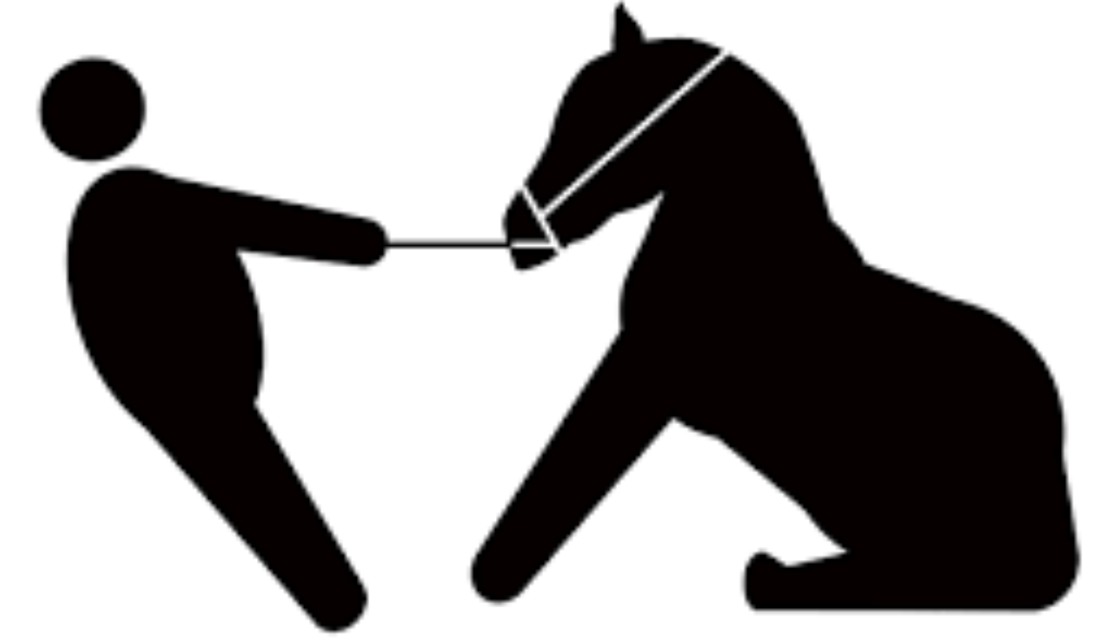
Newton’s Third Law:
The forces between two bodies in contact are equal in magnitude but opposite in direction.
This law represents a certain
symmetry in nature: forces always
occur in pairs, and one body cannot
exert a force on another without
experiencing a force itself.
We sometimes refer to this law loosely as action-reaction, where the force exerted is the action and the force experienced as a consequence is the reaction.
Often, we call the reaction the resistance force.
$$F=ma$$

Slide 10
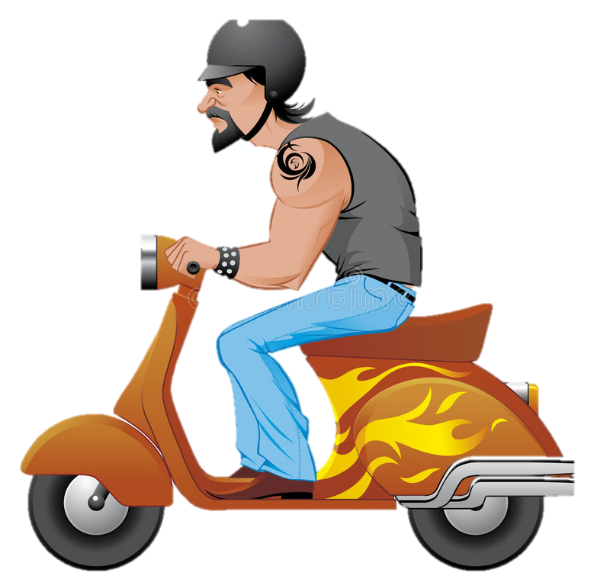
Example
A motorcyclist moves with an acceleration on 5 m s⁻² along a horizontal road against a total resistance of 120 N. The total mass of the rider and his machine is 400 kg. Find the driving force behind the engine.
5 m s⁻²
? N
400 kg
120 N
$$F=ma$$
It is unrealistic to draw a diagram like this for every question. Instead, model each question with a particle, as long as the force acting on it does not make it rotate

Slide 11
Example
A motorcyclist moves with an acceleration on 5 m s⁻² along a horizontal road against a total resistance of 120 N. The total mass of the rider and his machine is 400 kg. Find the driving force behind the engine.
5 m s⁻²
? N
400 kg
120 N
$F−R=ma$
$$F=ma$$
$F−120=400×5$
$F−120=2000$
$F=2120$
The driving force behind the engine is 2120 N.

Slide 12
Example
A wagon of mass 250 kg is pulled by a horizontal cable along a single track against a resisting force of 150 N. The wagon starts from rest. After 10 seconds it has covered a distance of 60 m. Find the tension in the cable.
$a$ m s⁻²
? N
250 kg
150 N
$u=0$
$t=10$
$s=60$
$$F=ma$$
$s=ut+\frac{1}{2}at^{2}$
$T−R=ma$
$60=0×10+\frac{1}{2}×{10}^{2}×a$
$T−150=250×1.2$
$1.2=a$
$T=450$
The tension in the cable is 450 N.

Slide 13
Try these! Read them carefully, draw a force diagram and don’t leave out any information.
At a particular instant a cabin cruiser, which is driven by a force of magnitude 5400N, is accelerating at 1.6 m s⁻² against a resistance of 1200N. Calculate the mass of the cabin cruiser.
A particle of mass 2.5 kg is pulled along a horizontal surface by a string parallel to the surface with an acceleration of 2.7 m s⁻². The frictional force resisting motion has magnitude 4 N. At the instant that the particle is moving with speed 3 m s⁻¹, the string breaks. Calculate how much further the particle moves before coming to rest.
A motor-boat of mass 8 tonnes is travelling along a straight course with a constant speed of 28 km h⁻¹. The constant force driving the boat forward has magnitude 780 N. The engine is now shut off. Calculate, to the nearest second, the time it takes the motor-boat to stop, assuming that the resistance remains the same as before.
2625 kg
2.81 m
$$F=ma$$
1 min 20 secs

Slide 14
Weight
The force of gravity with which
the earth attracts it.
All objects, when dropped, fall towards the earth in a vertical line with the same constant acceleration, provided there is no air resistance.
This is called acceleration due to gravity ($g$) and is 9.8 m s⁻² correct to 2 significant figures.
In SI units, the weight $W$ of an object of mass $m$ kg is approximately 9.8$m$ newtons.
$$F=ma$$
Approximately 9.78 m s⁻² at the equator and 9.83 m s⁻² at the poles

Slide 15
Think – Pair – Share
A ball is attached to one end of a piece of light inextensible string and the other end fixed to a point on a smooth horizontal table. The ball is then struck so that it moves in a horizontal circle. What happens to the ball if the string breaks?
$$F=ma$$
The ball will fly off at a tangent to the circle and move at constant speed.

Slide 16
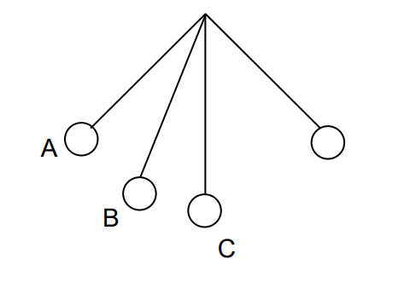
Think – Pair – Share
A bob on the end of a simple pendulum is swinging in an arc of a circle. Copy the diagram. Mark the forces acting at A, B, and C on the diagram.
In each case the force of gravity should act vertically downwards and the tension in the string should be clearly marked.
$$F=ma$$

Slide 17
Think – Pair – Share
The diagram shows a ball running round a smooth track and then leaving the track. Draw arrows to indicate the direction of the resultant force at A, B, C, D, and E. (The track is straight except for the lowest part where it is circular.)
At A the direction of motion of the ball is not changing, therefore, the resultant must act parallel to the track and since the ball will be accelerating down the track, the resultant must act down the track.
$$F=ma$$
At C the resultant must act parallel and down the track since the ball will be decelerating.
At D and E gravity is the only force so the resultant must be vertically downwards.
At A, B, and C in addition to gravity the reaction of the track has to be considered.
At B because the track is circular, the resultant must act towards the centre of the circle.
At all points the force of gravity is acting.

Slide 18
Discussion
Stand up.
Concentrate on the force which you feel pushing up into your feet.
What is this force?
What other forces are acting on you?
What happens when you press down onto the table in front of you with your arms?
What happens when you lift one leg up?
This is gravity.
$$F=ma$$

Slide 19
Discussion
Stand at arms’ length from a wall and place your palms against the wall at about shoulder height.
Concentrate on the force which you feel pushing up into your feet.
What happens as you press with increasing force against the wall?
Why does this happen?
$$F=ma$$

Slide 20
Discussion
In pairs, pull either end of the piece of string.
What do you feel?
Now Push either end of the pen.
What do you feel now?
How is it different from the string?
Can you feel tension in the pen? Thrust in the string? Why?
This is tension.
This is thrust.
$$F=ma$$

