Slide 1
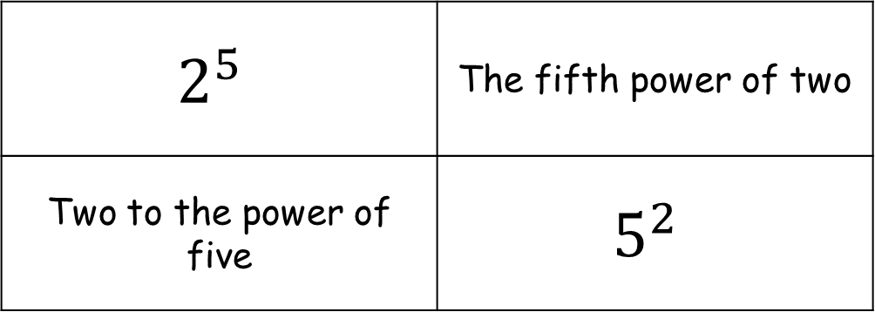
Settler
What’s the same and what’s different?
$$2^{5}$$ | The fifth power of two
Two to the power of five | $$5^{2}$$

Slide 2

Starter
Write down the (prime) factor components of the following terms.
Example: ${6y}^{3}=2×3×y×y×y$
1. $x^{2}$
2. ${2x}^{2}$
3. ${2x}^{3}y$
4. ${4x}^{3}y^{2}$
5. ${12x}^{2}y^{3}z$
$=x×x$
$=2×x×x$
$=2×x×x×x×y$
$=2×2×x×x×x×y×y$
$=2×2×3×x×x×y×y×y×z$

Slide 3
Multiplication Law
$a^{3}×a^{4}$
$$=a×a×a×a×a×a×a$$
$=a^{7}$
$$a^{m}×a^{n}$$
$=a^{m+n}$
“The base is the same and we’re multiplying the terms, so we add the indices”

Slide 4
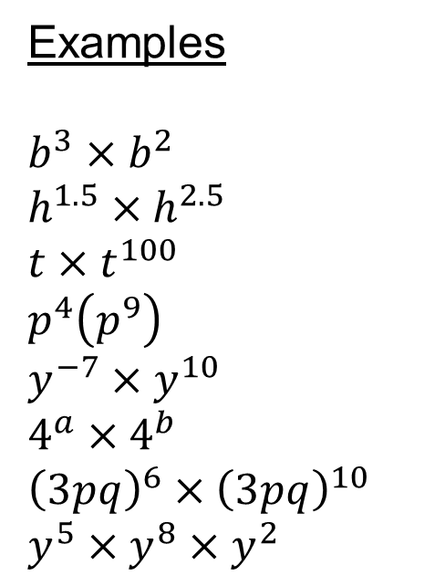
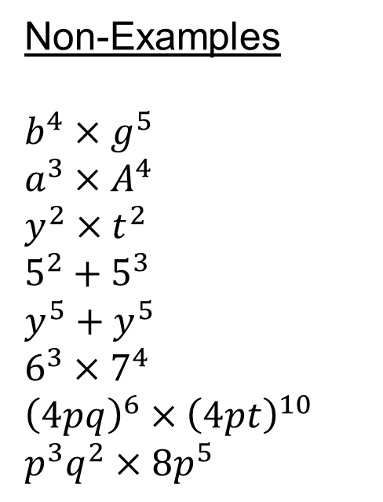
Multiplication Law
Examples
$b^{3}×b^{2}$
$h^{1.5}×h^{2.5}$
$t×t^{100}$
$p^{4}\left(p^{9}\right)$
$y^{−7}×y^{10}$
$4^{a}×4^{b}$
${\left(3pq\right)}^{6}×{\left(3pq\right)}^{10}$
$y^{5}×y^{8}×y^{2}$
Non-Examples
$b^{4}×g^{5}$
$a^{3}×A^{4}$
$y^{2}×t^{2}$
$5^{2}+5^{3}$
$y^{5}+y^{5}$
$6^{3}×7^{4}$
${\left(4pq\right)}^{6}×{\left(4pt\right)}^{10}$
$p^{3}q^{2}×{8p}^{5}$
Notes:
Jo Morgan @mathsjem www.resourceaholic.com

Slide 6



Multiplication Law
Simplify the following.
1. $2^{6}×2^{7}$
2. $5^{14}×5^{−5}$
3. $8^{4.5}×8^{2.5}$
4. $a^{5}×a^{3}×a^{4}$
5. $x×x^{3}$
6. ${4r}^{3}×{2r}^{6}$
7. ${3p}^{4}×p^{−7}$
1. $2^{8}×2^{8}×2^{8}$
2. $f^{14}×f^{−5}$
3. $4^{3.5}×4^{2.5}$
4. $g^{1.9}×g$
5. ${2x}^{3}×{5x}^{8}$
6. $b^{2}c^{3}×b^{5}$
7. ${3pq}^{2}×{2p}^{4}q$
1. $2^{5}×2^{−3}$
2. $h^{1.6}×h^{4}×h^{2}$
3. ${2a}^{3}×a$
4. ${4k}^{5}×−{2k}^{2}$
5. ${(3d)}^{6}×{(3d)}^{3}$
6. $a^{2}b^{4}×a^{−1}b^{3}$
7. $−{abc}^{2}×{ab}^{4}d^{2}$
Create multiplication questions which have the following answers:
1. ${84y}^{3}$ 2. ${63p}^{17}$ 3. ${12x}^{4}y^{6}$

Slide 7



Multiplication Law
Answers
1. $2^{13}$
2. $5^{9}$
3. $8^{7}$
4. $a^{12}$
5. $x^{4}$
6. ${8r}^{9}$
7. ${3p}^{−3}$
1. $2^{24}$
2. $f^{9}$
3. $4^{6}$
4. $g^{2.9}$
5. ${10x}^{11}$
6. $b^{7}c^{3}$
7. ${6p}^{5}q^{3}$
1. $2^{2}$
2. $h^{7.6}$
3. ${2a}^{4}$
4. ${−8k}^{7}$
5. ${(3d)}^{9}$
6. $ab^{7}$
7. $−{ab^{5}c}^{2}d^{2}$
Get a peer to check the questions you have created ☺

Slide 8
Power Law
${\left(a^{5}\right)}^{3}$
$$=a^{5}×a^{5}×a^{5}$$
$=a^{15}$
$${\left(a^{m}\right)}^{n}$$
$=a^{mn}$

Slide 9
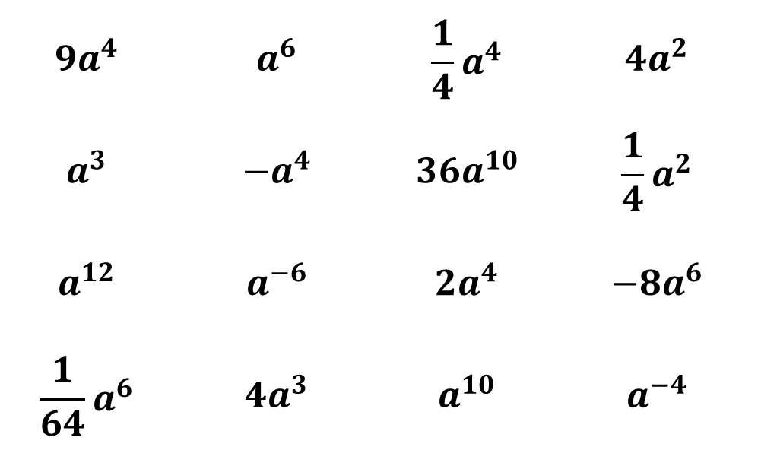
Power Law
Draw a 3x3 grid and fill it with 9 numbers from below.
$$9a^{4}$$ | $$a^{6}$$ | $$\frac{1}{4}a^{4}$$ | $$4a^{2}$$
$$a^{3}$$ | $$−a^{4}$$ | $${36a}^{10}$$ | $$\frac{1}{4}a^{2}$$
$$a^{12}$$ | $$a^{−6}$$ | $${2a}^{4}$$ | $${−8a}^{6}$$
$$\frac{1}{64}a^{6}$$ | $${4a}^{3}$$ | $$a^{10}$$ | $$a^{−4}$$

Slide 10
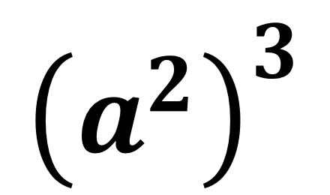
$${\left(a^{2}\right)}^{3}$$

Slide 11
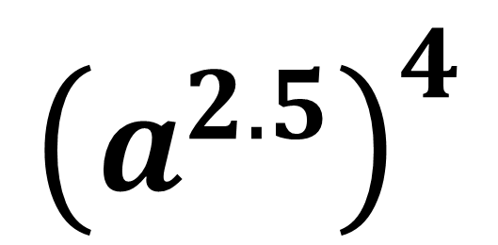
$${\left(a^{2.5}\right)}^{4}$$

Slide 12
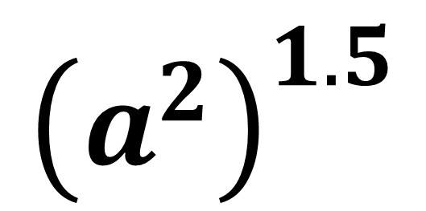
$${\left(a^{2}\right)}^{1.5}$$

Slide 13
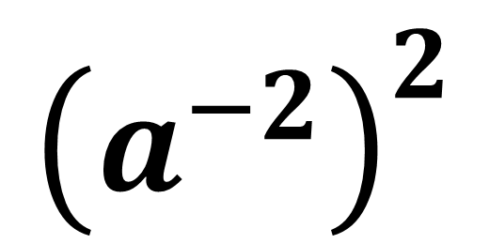
$${\left(a^{−2}\right)}^{2}$$

Slide 14
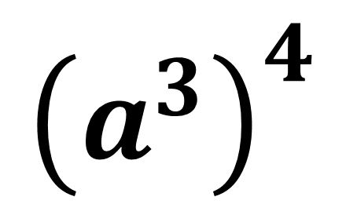
$${\left(a^{3}\right)}^{4}$$

Slide 15
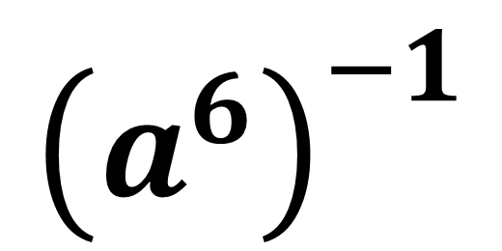
$${\left(a^{6}\right)}^{−1}$$

Slide 16
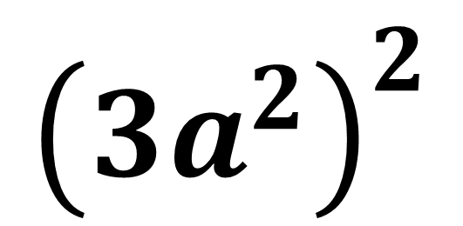
$${\left({3a}^{2}\right)}^{2}$$

Slide 17
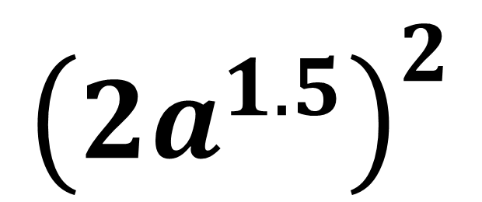
$${\left({2a}^{1.5}\right)}^{2}$$

Slide 18
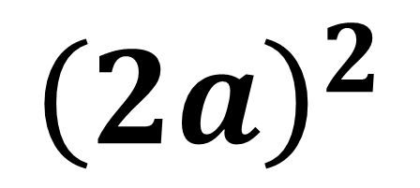
$${\left(2a\right)}^{2}$$

Slide 19
$${\left({2a}^{2}\right)}^{2}×{\left({3a}^{3}\right)}^{2}$$

Slide 20
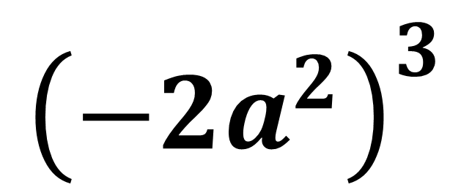
$${\left({−2a}^{2}\right)}^{3}$$

Slide 21
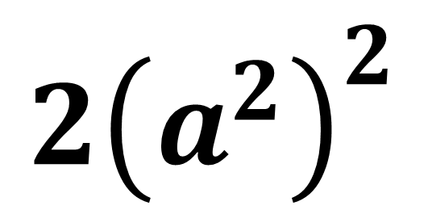
$${2\left(a^{2}\right)}^{2}$$

Slide 22
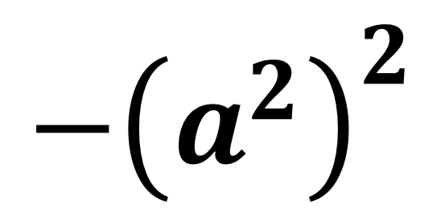
$${−\left(a^{2}\right)}^{2}$$

Slide 23
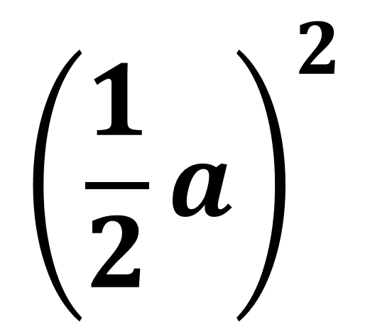
$${\left(\frac{1}{2}a\right)}^{2}$$

Slide 24
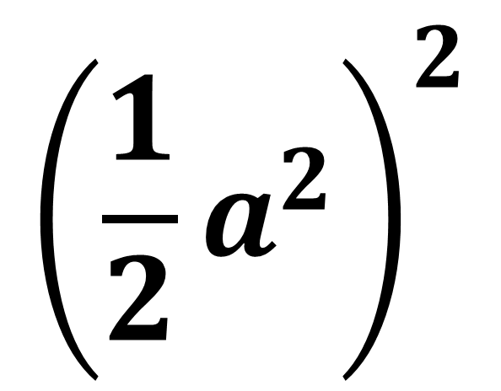
$${\left(\frac{1}{2}a^{2}\right)}^{2}$$

Slide 25
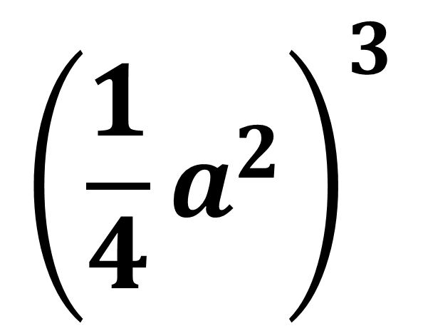
$${\left(\frac{1}{4}a^{2}\right)}^{3}$$

Slide 26


Power Law
Rewrite the following as powers of 2.
Example: $8^{2}={\left(2^{3}\right)}^{2}=2^{6}$
1. $4^{3}$
2. ${16}^{2}$
3. ${4×8}^{2}$
4. $2^{4}×4^{3}$
5. ${16}^{2}×{32}^{3}$
$={\left(2^{2}\right)}^{3}=2^{6}$
$={\left(2^{4}\right)}^{2}=2^{8}$
$={2^{2}×\left(2^{3}\right)}^{2}=2^{8}$
$=2^{4}×{\left(2^{2}\right)}^{3}=2^{10}$
$={\left(2^{4}\right)}^{2}×{\left(2^{5}\right)}^{3}=2^{23}$

Slide 27
Division Law
$\frac{a^{5}}{a^{3}}$
$=\frac{a×a×a×a×a}{a×a×a}$
$=a^{2}$
$$a^{m}÷a^{n}$$
$=a^{m−n}$
“The base is the same and we’re dividing the terms, so we subtract the indices”

Slide 28
Division Law
Task – Complete the Tarsia jigsaw by matching up the sides with corresponding questions and answers.
It will make a rectangle when finished!

Slide 29
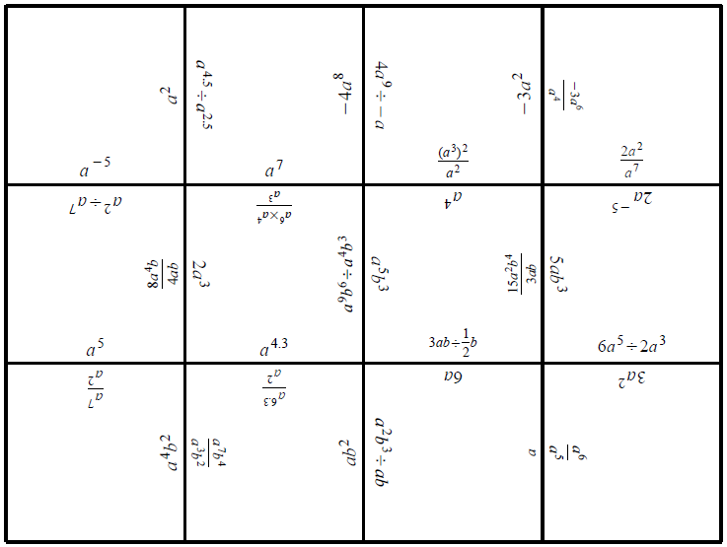
Division Law

Slide 30
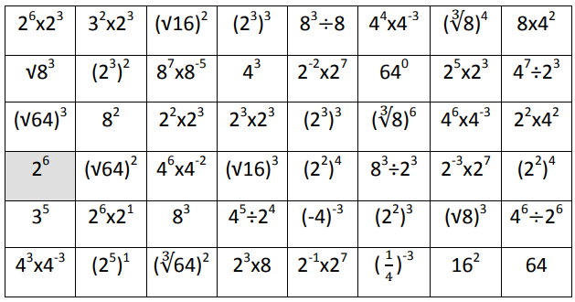
Task
Find the correct path through the maze. You can only move horizontally and vertically one square at a time.

Slide 31
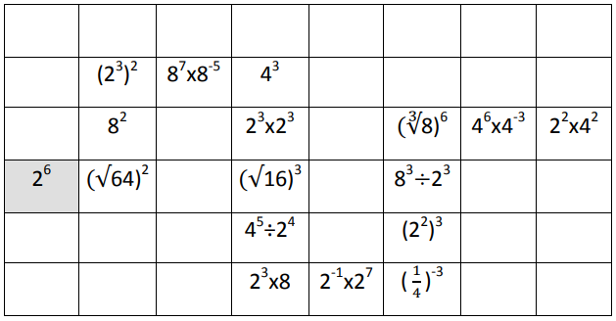
Solution

