Slide 1
Starter
Rearrange the formulae to make the variable in brackets the subject
T = 3k (k)
x = y – 1 (y)
Q = p (p)
3
A = 4r + 9 (r)
g = m (m)
v
t = m² (m)
C = 2πr (r)
P = 2t + 2w (t)
v = u + at (a)
k = 2p² (p)
g = e + 3f (f)
2
y = x + b (x)
a

Slide 2
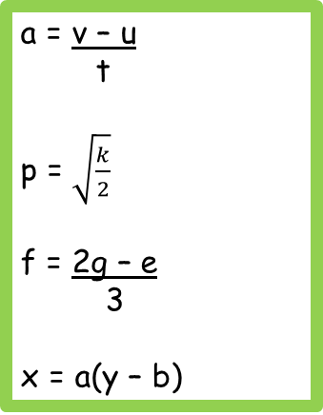
Answers
k = T
3
y = x + 1
p = 3Q
r = A – 9
4
m = gv
m = √t
r = _C_
2π
t = P – 2w
2
a = v – u
t
p = $\sqrt{\frac{k}{2}}$
f = 2g – e
3
x = a(y – b)

Slide 3
The graph of the inverse is the reflection of the graph in the line y = x

Slide 4
Match the graph of the function to the graph of its inverse.
A
B
C
D

Slide 5
Match the graph of the function to the graph of its inverse.
A
B
C
D

Slide 6
Match the graph of the function to the graph of its inverse.
A
B
C
D

Slide 7
Match the graph of the function to the graph of its inverse.
A
B
C
D

Slide 8
We find the inverse function by putting the original function equal to y and rearranging to make x the subject.
We use the notation f⁻¹(x) for the inverse function.
Function Inverse
f(x) = x + 4 “add 4” “subtract 4” f⁻¹(x) = x – 4
g(x) = 5x “times 5” “divide by 5” g⁻¹(x) = $\frac{x}{5}$
h(x) = 4x + 2 “times 4, add 2” “subtract 2, divide by 4” h⁻¹(x) = $\frac{x −2}{4}$

Slide 9
Find the inverse of the function f(x) = 2x² - 7
$y=2x^{2} −7$
$y+7=2x^{2}$
$\frac{y+7}{2}=x^{2}$
$\sqrt{\frac{y+ 7}{2}}=x$
Therefore f⁻¹(x) = $\sqrt{\frac{x+ 7}{2}}$
Let f(x) = y and rearrange to make x the subject

Slide 10
Find the inverse of the function f(x) = $\frac{3}{x −1}$
$y=\frac{3}{x −1}$
y(x – 1) = 3
xy - y = 3
xy = 3 + y
x = $\frac{3+y}{y}$
Therefore f⁻¹(x) = $\frac{3+x}{x}$
Let f(x) = y and rearrange to make x the subject

Slide 12
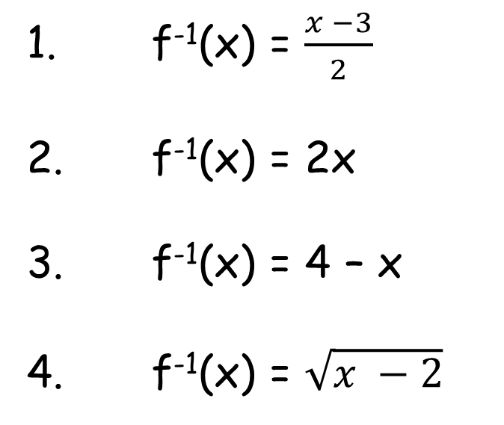
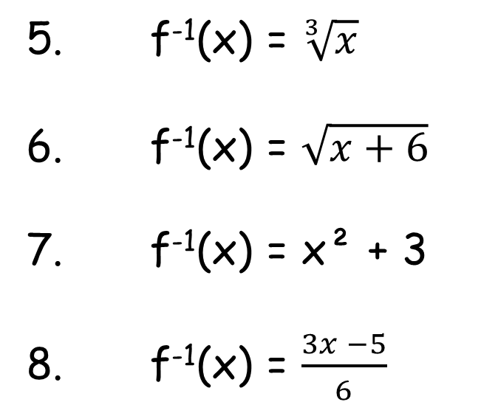
Answers
1. f⁻¹(x) = $\frac{x −3}{2}$
2. f⁻¹(x) = 2x
3. f⁻¹(x) = 4 – x
4. f⁻¹(x) = $\sqrt{x −2}$
5. f⁻¹(x) = $\sqrt[3]{x}$
6. f⁻¹(x) = $\sqrt{x+6}$
7. f⁻¹(x) = x² + 3
8. f⁻¹(x) = $\frac{3x −5}{6}$

Slide 13
Plenary
Guidance on the use of codes within this mark scheme
M1 – method mark for appropriate method in the context of the question A1 – accuracy mark B1 – Working mark C1 – communication mark QWC – quality of written communication oe – or equivalent cao – correct answer only ft – follow through sc – special case dep – dependent (on a previous mark or conclusion) indep – independent isw – ignore subsequent working
Work with a partner to create an exam style question on inverse functions.
Try to use the codes that would be used in a GCSE markscheme when you include your answers.
Once finished, fold in half so the markscheme is hidden, and swap with another pair.
Answer the new question with your partner then unfold the page to mark it using the markscheme.

