Slide 1
Starter
Write down all the features of a cube.
There may be some keywords below you could use to help you!

Slide 2
We can draw 2D representations of 3D shapes from two different angles:
This one has a front edge
This one has a front face
We can draw cubes from this angle on isometric paper (spotty triangle paper)
We can draw cubes from this angle on square paper (like you have in your books)

Slide 3
Draw a single cube on the isometric paper.
Make sure you have the paper this way with the dots going down, not across
Start by drawing just one face
Then complete the cube

Slide 4
Use the isometric paper to have a go at drawing one of these three shapes.

Slide 5
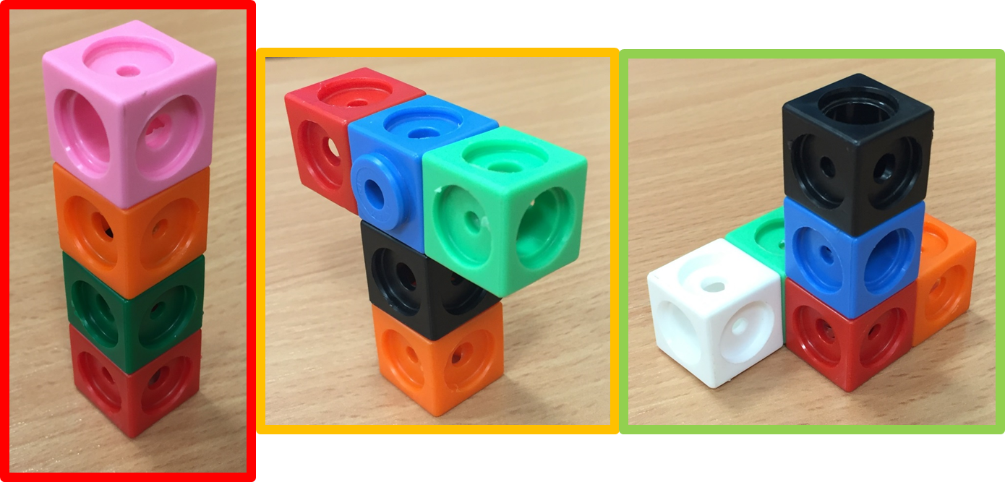

Slide 7
Plenary
Write 3 TOP TIPS that you need to remember when drawing 2D representations of 3D shapes

