Slide 1
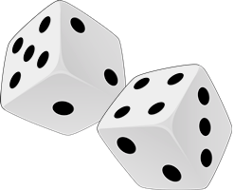
Starter
How many words can you find relating to probability?
1 - 4 Good
5 - 8 Ace
9 - 12 Awesome
13 + Superstar!

Slide 2
Impossible
Could
Likely
Poor
Even
Would
More
Definite
Probable
Good
Unlikely
May
Chance
Won’t
Never
Certain
Possible
Might
Improbable
Less

Slide 3
Task
Match the labels to the correct place on the probability scale
0 0.1 0.2 0.3 0.4 0.5 0.6 0.7 0.8 0.9 1
likely
unlikely
certain
impossible
even chance
100% chance
no chance
75% chance
50% chance
25% chance

Slide 4
Think – Pair – Share
Use the words to describe the probabilities of the events below:
You will celebrate your 10th birthday tomorrow.
Tomorrow you will have a cold.
It will rain tomorrow.
You will be struck by lightning tomorrow.
You will have something to drink tomorrow.
Sometime tomorrow you will watch television.
The next person you pass in the corridor will be male.
The sun will rise tomorrow morning.
Rolling the number six on a dice on one throw.
You will still be alive when you are 100.
Impossible?
?
Likely?
Unlikely?
Certain?
Likely?
Even chance?
Certain?
Unlikely?
Unlikely?

Slide 5
Sometimes words aren’t precise enough.
We’re mathematicians! How can we be more accurate when talking about probability?
We express probability as a number between 0 and 1.
The probability for an event which is IMPOSSIBLE is 0.
The probability for an event which is CERTAIN is 1.
Probability can be expressed as a fraction, a decimal or a percentage.

Slide 6
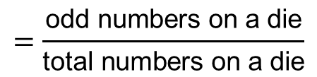
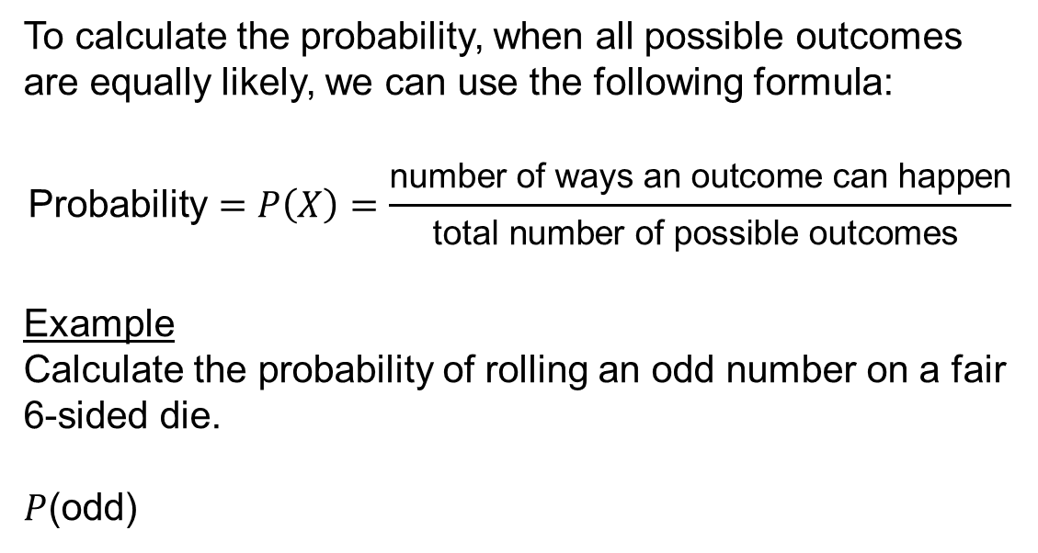

To calculate the probability, when all possible outcomes are equally likely, we can use the following formula:
$$\text{Probability}=P\left(X\right)=\frac{\text{number} \text{of} \text{ways} \text{an} \text{outcome} \text{can} \text{happen}}{\text{total} \text{number} \text{of} \text{possible} \text{outcomes} }$$
Example
Calculate the probability of rolling an odd number on a fair 6-sided die.
$P$(odd)
$$=\frac{\text{odd} \text{numbers} \text{on} \text{a} \text{die}}{\text{total} \text{numbers} \text{on} \text{a} \text{die}}$$
$$=\frac{3}{6}$$

Slide 7
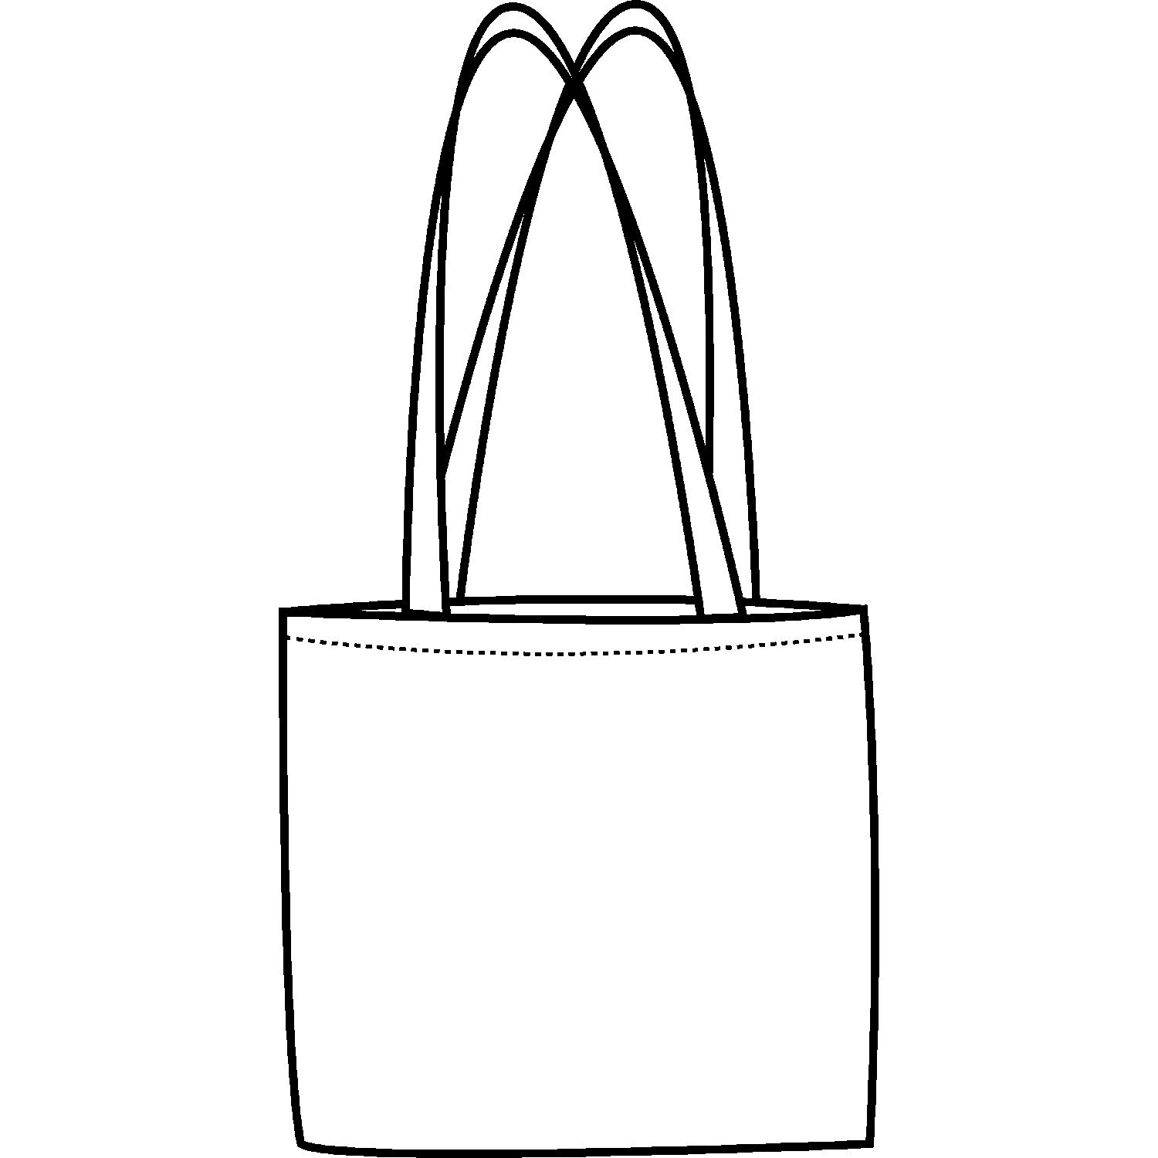
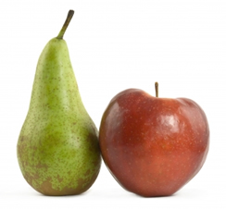
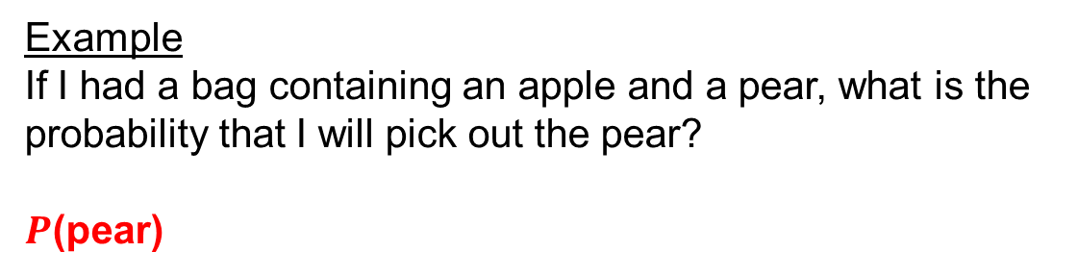

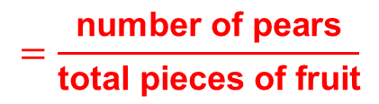
Example
If I had a bag containing an apple and a pear, what is the probability that I will pick out the pear?
$P$(pear)
$$=\frac{\text{number} \text{of} \text{pears}}{\text{tota}\text{l} \text{pieces} \text{of} \text{fruit}}$$
$$=\frac{1}{2}$$

Slide 8

Example
A box contains 3 bags of salt and vinegar crisps, 4 bags of cheese and onion crisps and 2 bags of beef crisps. One of these bags of crisps is taken from the box at random.
Work out the probability that the bag of crisps will be:
a) salt and vinegar
b) cheese and onion
c) beef
$\frac{3}{9}$
$\frac{4}{9}$
$\frac{2}{9}$

Slide 9
Task – Copy and complete
Event | Number of ways of achieving success | Number of possible outcomes | Probability
Throwing a 2
Throwing a 5
Throwing an odd number
Throwing more than 3
Throwing less than 5
Throwing 2 or more
Throwing a 7
Throwing an even number
Throwing less than 7

Slide 10
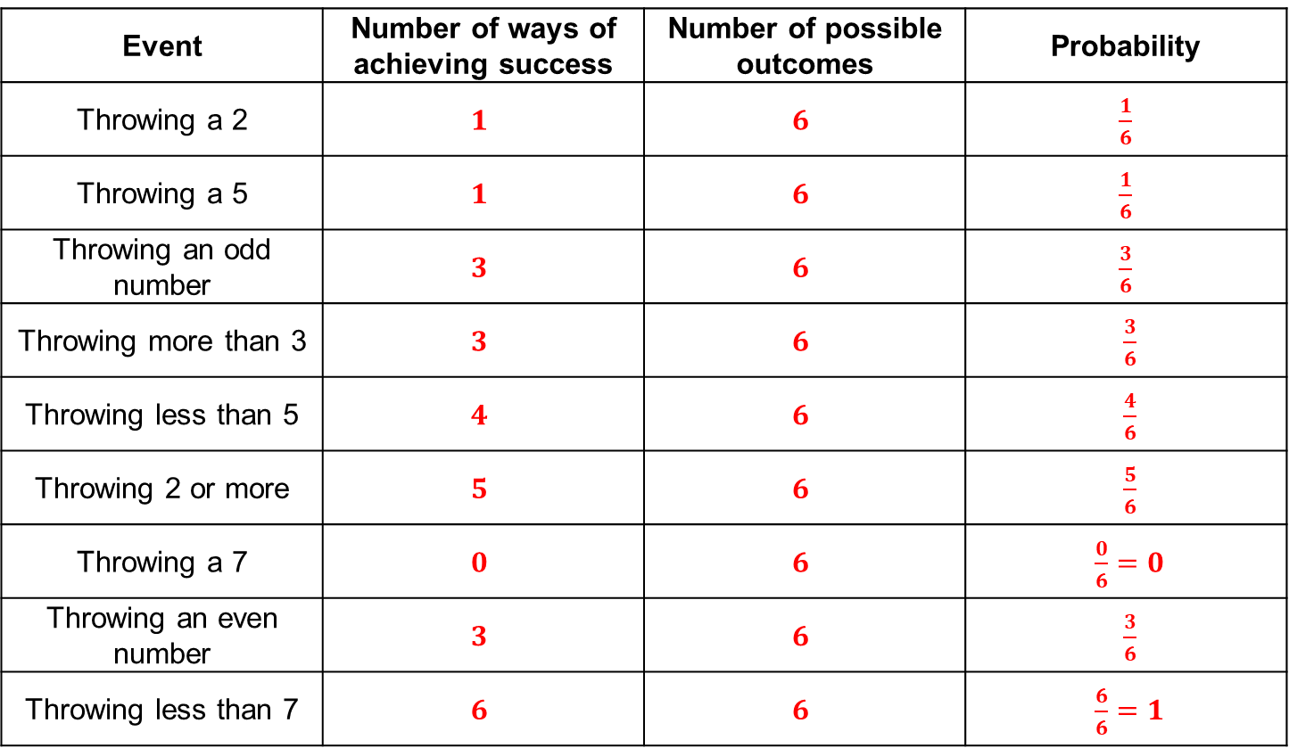
Answers
Event | Number of ways of achieving success | Number of possible outcomes | Probability
Throwing a 2 | $$1$$ | $$6$$ | $\frac{1}{6}$
Throwing a 5 | $$1$$ | $$6$$ | $\frac{1}{6}$
Throwing an odd number | $$3$$ | $$6$$ | $\frac{3}{6}$
Throwing more than 3 | $$3$$ | $$6$$ | $\frac{3}{6}$
Throwing less than 5 | $$4$$ | $$6$$ | $\frac{4}{6}$
Throwing 2 or more | $$5$$ | $$6$$ | $\frac{5}{6}$
Throwing a 7 | $$0$$ | $$6$$ | $\frac{0}{6}=0$
Throwing an even number | $$3$$ | $$6$$ | $\frac{3}{6}$
Throwing less than 7 | $$6$$ | $$6$$ | $\frac{6}{6}=1$

Slide 11
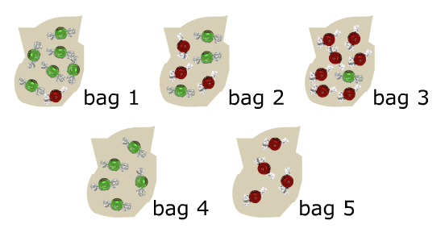
It is impossible that Ethan will take a red sweet from…
Bag 4
Bag 2
Bag 5
Bag 1
A
B
C
D

Slide 12
It is impossible that Ethan will take a red sweet from…
Bag 4
Bag 2
Bag 5
Bag 1
A
B
C
D

Slide 13
It is unlikely that Ethan will take a red sweet from…
Bag 4
Bag 2
Bag 5
Bag 1
A
B
C
D

Slide 14
It is unlikely that Ethan will take a red sweet from…
Bag 4
Bag 2
Bag 5
Bag 1
A
B
C
D

Slide 15
It is even chance that Ethan will take a red sweet from…
Bag 4
Bag 2
Bag 5
Bag 1
A
B
C
D

Slide 16
It is even chance that Ethan will take a red sweet from…
Bag 4
Bag 2
Bag 5
Bag 1
A
B
C
D

Slide 17
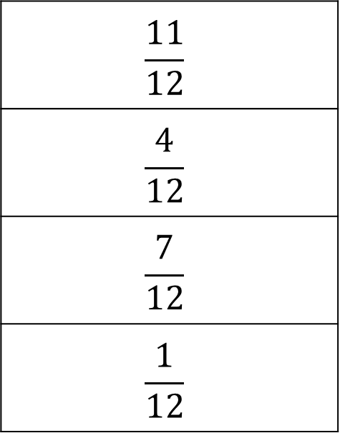
What is the probability of choosing a red counter from this bag?
$$\frac{11}{12}$$
$$\frac{4}{12}$$
$$\frac{7}{12}$$
$$\frac{1}{12}$$
A
B
C
D

Slide 18
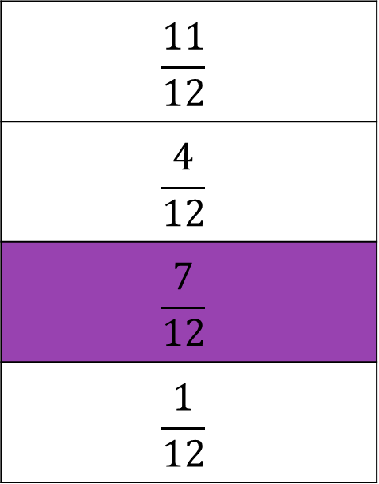
What is the probability of choosing a red counter from this bag?
$$\frac{11}{12}$$
$$\frac{4}{12}$$
$$\frac{7}{12}$$
$$\frac{1}{12}$$
A
B
C
D

Slide 19
What is the probability of choosing a yellow counter from this bag?
$$\frac{11}{12}$$
$$\frac{4}{12}$$
$$\frac{7}{12}$$
$$\frac{1}{12}$$
A
B
C
D

Slide 20
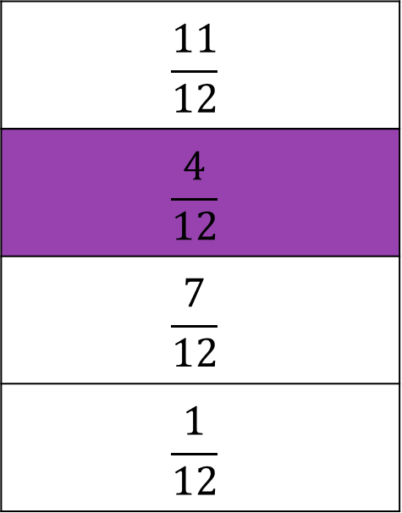
What is the probability of choosing a yellow counter from this bag?
$$\frac{11}{12}$$
$$\frac{4}{12}$$
$$\frac{7}{12}$$
$$\frac{1}{12}$$
A
B
C
D

Slide 21
What is the probability of not choosing a green counter from this bag?
$$\frac{11}{12}$$
$$\frac{4}{12}$$
$$\frac{7}{12}$$
$$\frac{1}{12}$$
A
B
C
D

Slide 22
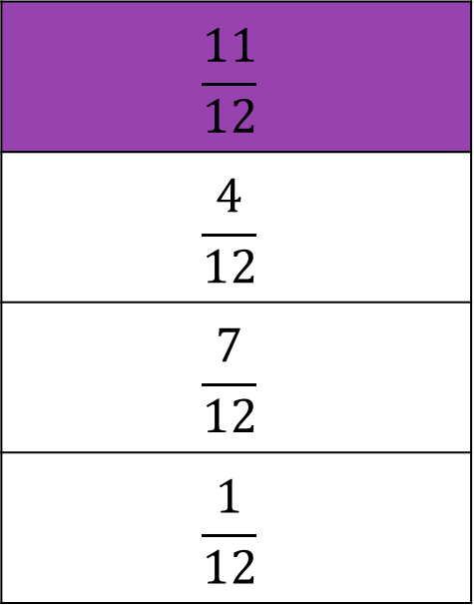
What is the probability of not choosing a green counter from this bag?
$$\frac{11}{12}$$
$$\frac{4}{12}$$
$$\frac{7}{12}$$
$$\frac{1}{12}$$
A
B
C
D

Slide 23
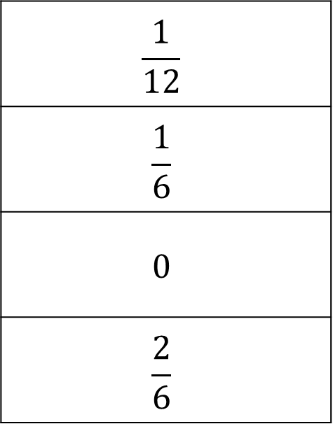
What is the probability of this spinner landing on pink?
$$\frac{1}{12}$$
$$\frac{1}{6}$$
$$0$$
$$\frac{2}{6}$$
A
B
C
D

Slide 24
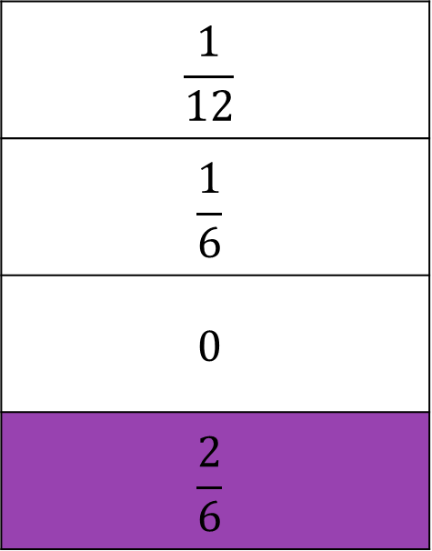
What is the probability of this spinner landing on pink?
$$\frac{1}{12}$$
$$\frac{1}{6}$$
$$0$$
$$\frac{2}{6}$$
A
B
C
D

Slide 25
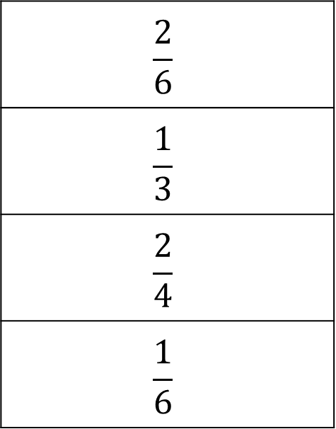
What is the probability of this spinner landing on yellow?
$$\frac{2}{6}$$
$$\frac{1}{3}$$
$$\frac{2}{4}$$
$$\frac{1}{6}$$
A
B
C
D

Slide 26
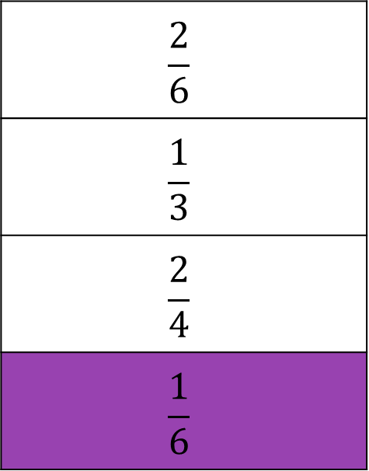
What is the probability of this spinner landing on yellow?
$$\frac{2}{6}$$
$$\frac{1}{3}$$
$$\frac{2}{4}$$
$$\frac{1}{6}$$
A
B
C
D

Slide 27
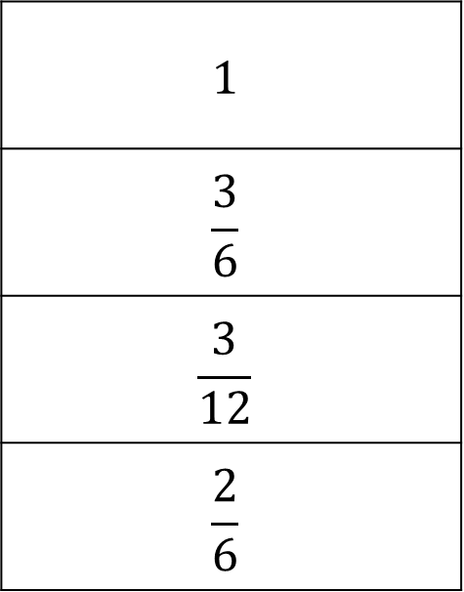
What is the probability of this spinner landing on blue?
$$1$$
$$\frac{3}{6}$$
$$\frac{3}{12}$$
$$\frac{2}{6}$$
A
B
C
D

Slide 28
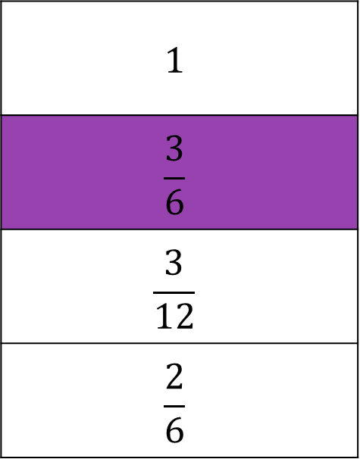
What is the probability of this spinner landing on blue?
$$1$$
$$\frac{3}{6}$$
$$\frac{3}{12}$$
$$\frac{2}{6}$$
A
B
C
D

Slide 29
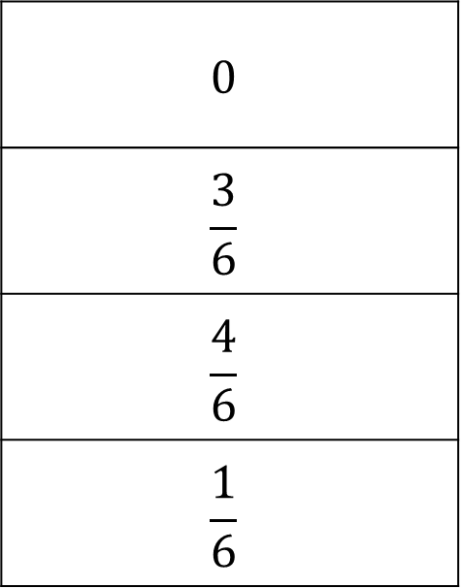
What is the probability of this spinner NOT landing on pink?
$$0$$
$$\frac{3}{6}$$
$$\frac{4}{6}$$
$$\frac{1}{6}$$
A
B
C
D

Slide 30
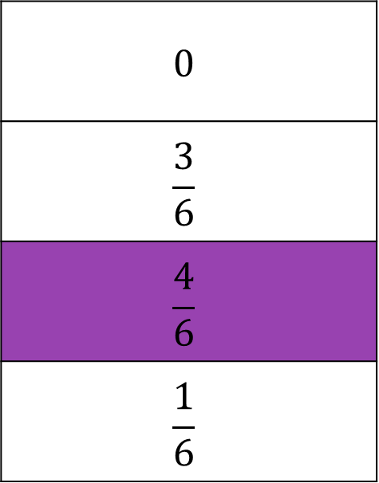
What is the probability of this spinner NOT landing on pink?
$$0$$
$$\frac{3}{6}$$
$$\frac{4}{6}$$
$$\frac{1}{6}$$
A
B
C
D

Slide 31
Mutually Exclusive Events
Mutually exclusive means “can’t happen at the same time”.
Examples
Turning left or turning right.
Going to Liverpool at 9am tomorrow, or going to Manchester at 9am tomorrow.
(You cannot turn left and right at the same time, or be in two places at once!)

Slide 32
Mutually Exclusive Events
Mutually exclusive means “can’t happen at the same time”.
Non-Examples
Turning left and scratching your head can happen at the same time.
Kings and Hearts, because you can have a King of Hearts.

Slide 33


Think – Pair – Share
Are the following pairs of statements mutually exclusive?
1) Winning a football match AND losing the same football match
2) Getting the bus AND missing the same bus
3) Watching a comedy DVD AND watching a romance DVD
4) Rolling a 2 on a dice AND rolling a number less than 3
5) Choosing a spade AND choosing a King

Slide 34
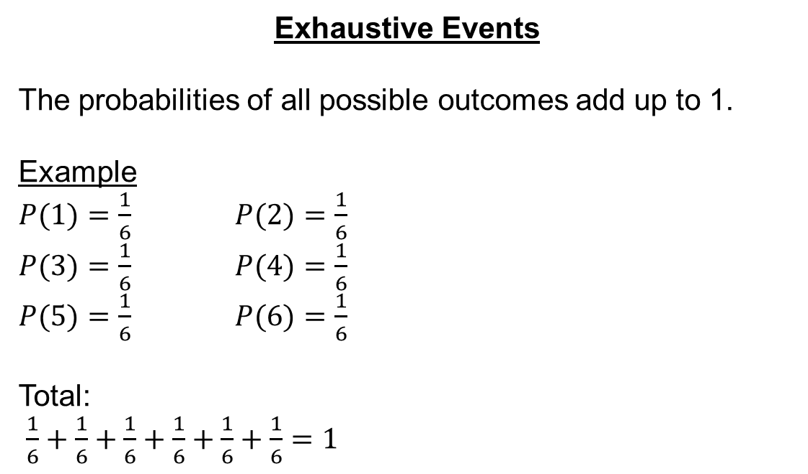
Exhaustive Events
The probabilities of all possible outcomes add up to 1.
Example
$P(1)=\frac{1}{6}$ $P(2)=\frac{1}{6}$
$P(3)=\frac{1}{6}$ $P(4)=\frac{1}{6}$
$P(5)=\frac{1}{6}$ $P(6)=\frac{1}{6}$
Total:
$\frac{1}{6}+\frac{1}{6}+\frac{1}{6}+\frac{1}{6}+\frac{1}{6}+\frac{1}{6}=1$

Slide 35
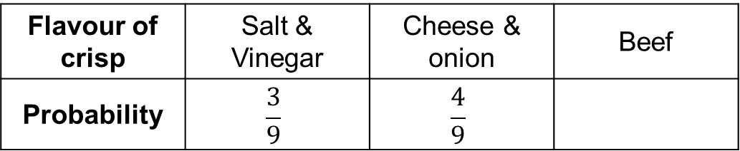
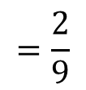
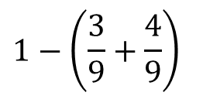
Example
A box contains 3 bags of salt and vinegar crisps, 4 bags of cheese and onion crisps and 2 bags of beef crisps. One of these bags of crisps is taken from the box at random. What is the probability they are beef?
Flavour of crisp | Salt & Vinegar | Cheese & onion | Beef
Probability | $$\frac{3}{9}$$ | $$\frac{4}{9}$$
$$1−\left(\frac{3}{9}+\frac{4}{9}\right)$$
$$=\frac{2}{9}$$

Slide 36


Example
In a survey during walk to school week, all the pupils at Winsford Academy either cycle, walk, come by bus or still come in a car. The probabilities they travel each way are below. What’s the probability they come by bus?
Method of Travel | Cycle | Walk | Bus | Car
Probability | 0.36 | 0.52 |  | 0.06
$P$(bus) $=1−(0.36+0.52+0.06)$
$$=0.06$$

Slide 38

Answers
Question 1
a) $\frac{7}{10}$ e) $2\%$
b) $\frac{3}{4}$ f) $44.5\%$
c) $0.79$ g) $\frac{3}{5}$
d) $75\%$ h) $\frac{3}{15}$
Question 2
a) $0.1$ b) $4\%$ c) $\frac{7}{20}$
Question 3
a) $\frac{3}{8}$ b) $\frac{1}{8}$
c)i.  ii. 
iii.  iv. 

Slide 39
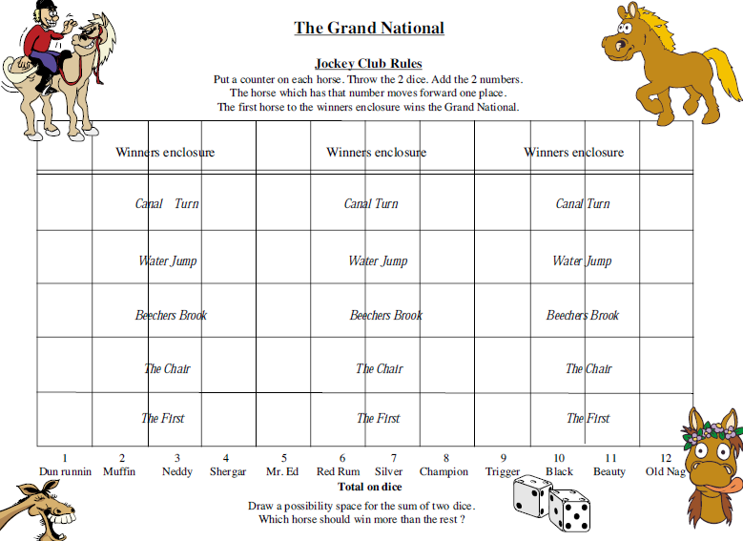
Notes:
10 ticks Grand National resource

Slide 40
Grand National Game
Which horse is most likely to win? Why?
Are there any horses that definitely won’t win? How do you know?
Play with the person next to you to test your hypothesis!

Slide 41


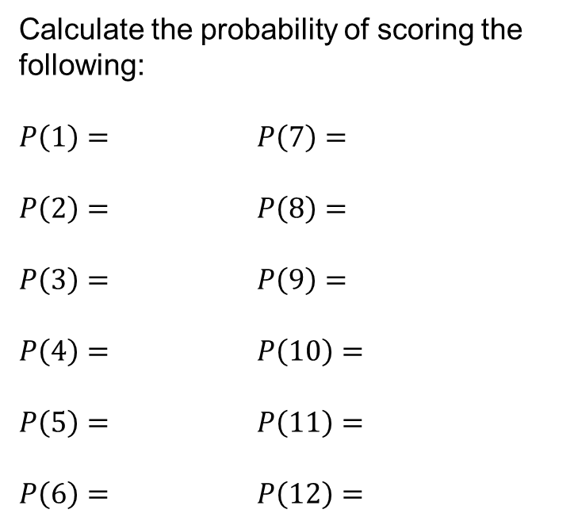











Sample Space Diagrams
Draw a sample space diagram to show all the possible outcomes when two dice are thrown and their scores added together.
$$+$$
Calculate the probability of scoring the following:
$P\left(1\right)=$ $P\left(7\right)=$
$P\left(2\right)=$ $P\left(8\right)=$
$P\left(3\right)=$ $P\left(9\right)=$
$P\left(4\right)=$ $P\left(10\right)=$
$P\left(5\right)=$ $P\left(11\right)=$
$P\left(6\right)=$ $P\left(12\right)=$
2
3
4
5
6
7
$$\frac{6}{36}$$
$$0$$
3
4
5
6
7
8
$$\frac{1}{36}$$
$$\frac{5}{36}$$
4
5
6
7
8
9
$$\frac{2}{36}$$
$$\frac{4}{36}$$
5
6
7
8
9
10
$$\frac{3}{36}$$
$$\frac{3}{36}$$
6
7
8
9
10
11
$$\frac{4}{36}$$
$$\frac{2}{36}$$
7
8
9
10
11
12
$$\frac{5}{36}$$
$$\frac{1}{36}$$

Slide 43

Answers
Question 1
a) $\frac{3}{16}$ b) $\frac{2}{16}$ c) $\frac{4}{16}$ d) $\frac{4}{16}$
Question 2
a) $\frac{8}{36}$ b) $0$ c) $\frac{4}{36}$ d) $\frac{24}{36}$
Question 3
a) $\frac{15}{25}$ b) $\frac{3}{25}$ c) $\frac{10}{25}$ d) $\frac{7}{25}$ e) $\frac{4}{25}$
Question 4
a) $\frac{2}{24}$ b) $\frac{6}{24}$ c) $\frac{7}{24}$ d) $\frac{1}{24}$ e) $\frac{5}{24}$

