Slide 1
Starter What is a circle?
You have 3 minutes to jot down everything important about a circle.
Can you create a definition with the person you’re sitting next to?
A circle is a 2-dimensional shape which is bounded by a continuous line which is always the same distance from the centre.

Slide 2
Centre

Slide 3
Circumference

Slide 4
Radius

Slide 5
Diameter

Slide 6
Task
Draw the centre, circumference, radius and diameter onto the three circle.
Use a different colour for each part and make sure you fill in the key.

Slide 7
Arc

Slide 8
Chord

Slide 9
Tangent

Slide 10
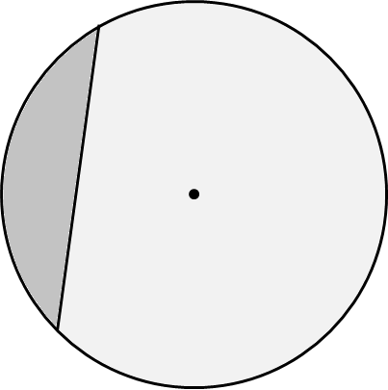
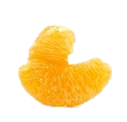
Segment

Slide 11
Sector

Slide 12
Parts of a Circle Bingo!
Pick 9 of the following words or phrases:
Diameter | Minor segment | Circumference | Tangent
Minor sector | Centre | Semi-circle | Radius
Arc | Major segment | Chord | Major sector

Slide 18
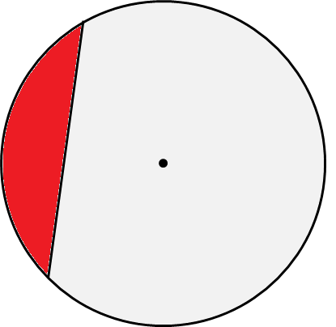

Slide 24
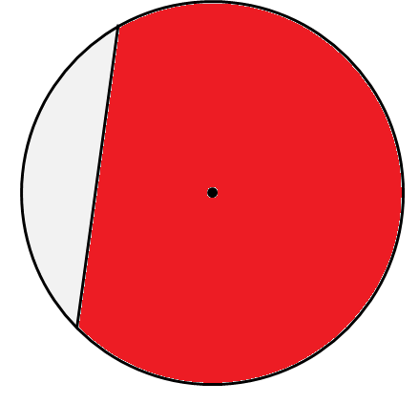

Slide 25
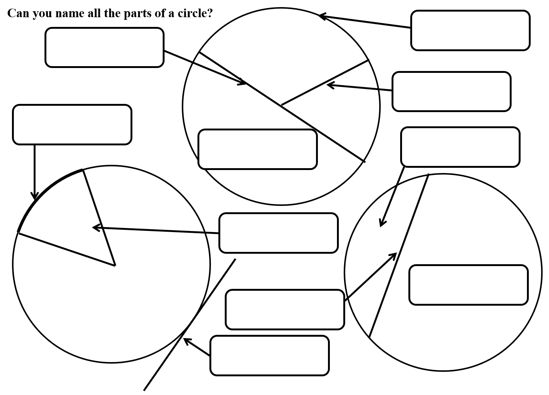
Task
Cut out the names of the parts of a circle and stick them in the correct box on the diagram.
Extension: Can you write a definition for each of these words and phrases?

Slide 26
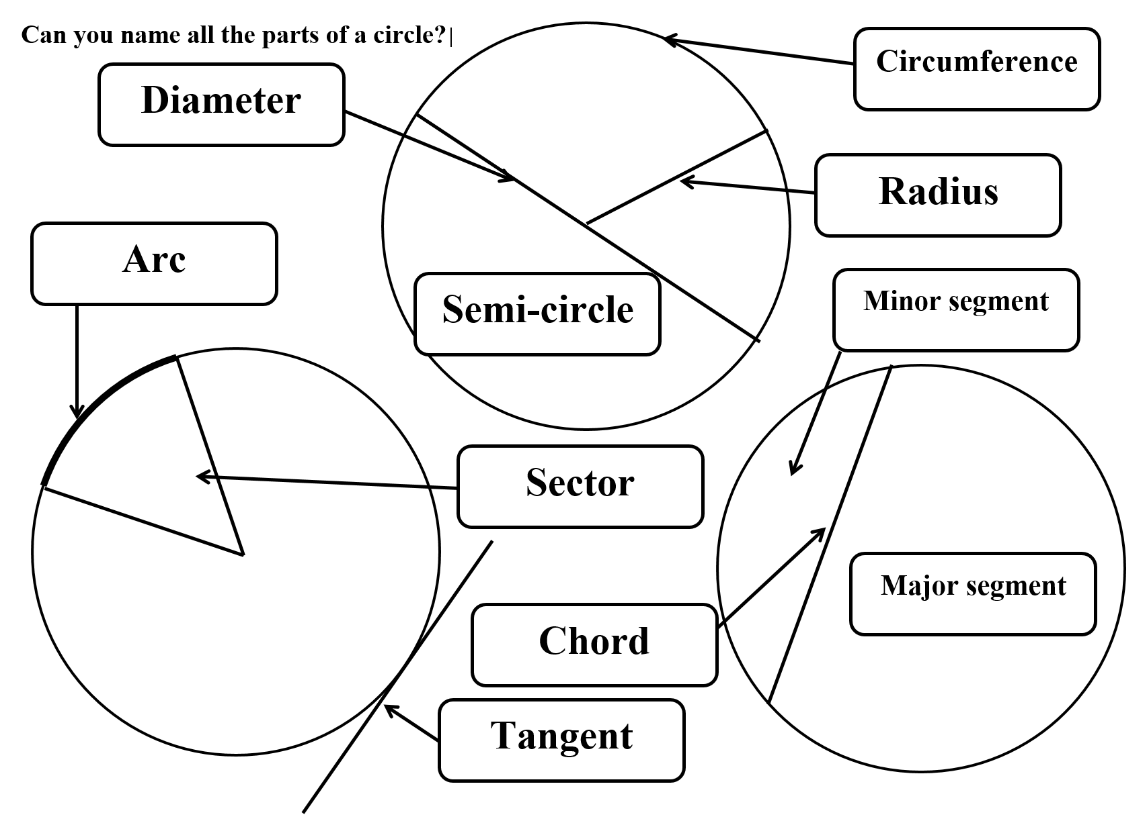
Answers

