Slide 1
Jason hired a van.
The company charges £90 per day plus the cost of the fuel used.
The van can travel 6 miles for each litre of fuel used.
Fuel costs 113.9p per litre.
On Monday, Jason hired the van and drove from London to Cardiff.
On Tuesday, Jason drove from Cardiff to Edinburgh.
On Wednesday, Jason drove from Edinburgh back to London and returned the van.
Jason was using the van for a job where he is to get paid £600.
Will Jason make a profit or a loss?
(8 marks)
Step 2
Step 3

Slide 2
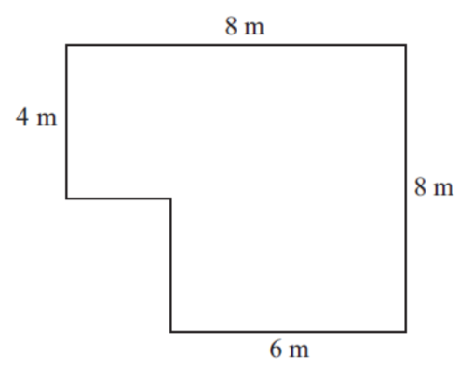
The diagram is a plan of the floor of Nikola’s room.
All the angles are right angles.
Nikola is going to lay flooring to cover all the floor.
She can choose either carpet tiles or wood strips.
Carpet tiles come in packs of 32 and are square. They measure 50 cm by 50 cm.
Wood strips come in packs of 10 and are rectangular. They measure 2 m by 25 cm.
She only wants to use one type of flooring and buy as few packs as she can.
Which type of flooring should she use?
(6 marks)
Step 2
Step 3

