Slide 1
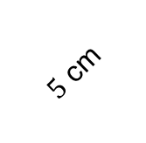
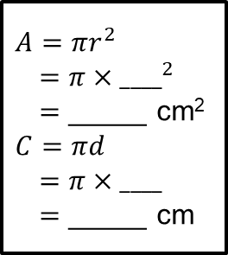
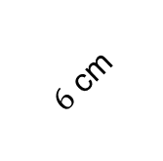
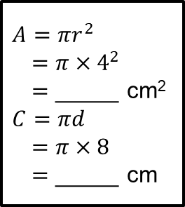
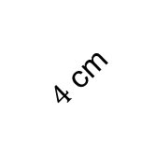
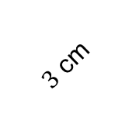
Starter – Option 1
Calculate the area and circumference of the following circles.
Give your answers correct to 2 decimal places.
$A=πr^{2}$
$=π{×4}^{2}$
$=$ _____ cm²
$C=πd$
$=π×8$
$=$ _____ cm
$A=πr^{2}$
$=π{×____}^{2}$
$=$ _____ cm²
$C=πd$
$=π×____$
$=$ _____ cm
$4$ cm
$5$ cm
$A=πr^{2}$
$=π{×____}^{2}$
$=$ _____ cm²
$C=πd$
$=π×____$
$=$ _____ cm
$A=πr^{2}$
$=π{×____}^{2}$
$=$ _____ cm²
$C=πd$
$=π×____$
$=$ _____ cm
$6$ cm
$3$ cm

Slide 2
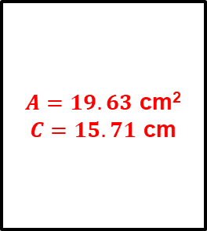
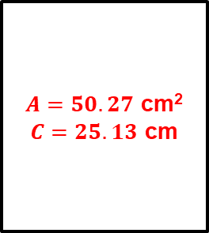
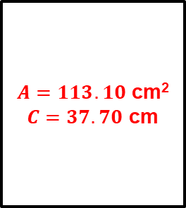
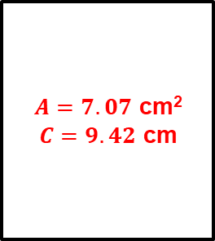
Answers
$A=50.27$ cm²
$C=25.13$ cm
$A=19.63$ cm²
$C=15.71$ cm
$4$ cm
$5$ cm
$A=7.07$ cm²
$C=9.42$ cm
$A=113.10$ cm²
$C=37.70$ cm
$6$ cm
$3$ cm

Slide 3
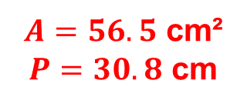
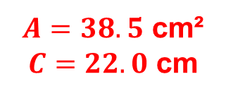
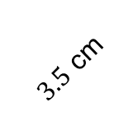
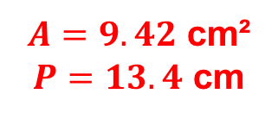
Starter – Option 1
Calculate the area and circumference/perimeter of the following shapes. Give your answers correct to 3 significant figures.
$3.5$ cm
$2$ cm
$12$ cm
$A=38.5$ cm²
$C=22.0$ cm
$A=56.5$ cm²
$P=30.8$ cm
$A=9.42$ cm²
$P=13.4$ cm

Slide 4
Think – Pair – Share
How would you calculate the area of this sector?
$6$ cm
$\frac{1}{4}$ of the area of the whole circle

Slide 5
Think – Pair – Share
How would you calculate the area of this sector?
$8$ cm
$$60°$$
$\frac{1}{6}$ of the area of the whole circle

Slide 6
Think – Pair – Share
How would you calculate the area of this sector?
$$53°$$
$4$ cm
$\frac{53}{360}$ of the area of the whole circle

Slide 7
Example
Calculate the area of this sector and the length of its arc. Give your answers correct to $2$ decimal places.
Area $=\frac{53}{360}×π×4^{2}$
$=7.40$ cm²
Length $=$ $\frac{53}{360}×π×8$
$=3.70$ cm
$$53°$$
$4$ cm

Slide 8
Example
Calculate the area of this sector and the length of its arc. Give your answers correct to $2$ decimal places.
Area $=\frac{237}{360}×π×{6.2}^{2}$
$=79.50$ cm²
Length $=$ $\frac{237}{360}×π×12.4$
$=25.65$ cm
$6.2$ m
$$237°$$

Slide 9
$$r$$
Area of sector $=\frac{θ}{360}×π×r^{2}$
$θ°$
Length of arc $=\frac{θ}{360}×π×d$

Slide 10
Checkpoint – Your Turn!
Calculate the area of this sector and the length of its arc. Give your answers correct to $2$ decimal places.
Area $=\frac{26}{360}×π×{6.5}^{2}$
$=9.59$ cm²
Length $=$ $\frac{26}{360}×π×13$
$=2.95$ cm
$$26°$$
$6.5$ m

Slide 11
Example
The length of the arc on this sector is $2.54$ cm. Calculate the angle at the centre. Give your answer correct to $1$ decimal place.
$L=\frac{θ}{360}×π×d$
$2.54=\frac{θ}{360}×π×6.4$
$÷π,÷6.4$ $÷π,÷6.4$
$0.126…=\frac{θ}{360}$
$×360$ $×360$
$45.5=θ$
$2.54$ cm
$3.2$ cm

Slide 12
Example
The area of this sector is $78.6$ mm². Calculate the angle at the centre. Give your answer correct to $1$ decimal place.
$A=\frac{θ}{360}×π×r^{2}$
$78.6=\frac{θ}{360}×π×7^{2}$
$÷π,÷7^{2}$ $÷π,÷7^{2}$
$0. 510…=\frac{θ}{360}$
$×360$ $×360$
$183.8=θ$
$7$ mm
$78.6$ mm²

Slide 14
Extension
£20.97
$$105°$$
$1.85$ m
The diagram shows a pond. The pond is in the shape of a sector of a circle. Craig is going to put edging on the perimeter of the pond. Edging is sold in lengths of 2.5 metres. Each length of edging costs £6.99. Work out the total cost of edging Craig needs to buy.

Slide 15
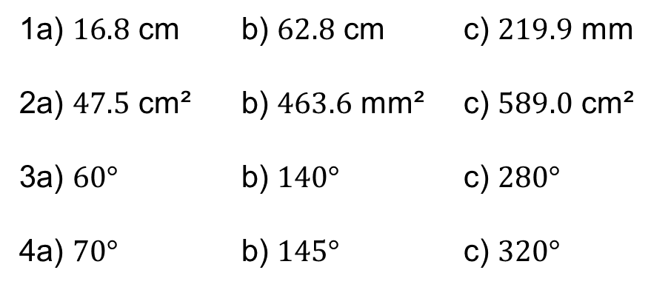
Answers
1a) $16.8$ cm b) $62.8$ cm c) $219.9$ mm
2a) $47.5$ cm² b) $463.6$ mm² c) $589.0$ cm²
3a) $60°$ b) $140°$ c) $280°$
4a) $70°$ b) $145°$ c) $320°$

Slide 16
Plenary
Complete the exit ticket and place it on my desk ☺

