Slide 1
Starter
How many special sequences can you think of? (ie. sequences with special names)
Example: triangular numbers

Slide 2
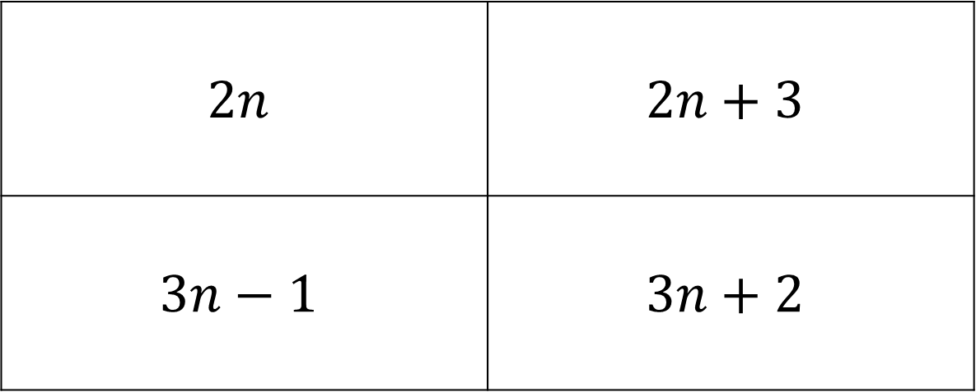
What is the $n^{th}$ term of
2, 5, 8, 11, 14…
$$2n$$ | $$2n+3$$
$$3n−1$$ | $$3n+2$$
A
B
C
D

Slide 3
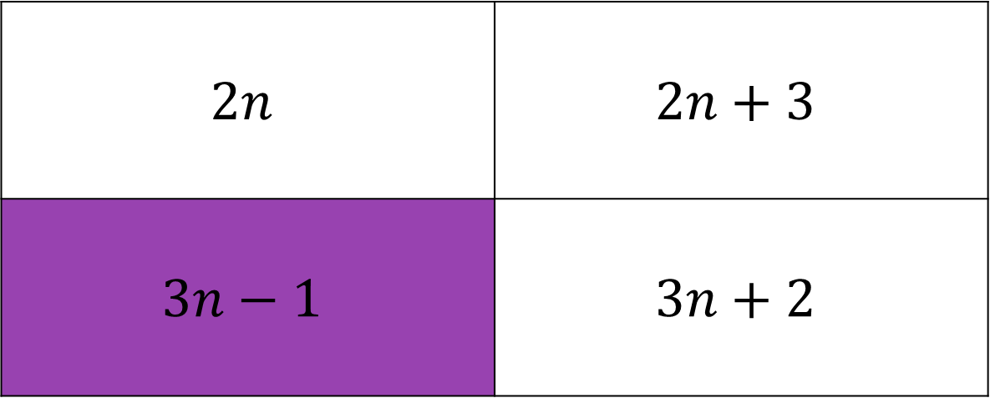
What is the $n^{th}$ term of
2, 5, 8, 11, 14…
$$2n$$ | $$2n+3$$
$$3n−1$$ | $$3n+2$$
A
B
C
D

Slide 4
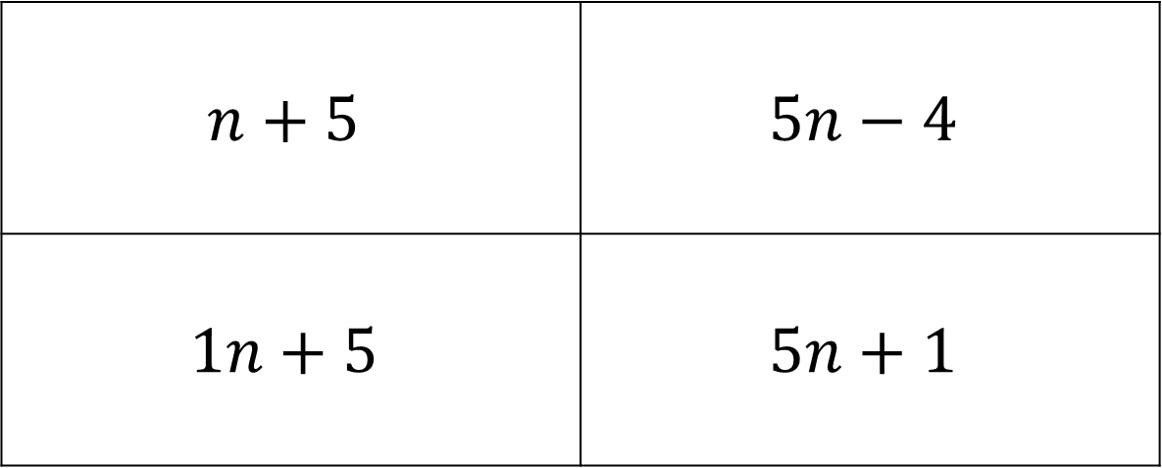
What is the $n^{th}$ term of
1, 6, 11, 16, 21…
$$n+5$$ | $$5n−4$$
$$1n+5$$ | $$5n+1$$
A
B
C
D

Slide 5
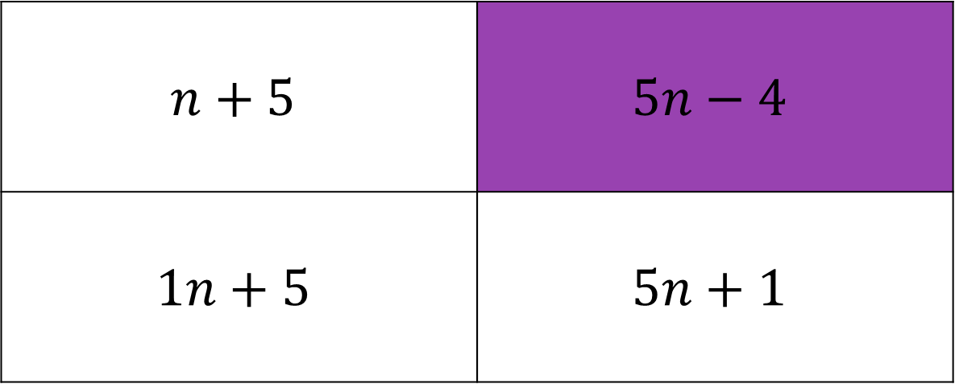
What is the $n^{th}$ term of
1, 6, 11, 16, 21…
$$n+5$$ | $$5n−4$$
$$1n+5$$ | $$5n+1$$
A
B
C
D

Slide 6
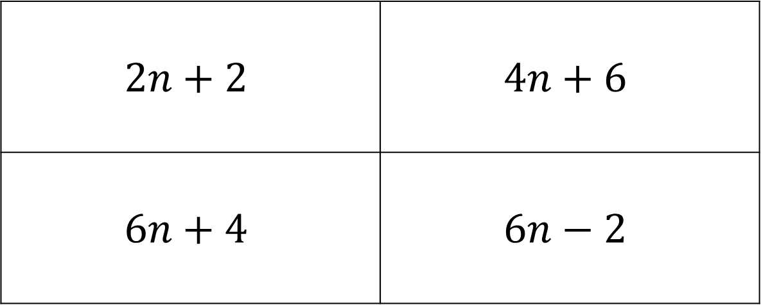
What is the $n^{th}$ term of
4, 10, 16, 22, 28…
$$2n+2$$ | $$4n+6$$
$$6n+4$$ | $$6n−2$$
A
B
C
D

Slide 7
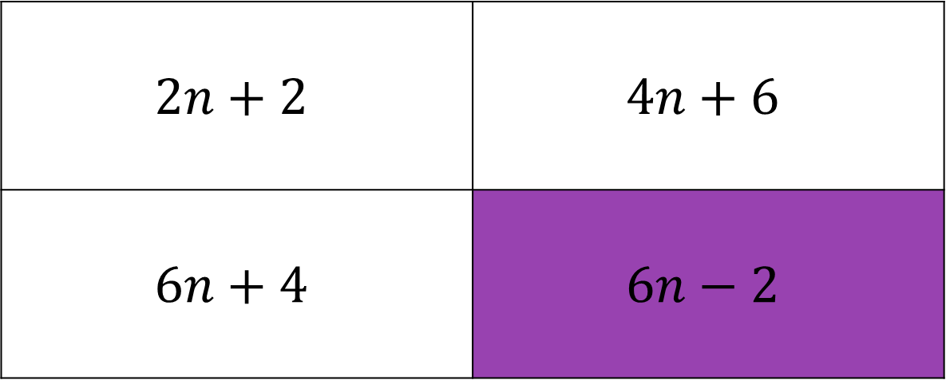
What is the $n^{th}$ term of
4, 10, 16, 22, 28…
$$2n+2$$ | $$4n+6$$
$$6n+4$$ | $$6n−2$$
A
B
C
D

Slide 8
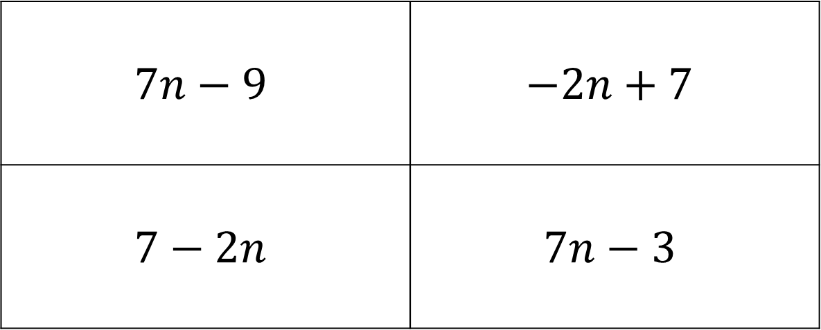
What is the $n^{th}$ term of
-2, 5, 12, 19, 26…
$$7n−9$$ | $$−2n+7$$
$$7−2n$$ | $$7n−3$$
A
B
C
D

Slide 9
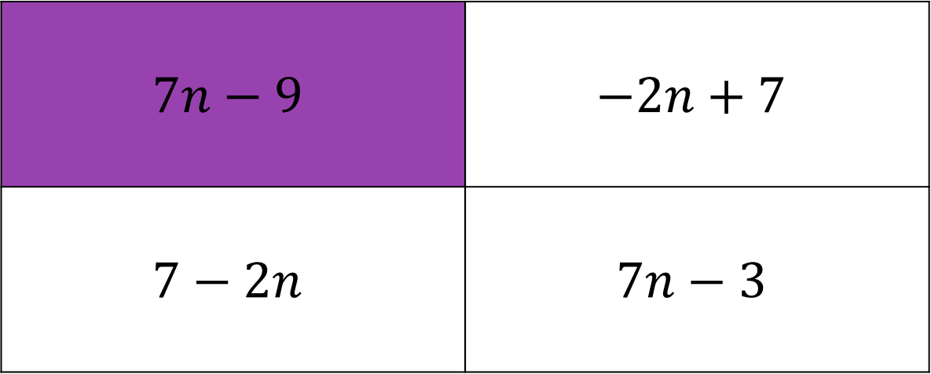
What is the $n^{th}$ term of
-2, 5, 12, 19, 26…
$$7n−9$$ | $$−2n+7$$
$$7−2n$$ | $$7n−3$$
A
B
C
D

Slide 10
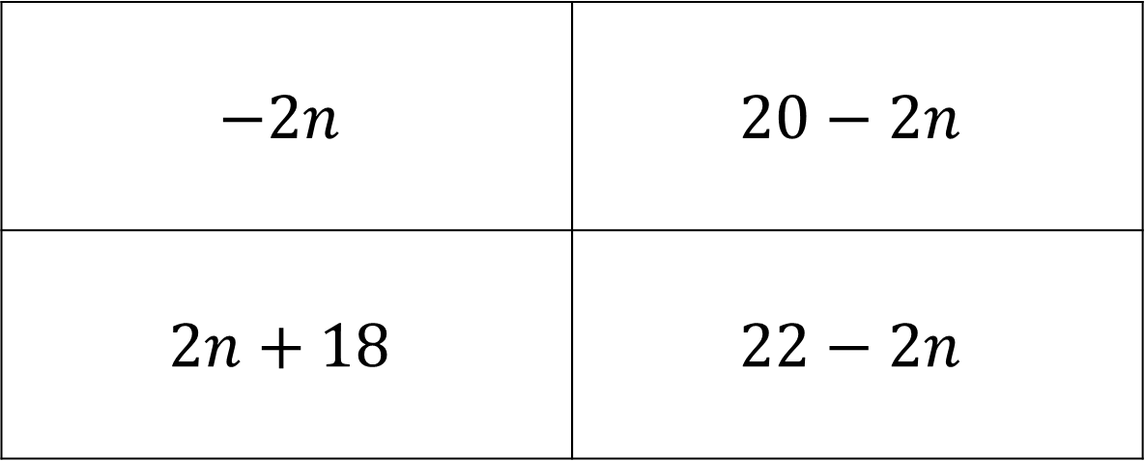
What is the $n^{th}$ term of
20, 18, 16, 14, 12…
$$−2n$$ | $$20−2n$$
$$2n+18$$ | $$22−2n$$
A
B
C
D

Slide 11
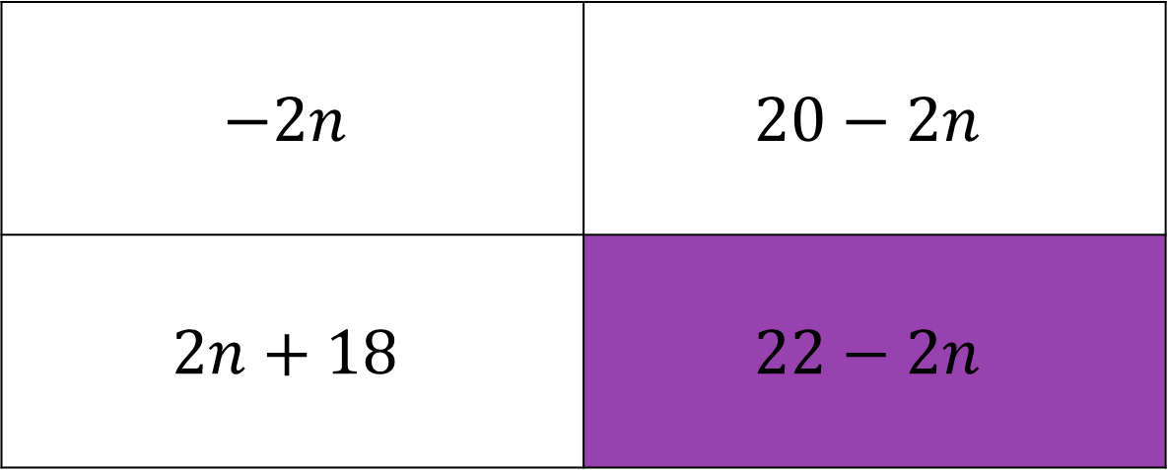
What is the $n^{th}$ term of
20, 18, 16, 14, 12…
$$−2n$$ | $$20−2n$$
$$2n+18$$ | $$22−2n$$
A
B
C
D

Slide 12
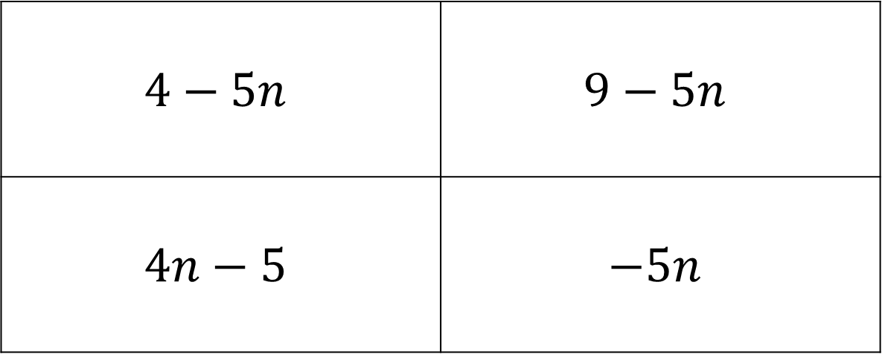
What is the $n^{th}$ term of
4, -1, -6, -11, -16…
$$4−5n$$ | $$9−5n$$
$$4n−5$$ | $$−5n$$
A
B
C
D

Slide 13
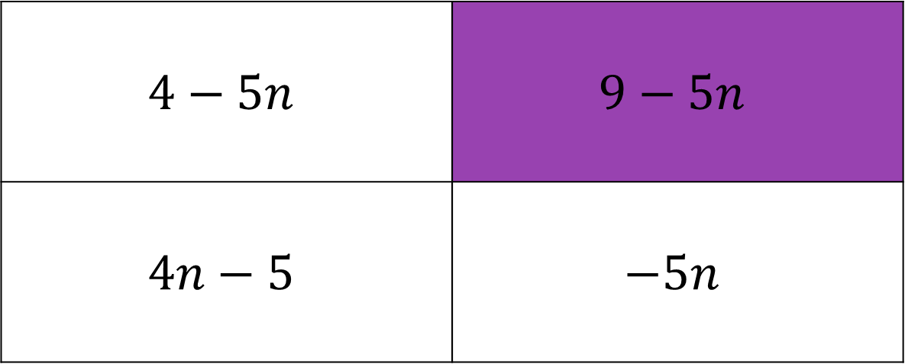
What is the $n^{th}$ term of
4, -1, -6, -11, -16…
$$4−5n$$ | $$9−5n$$
$$4n−5$$ | $$−5n$$
A
B
C
D

Slide 14
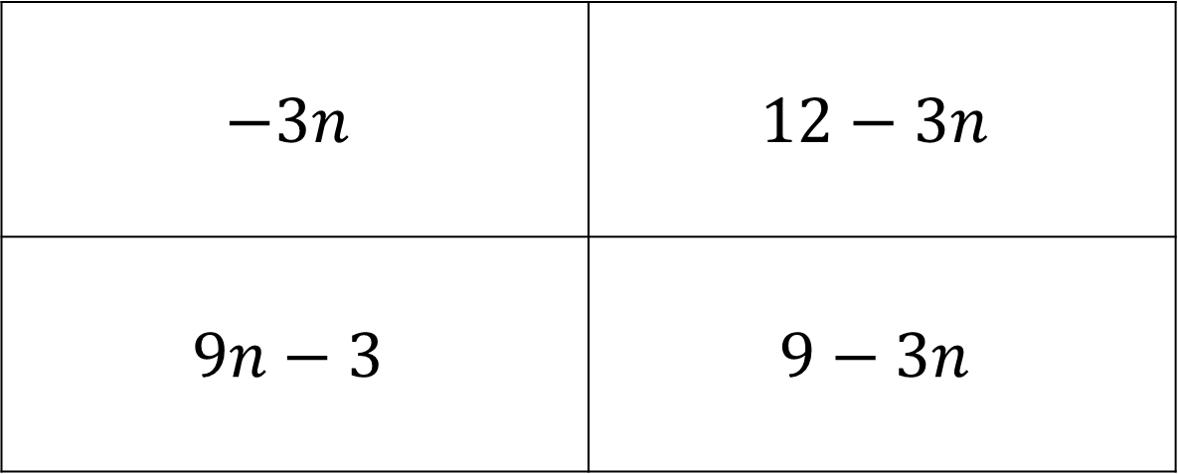
What is the $n^{th}$ term of
9, 6, 3, 0, -3…
$$−3n$$ | $$12−3n$$
$$9n−3$$ | $$9−3n$$
A
B
C
D

Slide 15
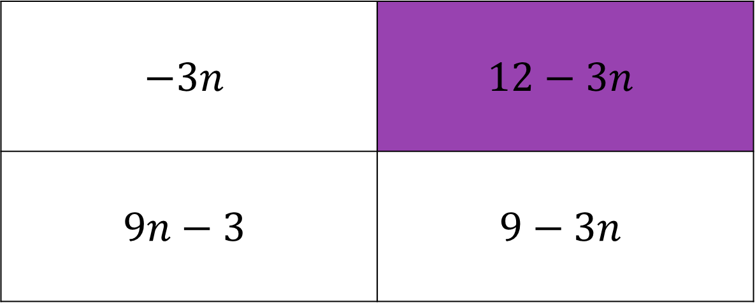
What is the $n^{th}$ term of
9, 6, 3, 0, -3…
$$−3n$$ | $$12−3n$$
$$9n−3$$ | $$9−3n$$
A
B
C
D

Slide 16
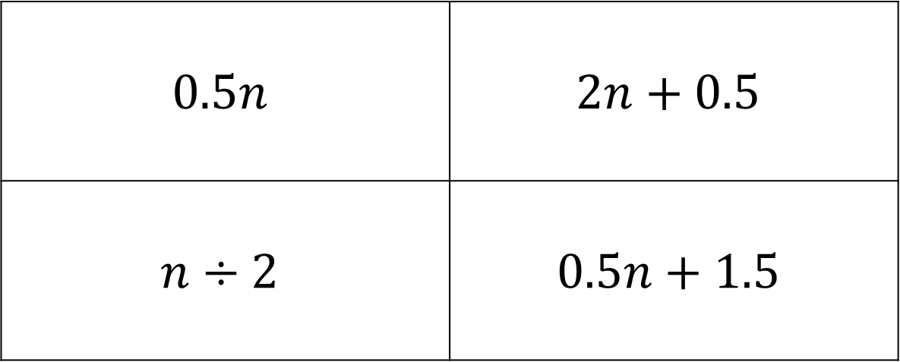
What is the $n^{th}$ term of
2, 2.5, 3, 3.5, 4…
$$0.5n$$ | $$2n+0.5$$
$$n÷2$$ | $$0.5n+1.5$$
A
B
C
D

Slide 17
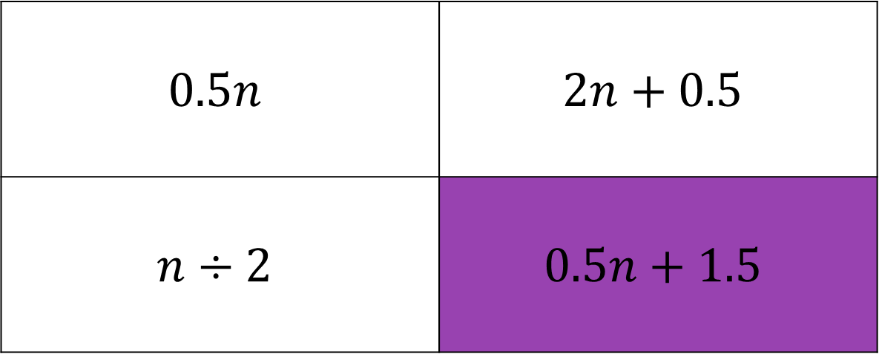
What is the $n^{th}$ term of
2, 2.5, 3, 3.5, 4…
$$0.5n$$ | $$2n+0.5$$
$$n÷2$$ | $$0.5n+1.5$$
A
B
C
D

Slide 18
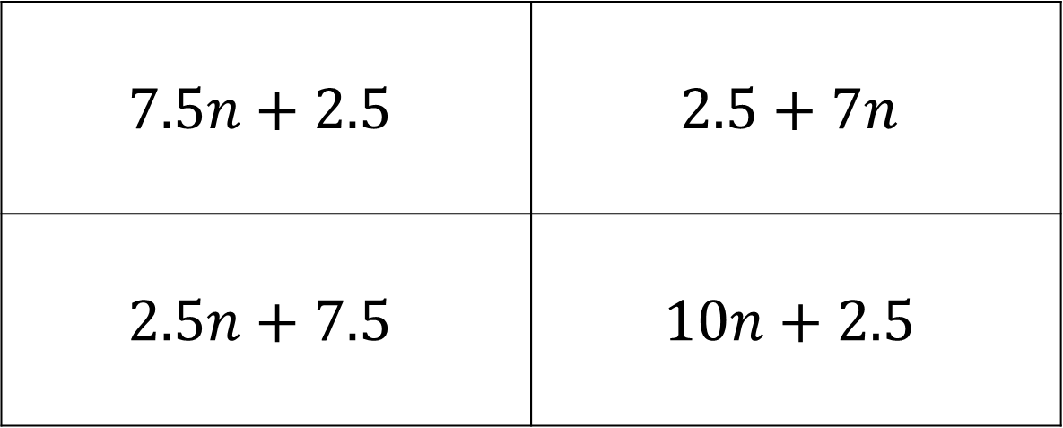
What is the $n^{th}$ term of
10, 12.5, 15, 17.5, 20…
$$7.5n+2.5$$ | $$2.5+7n$$
$$2.5n+7.5$$ | $$10n+2.5$$
A
B
C
D

Slide 19
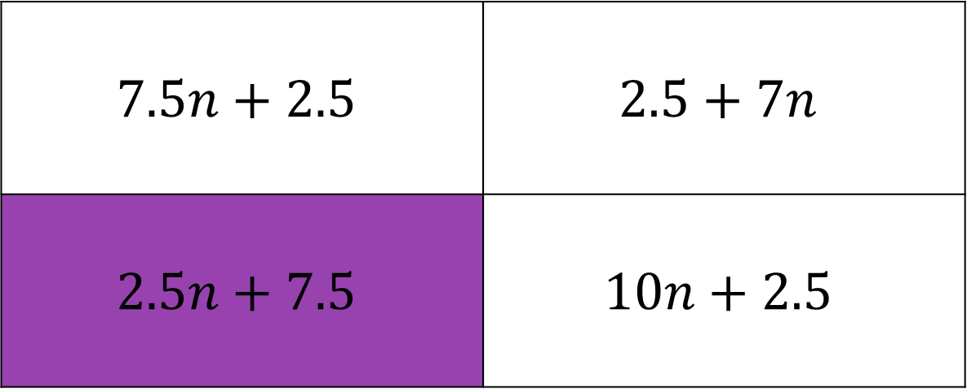
What is the $n^{th}$ term of
10, 12.5, 15, 17.5, 20…
$$7.5n+2.5$$ | $$2.5+7n$$
$$2.5n+7.5$$ | $$10n+2.5$$
A
B
C
D

Slide 20
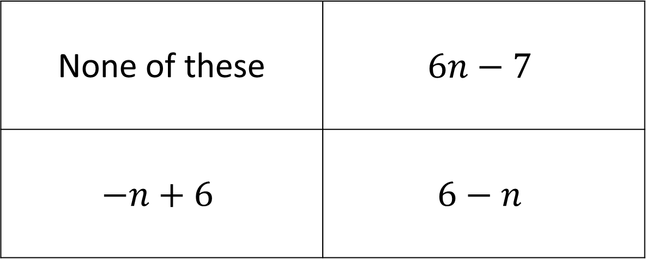
What is the $n^{th}$ term of
-1, 5, 15, 29, 47…
None of these | $$6n−7$$
$$−n+6$$ | $$6−n$$
A
B
C
D

Slide 21
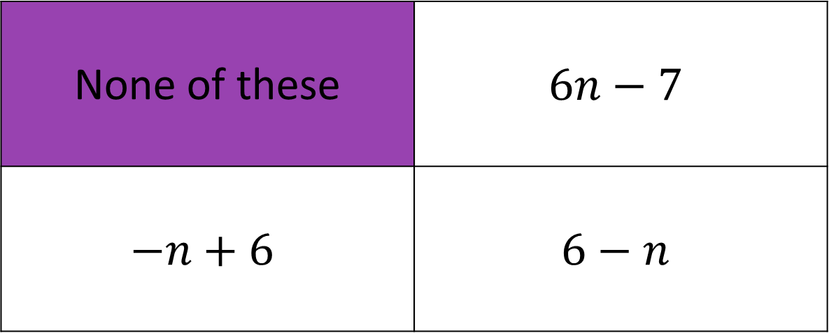
What is the $n^{th}$ term of
-1, 5, 15, 29, 47…
None of these | $$6n−7$$
$$−n+6$$ | $$6−n$$
A
B
The problem here is that the sequence doesn’t go up or down in nice equal steps, the steps get bigger and bigger each time.
Do we give up? Nope, lets look at how to find the $n^{th}$ term of these sequences ☺
C
D

Slide 22
What is the $n^{th}$ term of
-1 5 15 29 47
6 10 14 18
4 4 4
Because the second difference is the same, we call the sequence quadratic, and we know the equation will have $n2$ in it.

Slide 23
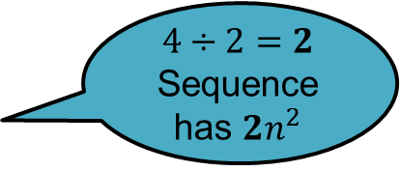
What is the $n^{th}$ term of
-1 5 15 29 47
6 10 14 18
$$4÷2=2$$
Sequence has $2n^{2}$
4 4 4
$$T$$ | -1 | 5 | 15 | 29 | 47
$$2n2$$ | 2 | 8 | 18 | 32 | 50
$$T−2n^{2}$$ | -3 | -3 | -3 | -3 | -3
Sequence is $2n2−3$

Slide 24
What is the $n^{th}$ term of
5 14 29 50 77
9 15 21 27
$$6÷2=3$$
Sequence has $3n^{2}$
6 6 6
$$T$$ | 5 | 14 | 29 | 50 | 77
$$3n2$$ | 3 | 12 | 27 | 48 | 75
$$T−3n^{2}$$ | 2 | 2 | 2 | 2 | 2
Sequence is $3n2+2$

Slide 25
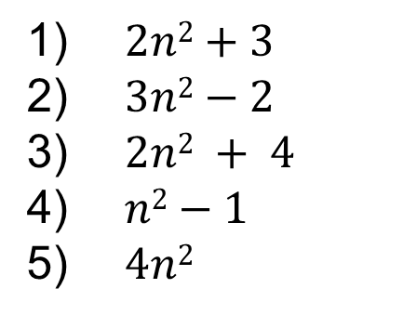
Stage One Answers
$2n2+3$
$3n2−2$
$2n2 + 4$
$n2−1$
$4n2$

Slide 26
What is the $n^{th}$ term of
4 13 26 43 64
9 13 17 21
$$4÷2=2$$
Sequence has $2n^{2}$
4 4 4
$$T$$ | 4 | 13 | 26 | 43 | 64
$$2n2$$ | 2 | 8 | 18 | 32 | 50
$$T−2n^{2}$$ | 2 | 5 | 8 | 11 | 14
This sequence is $3n−1$
Sequence is $3n2+2$

Slide 27
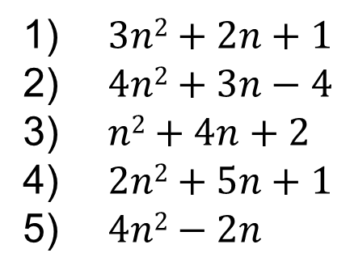
Stage Two Answers
$3n2+2n+1$
$4n2+3n−4$
$n2+4n+2$
$2n2+5n+1$
$4n2−2n$

