Slide 1
Starter
Using a protractor, draw the following angles:
26° 154° 201°

Slide 2
We can construct a triangle accurately (using a ruler, a protractor and a pair of compasses) given three pieces of information:
side, angle, side;
angle, side, angle; or
side, side, side.

Slide 3
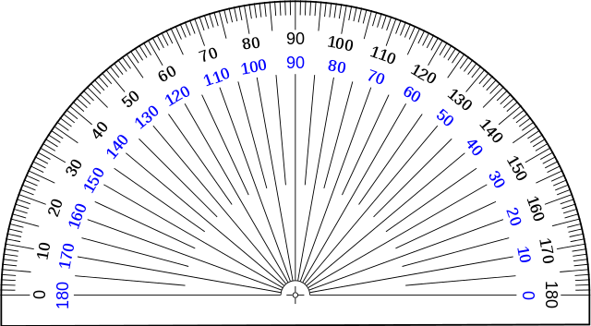
Example: side, angle, side
Construct a triangle $PQR$ with lines $PQ=8$ cm, $QR=5$ cm and $P\hat{Q}R=40°$
$$R$$
$5$ cm
$$40°$$
$$P$$
$$Q$$
$8$ cm
Draw an $8$ cm line and label the ends $P$ and $Q$. This is the line $PQ$.
Place the centre of the protractor on $Q$ with the $0°$ line pointing to $P$.
Measure a $40°$ angle clockwise from $0°$. Mark it with a dot.
Draw a $5$ cm line from $Q$ through the dot. Label the end of this line $R$.
Join up $P$ and $R$ to complete the triangle.

Slide 4
Example: side, angle, side
Construct a triangle $ABC$ with lines $AB=9$ cm, $A\hat{B}C=30°$ and $B\hat{A}C=50°$
$$C$$
$$50°$$
$$30°$$
$$A$$
$$B$$
$9$ cm
Draw a $9$ cm line and label the ends $A$ and $B$. This is the line $AB$.
Place the centre of the protractor on $B$ with the 0° line pointing to $A$.
Measure a $30°$ angle clockwise from 0°. Mark it with a dot.
Draw a line from $B$ through the dot.
Place the centre of the protractor on $A$ with the 0° line pointing to $B$.
Measure a $50°$ angle anticlockwise from 0°. Complete as with other angle.
Point $C$ is where the two lines meet.

Slide 5
Example: side, angle, side
Construct a triangle $FGH$ with side lengths $FG=10$ cm, $GH=6$ cm and $FH=7$ cm.
$$H$$
$7$ cm
$6$ cm
$$F$$
$$G$$
$10$ cm
Draw a $10$ cm line and label the ends $F$ and $G$. This is the line $FG$.
Set your compasses to $6$ cm and, with the point on $G$, draw an arc.
Set your compasses to $7$ cm and, with the point on $F$, draw an arc.
Label this point $H$ and join $F$ to $H$ then $G$ to $H$ to get the lines $FH$ and $GH$.

Slide 6
Extension: Triangle construction tangram

Slide 7
Plenary
Accurately construct the quadrilateral using the given information.
How long is the top side of the quadrilateral?
5 cm
100°
120°
2 cm
6 cm

