Slide 1
Work out the answers to the maths problems.
Every problem is marked with a different letter corresponding to the boxes above.
Transpose the solution of the problem to a letter using the cipher (right) and enter it under the appropriate box to reveal the word.
Return to a maths teacher once you’ve found the answer for a prize!

Slide 2
11 9 7 5 ___

Slide 3
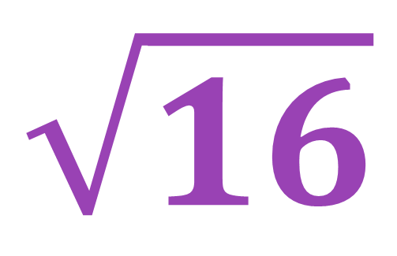
$$\sqrt{16}$$

Slide 4
$$100÷50$$

Slide 5
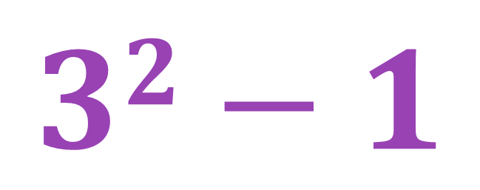
$$32−1$$

Slide 6
Calculate the area of this rectangle
3 cm
4 cm

Slide 7
$$8−4×2$$

Slide 8
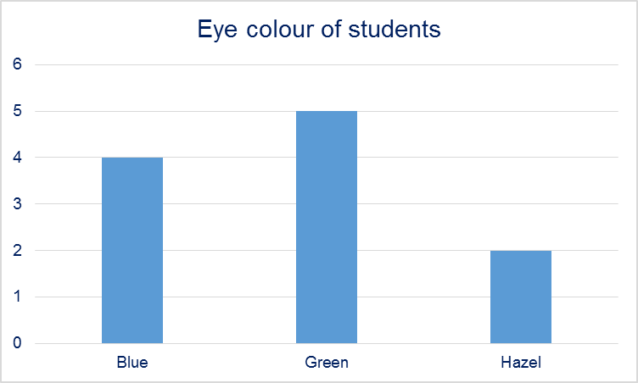
Frequency
Eye colour
How many students were asked altogether?

