Slide 1
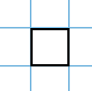
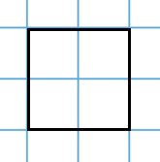
Starter
What’s the next size square you could draw on the pages in your book?
What about the next one?
How many small squares are inside each of the big squares?
1
9
4
We call these square numbers
16
25

Slide 2

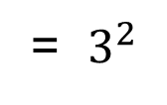
Square Numbers
Area =
$3×3$
= $3^{2}$
= $9$
$$3^{2}$$
Square
$$3$$
$$9$$
Square root
$$\sqrt{9}$$

Slide 3
What’s the next size cube you could make?
What about the next one?
How many multilink cubes are each of these bigger cubes made of?
1
8
We call these cube numbers
27
64

Slide 4
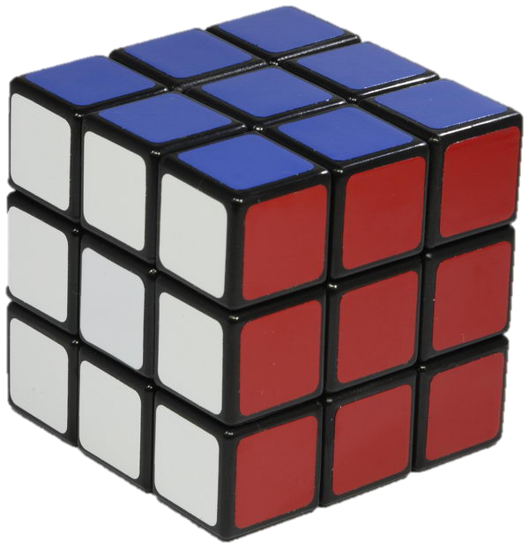
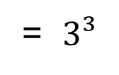
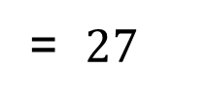
Cube Numbers
Volume =
$$3×3×3$$
= $3³$
= $27$
$$3³$$
Cube
$$3$$
$$27$$
Cube root
$$\sqrt[3]{27}$$

Slide 5
Squares and Cubes
Copy and complete:
Number | Squared | Cubed
1 | 1 | 1
2 | 4 | 8
3 | 9
4
5
6
7
8
9
10

Slide 6
Squares and Cubes
Copy and complete:
Number | Squared | Cubed
1 | 1 | 1
2 | 4 | 8
3 | 9 | 27
4 | 16 | 64
5 | 25 | 125
6 | 36 | 216
7 | 49 | 343
8 | 64 | 512
9 | 81 | 729
10 | 100 | 1000

Slide 7


Examples
$3^{2}$
$\sqrt{16}$
$6^{3}$
$\sqrt[3]{8}$
$=9$
$=4$
$=216$
$=2$

Slide 8
Squares, Cubes and Roots
In pairs, find the quote by answering the questions on squares, cubes and roots.

Slide 9
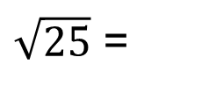
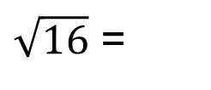
Estimating Roots
Explain how we know $\sqrt{17}$ lies between 4 and 5.
$\sqrt{16}$ =
4
$\sqrt{17}$
$\sqrt{25}$ =
5
$\sqrt{17}$ lies between $\sqrt{16}$ and $\sqrt{25}$, therefore lies between 4 and 5.

Slide 10
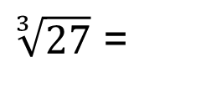
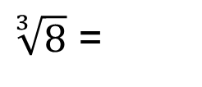
Estimating Roots
Explain how we know $\sqrt[3]{10}$ lies between 2 and 3.
$\sqrt[3]{8}$ =
2
$\sqrt[3]{10}$
$\sqrt[3]{27}$ =
3
$\sqrt[3]{10}$ lies between$\sqrt[3]{8}$ and$\sqrt[3]{27}$, therefore lies between 2 and 3.

Slide 12
Answers
$\sqrt{30}$ lies between $\sqrt{25}$ and $\sqrt{36}$ therefore lies between 5 and 6.
$\sqrt[3]{110}$ lies between $\sqrt[3]{64}$ and $\sqrt[3]{125}$, therefore lies between 4 and 5.
$\sqrt{60}$ lies between $\sqrt{49}$ and $\sqrt{64}$, therefore lies between 7 and 8.
$\sqrt[3]{30}$ lies between $\sqrt[3]{27}$ and $\sqrt[3]{64}$, therefore lies between 3 and 4.
$\sqrt{90}$ lies between $\sqrt{81}$ and $\sqrt{100}$, therefore lies between 9 and 10.
$\sqrt[3]{200}$ lies between $\sqrt[3]{125}$ and $\sqrt[3]{216}$, therefore lies between 5 and 6.

Slide 13
Why are 1, 4, 9, 16 called square numbers?
How would you find the 15th square number?
Which is the square number closest to 30?
The sum of two square numbers is 20. What are they?

