Slide 1


Starter
Simplify
1. $a+a+a$
2. $3a+2b+4a$
3. $(a+3)+(2a+4)$
4. $a×a×a$
5. $a×b×c$
6. $2a×3b$
7. $3a×a×2b$
8. $a(2a+3)$
9. $2a(3a+4)$
10. $(a+3)(2a+3)$
$=3a$
$=7a+2b$
$=3a+7$
$=a³$
$=abc$
$=6ab$
$=6a²b$
$=2a²+3a$
$=6a²+8a$
$=2a^{2}+9a+9$

Slide 2
2 cm
2 cm
6 cm
5 cm
3 cm
8 cm
What are the lengths of the missing sides?

Slide 3
2 cm
2 cm
6 cm
5 cm
3 cm
8 cm
5 + 2 + 2 + 6 + 3 + 8
Perimeter = 26 cm

Slide 4
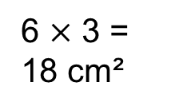
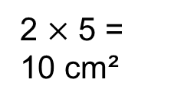
2 cm
2 cm
6 cm
5 cm
3 cm
8 cm
+
2 $×$ 5 = 10 cm²
6 $×$ 3 = 18 cm²
Area = 28 cm²

Slide 5
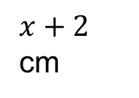



Write an expression for the perimeter of this rectangle.
$2x$ cm
$x+2$ cm
Perimeter = base + height + base + height
$=2x+x+2+2x+x+2$ cm
$=6x+4$ cm

Slide 6



Write an expression for the area of this rectangle.
$2x$ cm
$x+2$ cm
Area = base $×$ height
$=2x(x+2)$ cm²
$=2x²+4x$ cm²

Slide 7


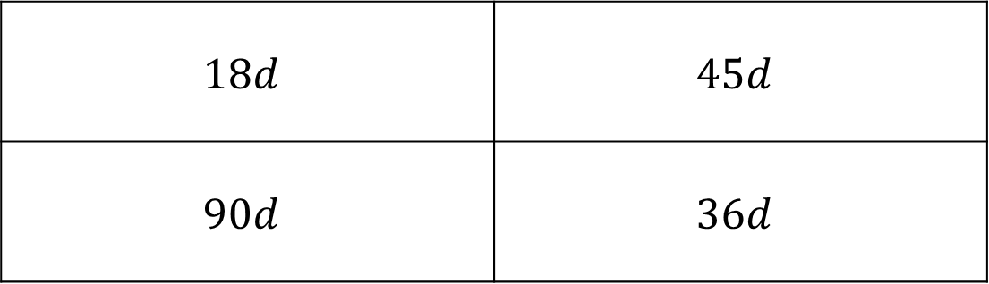
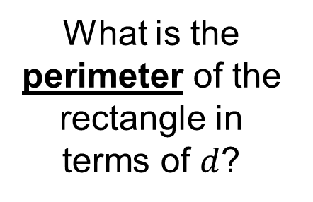
$$15d$$
What is the perimeter of the rectangle in terms of $d$?
$$3d$$
$$18d$$ | $$45d$$
$$90d$$ | $$36d$$
A
B
C
D

Slide 8
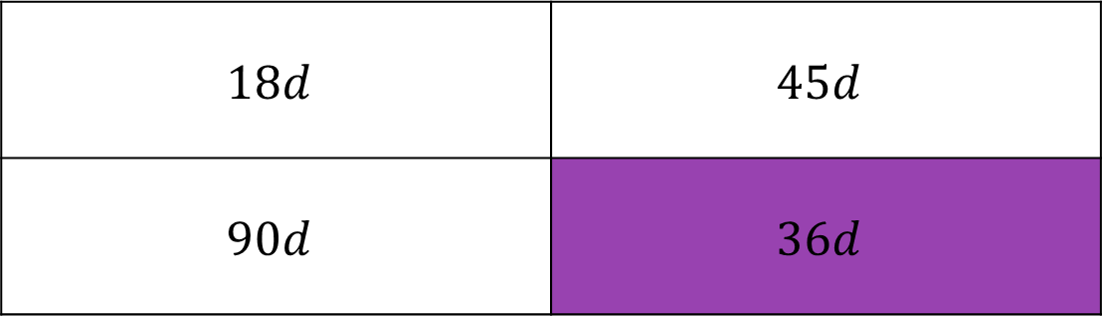
$$15d$$
What is the perimeter of the rectangle in terms of $d$?
$$3d$$
$$18d$$ | $$45d$$
$$90d$$ | $$36d$$
A
B
C
D

Slide 9
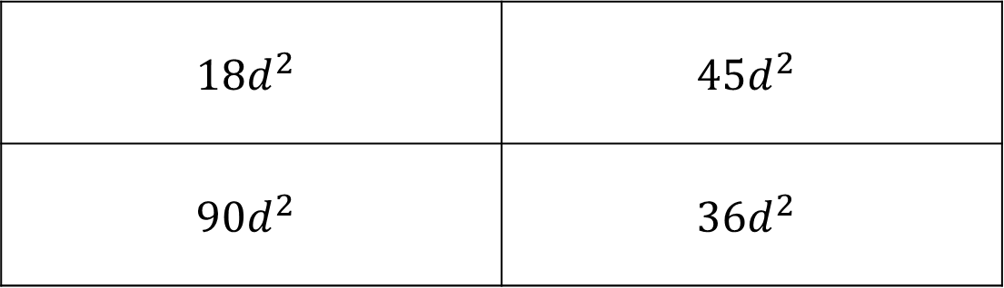
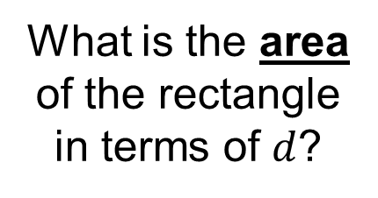
$$15d$$
What is the area of the rectangle in terms of $d$?
$$3d$$
$$18d^{2}$$ | $$45d^{2}$$
$$90d^{2}$$ | $$36d^{2}$$
A
B
C
D

Slide 10
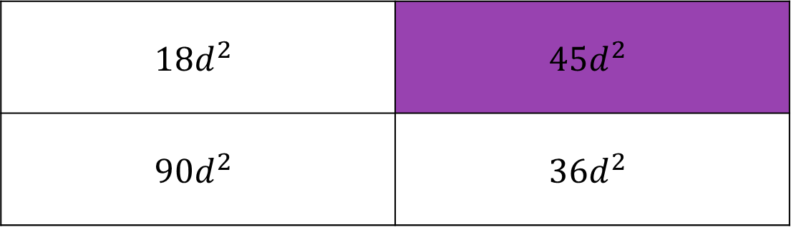
$$15d$$
What is the area of the rectangle in terms of $d$?
$$3d$$
$$18d^{2}$$ | $$45d^{2}$$
$$90d^{2}$$ | $$36d^{2}$$
A
B
C
D

Slide 11


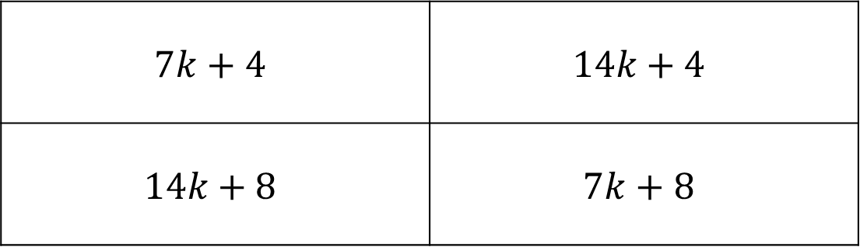
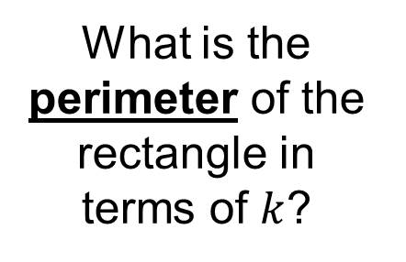
$$5k+3$$
What is the perimeter of the rectangle in terms of $k$?
$$2k+1$$
$$7k+4$$ | $$14k+4$$
$$14k+8$$ | $$7k+8$$
A
B
C
D

Slide 12
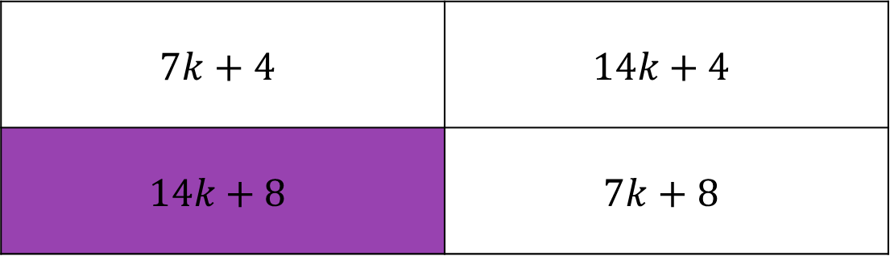
$$5k+3$$
What is the perimeter of the rectangle in terms of $k$?
$$2k+1$$
$$7k+4$$ | $$14k+4$$
$$14k+8$$ | $$7k+8$$
A
B
C
D

Slide 13

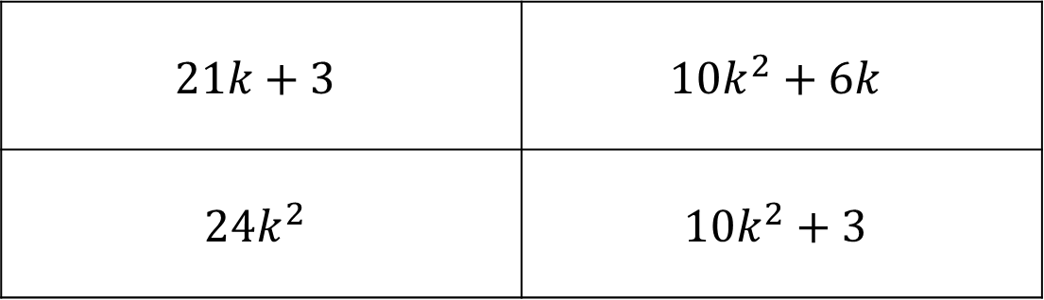
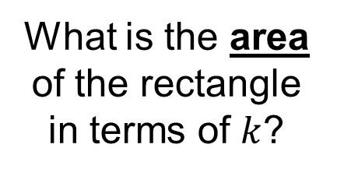
$$5k+3$$
What is the area of the rectangle in terms of $k$?
$$2k$$
$$21k+3$$ | $$10k^{2}+6k$$
$$24k^{2}$$ | $$10k^{2}+3$$
A
B
C
D

Slide 14
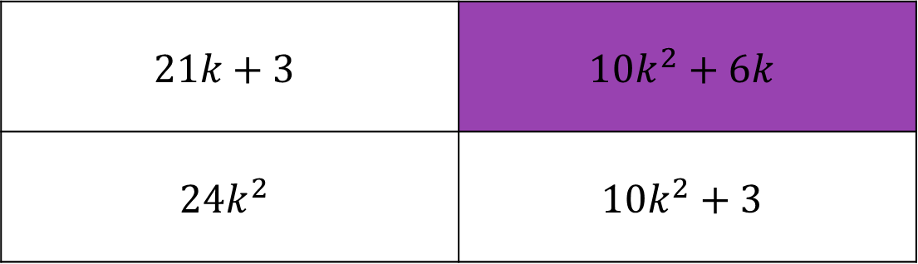
$$5k+3$$
What is the area of the rectangle in terms of $k$?
$$2k$$
$$21k+3$$ | $$10k^{2}+6k$$
$$24k^{2}$$ | $$10k^{2}+3$$
A
B
C
D

Slide 15

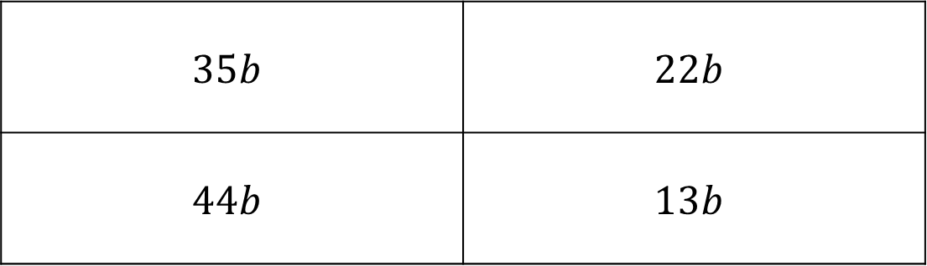

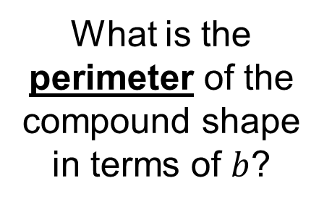


What is the perimeter of the compound shape in terms of $b$?
$$7b$$
$$10b$$
$$6b$$
$$12b$$
$$35b$$ | $$22b$$
$$44b$$ | $$13b$$
A
B
C
D

Slide 16
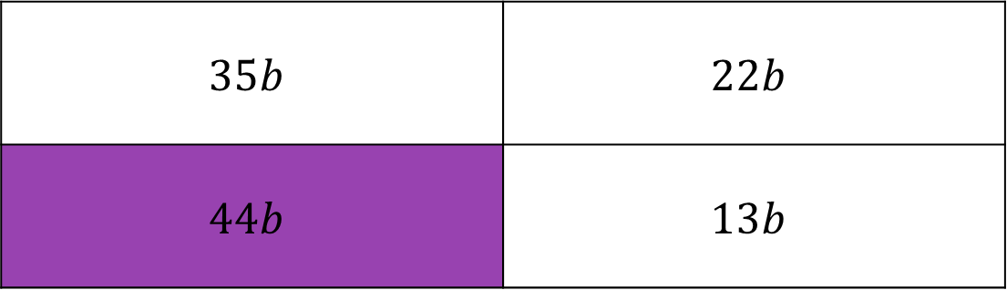
What is the perimeter of the compound shape in terms of $b$?
$$7b$$
$$10b$$
$$6b$$
$$12b$$
$$35b$$ | $$22b$$
$$44b$$ | $$13b$$
A
B
C
D

Slide 17
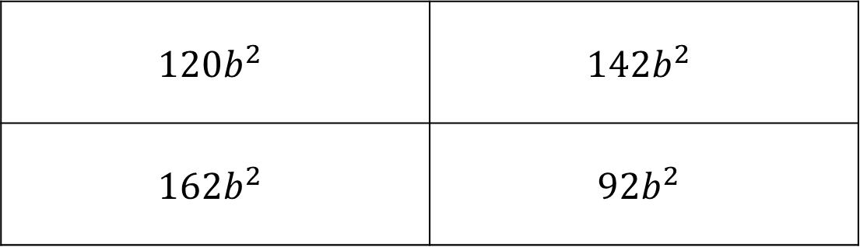
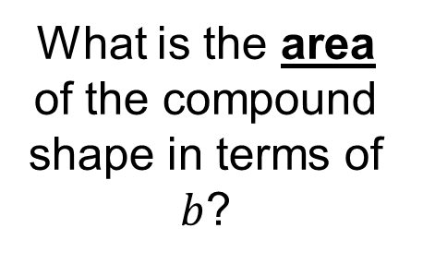
What is the area of the compound shape in terms of $b$?
$$7b$$
$$10b$$
$$6b$$
$$12b$$
$$120b^{2}$$ | $$142b^{2}$$
$$162b^{2}$$ | $$92b^{2}$$
A
B
C
D

Slide 18
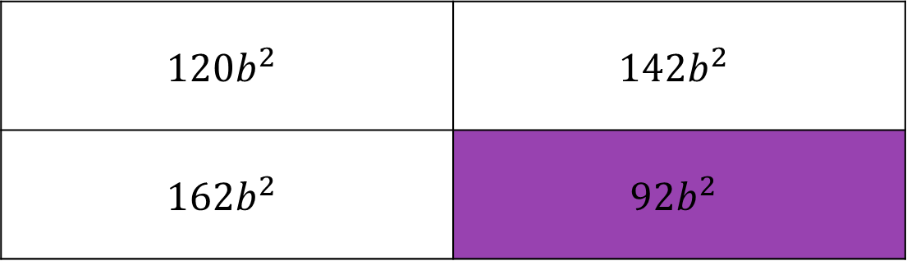
What is the area of the compound shape in terms of $b$?
$$7b$$
$$10b$$
$$6b$$
$$12b$$
$$120b^{2}$$ | $$142b^{2}$$
$$162b^{2}$$ | $$92b^{2}$$
A
B
C
D

Slide 19
Copy and complete the sentences below:
Angles in a triangle add up to ____^{o.}
Angles in a quadrilateral add up to ____^{o.}
Opposite sides of a rectangle are _______.
Right angles are ____º.
All sides of a square are _______.
There are three different types of triangle: ___________, __________ and ________.
Shape facts that might be useful!
180
360
equal
90
equal
equilateral
isosceles
scalene

Slide 20

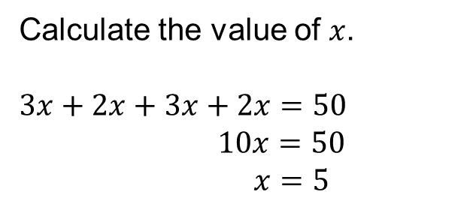

$3x$ cm
$2x$ cm
Perimeter = 50 cm
Calculate the value of $x$.
$3x+2x+3x+2x=50$
$$10x=50$$
$$x=5$$

Slide 21

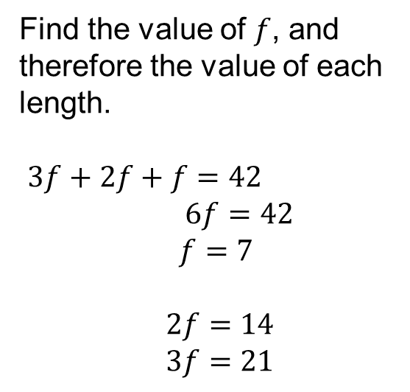


Find the value of $f$, and therefore the value of each length.
$3f+2f+f=42$
$6f=42$
$f=7$
$2f=14$
$3f=21$
$f$ cm
$2f$ cm
$3f$ cm
Perimeter = 42 cm
Is this solution realistic?
What happens if you try to draw the triangle?

Slide 22






What do all the angles in a triangle sum to?
$$2x+10⁰$$
$$2x+40⁰$$
$$x+30⁰$$
$$2x+10+2x+40+x+30=180$$
$$5x+80=180$$
$$5x=100$$
$$x=20$$

Slide 23
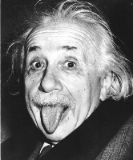
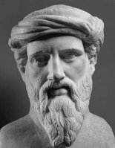
Tick or Trash
Decide who has the correct answer for each question.
You must show all of your working in your exercise book.

Slide 24
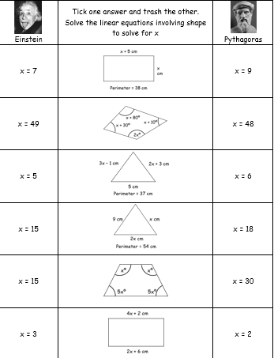

Slide 25
Task
Complete the questions.
Show your working fully. This can be on the diagrams.
Use algebra rather than trial and improvement.

Slide 26
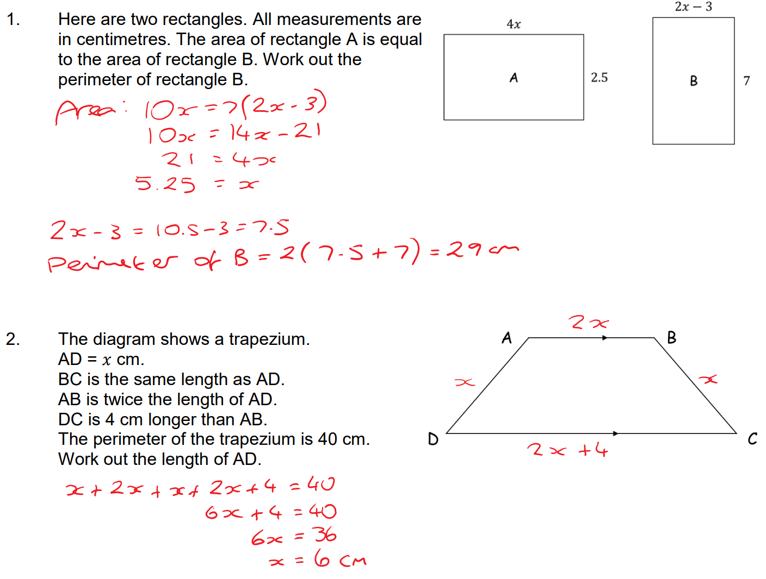
Answers

Slide 27
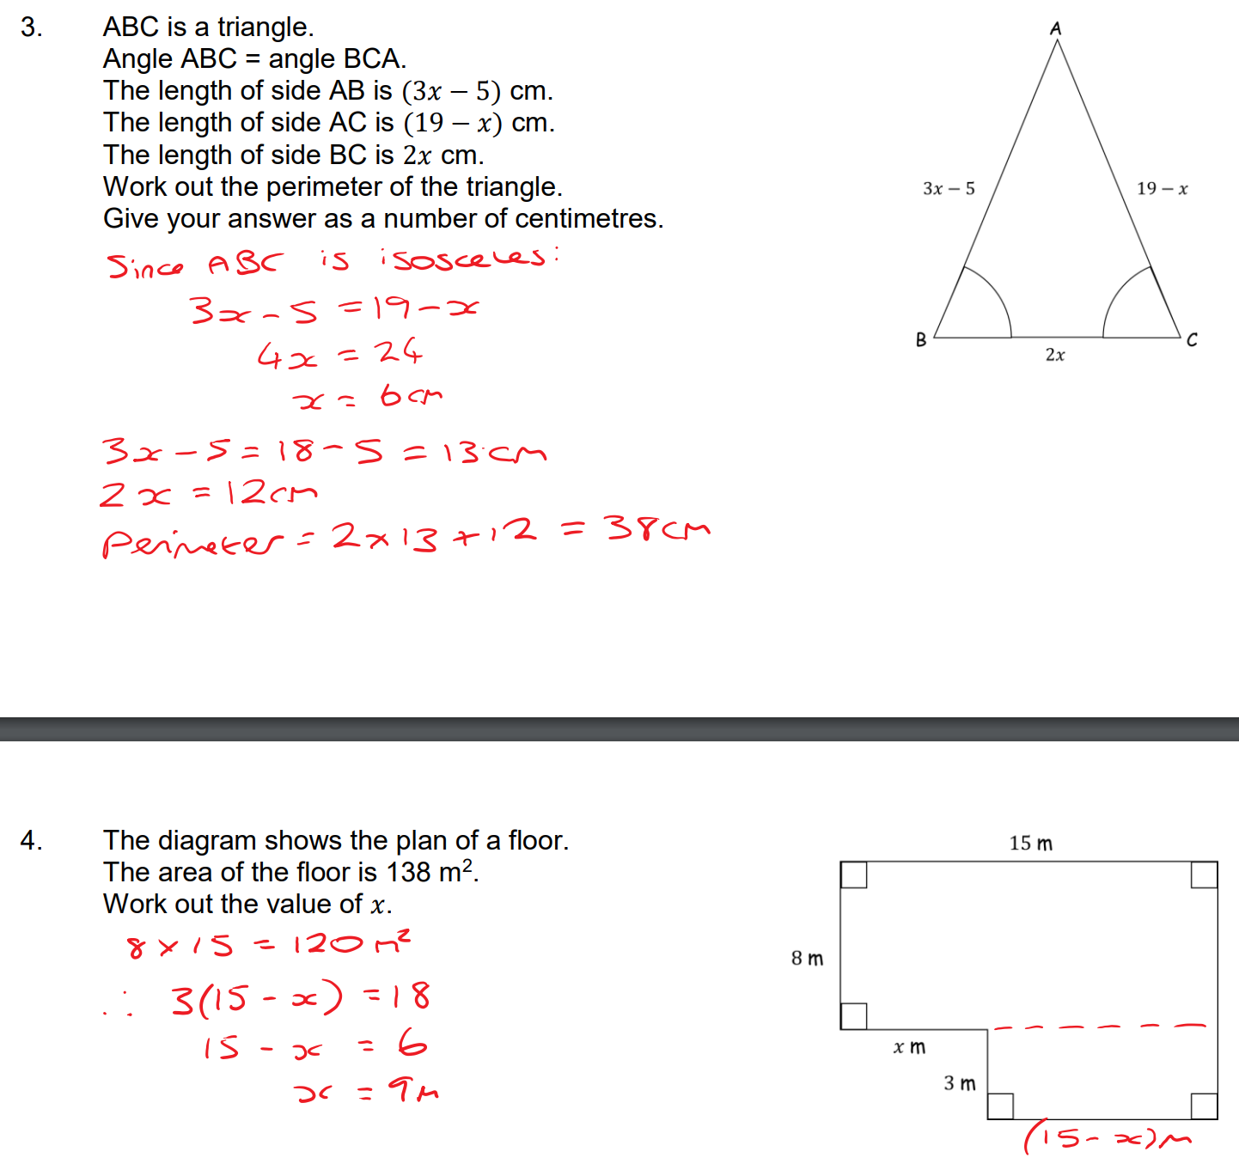
Answers

Slide 28
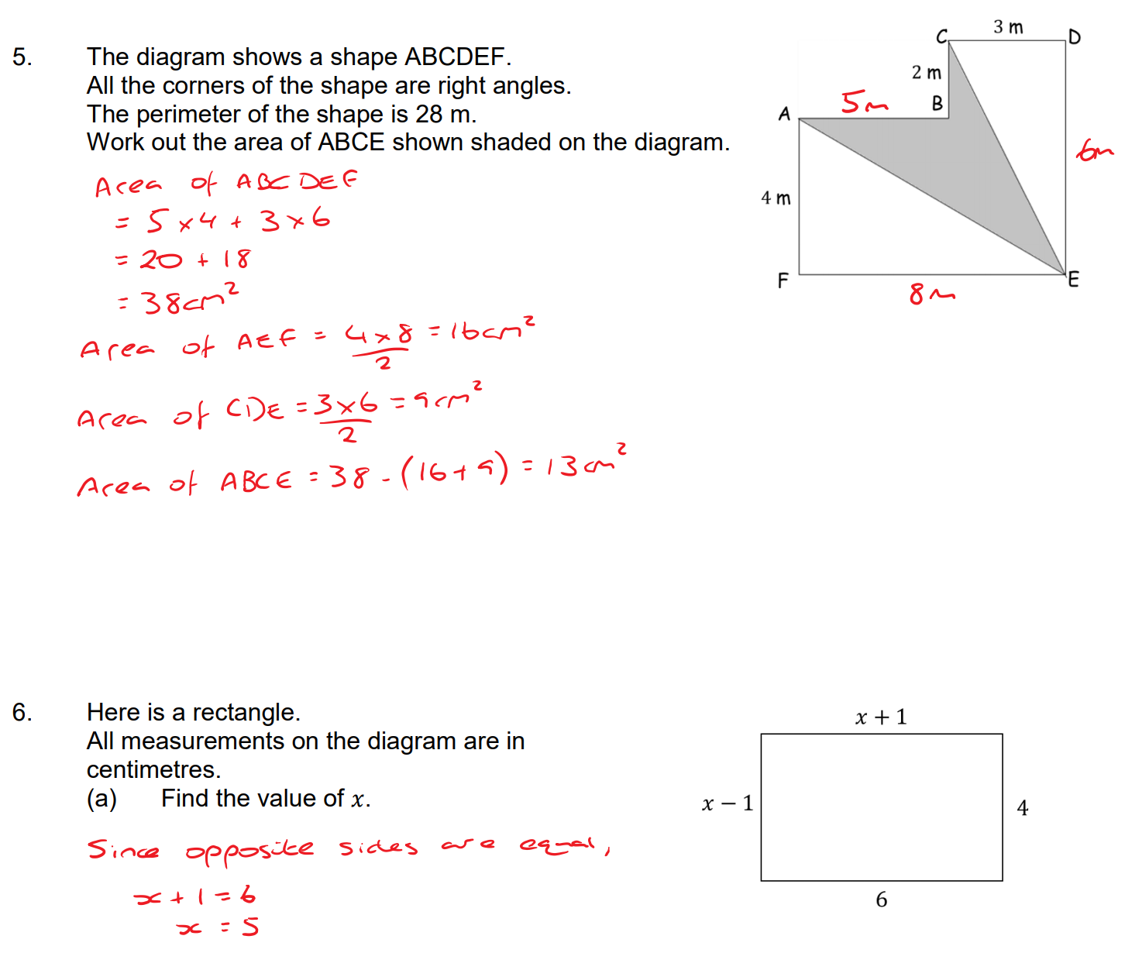
Answers

Slide 29
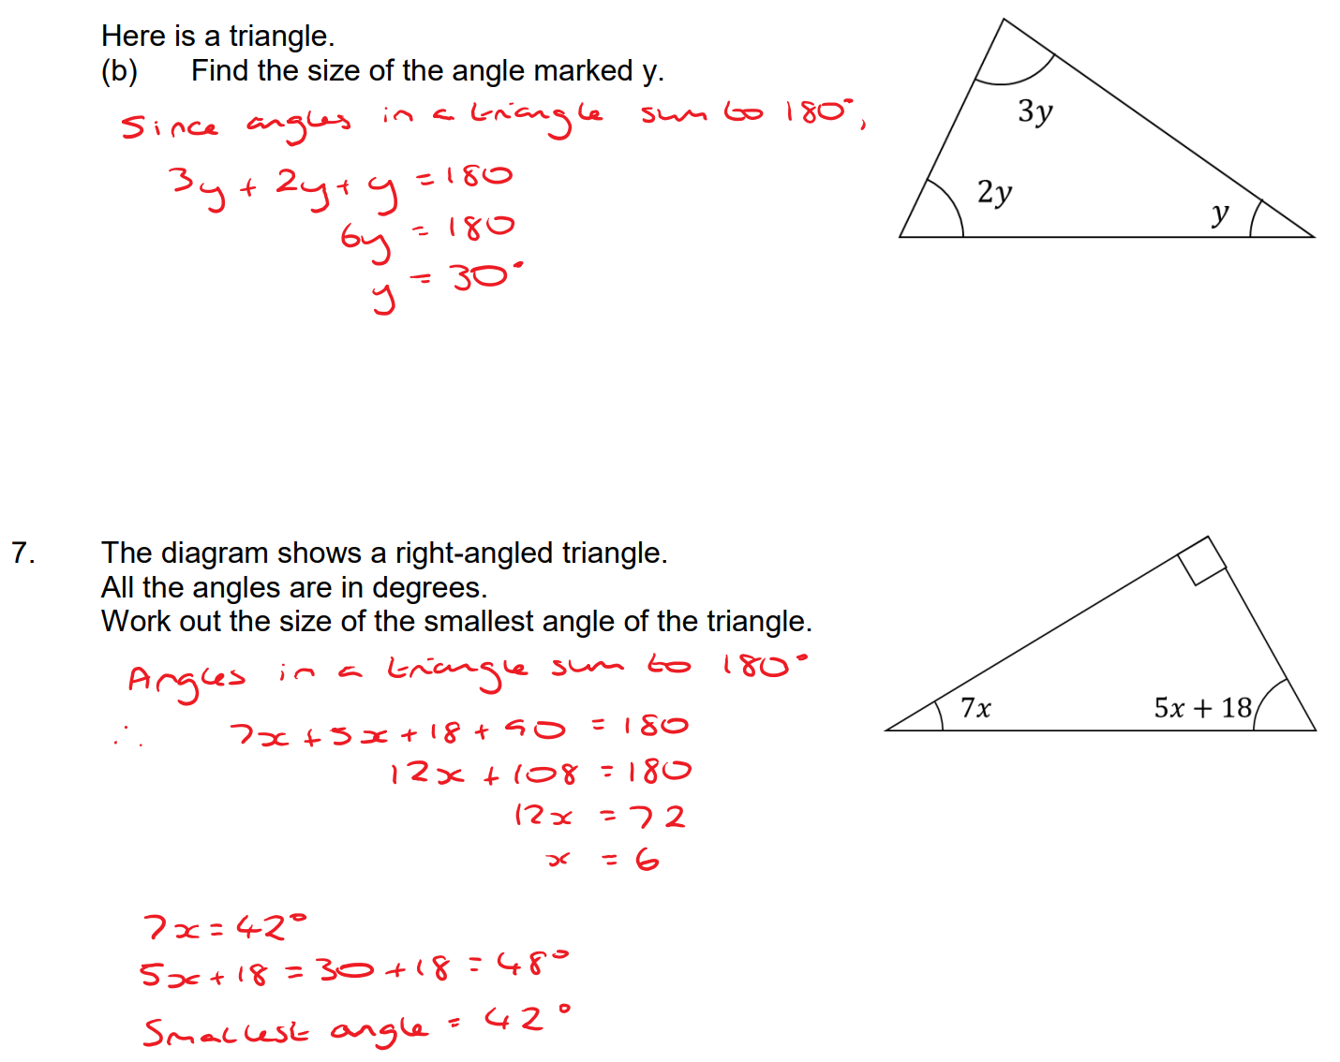
Answers

Slide 30
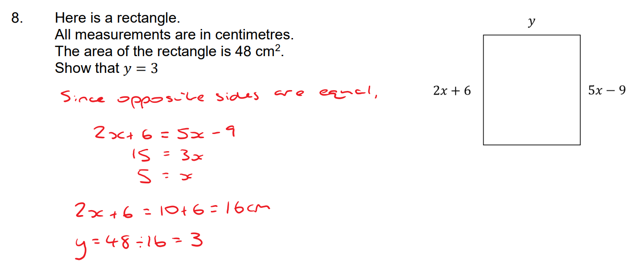
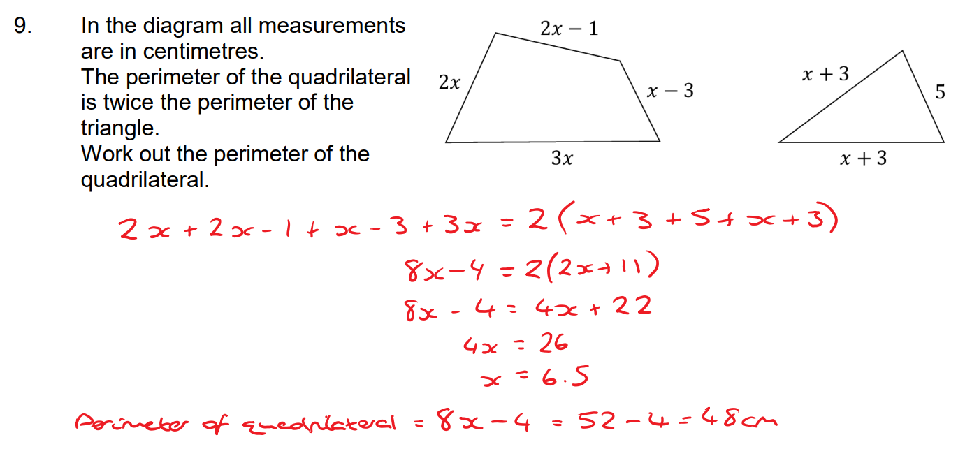
Answers

Slide 31
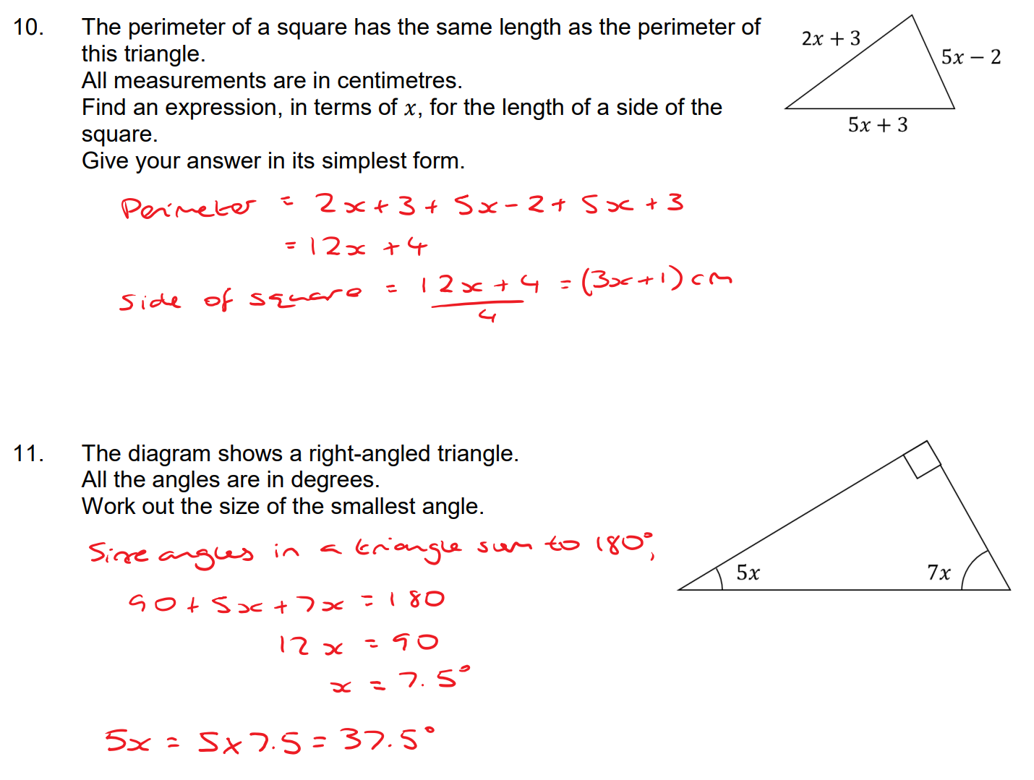
Answers

Slide 32
Students will need to be able to factorise and solve quadratics to move on…

Slide 33

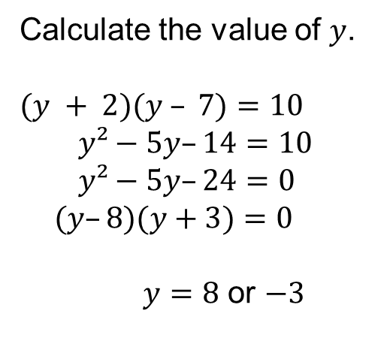
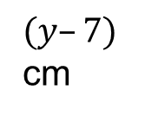
$(y+2)$ cm
Calculate the value of $y$.
$(y + 2)(y – 7)=10$
$y²−5y–14=10$
$y²−5y–24=0$
$(y–8)(y+3)=0$
$y=8$ or $−3$
$(y–7)$ cm
Area = 10 cm²

Slide 34



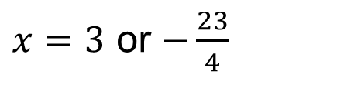

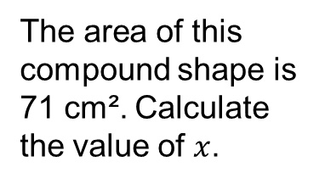




$$x+2$$
The area of this compound shape is 71 cm². Calculate the value of $x$.
$$2x$$
$$2x+1$$
$$x+3$$
$$3x+2$$
$$(x+2)(2x+1)+2x(x+3)=71$$
$$2x²+x+4x+2+2x²+6x=71$$
$$4x²+11x−69=0$$
$x=3$ or $−\frac{23}{4}$
$$(4x+23)(x–3)=0$$

Slide 36

Answers
1. $x=3.5$
2. $x=7$
3. $y=3$, perimeter = 32 cm
4. $x=15$
5. $x=12$
6a. $x=4$
b. Perimeter = 40 cm

